Slide 1
Your talk title goes here
Your Name • @your_social_handle • you@redhat.com

Slide 2
Cold open
Notes:
Diving straight into your presentation is a great way to engage the audience and get them interested in the topic immediately.
And the audience will be aware that an introduction is an introduction, without you telling them that it is an introduction!

Slide 3
Forecast
Listing section titles lets your audience know what to expect
Don’t just read these, though; people won’t like that
Coming up, you’ll find out what not to do
You’ll see some useful clipart
And it will all be tied up with a call to action and conclusions

Slide 4
Listing section titles lets your audience know what to expect
Notes:
Listing sections also helps you to structure your talk, and easily expand or contract content as appropriate.

Slide 6
Don’t just read these, though; people won’t like that
Notes:
You should talk around a section title slide - motivate what’s coming up and emphasise the relevant parts of what you have previously presented.
Section title slides are also a good place to stop and get the pulse of the audience and draw them back in. You could try asking them to raise their hands if they have used technology X, or ask a key question which will be answered in the next section to get them thinking.

Slide 8
What not to do
Notes:
Perhaps the easiest way to ensure that your slide deck is up to scratch is to make sure that you are not following any well-known slide anti patterns. I’m sure everyone has been to a presentation where the slides were overcrowded, uninformative or unclear. Let’s take a look at some of those types of slides now.

Slide 9
What makes for bad slides?
One characteristic of bad slides is that they often have too much text or serve as an outline for a lazy speaker who has failed to adequately prepare, meaning that the audience will be reading instead of listening
Also feature many sentence fragments
Because font size is too small, readability suffers, key points not reinforced, audience asleep
Fortunately, you can print this out and read it later, gathering much of benefit of attending talk
Unfortunately, slides like this make you wonder why you are bothering to attend the presentation in the first place
Notes:
As well as this slide being overpopulated and undersized,
NOTICE that this bad slide also inspires a bad presentation!

Slide 10
Bad slides need not be verbose

Slide 11
Make slides that support you
(not that make you unnecessary — see presenter notes!)
(“credits”: OSHA, USDA, DOL)
Notes:
Slides shouldn’t just be a low-density way to convey prose; they should support your presentation. These examples of publicly-available slide decks from US Government agencies are good examples of what not to do.

Slide 12
Sidebar: positive suggestions

Slide 13


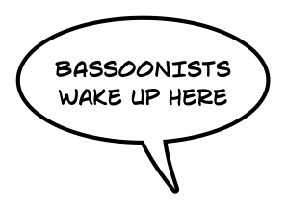


Use transparency (see notes)
Notes:
The animated figure on the left shows how you’d use transparency to highlight important points in a figure — in this case, in Beethoven’s 5th symphony
The animated figure on the right shows how you’d use transparency to de-emphasize the parts of a figure or diagram you aren’t talking about

Slide 14

Transparency is great for code
var nextModel = initialModel
for (int i = 0; i < iterations; i++) {
val newState = examples.aggregate(ModelState.empty()) {
{ case (state: ModelState, example: Example) =>
state.update(nextModel.lookup(example, i), example) }
{ case (s1: ModelState, s2: ModelState) => s1.combine(s2) }
}
nextModel = modelFromState(newState)
}
var nextModel = initialModel
for (int i = 0; i < iterations; i++) {
val newState = examples.aggregate(ModelState.empty()) {
{ case (state: ModelState, example: Example) =>
state.update(nextModel.lookup(example, i), example) }
{ case (s1: ModelState, s2: ModelState) => s1.combine(s2) }
}
nextModel = modelFromState(newState)
}
“fold”: update the state for this partition with a single new example
Notes:
Transparency is especially great for stepping through code and explaining it in context. This is the middle frame of a discussion of a parallel machine learning algorithm.

Slide 15
Use simple figures
Notes:
There’s no need for photorealistic gradients — use basic shapes and combinations of basic shapes to make simple, iconic figures. If you’re worried they’re too abstract, just explain them!

Slide 16
Boolean operations on objects
Notes:
You can make more complicated shapes out of boolean combinations of other shapes; in this example, we’ve made a 15-tooth gear from three circles and a 15-pointed star.

Slide 17
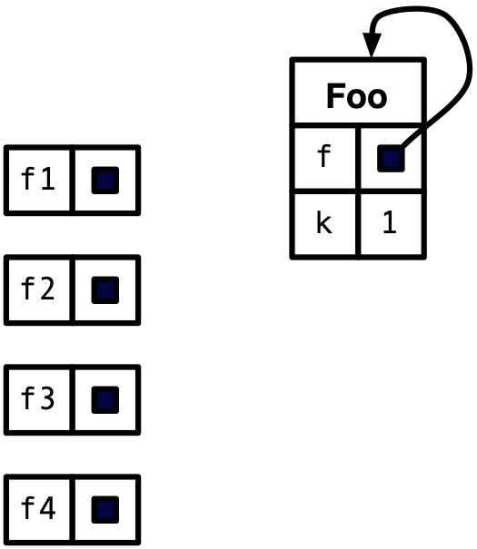
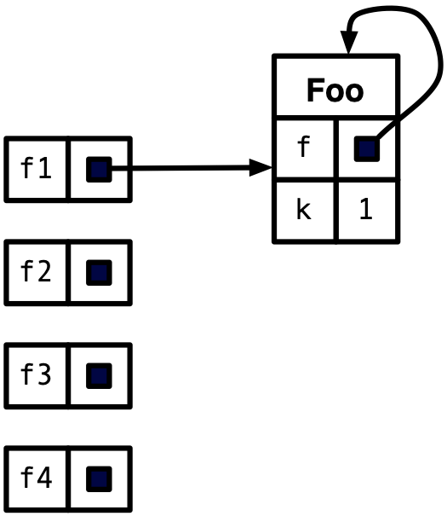
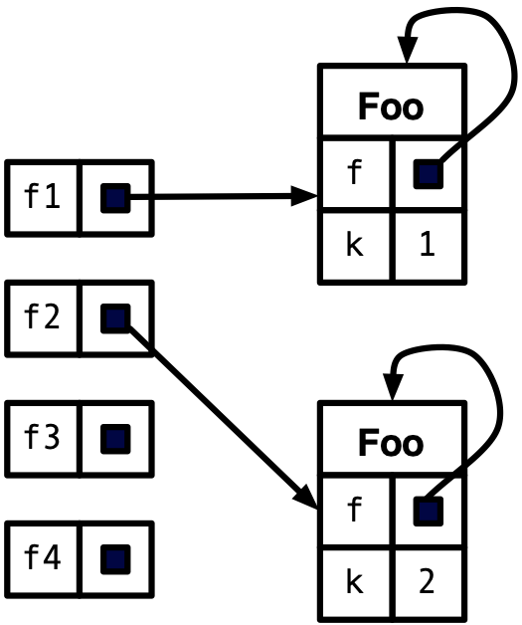
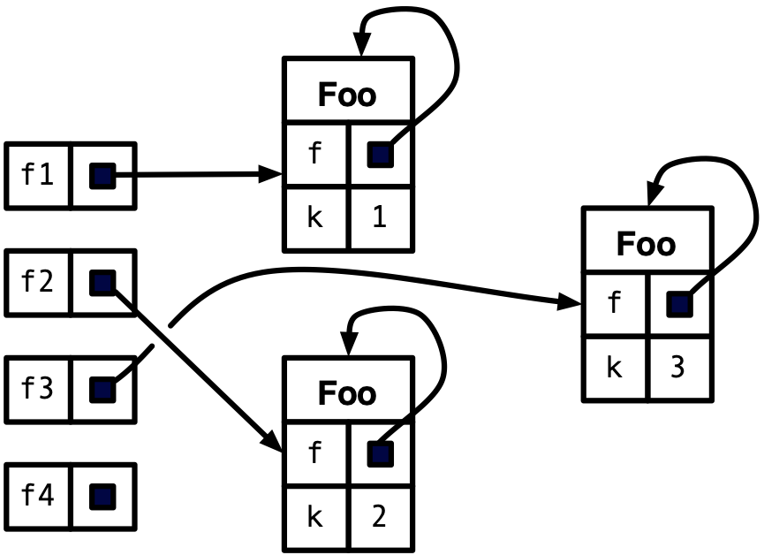
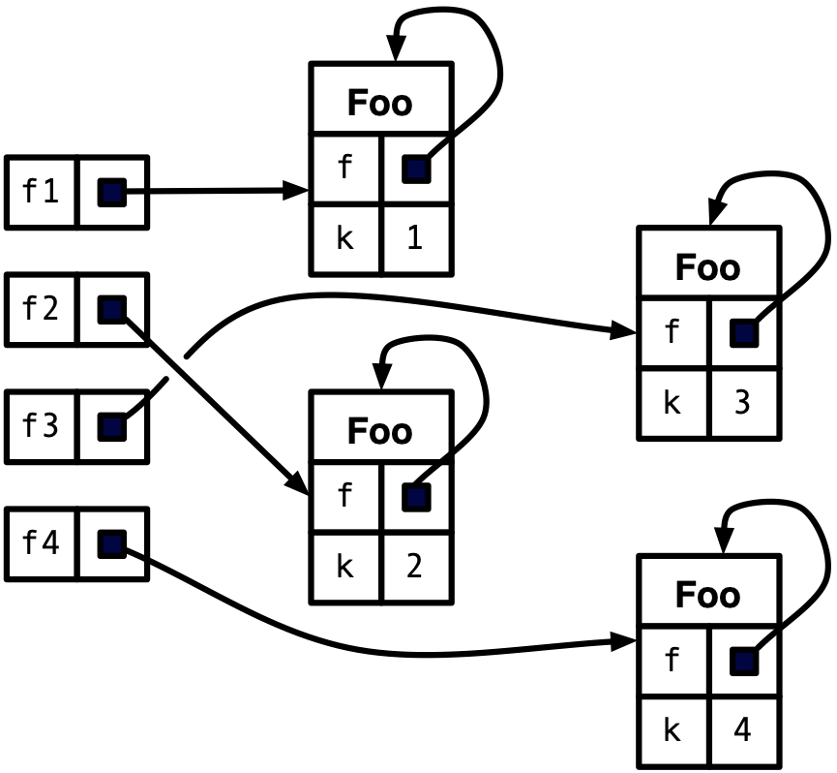
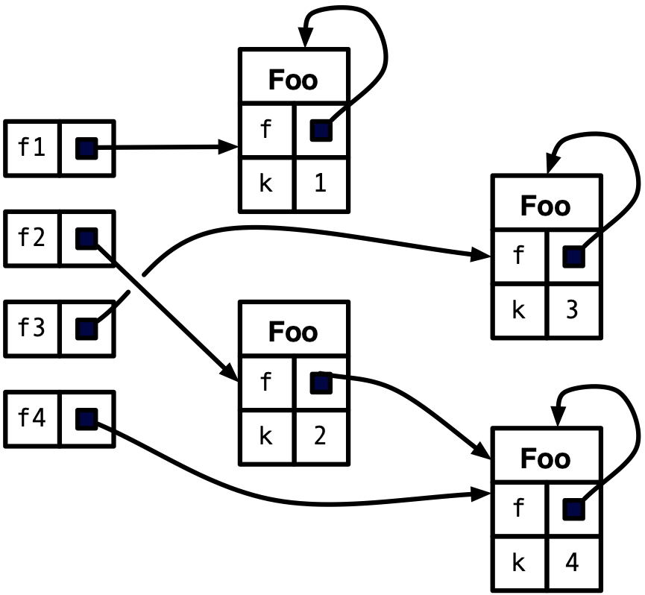
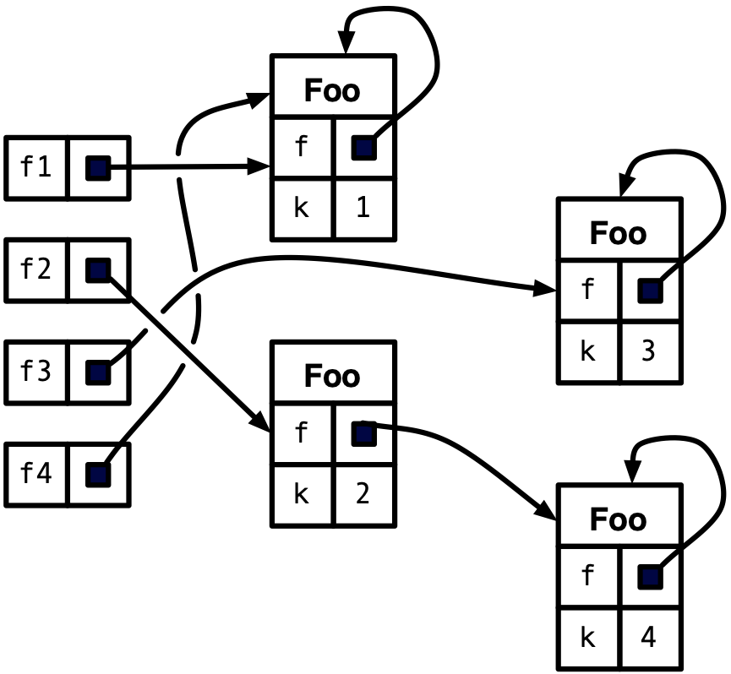
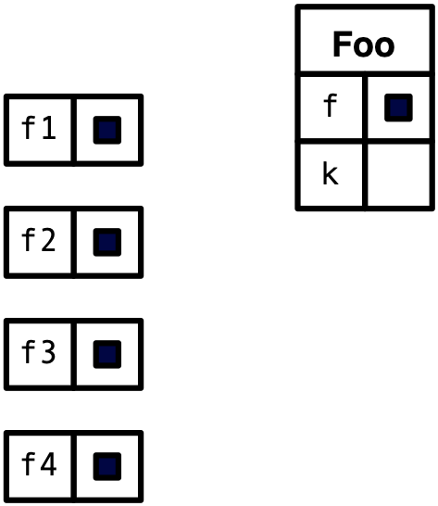

Show processes by animating
public class Foo {
private Foo f;
private int k;
public Foo(int k) {
this.k = k;
this.f = this;
}
public void sF(Foo f) {
this.f = f;
}
public static void main(String args) {
Foo f1, f2, f3, f4;
f1 = new Foo(1);
f2 = new Foo(2);
f3 = new Foo(3);
f4 = new Foo(4);
f2.sF(f4);
f4 = f1;
// BANG
}
}

Slide 18
Useful clipart

Slide 19
Intelligent applications
events
transform
developer UI
web and mobile
databases
transform
federate
archive
file, object storage
transform
reporting
models
train
management

Slide 20
Machine learning workflows
codifying problem and metrics
data collection and cleaning
feature engineering
model training
and tuning
model
validation
model
deployment
monitoring,
validation

Slide 21
Feature engineering & training

Slide 22
ML models and storage

Slide 23
Devices, apps, documents, data

Slide 24

Laptop stickers

Slide 25

Demo

Slide 26

Hands-on Tutorial

Slide 27
Call to action and conclusions

