Slide 1
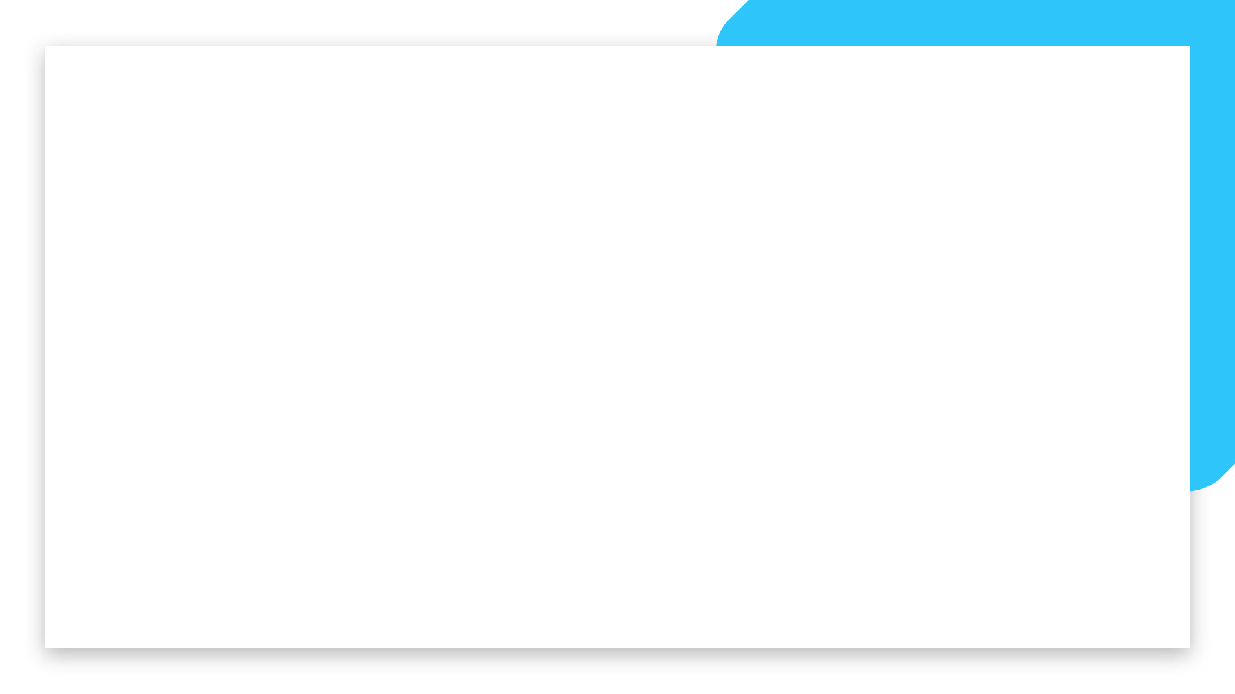


Data Science and Machine Learning
Bootcamp
IRON KAGGLE

Slide 2
Iron Kaggle
LETS COMPETE! Before you jump further, we want you to have an end-to-end experience of solving a Machine Learning problem.
So let’s try and predict the sales of shops, shall we?
You have a dataset containing information on shops’ sales per day (and several characteristics of them) - your goal is to predict the sales!
Welcome

Slide 3
Iron Kaggle
Training data (640841 entries): we will share with you a training set of store sales per day, with bits of information of what happened in that day in that store.
Real-Life Data (+70k entries): we will also share with you entries without the sales. This will be used (on the teachers side) to verify how good your model really is!
Welcome

Slide 4
Iron Kaggle
Expected Deliver:
“Real-life data set” with an extra column called “sales”, with your predictions. Name this G1.csv (or G2, G3...)
An expected value of R2 of performance of your model. Save the number in a file g1_r2_prediction.txt (or G2, G3...)
A 5’ presentation on the choices you did and the road you took
Your code (jupyter notebook)
Upload everything to your Github repo.
Welcome

Slide 5
Iron Kaggle - Results
 | Group 1: | Group 2: | Group 3: | Group 4: | Group 5:
R2 Prediction (how much your thought your model would perform)
R2 Score (how your model performed with real life data)
R2 Difference
Welcome

Slide 6
Iron Kaggle
Schedule:
9am: Introduction, Group organization, framing the problem
9.30am: Development time
12pm: Checkpoint
1pm: Lunch break
2pm: You will receive the “real-life” data
5pm: presentations + winner announcement
Welcome

Slide 7
Iron Kaggle
Winners:
Winner 1 -> Group with the highest R2 score
Winner 2 -> Group with the most correct prediction of their own R2 score
BOTH CAN BE THE SAME GROUP
Welcome

Slide 8
Good luck
Let’s get started!

