Slide 1
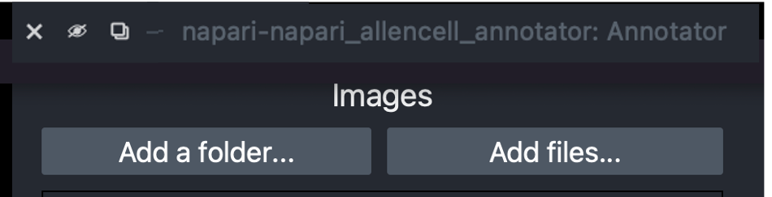


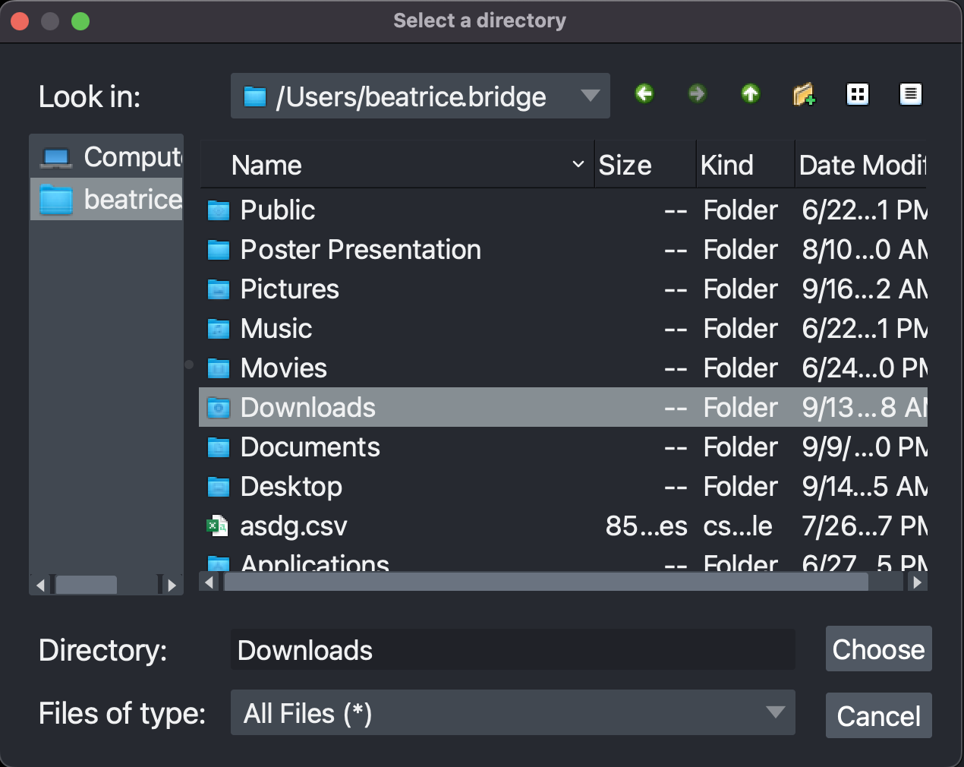
Annotator: Add Images
Add Files and Folders
There is no drag and drop option.
If you are annotating images from the Allen network, copy them into your folder before trying to add them.
Select Add a folder to add every file in a folder.
If there are files in the folder that are not a supported file type those files won’t be added
Select Add files to multi-select files.
tiff
ome.tiff
png
jpeg
czi
ome.zarr
Using the File Finder
Use the green arrows to navigate back/forward to previous folders.
Use the grey arrow to choose from a list of recent paths.
Select the folder or files and click Choose to complete.
Can’t find a folder?
Try finding the path to the folder outside of the Annotator.
Windows: New file explorer window → click into folder → look at the top title bar for file path
MacOS: New finder window → right-click on the folder → Get Info → Where
Shuffle and Hide
If images are shuffled and hidden:
No image names are shown
Images are in a random order
Images can’t be deleted
Images can be un-hidden and un-shuffled.
Images are returned to original order

Slide 2

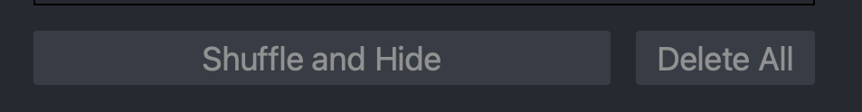
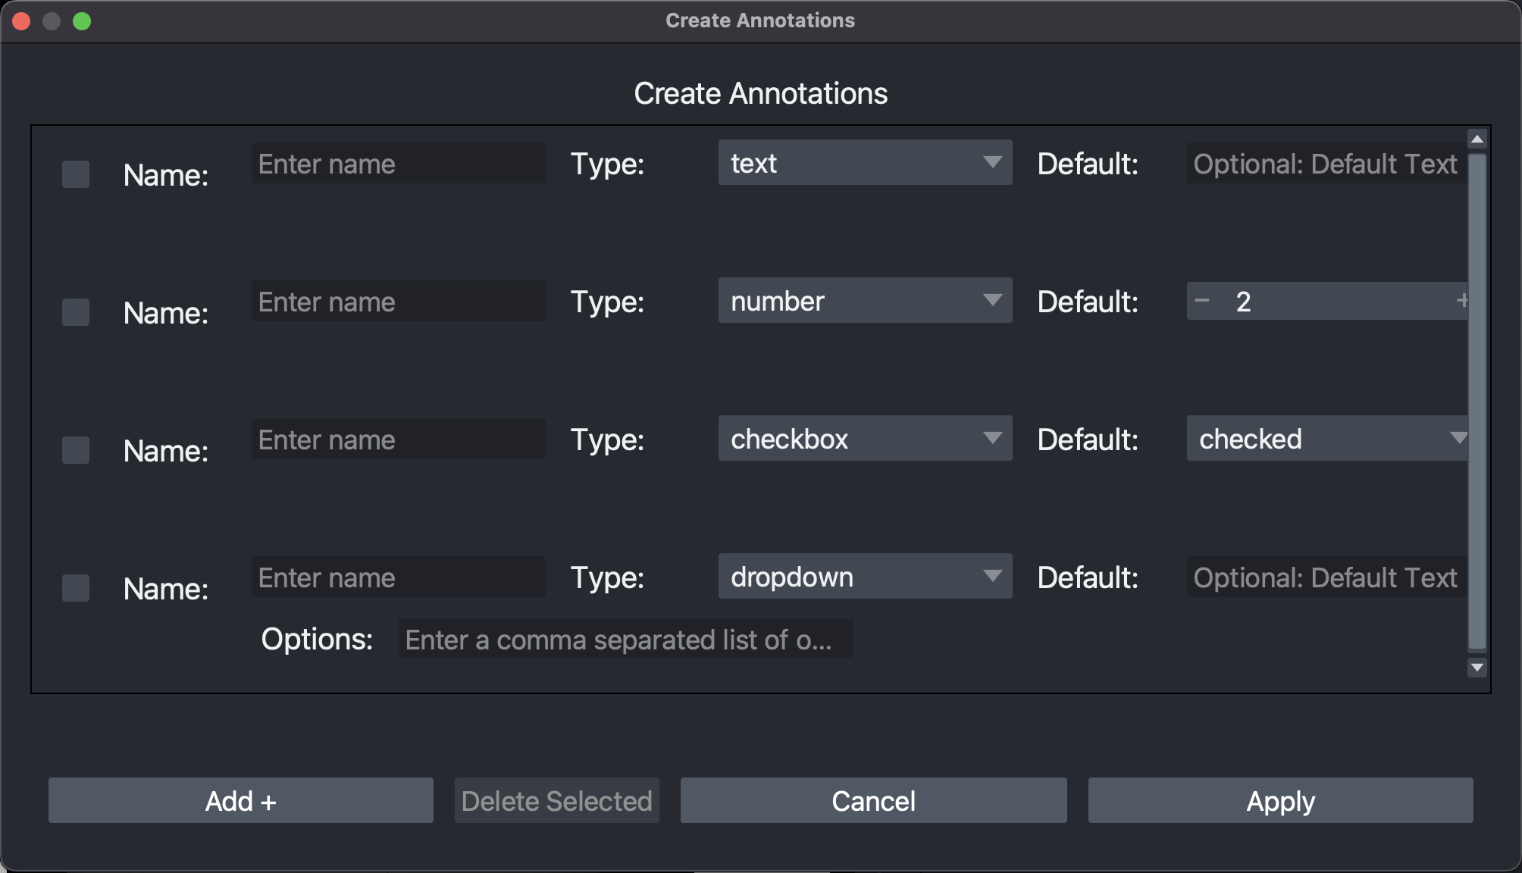
Deleting Images
Delete All to clear selected images.
To Delete Selected images, check the box on the right of each image.
Windows Users: to see image check boxes scroll to the right
Annotator: Add Annotations
Create New Annotation Template
Select Create Template if you are going to be starting a new set of annotations.
If you are using the same annotation criteria/template as others, using Import Template is the better option.
In the create annotations popup, Add up to 10 annotations.
You can Delete Selected template items by checking the box on the left and then clicking the delete button.
Template items can be reordered with drag-and-drop.
Cancel will discard all items and close the popup.
Apply will close the popup and show a preview of the template in the main window
There are 5 annotation types:
Text: allows letters and numbers.
Number: allows 2-digit numbers. For 3-digit numbers use text.
Checkbox: use for pass-fail or yes-no annotations.
Dropdown: allows the annotator to select from a set list of options.
Point: allows creating points on an image.
Default values will be automatically filled in for the annotation. Useful if you anticipate writing or selecting the same value for many of the images.

Slide 3
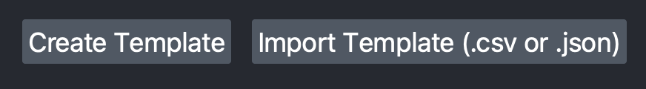
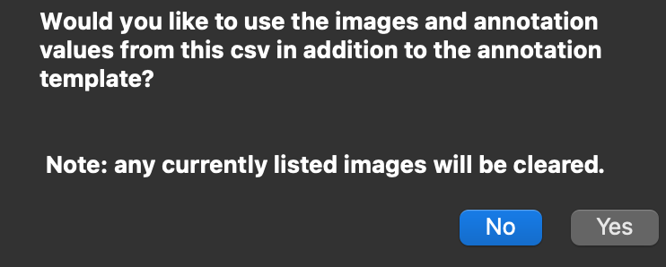
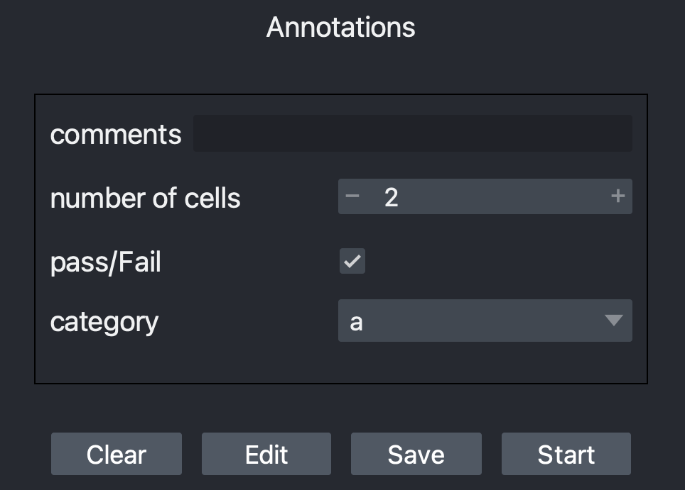
Import an Existing Annotation Template
Import a Template to re-use an existing set of annotations.
In the file dialog popup, make sure to select the file type you are using.
A JSON file contains only the annotation template.
A CSV file contains
a list of files
an annotation template
annotation values
Select No in the popup if you only want to
use the annotation template.
Select Yes to continue annotating the
image list in this csv.
Annotation Template Preview
Clear will remove all annotation items currently shown.
Edit allows adding, deleting, and altering the annotation template.
Editing the template is not available if you are continuing annotating from a csv file
Save will allow you to save the annotation template in a JSON file. You can create a new file or overwrite an existing JSON file.
Use this JSON file to share an annotation template so others can use your template.
Click Start to begin annotating!
Once annotation begins, no further editing or changes are allowed.
You will be asked to select or create a CSV file.
Choose a destination folder where you want the CSV to be placed and name the file
Or find and select an existing csv
If you are continuing annotating a previously created CSV and replace that file, you will not lose any annotations.

Slide 4
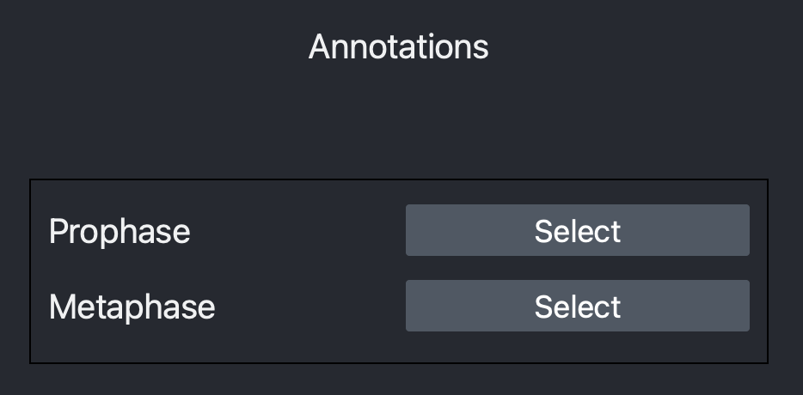
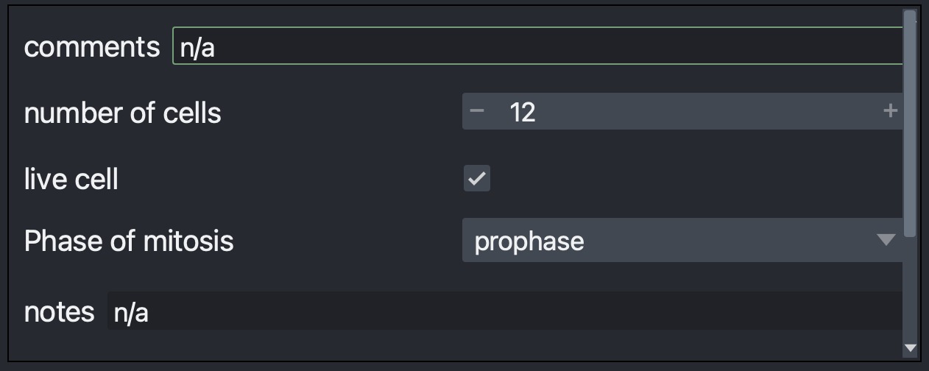
Annotating
Exit: save values to CSV, exit annotation, return to start.
Save: save values to CSV. Annotations are not automatically saved, so make sure to save periodically and exit the Annotator using the Exit button.
Next/Previous: move to a new image.
Point Annotating
To start point annotating, click Select. You will be able to add points to the image.
Click Finish to complete.
If you move to a new annotation item or image without clicking Finish, point annotations will be automatically recorded.
Annotator: Helpful Hints
Keyboard Shortcuts
The following keyboard shortcuts can be used while annotating.
 | Next Image | Previous Image
Windows | CTRL + > or CTRL + SHIFT + . | CTRL + < or CTRL + SHIFT + ,
MacOS | CMD + > or CMD + SHIFT + . | CMD + < or CMD + SHIFT + ,

Slide 5

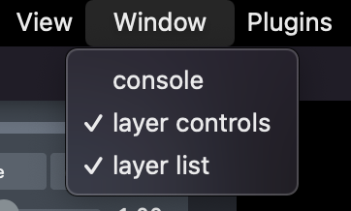
Keyboard Shortcuts
The annotation highlighted in green is the current annotation. To move the cursor/focus up or down an annotation, use the following.
Depending on the current annotation type, there are additional shortcuts.
 | Down | Up
Windows | CTRL + ENTER | CTRL + SHIFT + ENTER
MacOS | CMD + RETURN | CMD + SHIFT + RETURN
Checkbox | Toggle Check
Windows | CTRL + SHIFT + SPACE
MacOS | CMD + SHIFT + SPACE
Drop Down | Move Between Options | Select an Option
 | Arrow Keys | Enter/Return
Napari Window Hints
To move the plugin to a separate window, click the multi-window icon on the top of the plugin.
If you do not need to use layers, you can close the layer controls and make more room for image viewing by clicking Window and unchecking layer controls and layer list.

