Slide 1
secure data hiding in images using steganography
CAPSTONE PROJECT
Presented By
Student Name : Kavya B Raj
College Name & Department : Kristu Jayanti College Autonomous (Computer Science Department)

Slide 2
OUTLINE
Problem Statement
Technology used
Wow factor
End users
Result
Conclusion
Git-hub Link
Future scope

Slide 3
Problem Statement
Steganography addresses the need to conceal the existence of a secret message within a cover image, differentiating itself from cryptography, which focuses on protecting the content of the message.
Digital image steganography is growing in use, especially where strong encryption is outlawed.
Steganography can be limited under laws, since governments already claimed that criminals use these techniques to communicate.
Steganography is a technique for hiding data within an ordinary, nonsecret file or message to avoid detection.
The primary advantage of using steganography to hide data over cryptography is that it helps obscure the fact that sensitive data is hidden in the file or other content carrying the hidden text.

Slide 4
Technology used
Image Steganography: Hides secret data within an image, so hackers cannot discover the records5. The overall process of image steganography is to hide sensitive data inside a cover image without degrading the original image.
Least Significant Bit (LSB): A common spatial domain method where the least significant bits of an image are replaced with the bits of the secret message3. If the least significant bits are changed, there will be a minor change in the image that will not be visible to the human eye3.
Steganography Software: Used for hiding data, keeping track of which bits of the cover text file contain hidden data, encrypting the data to be hidden, and extracting hidden data by its intended recipient1.
OpenStego: An open-source steganography program1.
Image Steganography: A JavaScript tool that hides images inside other image files.
Other tools like Command Prompt,Python and IDE.

Slide 5
Wow factors
Steganography provides better security by hiding the secret message.
The technique can send secret messages so secret that other people cannot even imagine the information’s existence.
Using both steganography and cryptography can improve the security of protected information and prevent detection of the secret communication.
Steganography offers a layer of security beyond cryptography by concealing the very existence of a secret message.
Even if someone intercepts the image, they won't know there's a hidden message unless they know the steganography technique used.
The real "wow" factor comes from combining steganography with cryptography.
First, encrypt the message using a strong encryption algorithm.
hen, hide the encrypted message within an image using steganography.

Slide 6
End users
Steganography may become limited under laws, since governments already claimed that criminals use these techniques to communicate.
Steganography's possible uses include hiding data on the network in case of a breach, peer-to-peer private communications, posting secret communications on the Web to avoid transmission, and embedding corrective audio or image data in case corrosion.
People seeking private communication channels.
Journalists and Activists who are protecting sources and communicating securely in hostile environments.
Businesses ,protecting intellectual property by embedding watermarks or serial numbers in images.

Slide 7
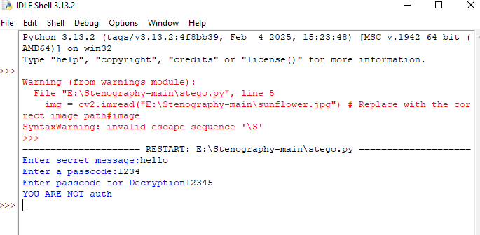
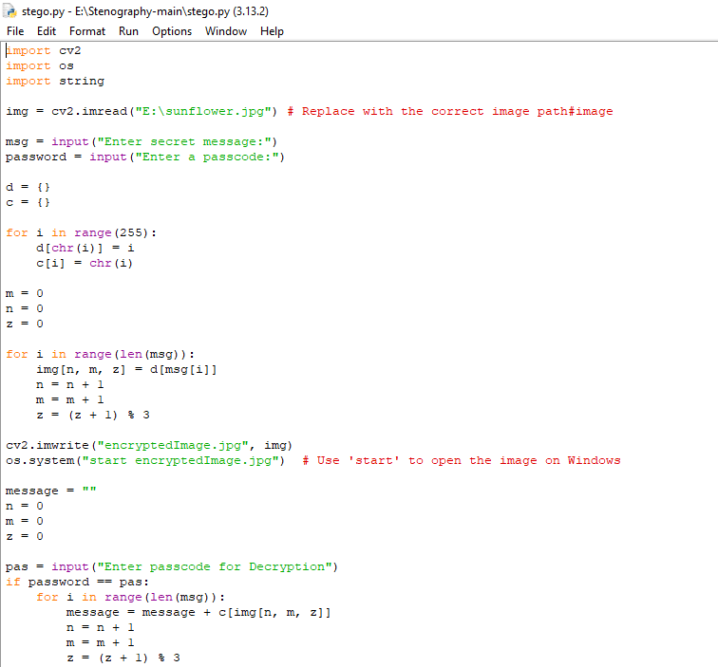
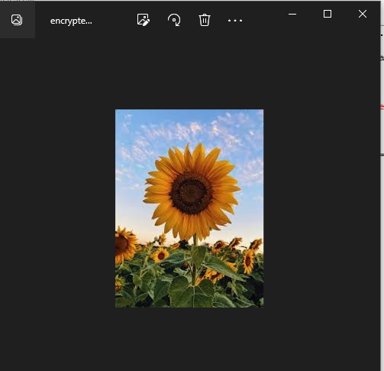
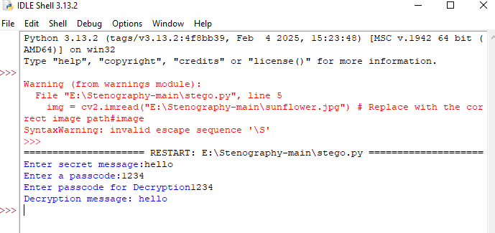
Results

Slide 8
Conclusion
Steganography is a technique for hiding data within an ordinary, nonsecret file or message to avoid detection.
The primary advantage of using steganography to hide data over cryptography is that it helps obscure the fact that sensitive data is hidden in the file or other content carrying the hidden text.

Slide 9
GitHub Link
https://github.com/aicteintern45/AICTE-INTERNSHIP-PROJECT.git

Slide 10
THANK YOU

