Slide 1
Analyzing Housing Prices
Nora El-Ruwie & Aida Bah

Slide 2
Hypothesis
Null Hypothesis: For the Kaggle Housing Prices dataset there will be no significant difference in house sale prices based on various features like number of bedrooms, number of bathrooms, area, square footage, etc.
Alternative Hypothesis: For the Kaggle Housing Prices dataset there will be a significant difference in house sale prices based on the various features like number of bedrooms, number of bathrooms, area, square footage, etc.

Slide 3
README. & Outline

Slide 4
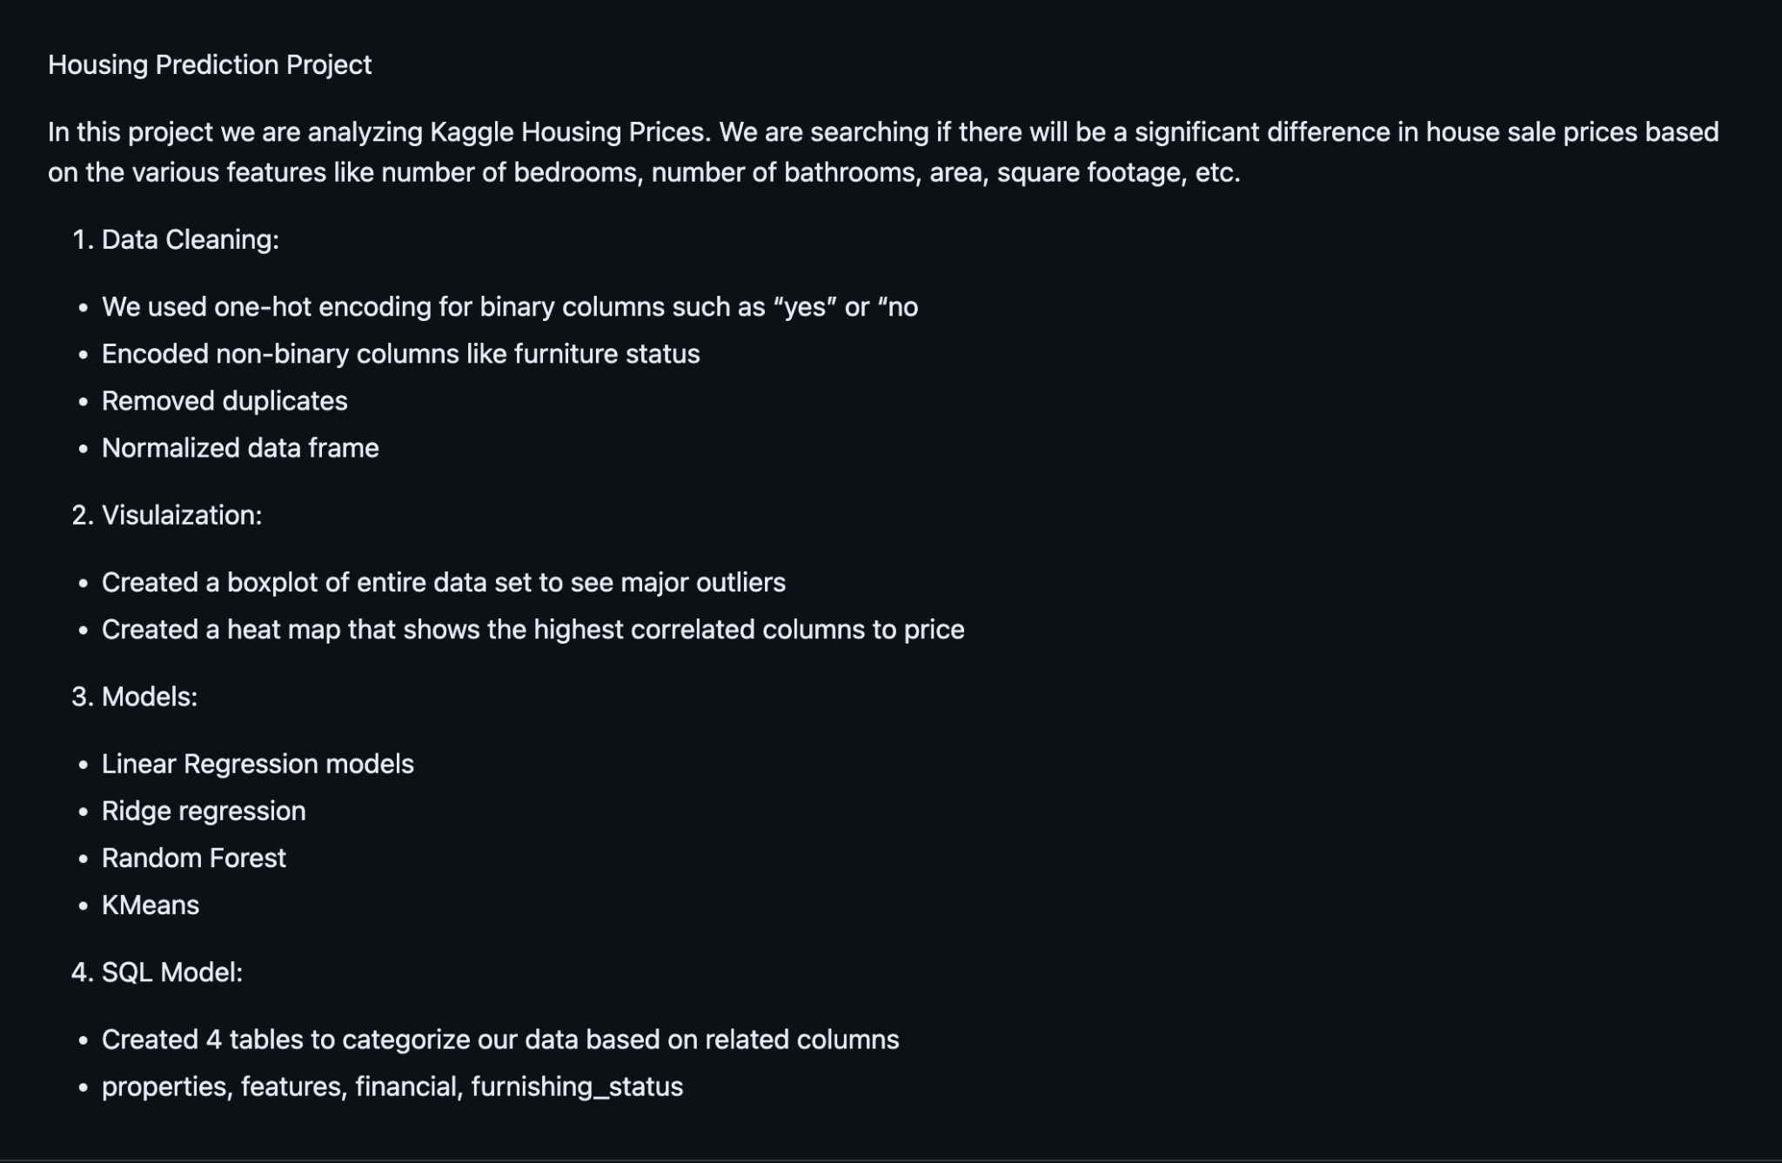

Slide 5
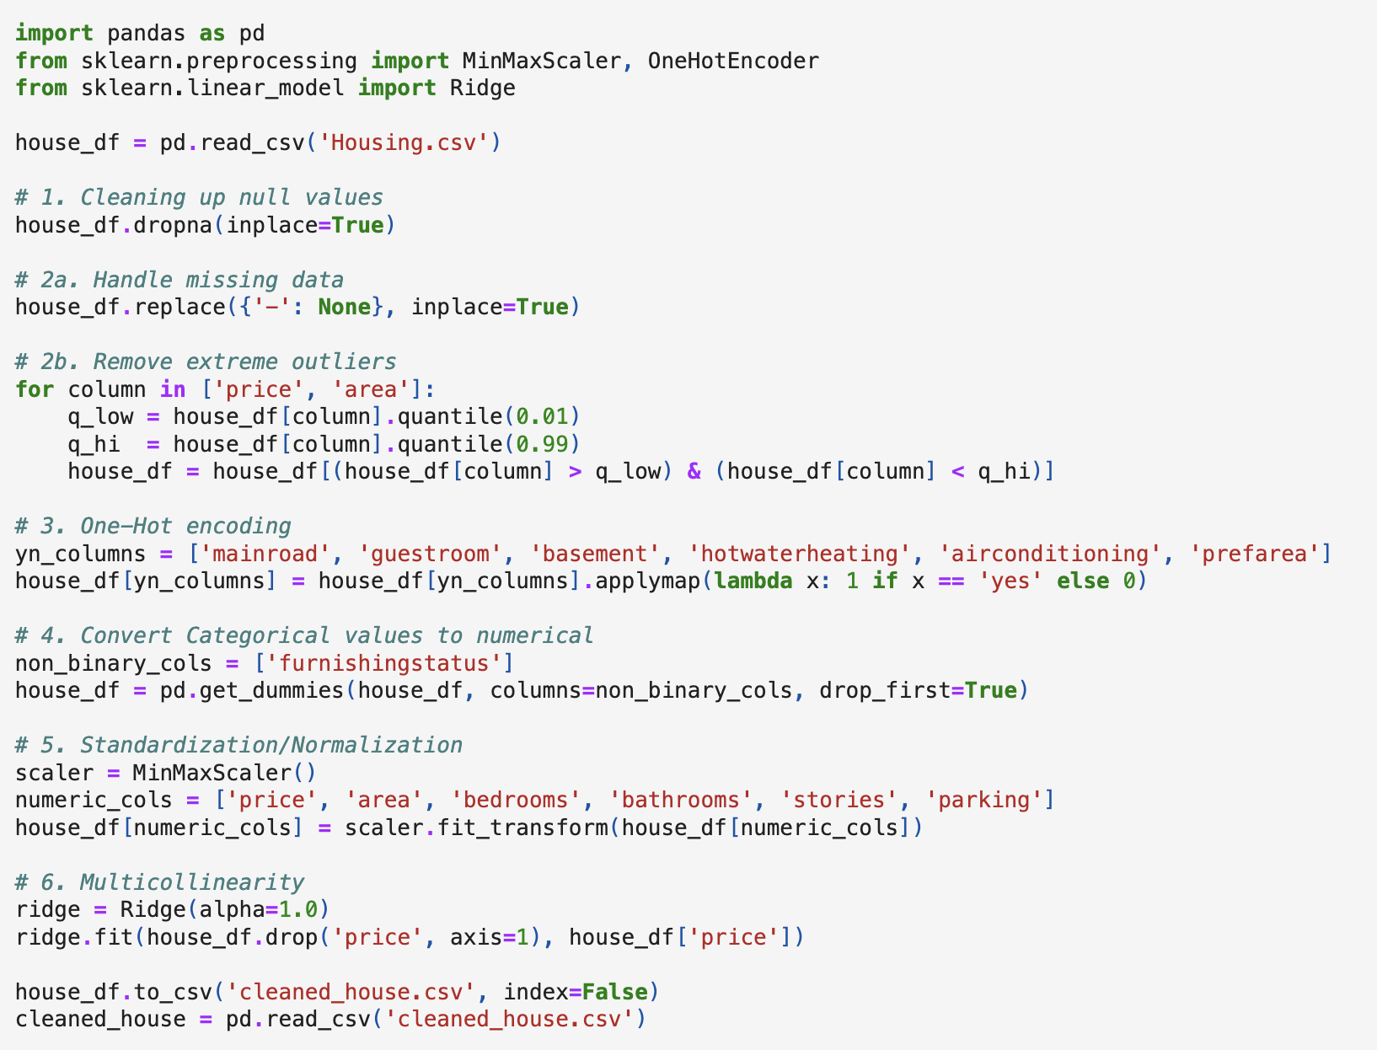
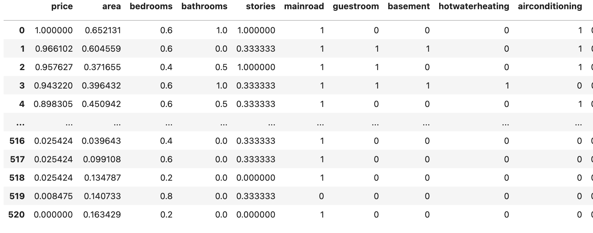
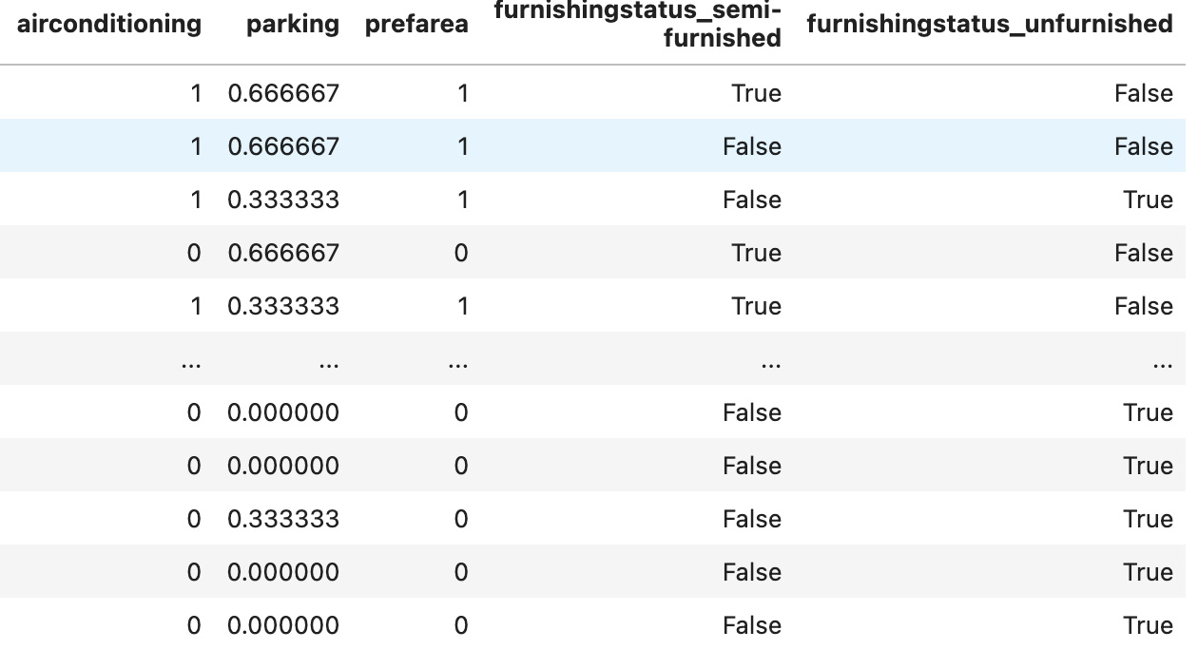
Our Dataset
Kaggle House Pricing Dataset
https://www.kaggle.com/datasets/yasserh/housing-prices-dataset

Slide 6
Visuals

Slide 7
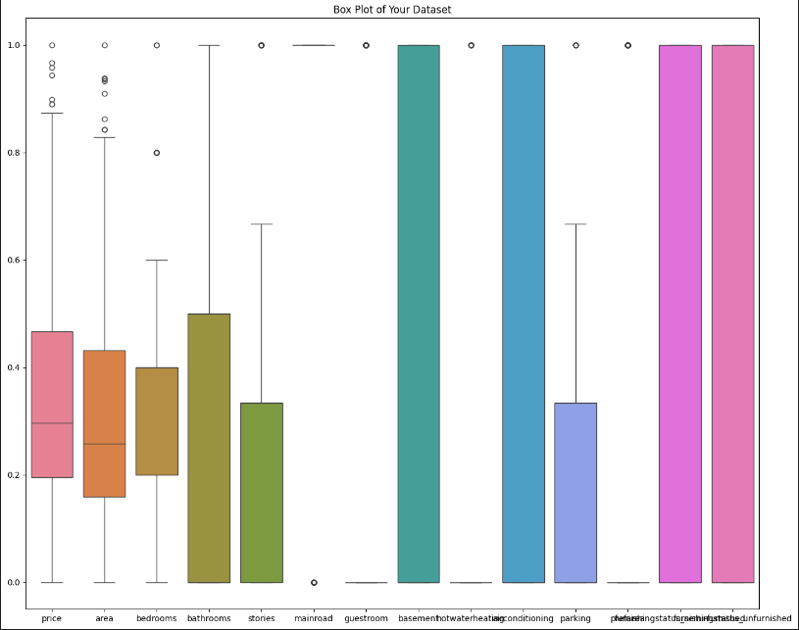

Slide 8
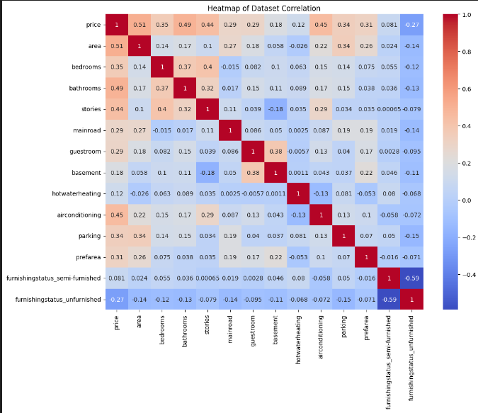

Slide 9
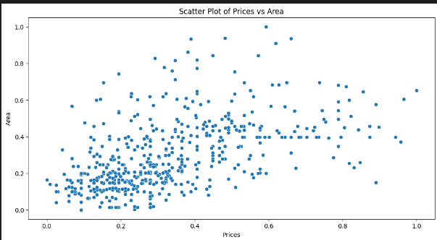
Visuals

Slide 10
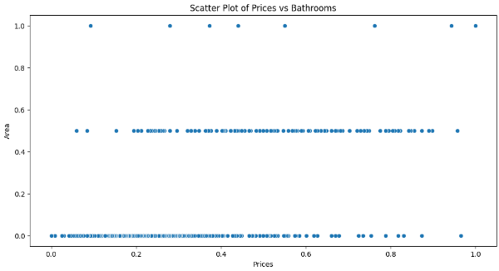

Slide 11
Models
What models did we use?
Linear Regression
Random Forest
KMeans

Slide 12
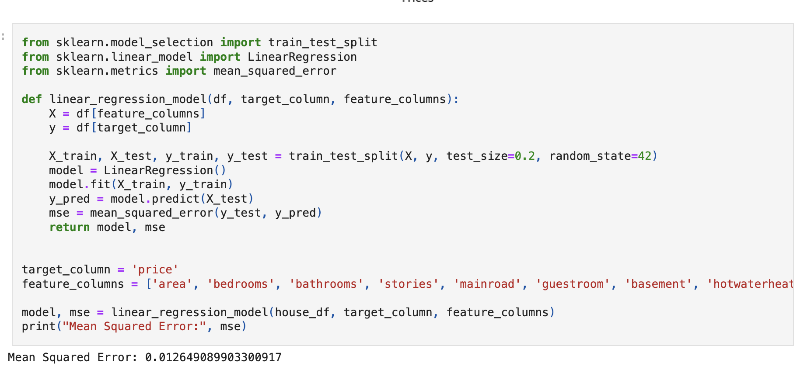
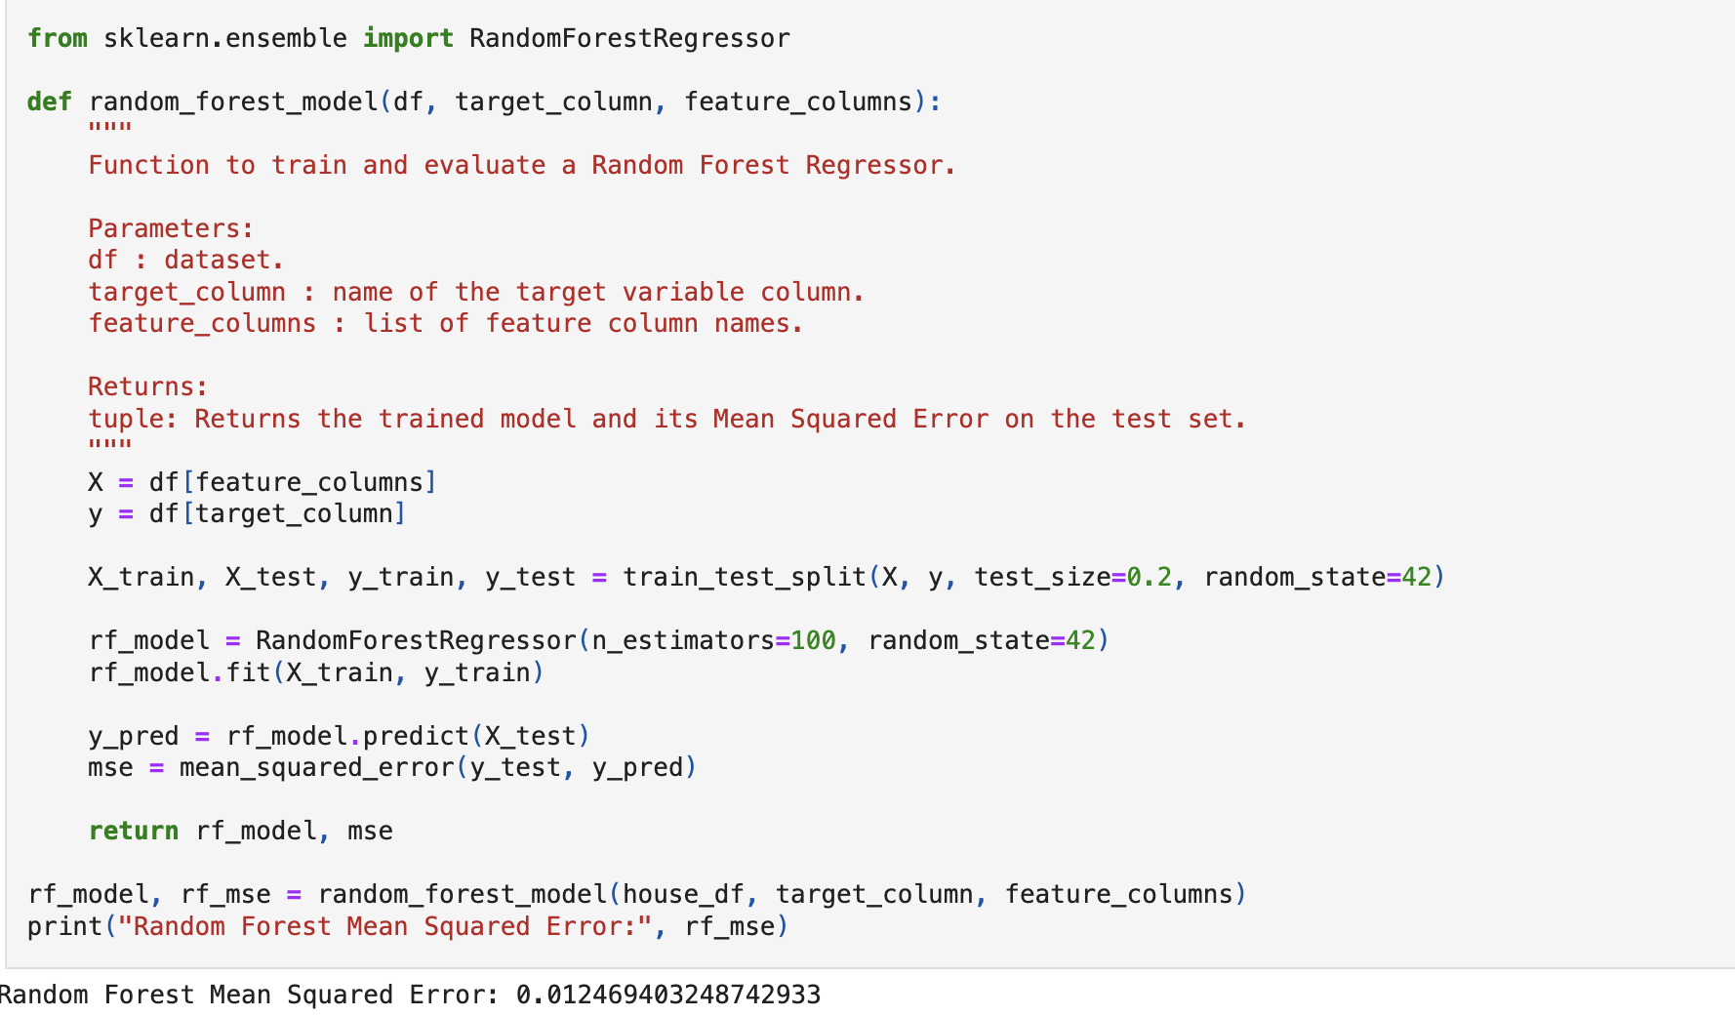
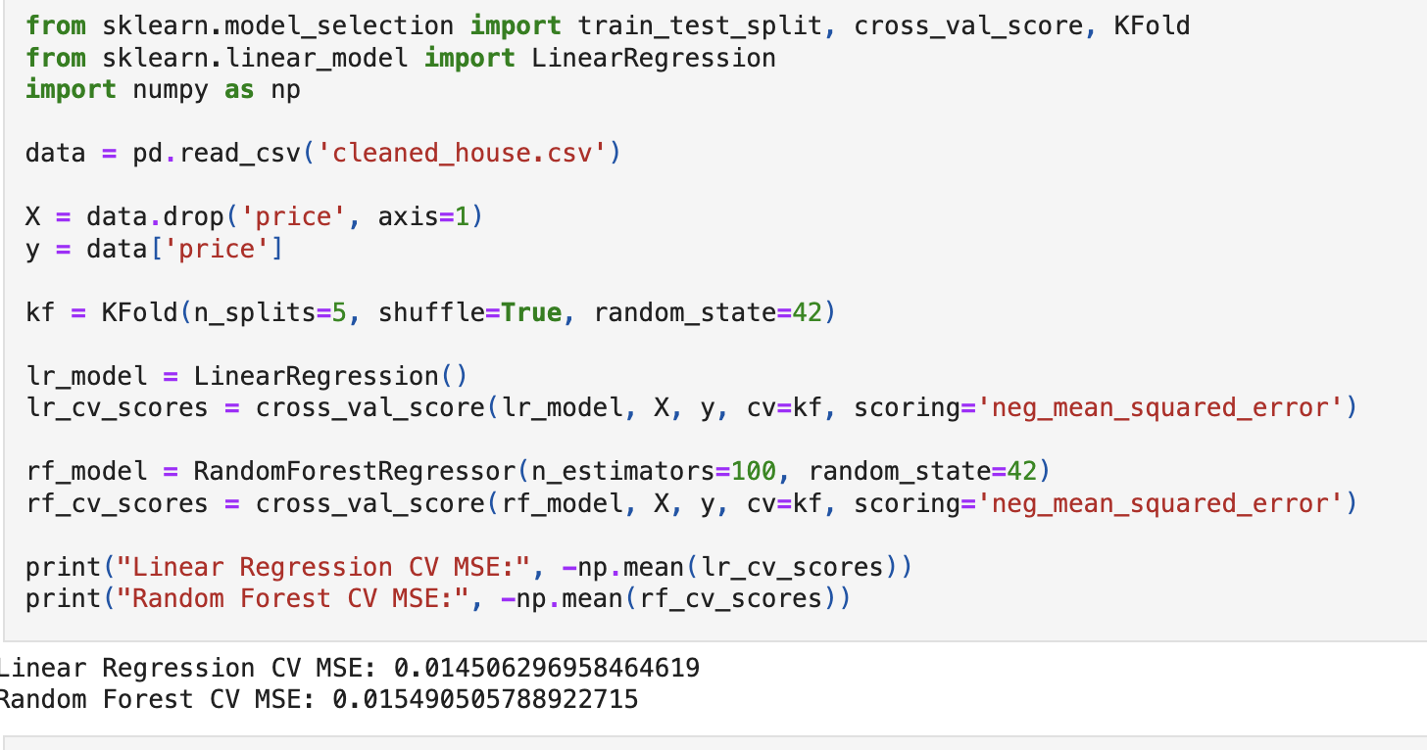
Models: Linear Regression & Random Forest

Slide 13
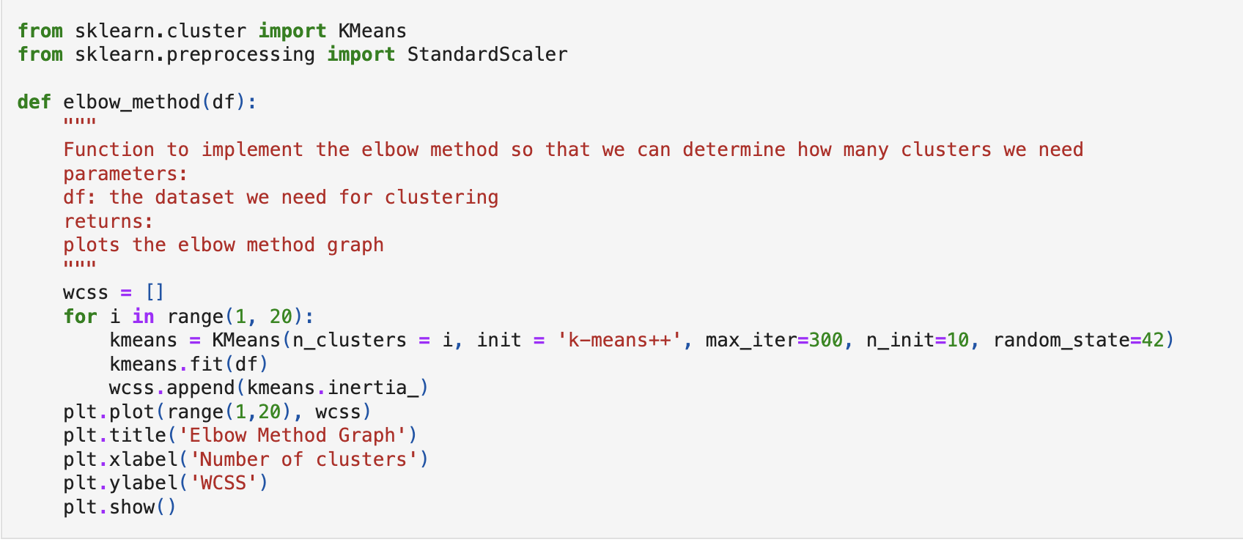
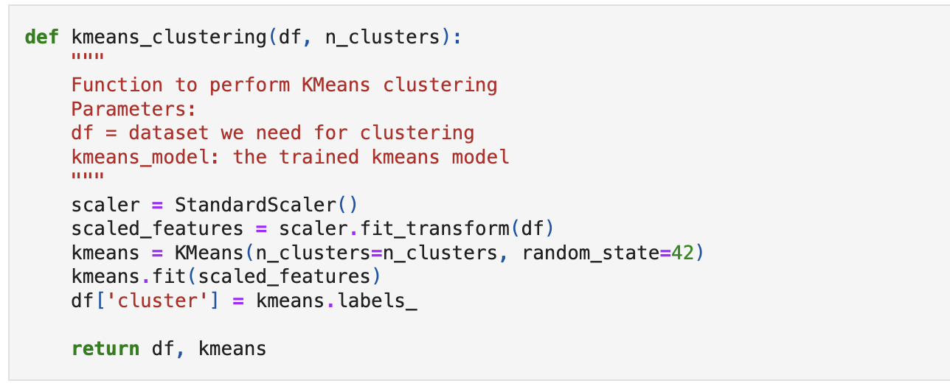
Model: K Means Clustering

Slide 14
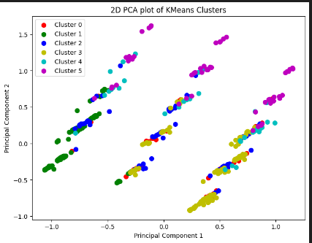
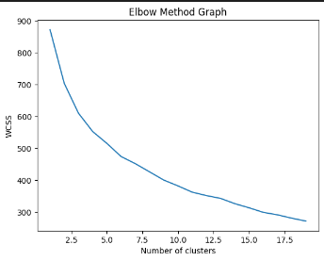
Model: KMeans Clustering

Slide 15
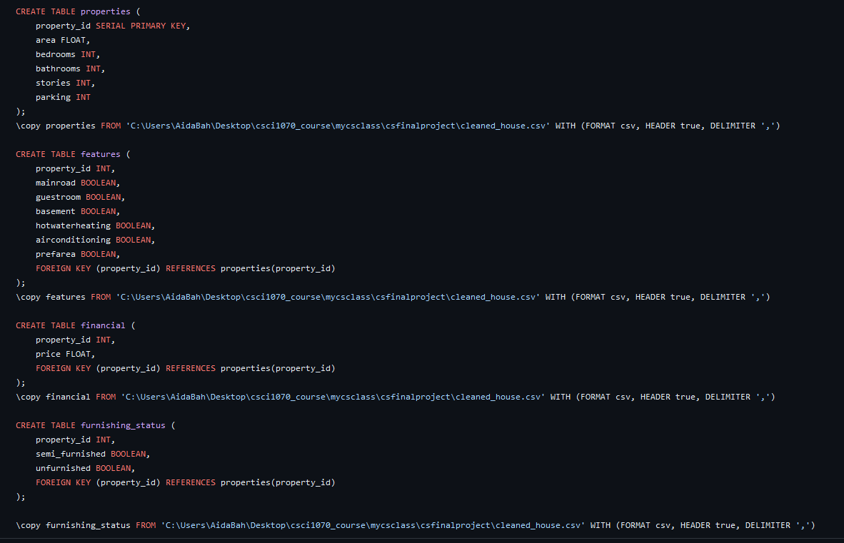
SQL TABLES

Slide 16
Thank you!

