Slide 1
Exploring Bias in datasets
Group 5

Slide 2
agenda
Dataset Overview
Methods
Key Findings
Implications of Dataset Bias
Connecting to Research
What Should Be Done
Conclusion

Slide 3
Dataset overview
What was used
  Dataset used was FairFace from kaggle
  Face attribute dataset for balanced race, gender, and age
Why it's used
  Facial Recognition
  Fairness research
Size of dataset
  Train: 86,744 images
  Validation: 10,954 images

Slide 4
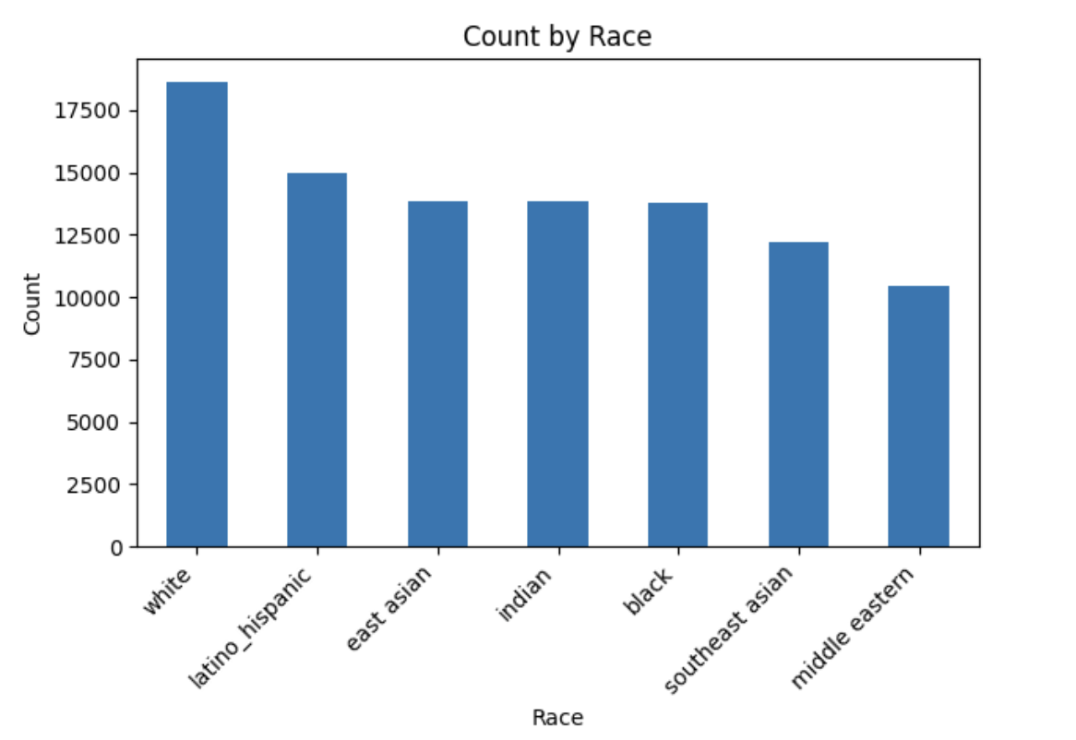
methods
Cleaned labels
Checked distributions for gender, race, age
Looked at race and gender together
Used ResNet embeddings
Decision Tree
K-Nearest Neighbors (KNN)

Slide 5
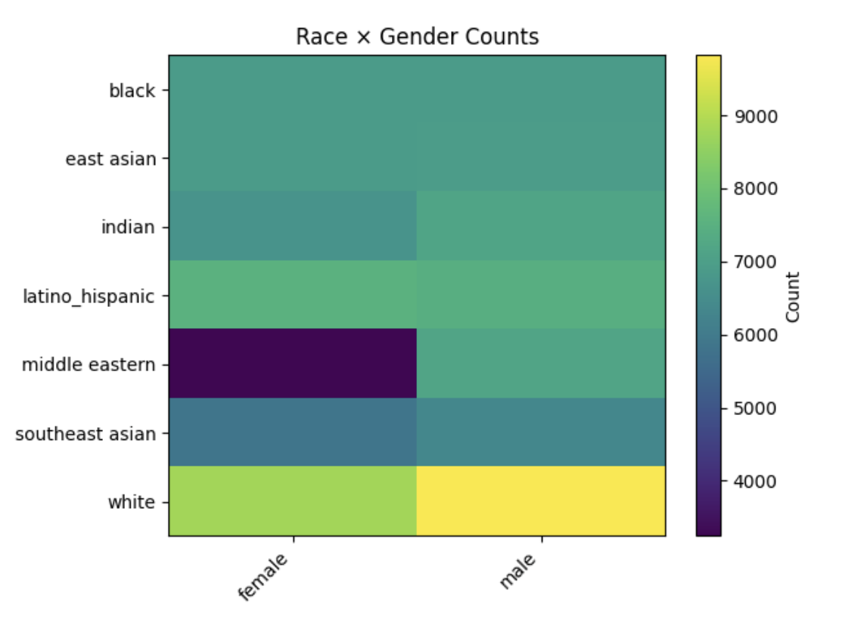
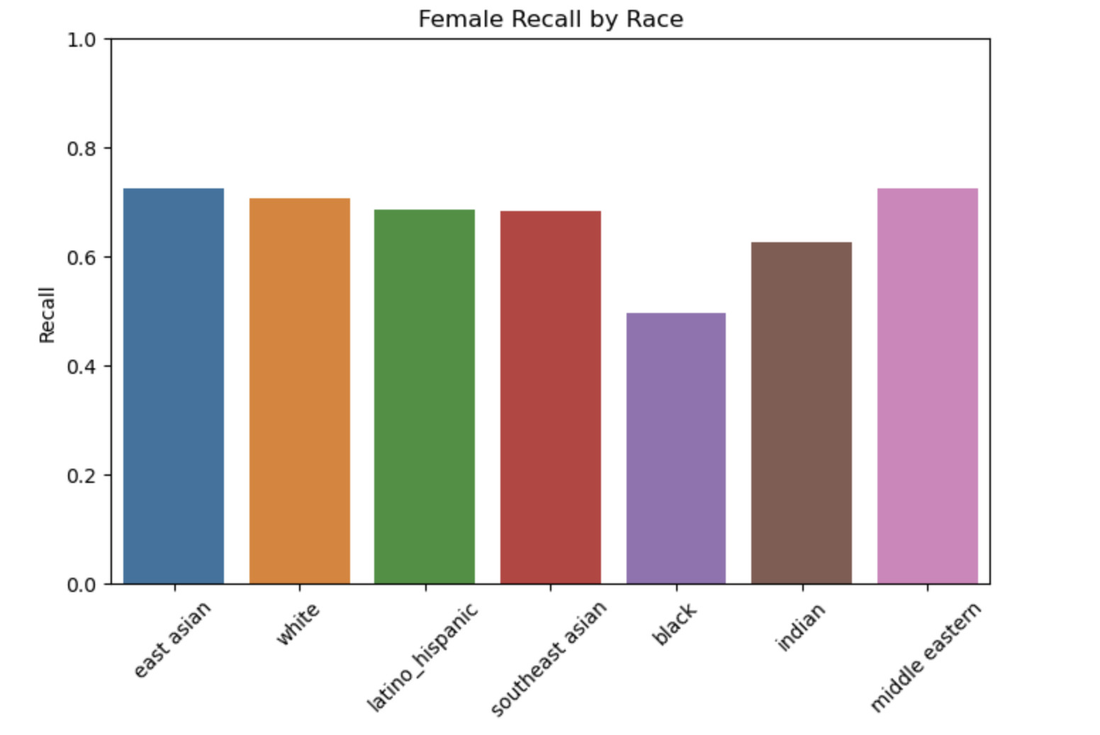
Key Findings
More males than females
White individuals most represented
Middle Eastern least represented
Young adults dominate dataset
Some race–gender groups underrepresented

Slide 6
Implications of dataset bias
Models learn patterns from dominant groups
Underrepresented groups get worse predictions
This creates unfair outcomes:
  hiring
  policing
  phone face unlock
  surveillance

Slide 7
connecting to research
Representation bias
Sampling bias
Feedback loops
Importance of dataset documentation

Slide 8
what should be done
Audit datasets before training
Balance data where possible
Track performance by subgroup
Use documentation (datasheets)

Slide 9
conclusion
Bias in datasets leads directly to bias in models and FairFace clearly shows why representation matters.

