Slide 1

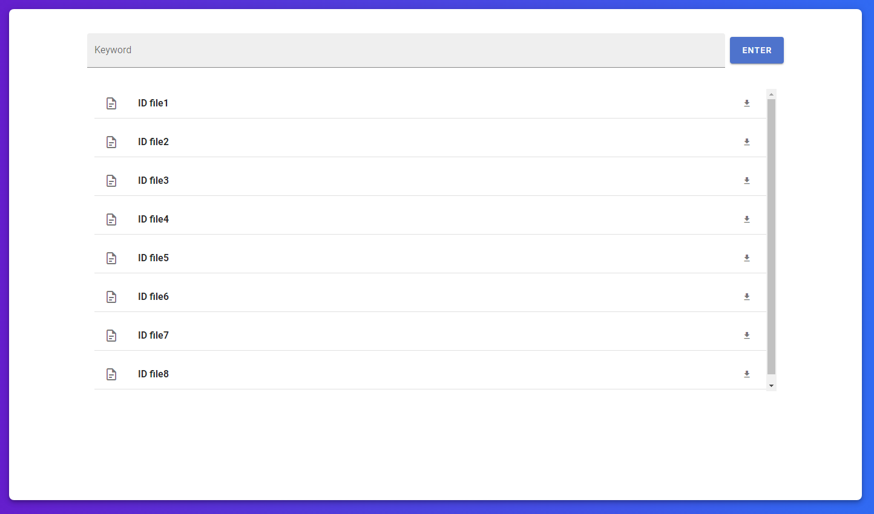

Fuzzy Search On Encrypted Cloud Data
Aidan Lane
Rensselaer Polytechnic Institute
lanea3@rpi.edu
Motivation
More systems moving to the cloud means sensitive data is constantly being transferred over a network to and from consumers.
A popular system is querying for data/results using approximate string matching (i.e. Fuzzy Search)
Our goal is to encrypt every subprocess of Fuzzy Search in an efficient way for a cloud file storage system.
System Design
Frontend
Written in Vue.js (JavaScript)
Allows a user to enter keywords and received a list of associated files back
Cloud Stack
Two core cloud-based systems: Google Cloud Storage and CloudSQL
Cloud Storage: Google’s solution for bucket-based object storage. We use Google’s Python API to upload and download to the cloud. communication behavior
CloudSQL: A compute-engine based solution for database management. Runs a sharded Postgres instance for storing n-grams and associated data
String Similarity
Jaccard Score
Fuzzy matching works by dissecting two strings into components called n-grams. (Substrings of length n).
For this system we use a Jaccard Score function to compare these sets of n-grams.
N-gram Generation
There are multiples ways n-grams can be generated.
We can augment a string based on its content. For example, separating a phrase into two keywords or including spaces, resulting in a single iteration.
N-grams are generated in O(n) in using a sliding window approach, generating a set of k unique n-grams.
Backend
Written in Python using Bazel as the build system.
Uses a terminal based application for uploading files and keywords.
Future Work
Explore more heuristic approaches to optimize database querying:
- Better n-gram indexing, database sharding
Use Google Spanner instead of CloudSQL to allow for distributed database operations (better scalability).
Encryption
AES
File data is encrypted using the Advanced Encryption Standard. This system uses a shared 128-bit session key between the user and client.
AES is also used to obfuscate file names for an added layer of security.
N-gram Matching
When a file is uploaded with tagged keywords, the keywords are converted into n-gram sets and encrypted with AES.
Each encrypted n-gram is inserted into the database with a b-tree index on the (n-gram, file, keyword).
Once a keyword is entered to match, the table is joined on an array of the keyword’s generated n-grams.
Results are grouped file named and then given a Jaccard score.
References
Daemen, J., & Rijmen, V. (1999). AES proposal: Rijndael.
Milanov, E. (2009). The RSA algorithm. RSA laboratories, 1-11.
Niwattanakul, S., Singthongchai, J., Naenudorn, E., & Wanapu, S. (2013, March). Using of Jaccard coefficient for keywords similarity. In Proceedings of the international multiconference of engineers and computer scientists (Vol. 1, No. 6, pp. 380-384).
RSA
A public key encryption scheme used for a secure handshake to share the session key between the server and client.

