Slide 1
Software Maintenance
Main issues:
why maintenance is such an issue
reverse engineering and its limitations
how to organize maintenance
Notes:
© SE, Maintenance, Hans van Vliet
Note that the book is misleadingly simple.
Just reading the book is like learning to swim without getting wet.

Slide 2
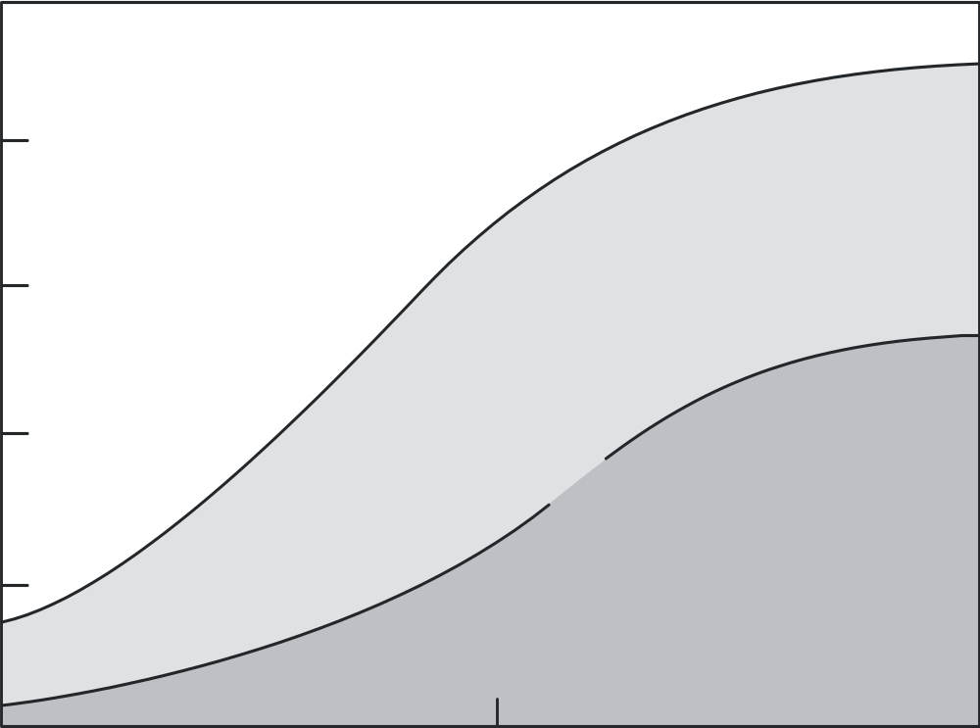
Relative distribution of software/hardware costs
100
Hardware
Development
60
Percent of total cost
Software
20
Maintenance
1955
1970
1985
Year
©2008 John Wiley & Sons Ltd.
www.wileyeurope.com/college/van vliet

Slide 3
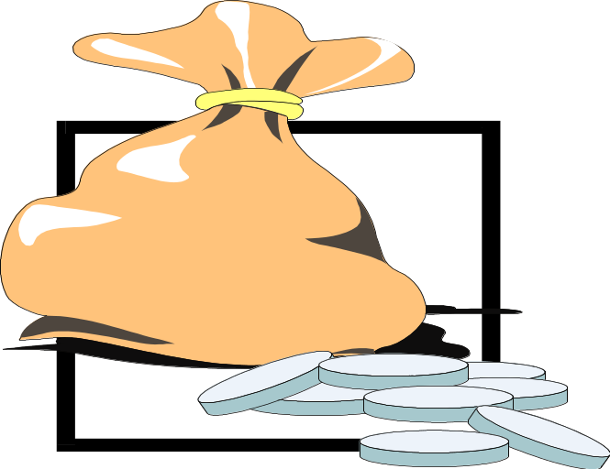
Point to ponder #1
Why does software maintenance cost so much?
©2008 John Wiley & Sons Ltd.
www.wileyeurope.com/college/van vliet

Slide 4

Software Maintenance, definition
The process of modifying a software system or
component after delivery to correct faults, improve
performance or other attributes, or adapt to a
changed environment
©2008 John Wiley & Sons Ltd.
www.wileyeurope.com/college/van vliet

Slide 5
Maintenance is thus concerned with:
correcting errors found after the software has been delivered
adapting the software to changing requirements, changing environments, ...
©2008 John Wiley & Sons Ltd.
www.wileyeurope.com/college/van vliet
Notes:
© SE, Maintenance, Hans van Vliet
- IBM OS 360: 1000 errors per release, and this number did not really go down over time
- quick and dirty bug fixes increase the system’s entropy
- maintenance is usually done under pressure

Slide 6
Key to maintenance is in development
Higher quality ⇒ less (corrective) maintenance
Anticipating changes ⇒ less (adaptive and perfective) maintenance
Better tuning to user needs ⇒ less (perfective) maintenance
Less code ⇒ less maintenance
©2008 John Wiley & Sons Ltd.
www.wileyeurope.com/college/van vliet

Slide 7
Kinds of maintenance activities
corrective maintenance: correcting errors
adaptive maintenance: adapting to changes in the environment (both hardware and software)
perfective maintenance: adapting to changing user requirements
preventive maintenance: increasing the system’s maintainability
©2008 John Wiley & Sons Ltd.
www.wileyeurope.com/college/van vliet
Notes:
© SE, Maintenance, Hans van Vliet
- adaptive maintenance does not change the functionality of the system
- people often have trouble distinguishing between adaptive and perfective maintenance
- since most present-day development does not start from scratch, part of maintenance resembles development: both concern the evolution of a system; see also exercise 10 of chapter 14.

Slide 8
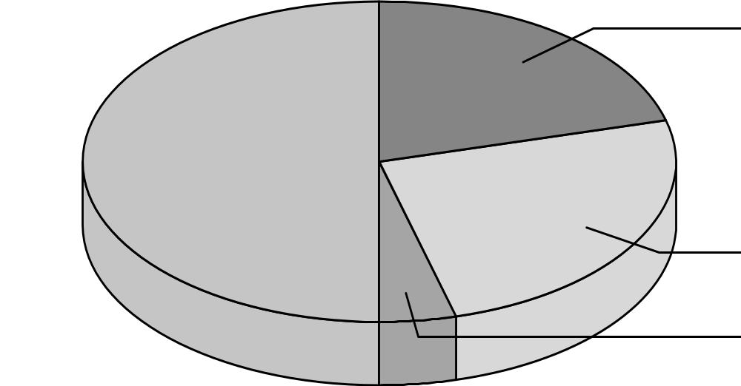
Distribution of maintenance activities
corrective 21%
perfective 50%
adaptive 25%
preventive 4%
©2008 John Wiley & Sons Ltd.
www.wileyeurope.com/college/van vliet

Slide 9
Growth of maintenance problem
1975: ~75,000 people n maintenance (17%)
1990: 800,000 (47%)
2005: 2,500,000 (76%)
2015: ??
(Numbers from Jones (2006))
©2008 John Wiley & Sons Ltd.
www.wileyeurope.com/college/van vliet

Slide 10
Shift in type of maintenance over time
Introductory stage: emphasis on user support
Growth stage: emphasis on correcting faults
Maturity: emphasis on enhancements
Decline: emphasis on technology changes
©2008 John Wiley & Sons Ltd.
www.wileyeurope.com/college/van vliet

Slide 11
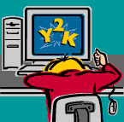
Major causes of maintenance problems
Unstructured code
Insufficient domain knowledge
Insufficient documentation
©2008 John Wiley & Sons Ltd.
www.wileyeurope.com/college/van vliet

Slide 12
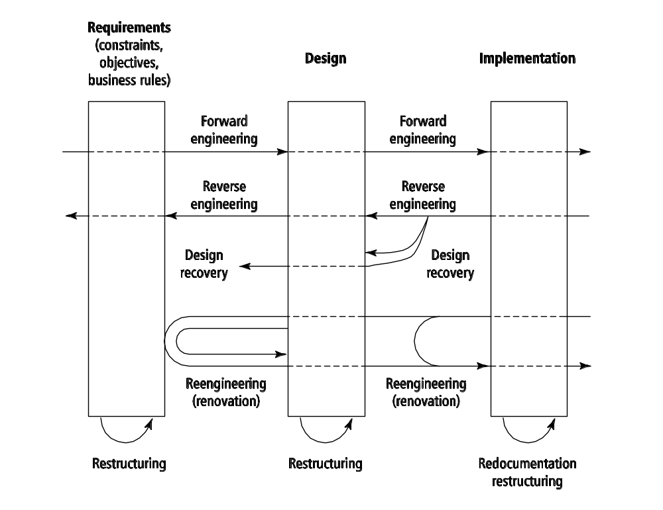
Reverse engineering
©2008 John Wiley & Sons Ltd.
www.wileyeurope.com/college/van vliet

Slide 13
Reverse engineering
Does not involve any adaptation of the system
Akin to reconstruction of a blueprint
Design recovery: result is at higher level of abstraction
Redocumentation: result is at same level of abstraction
©2008 John Wiley & Sons Ltd.
www.wileyeurope.com/college/van vliet

Slide 14
Restructuring
Functionality does not change
From one representation to another, at the same level of abstraction, such as:
  From spaghetti code to structured code
  Refactoring after a design step in agile approaches
  Black box restructuring: add a wrapper
  With platform change: migration
©2008 John Wiley & Sons Ltd.
www.wileyeurope.com/college/van vliet

Slide 15
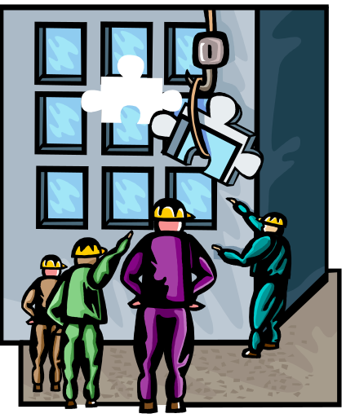
Reengineering (renovation)
Functionality does change
Then reverse engineering step is followed by a forward engineering step in which the changes are made
©2008 John Wiley & Sons Ltd.
www.wileyeurope.com/college/van vliet

Slide 16

Refactoring in case of bad smells
Long method
Large class
Primitive obsession
Data clumps
Switch statements
Lazy class
Duplicate code
Feature envy
Inappropriate intimacy
…
©2008 John Wiley & Sons Ltd.
www.wileyeurope.com/college/van vliet

Slide 17
Categories of bad smells
Bloaters: something has grown too large
Object-oriented abusers: OO not fully exploited
Change preventers: hinder further evolution
Dispensables: can be removed
Encapsulators: deal with data communication
Couplers: coupling too high
©2008 John Wiley & Sons Ltd.
www.wileyeurope.com/college/van vliet

Slide 18
Program comprehension
Role of programming plans, beacons
As-needed strategy vs systematic strategy
Use of outside knowledge (domain knowledge, naming conventions, etc.)
©2008 John Wiley & Sons Ltd.
www.wileyeurope.com/college/van vliet

Slide 19
Software maintenance tools
Tools to ease perceptual processes (reformatters)
Tools to gain insight in static structure
Tools to gain insight in dynamic behavior
Tools that inspect version history
©2008 John Wiley & Sons Ltd.
www.wileyeurope.com/college/van vliet

Slide 20
Analyzing software evolution data
Version-centered analysis: study differences between successive versions
History-centered analysis: study evolution from a certain viewpoint (e.g. how often components are changed together)
©2008 John Wiley & Sons Ltd.
www.wileyeurope.com/college/van vliet

Slide 21
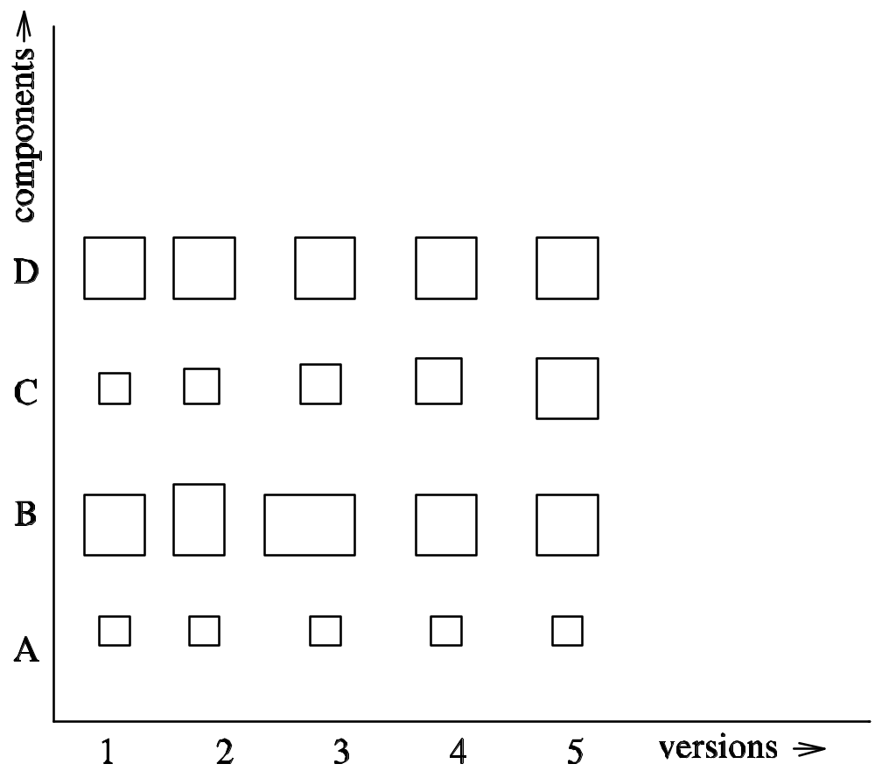
Example version-centered analysis
©2008 John Wiley & Sons Ltd.
www.wileyeurope.com/college/van vliet

Slide 22
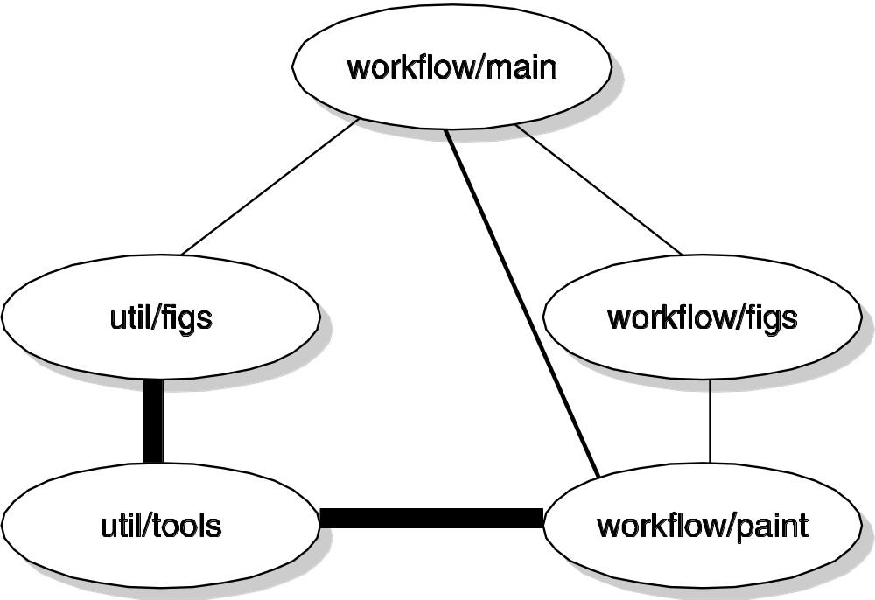
Example history-centered analysis
©2008 John Wiley & Sons Ltd.
www.wileyeurope.com/college/van vliet

Slide 23
Organization of maintenance
W-type: by work type (analysis vs programming)
A-type: by application domain
L-type: by life-cycle type (development vs maintenance)
L-type found most often
©2008 John Wiley & Sons Ltd.
www.wileyeurope.com/college/van vliet

Slide 24
Advantages of L-type departmentalization
Clear accountability
Development progress not hindered by unexpected maintenance requests
Better acceptance test by maintenance department
Higher QoS by maintenance department
Higher productivity
©2008 John Wiley & Sons Ltd.
www.wileyeurope.com/college/van vliet

Slide 25
Disadvantages of L-type departmentalization
Demotivation of maintenance personnel because of status differences
Loss of system knowledge during system transfer
Coordination costs
Increased acceptance costs
Duplication of communication channels with users
©2008 John Wiley & Sons Ltd.
www.wileyeurope.com/college/van vliet

Slide 26
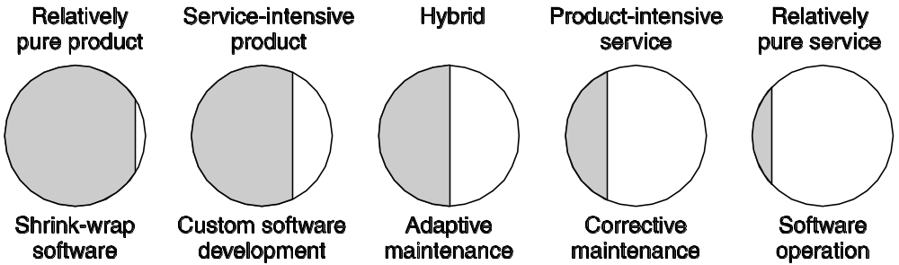
Product-service continuum and maintenance
©2008 John Wiley & Sons Ltd.
www.wileyeurope.com/college/van vliet

Slide 27
Service gaps
Expected service as perceived by provider differs from service expected by customer
Service specification differs from expected service as perceived by provider
Service delivery differs from specified services
Communication does not match service delivery
©2008 John Wiley & Sons Ltd.
www.wileyeurope.com/college/van vliet

Slide 28
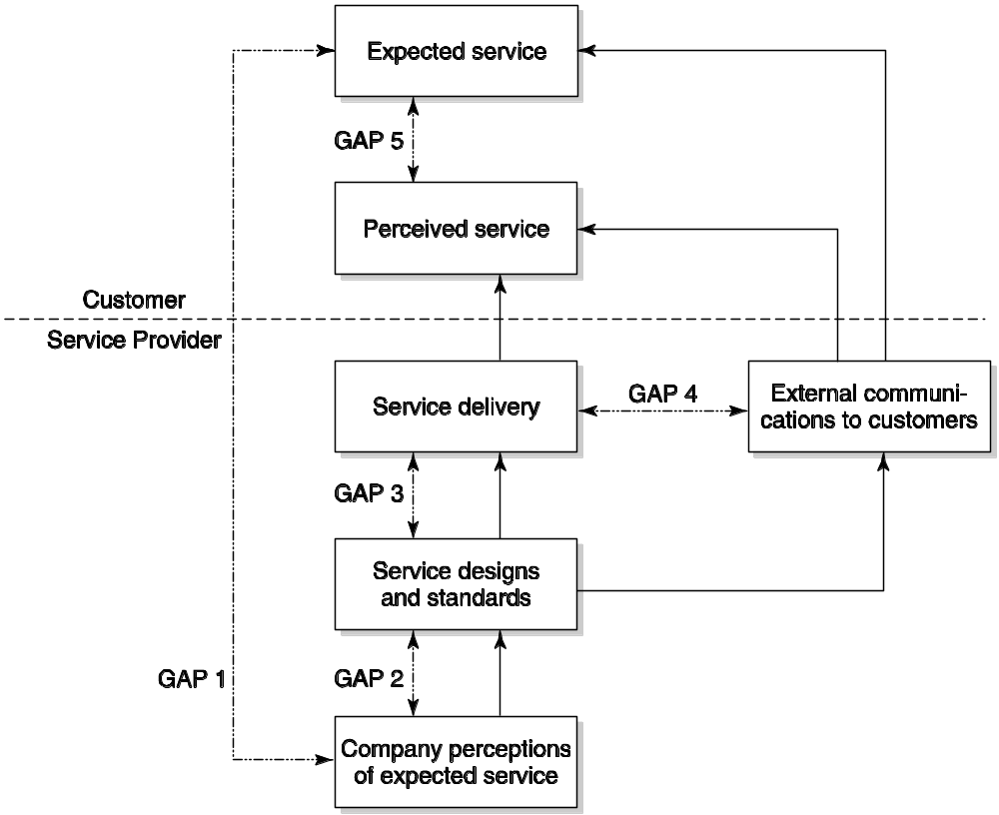
Gap model of service quality
©2008 John Wiley & Sons Ltd.
www.wileyeurope.com/college/van vliet

Slide 29

Maintenance control
Configuration control:
  Identify, classify change requests
  Analyze change requests
  Implement changes
Fits in with iterative enhancement model of maintenance (first analyze, then change)
As opposed to quick-fix model (first patch, then update design and documentation, if time permits)
©2008 John Wiley & Sons Ltd.
www.wileyeurope.com/college/van vliet

Slide 30
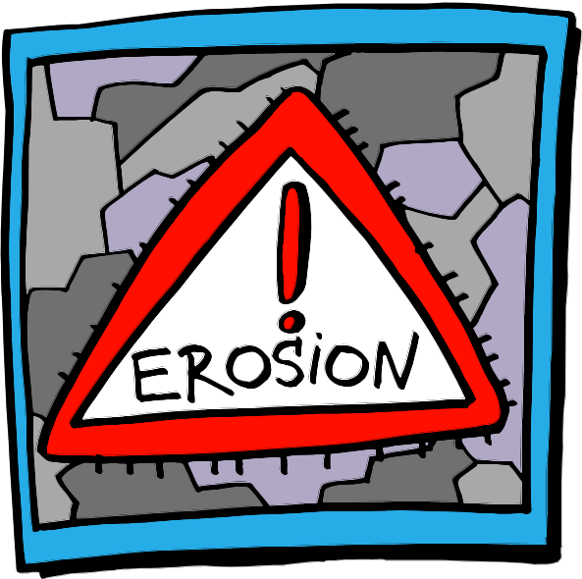
Indicators of system decay
Frequent failures
Overly complex structure
Running in emulation mode
Very large components
Excessive resource requirements
Deficient documentation
High personnel turnover
Different technologies in one system
©2008 John Wiley & Sons Ltd.
www.wileyeurope.com/college/van vliet

Slide 31
SUMMARY
most of maintenance is (inevitable) evolution
Maintenance problems:
  Unstructured code
  Insufficient knowledge about system and domain
  Insufficient documentation
  Bad image of maintenance department
Lehman’s 3rd law: a system that is used, will change
©2008 John Wiley & Sons Ltd.
www.wileyeurope.com/college/van vliet
Notes:
© SE, Maintenance, Hans van Vliet

