Slide 1
Software Tools
Main issues:
wide variety of tools
role of tools in development process
a tool is a tool, not a solution to a problem
©2008 John Wiley & Sons Ltd.
www.wileyeurope.com/college/van vliet
Notes:
© SE, Tools, Hans van Vliet
Note that the book is misleadingly simple.
Just reading the book is like learning to swim without getting wet.

Slide 2

Classification of tools
Tool: supports one task
Workbench: supports limited set of activities (e.g. design)
Environment: supports entire process
  Toolkit: just a bunch of tools
  Language-centered: e.g. around Java
  Integrated: centered around central repository with artifacts
  Process-centered: based on model of the software process
©2008 John Wiley & Sons Ltd.
www.wileyeurope.com/college/van vliet
Notes:
© SE, Tools, Hans van Vliet

Slide 3
Dimensions for classification of tools
Breadth: tool, workbench, …
Problem class: embedded, business, …
System size: small … large
User scale: individual, city, state, …
Number of sites
Process: product, people, or both
Process support: none, fixed, variable
Execution paradigm: state machine, Petri nets, …
©2008 John Wiley & Sons Ltd.
www.wileyeurope.com/college/van vliet

Slide 4

Toolkits
Prime example: UNIX
Tools know little to nothing of the objects they manipulate
Mutual alignment of tools is an issue
©2008 John Wiley & Sons Ltd.
www.wileyeurope.com/college/van vliet

Slide 5
Language-centered environments
Often programming environment, and visual,
Present-day examples: Studio .NET, Eclipse
Long learning curve
©2008 John Wiley & Sons Ltd.
www.wileyeurope.com/college/van vliet

Slide 6
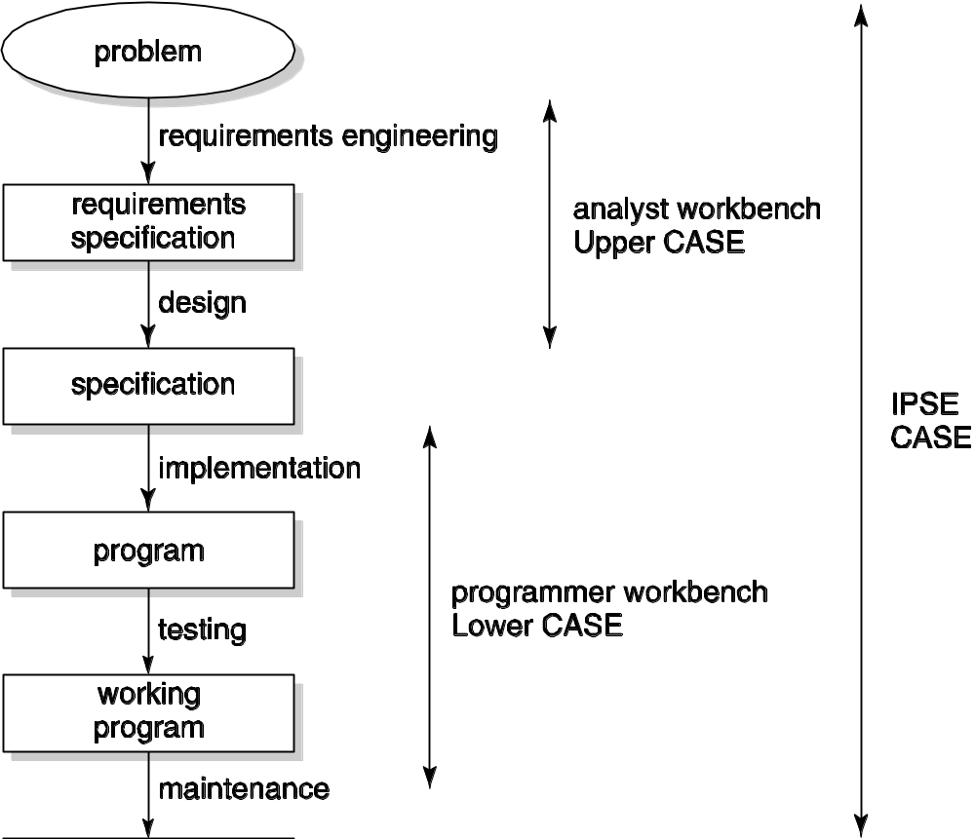
Scope of integrated environments
©2008 John Wiley & Sons Ltd.
www.wileyeurope.com/college/van vliet

Slide 7

Analyst workbench
Focus on early phases: requirements and design
(“syntax-directed”) drawing of pictures
Analysis support, e.g. consistency
Managing information, e.g. set of requirements
Report generation
©2008 John Wiley & Sons Ltd.
www.wileyeurope.com/college/van vliet

Slide 8
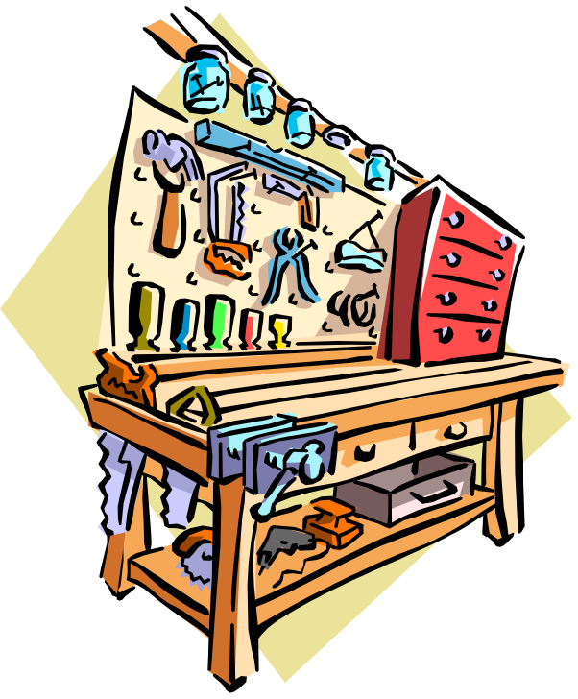
Programmer workbench
Editing, analyzing, code
Debugging and instrumentation tools
Test coverage tools
Central tool: configuration control
©2008 John Wiley & Sons Ltd.
www.wileyeurope.com/college/van vliet

Slide 9

Management workbench
Configuration control, including management of change requests
Work assignment
Effort estimation tools
©2008 John Wiley & Sons Ltd.
www.wileyeurope.com/college/van vliet

Slide 10
Process-centered environment (PSEE)
Based on a model of the process, e.g. in the form of a Petri net
Resemble workflow management systems
Formal models are rigid, can be stiffling
©2008 John Wiley & Sons Ltd.
www.wileyeurope.com/college/van vliet

Slide 11
Summary
Wide variety of tools, with different scope
Impediment: rigidity of tools
  They should support collaboration, not just automation
Tool adoption:
  Do they really help?
  Learning curve
A tool is a tool, not a solution to a problem
©2008 John Wiley & Sons Ltd.
www.wileyeurope.com/college/van vliet

