Slide 1
Autonomous Field Rover
P
R
O
J
E
C
T
P
L
A
N
Robot that autonomously creates a 3D map of a given field.
Presented by: Nathan Lancaster, Austyn Smock, Aidan Pantoya

Slide 2
Pi Setup and Documentation
SRS
Software Diagrams
Raspberry Pi VNC
Raspberry Pi RealSense Software installation
D415 camera interfacing
Executing programs and commands through Python

Slide 3
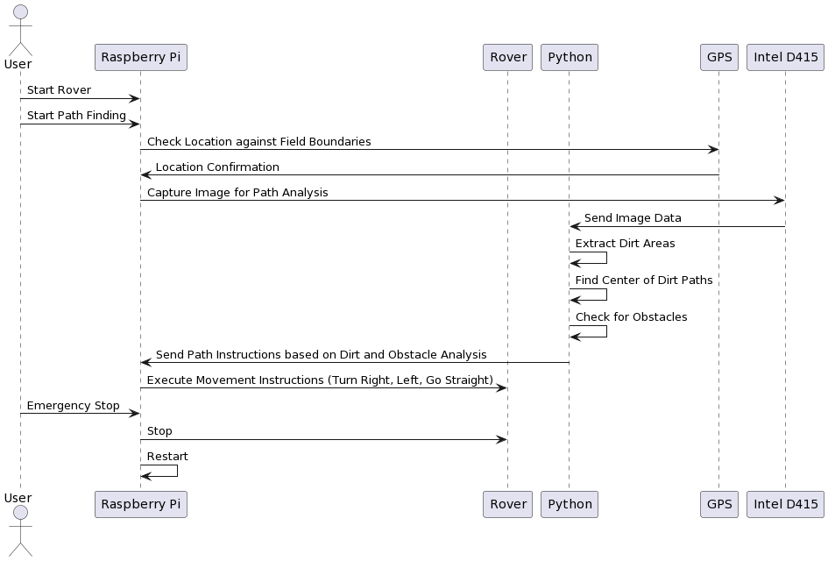
Smart Field Navigation
Define Field Boundaries
Path Planning Algorithm
Obstacle Detection
Autonomous Navigation Logic
Emergency Stop and Reset

Slide 4
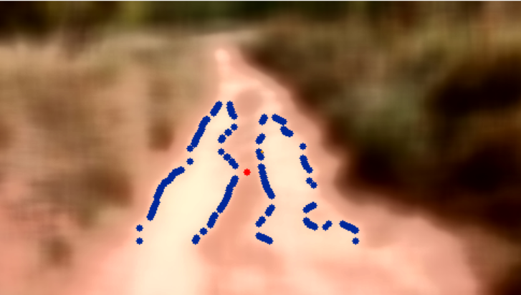
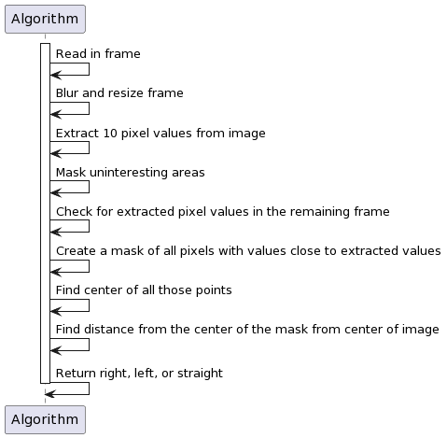

Path Planning Algorithm

Slide 5
3D Mapping
Hardware Setup
Image Stitching and Capture
GPS Integration
Data Storage and Management
3D Mapping Algorithm
Data Visualization / Map Generation

Slide 6
User Interface
Python Interface for basic control
Communication with Rover and Pi
Implement C++ functionality to Python UI

Slide 7
Sustainability and Convenience
Task Scheduling
Weather Forecast Integration
Battery Life / Health

Slide 8
QUESTIONS?

