Slide 1
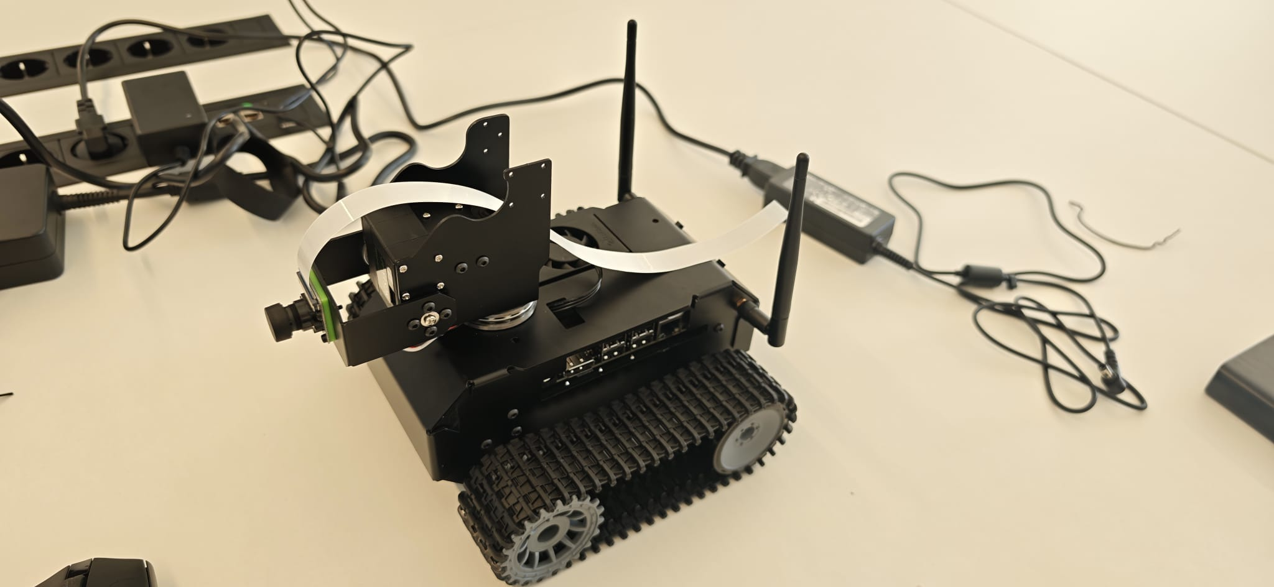

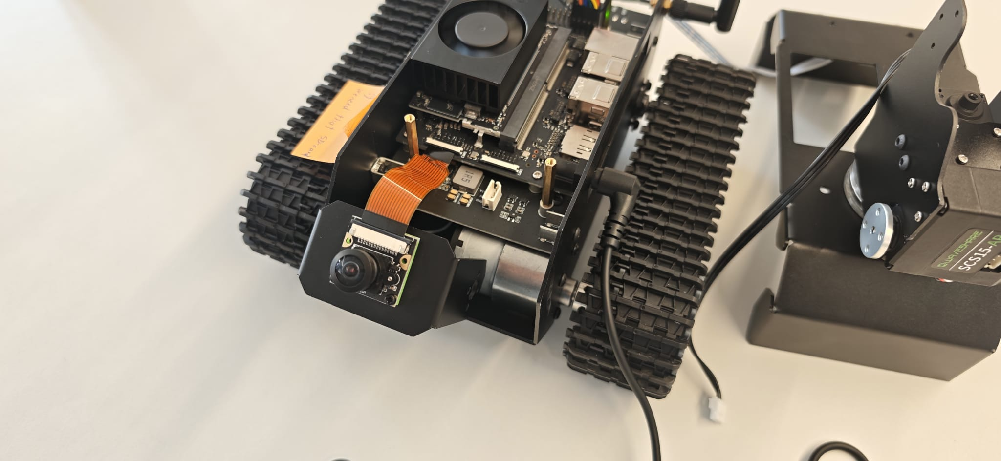











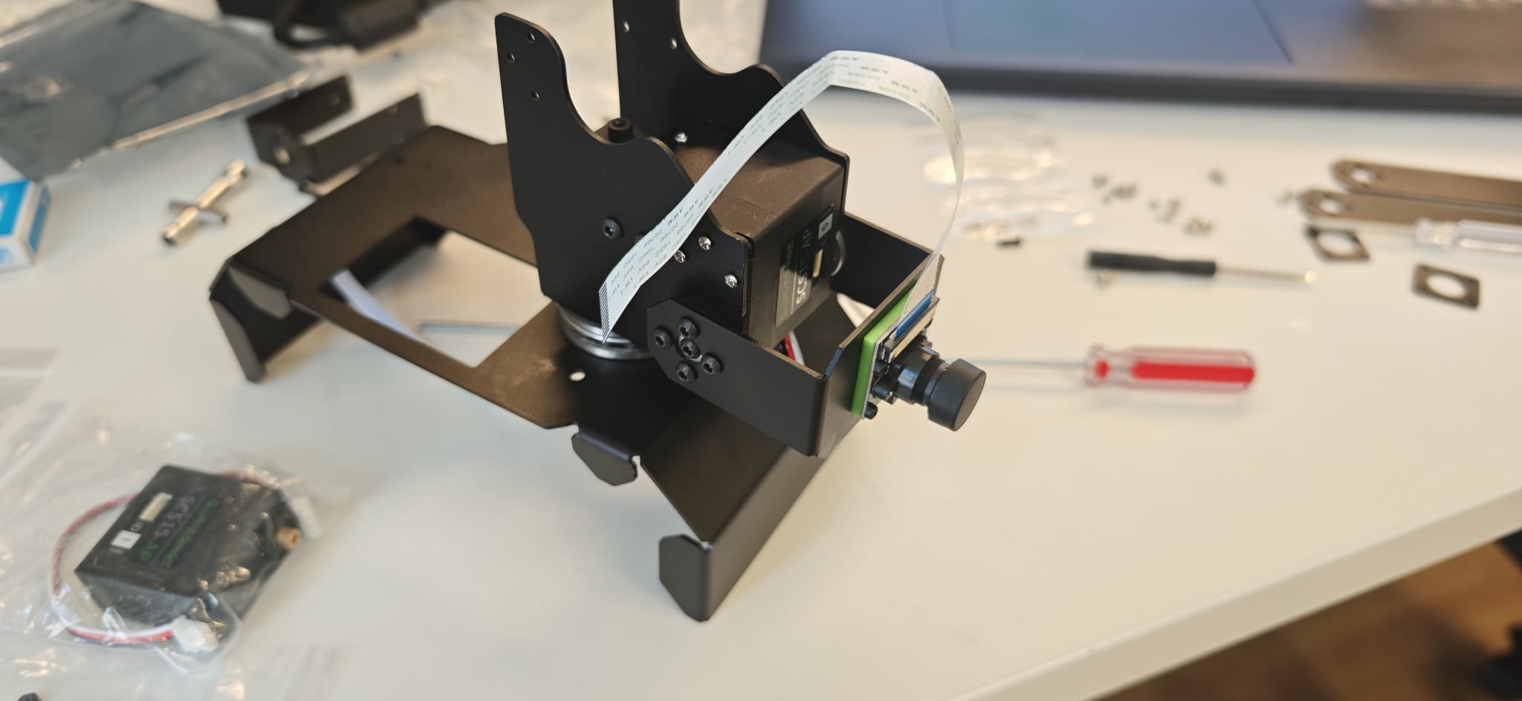

Can a Robot
Teach Itself to Drive?
A university project in AI-powered autonomous robotics
Denis Vasilev · Adam Ryan · Aidan Ryan · Nora Cerveny — IMC Krems SS 2026
What did we build?
We built a small tracked robot that can see the world through a camera and use AI to navigate — no remote control needed.
How it works
Camera
→
Lane Detection
→
Object Detection
→
Fusion
→
Decision
Records the road
in real time
Finds road edges
& lane lines
Spots obstacles
using YOLO AI
Combines both into
one view of the world
Steer, speed up,
or stop safely
What we had to overcome
✅ Fixed
✅ Fixed
✅ Fixed
Wrong OS
No WiFi
Power Mismatch
5 operating system versions tried before the robot would even switch on.
The wireless driver was missing from the OS. We compiled and installed it manually.
The kit was built for an older chip. We designed a new power setup using a USB-C bank.
✅ Fixed
✅ Fixed
🔄 Ongoing
Camera Invisible
Arm Gone Haywire
Motors Silent
One hidden config line blocked the camera driver. Fixed — live video feed confirmed.
The robotic arm tangled its own cables. We recalibrated all servo positions.
Drive motors won't move despite correct commands. Root cause still under investigation.
How far did we get?
Camera mount & servo arm — mid-assembly
What we learned
What's next
Real-world hardware is full of surprises.
Most of our semester was spent making the robot's brain and body talk to each other — something the kit wasn't designed for.
That problem-solving IS the engineering.
Fix the drive motors so the robot can actually move
Add a second sensor (ultrasonic or lidar) for true fusion
Train the AI on footage from this robot's own camera
Mount battery on-board for fully wireless operation
IMC Krems University of Applied Sciences · Capstone Project SS 2026 · Denis Vasilev · Adam Ryan · Aidan Ryan · Nora Cerveny

