Slide 1
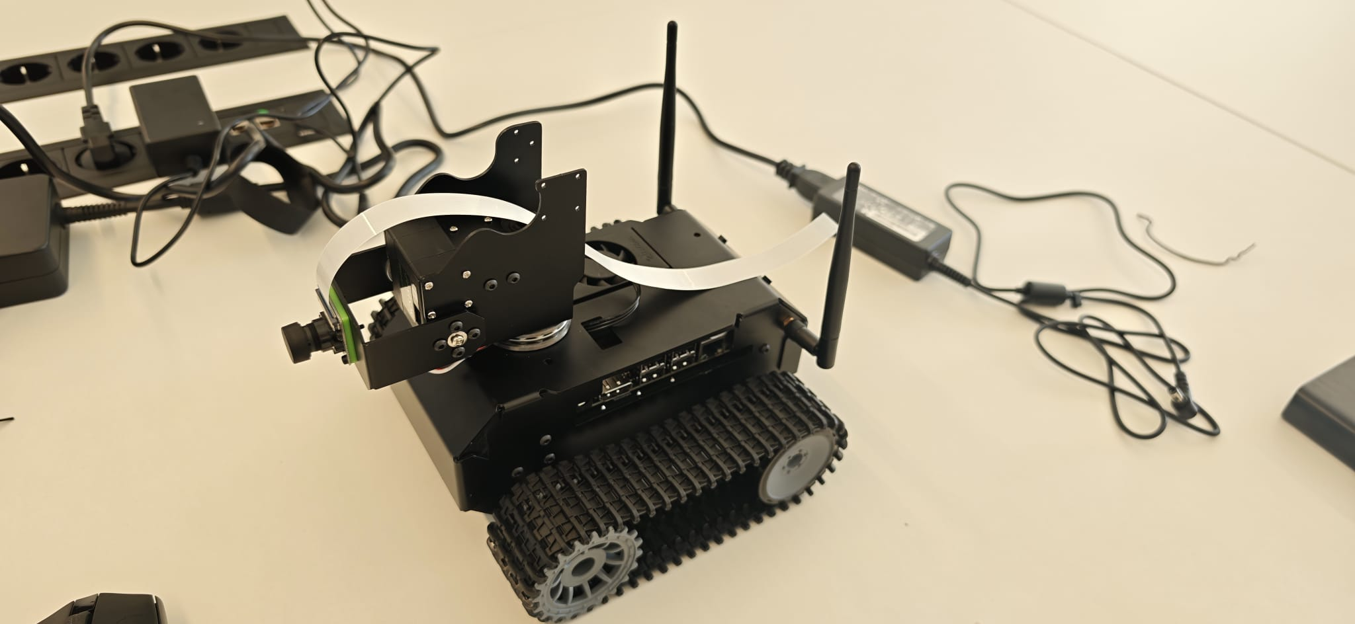
Self-Driving Robot
Data Science Capstone Project
Summer Semester 2026
Team Denis Vasilev · Adam Ryan · Aidan Ryan · Nora Cerveny
IMC Krems University of Applied Sciences
Notes:
Welcome! Introduce the project briefly. This was a semester-long capstone project to build a self-driving robot from scratch using real AI hardware. Four team members, divided between hardware and software.

Slide 2


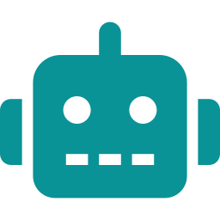
Why Build a Self-Driving Robot?
The Big Picture
The Sensor Challenge
Our Contribution
Self-driving vehicles could free up billions of hours of commuting, cut road accidents, and reduce fuel waste. But making them work reliably is still an open challenge.
Cars need to "see" the world — with cameras, radar, and lidar — and make split-second decisions even in bad weather, poor lighting, or unexpected obstacles.
We built a miniature version of this problem: a tracked robot that uses a camera and AI to navigate its environment — detecting lanes, recognizing objects, and steering itself.
Think of this project as a 1:20 scale test bench for real autonomous driving research.
Notes:
Self-driving is a hot topic. Explain why it matters to everyday people. Our project is a small-scale version of what Tesla, Waymo etc. are doing — great for learning the core challenges.

Slide 3


Meet the Team
Hardware Team
Software Team
Denis Vasilev
Aidan Ryan
Nora Cerveny
Adam Ryan
Assembled the physical robot chassis
Flashed & configured the operating system
Solved WiFi driver & power compatibility issues
Got the camera and servo arm working
Wired up and tested all electronic components
Set up Python AI environment (CUDA, TensorRT)
Integrated the YOLO object detection model
Developed lane detection software pipeline
Built the logic to fuse sensor data for decisions
Planned the autonomous control architecture
Notes:
Two hardware, two software. Hardware was responsible for getting the physical robot running. Software planned the AI pipeline. In practice, hardware challenges dominated most of the semester.

Slide 4
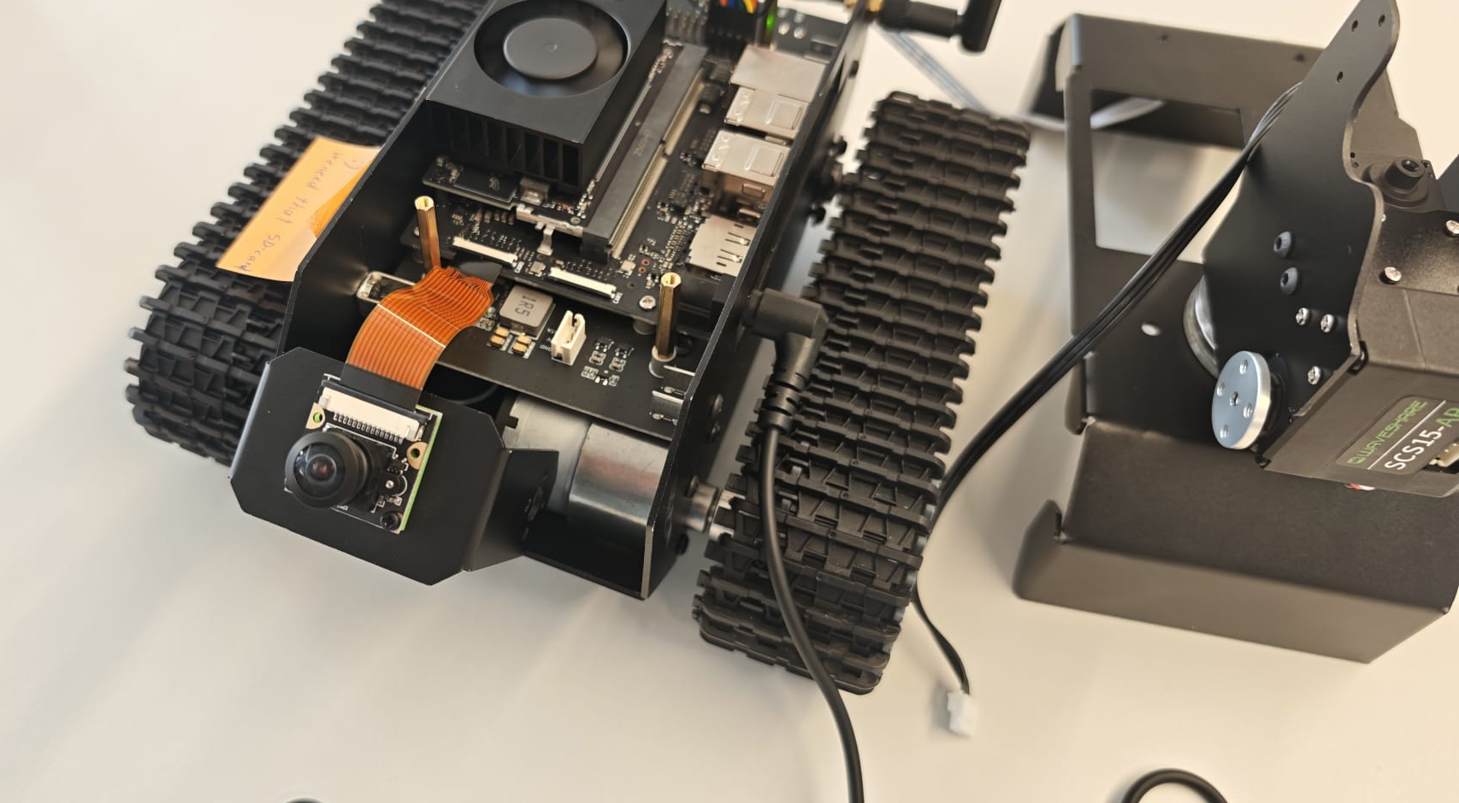
The Robot — What's Inside?
BRAIN
NVIDIA Jetson Orin Nano Super — AI chip with 1024 GPU cores
EYES
IMX219-160 camera — wide-angle 8MP lens, 160° field of view
LEGS
Dual tank-track motors — go anywhere, even on rough surfaces
ARM
5 servo robotic arm — can grab, tilt & pan the camera
DISPLAY
Tiny OLED screen — shows live WiFi, CPU & system status
Notes:
Walk through each component. Emphasize the brain (Jetson) is a real AI chip — the same class of hardware used in research robotics. The camera feeds into the AI for decision-making.

Slide 5
The Plan — Three Levels of Difficulty
Task C
Task B
Task A
Foundation
Perception
Autonomy
Build and configure the hardware: assemble the robot, install the OS, connect all sensors & motors, and verify everything turns on and works together.
Give the robot eyes and understanding: merge live camera data, lane detection lines, and YOLO object recognition into one real-time picture of the world.
Make the robot drive itself: use the fused perception data to automatically steer, speed up or slow down, and stop safely when something is in the way.
✅ Completed (with many obstacles!)
⚠️ Partially started/completed — blocked by hardware
⏳ Not yet started — requires Task B first
Notes:
The project was designed as three progressive milestones: build it, see with it, drive with it. Task C was the hardware foundation. Tasks B and A are the AI layers on top.

Slide 6

How the AI Was Supposed to Work
Camera
Lane Detection
YOLO Object
Detection
Fusion Layer
Control
Policy
→
→
→
→
Records live video 30fps
Finds road edges using computer vision
Spots obstacles & signs in real time
Combines both into one map of the world
Decides: steer, stop, or go
Camera → Detect lanes & objects → Fuse information → Make a driving decision
CUDA 12.6
TensorRT 10
OpenCV 4.8
YOLOv8
GStreamer
JetPack 6.2
Notes:
This is the software architecture as designed. Walk through each step simply: camera sees, AI detects lanes and objects, we merge both into a unified view, then the robot decides what to do.

Slide 7



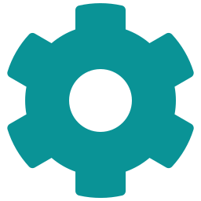
Results — Chipping Away at the Compatibility Challenge
The JETANK kit was built for an older chip (Jetson Nano). We used its newer successor (Jetson Orin Nano). Almost nothing worked out of the box.
Wrong Operating System
✅ Resolved
No Wi-Fi Out of the Box
✅ Resolved
5 different OS images tried before one booted. The hardware was a newer generation that the kit's software was not made for.
The wireless driver was missing from the stripped-down OS. We manually compiled and installed it.
Power Incompatibility
✅ Resolved
Camera Not Recognized
✅ Resolved
The kit's power board outputs 5V. The new Jetson needs 9–20V. We designed a split power system with a USB-C power bank.
The camera needed a low-level system config file edit to activate its driver. One line of configuration, hours to diagnose.
Arm Went Haywire
✅ Resolved
Motors Wouldn't Move
🔄 In Progress
The servo arm calibration values were wrong post-assembly — it spun aggressively and tangled its own cables. We recalibrated all positions.
Despite sending correct commands and finding two software bugs, the tank motors still won't respond. Root cause is under investigation.
Notes:
This is the story of the semester. One compatibility wall after another. Each one was solvable, but each took hours to days of debugging. The motors are the last unsolved issue.

Slide 8
What We Achieved — At a Glance
5 of 6
5+
10+
Hardware Issues
Resolved
OS Images
Tried
Bug Fixes
Applied
Notes:
Visual summary of where we got to. Most hardware setup tasks are done. The motors and the AI pipeline are the two remaining gaps. Great to show this as a bar chart for audience clarity.

Slide 9
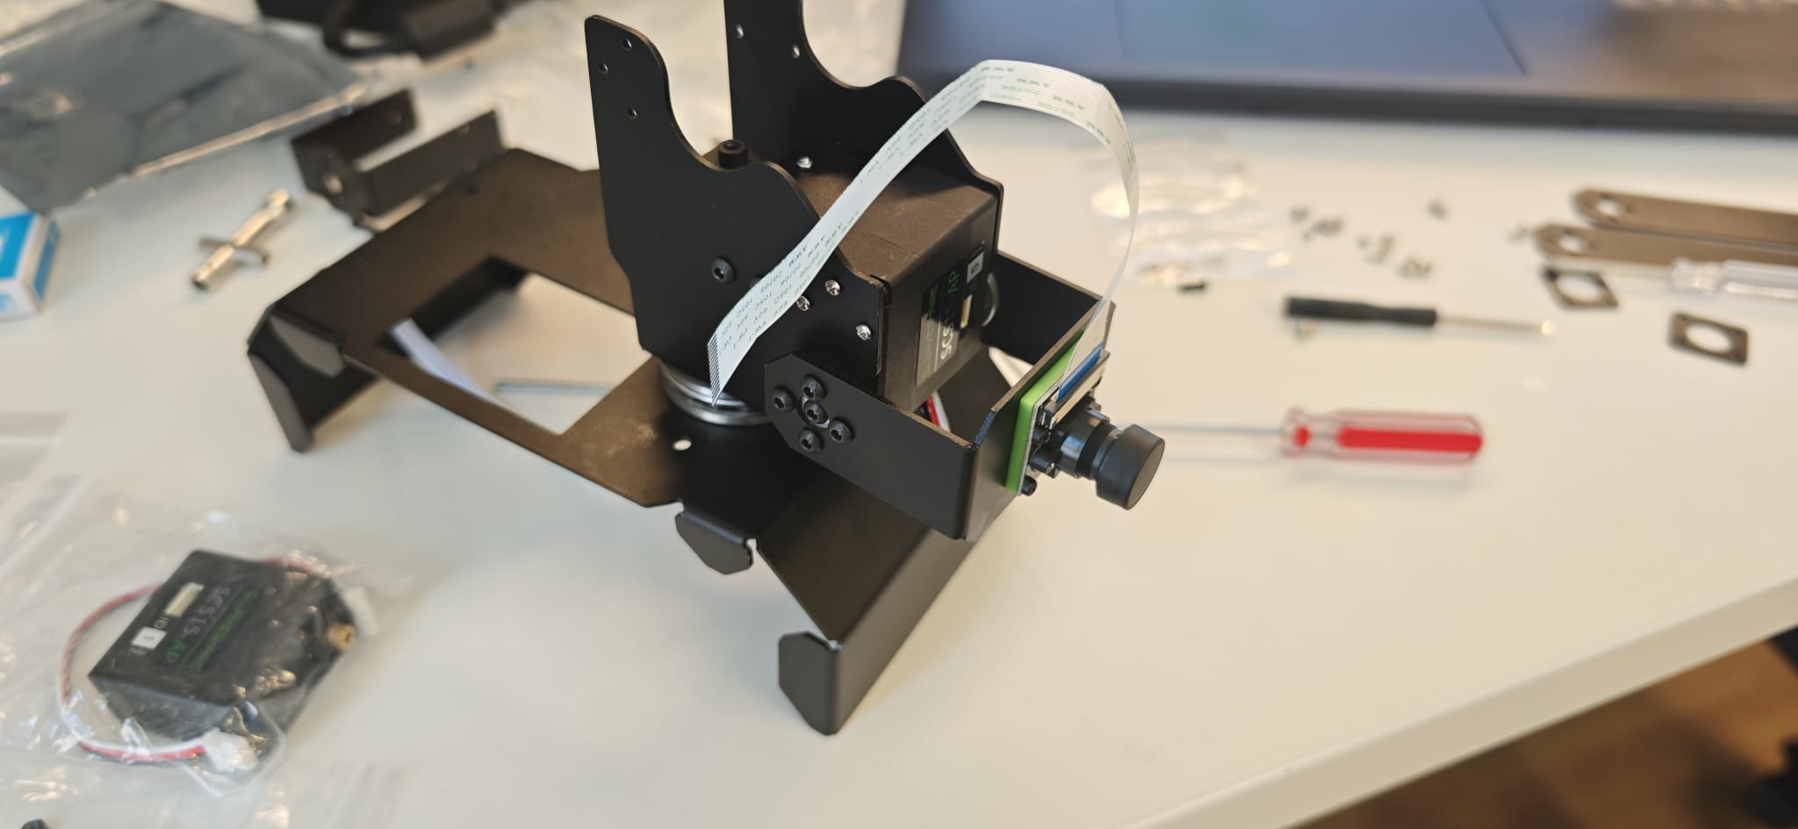
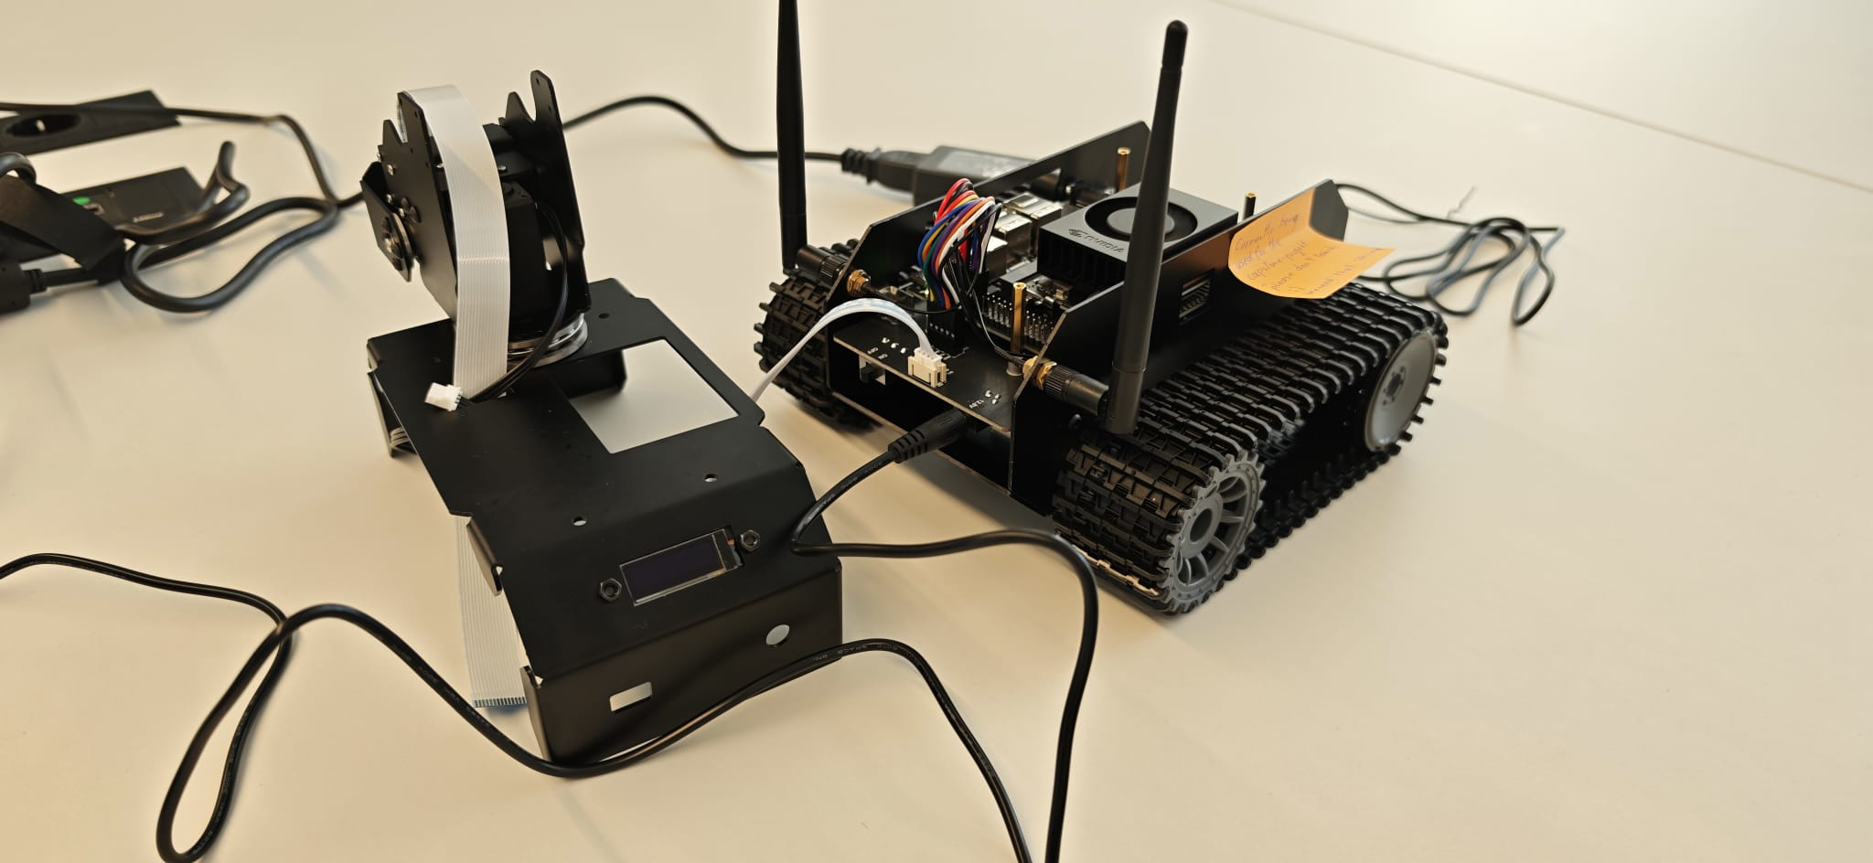
From the Lab — Our Robot in Action
Fully assembled JETANK
Jetson Orin Nano Super module
Camera mount & servo assembly
Mid-build — chassis & arm separated
Notes:
Show the audience the real robot. These are photos from our actual sessions. Point out key elements: the camera on the arm, the Jetson board, the tank tracks.

Slide 10

Conclusion & What's Next
We successfully brought an advanced AI robotics platform to life — despite navigating significant compatibility barriers that the original kit was never designed to handle. That problem-solving journey is itself a valuable engineering outcome.
Key Takeaways
Future Work
Real hardware has surprises that no manual prepares you for
Systematic debugging is as important as writing good code
Documentation during the project saved hours later
A modular design (split power, separate software layers) makes problems easier to isolate
Replace Jetson Nano Orin → classic Jetson Nano for full compatibility
Resolve motor driver mystery (oscilloscope + schematic review)
Add a second sensor (ultrasonic or lidar) for true sensor fusion
Train a custom YOLO model on the robot's actual camera footage
3D-print a power bank bracket for fully untethered operation
Notes:
Wrap up by emphasizing what was learned, not just what was built. The compatibility work IS the result. Future work: fix motors, add more sensors, train custom AI model.

Slide 11
Thank You!
Denis Vasilev · Adam Ryan · Aidan Ryan · Nora Cerveny
IMC Krems — Capstone Project SS 2026
Questions?
Notes:
Open the floor for questions. Key points to mention if needed: the biggest surprise was how much the OS/kernel version mattered for hardware compatibility. The AI pipeline would have been straightforward if the hardware worked as expected.

