Slide 1
Defund Police
Aidan Wolfe & Chasity Savella

Slide 2
Presentation Overview
01
02
03
04
Implementation project
Data analysis and discussion
Conclusion and questions
Recap last presentation
Summary of racial disparity in data models
Mapping police violence database and Plotly
Heat maps, scatter plot, bar charts

Slide 3
Police Violence and Racial Disparity
In our last presentation, we reviewed papers that discussed racial disparity in data-informed models. If biased data is used to train risk assessment tools, a negative feedback loop is created, allowing inequality to perpetuate.
Over the life course, about 1 in every 1,000 black men can expect to be killed by the police.
With this project, we are hoping to educate others about the racial disparity experienced by Black people in our criminal justice system. Using a crowd-sourced database, we programmatically produced visualizations to map police violence between 2013 and 2020.

Slide 4

Mapping police violence database

Slide 5
Mapping police violence database
U.S. government does NOT track how many people are killed by police
“Law enforcement agencies across the country have failed to provide us with even basic information about the lives they have taken.”
Data compiled from three sources
FatalEncounters.org
U.S. Police Shootings Database
KilledByPolice.net
“... estimates suggest that our database captures 92% of the total number of police killings that have occurred since 2013.”
“We hope these data will be used to provide greater transparency and accountability for police departments as part of the ongoing campaign to end police violence in our communities.”

Slide 6
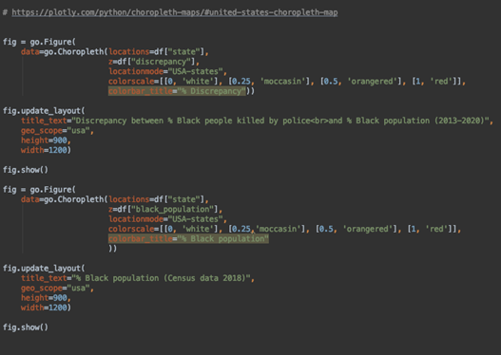
Implementation
The goal was to generate visualizations of discrepancies between black and white people as victims of police violence
Data from the Mapping Police Violence database
Formatted each table we wanted to use as .csv files
Pandas to read data into Python script as dataframe
Plotly
Plotly graph objects
Plotly express

Slide 7
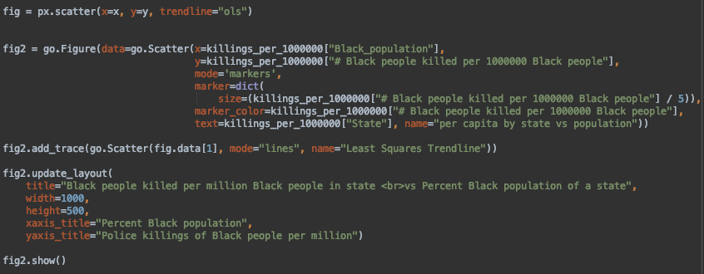
Implementation

Slide 8
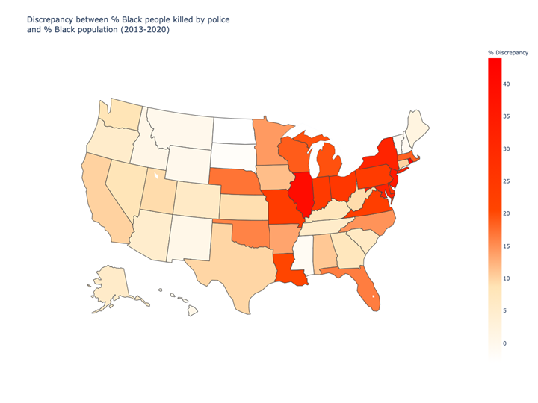
Discrepancy =
% police killings with Black victims - % Black population of a given state

Slide 9
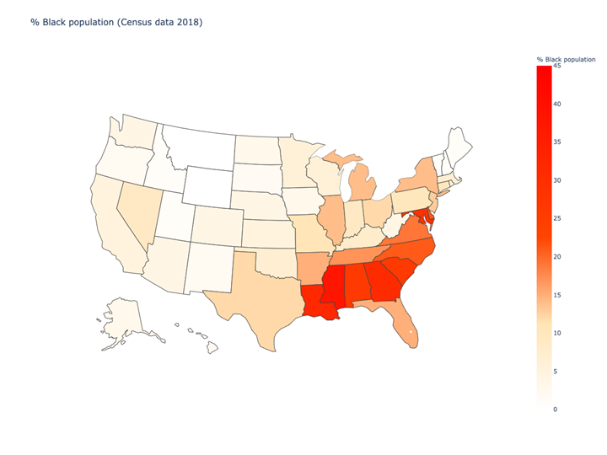

Slide 10
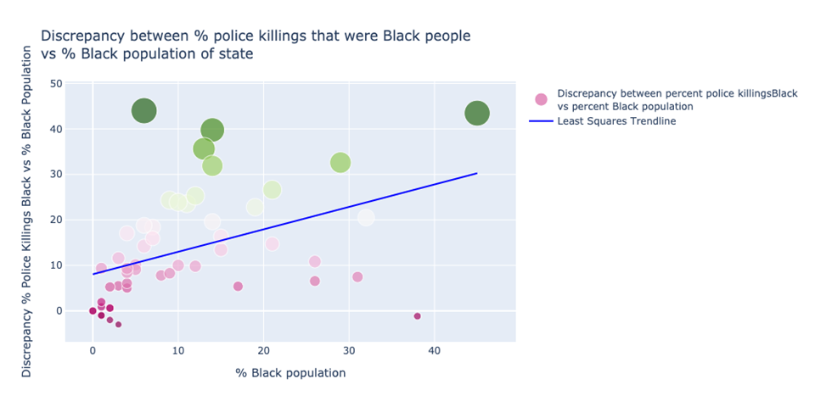

Slide 11
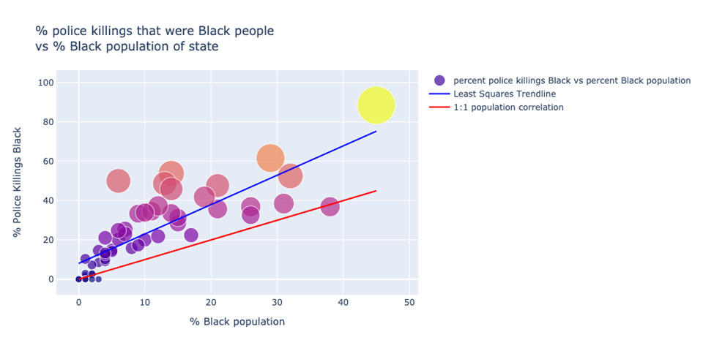

Slide 12
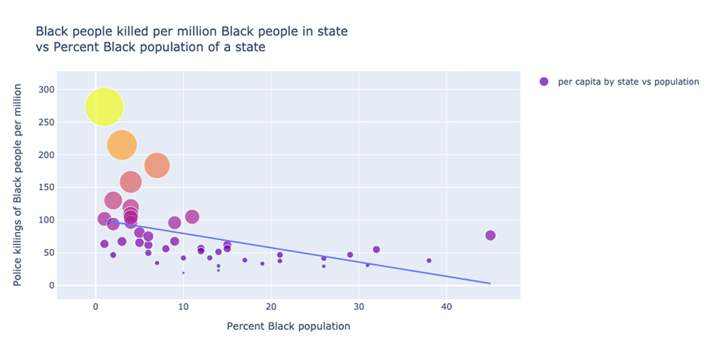

Slide 13
RACE IDENTITY OF PEOPLE KILLED
2.64
6.6 Black people
Killed per million
Black people were killed
3.8 Hispanic people
Killed per million
Times more often than white people
2.5 White people
Killed per million

Slide 14
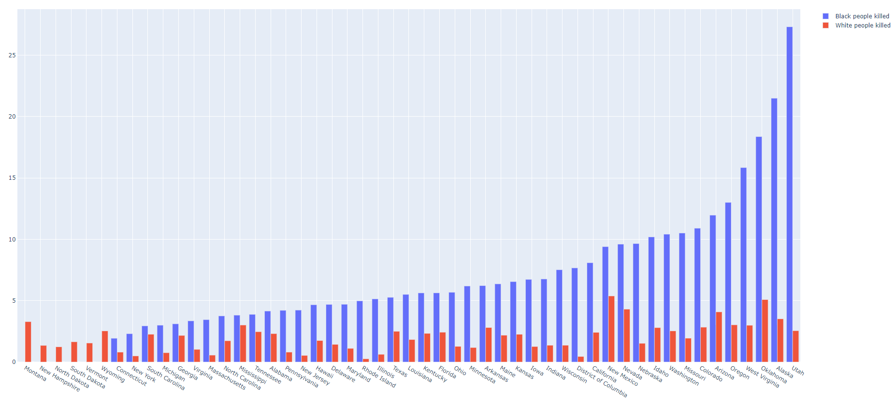

Slide 15
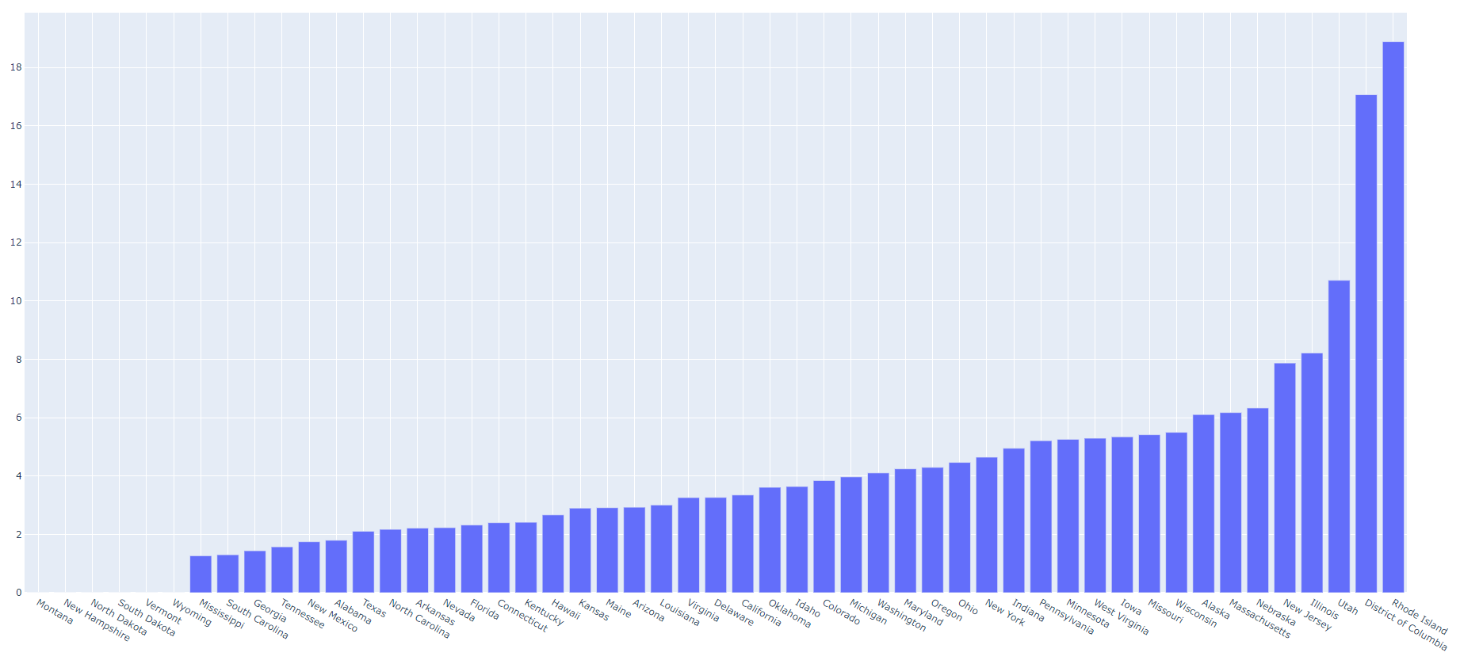

Slide 16
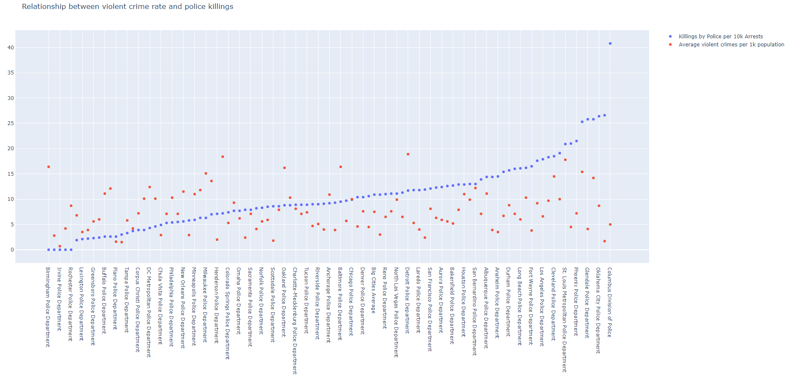

Slide 17
Conclusion
https://www.reimagineoregon.org/policydemands/divest
https://www.reimagineoregon.org/policydemands/community-safety
https://m4bl.org/policy-platforms/end-jails-prisons-detention/
https://m4bl.org/policy-platforms/end-the-war-on-drugs/
https://m4bl.org/policy-platforms/the-demilitarization-of-law-enforcement/
https://m4bl.org/policy-platforms/end-use-of-criminal-history/

Slide 18
THANKS
Please keep this slide for attribution.

