Slide 1


WPTO Wave Hindcast Dataset Introduction
Aidan Bharath (NREL)

Slide 2
WPTO Wave Hindcast Dataset Introduction
Introduction to the Datasets
Brief Description of the Data
Motivation for the Dataset
Available Tools For Access
What the data looks like
Ways it can be added to a workflow
Future Plans
Code Examples for dataset access through a command line interface and python can currently be found:
https://github.com/aidanbharath/WPTO_Wave_hindcast_Tutorial

Slide 3
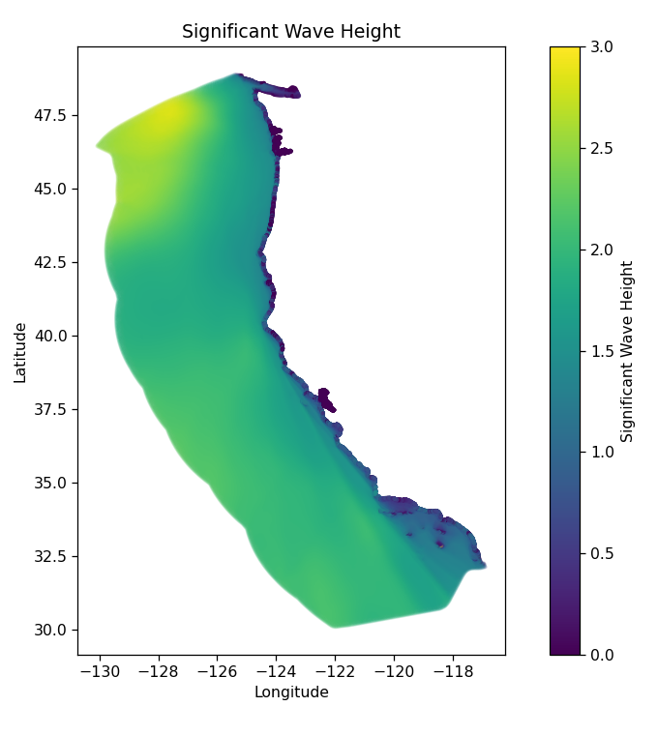
Spatial Dataset – West Coast ~2.6 Tb
Spanning the U.S. Exclusive Economic Zone
~200 m resolution in shallow water.
3-hour Time Step resolution
Dataset covers 32 years:
01/01/1979 - 12/31/2010.
Bulk Parameter data is indexed by:
[“coordinates”, “time”] - ~(700k, 93504) data points
Variable Names | Units
energy_period | Seconds
maximum_energy_period | Degrees_True
mean_absolute_period | Seconds
mean_zero-crossing_period | Seconds
omni-directional_wave_period | Watts
peak_period | Seconds
significant_wave_height | Meters
water_depth | Meters
spectral_width | None
directionality_coefficient | None

Slide 4
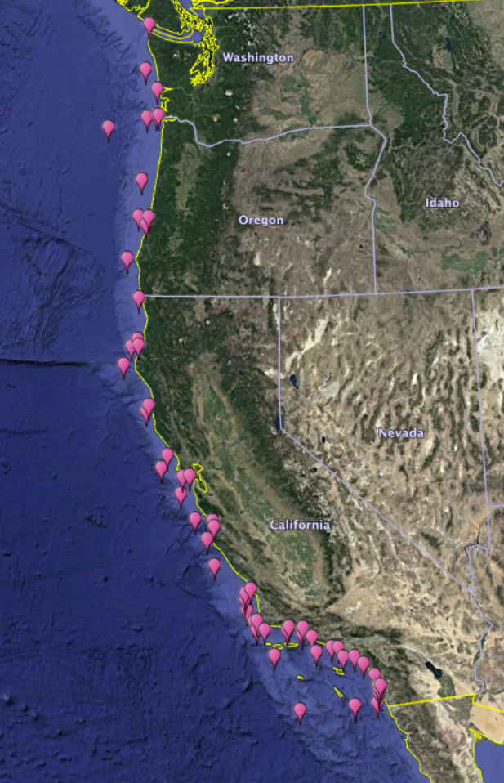
Virtual Buoys – West Coast ~176 Gb
57 virtual buoy locations along the West Coast are available and will be continually expanded upon
1-hour Time Step resolution
Dataset spans 32 years:
01/01/1979 - 12/31/2010.
Bulk Parameter are index by:
[“coordinates”, “time”] - ~(57,280512) data points
The Virtual Buoys contain directional wave spectrum datasets which are indexed as:
[“time”, “frequency”, “direction”, “coordinates”] - ~(280512,29,36,57) data points
Variable Names | Units
directional_wave_spectrum | m²degrees⁻¹Hz⁻¹
maximum_energy_direction | degrees_true
mean_wave_direction | degrees_true
frequency_bin_edges | Hz

Slide 5
Motivation for the Dataset
Benefits to Industry / Commercialization
Site Selection / Project Planning
Detailed LCOE estimates
Benefits to Modelers
Extensive access to data for boundary conditions
Typical year estimates
Benefits to Researchers / Developers
Greater access to Wave Climate data for developing PBE projects

Slide 6
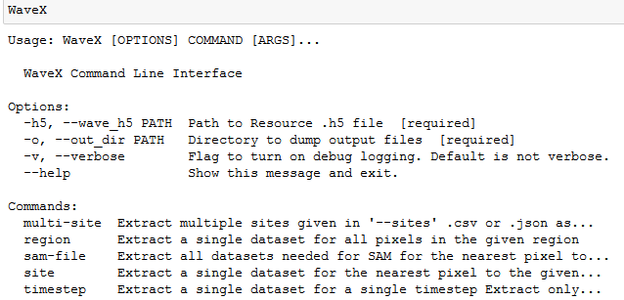
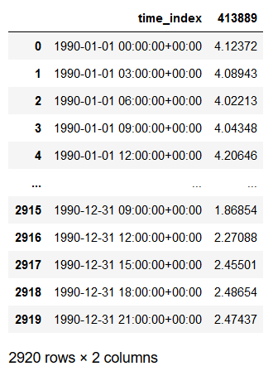
Visualizing and Working with the Data
Command Line Interface
Simple CSV Formats
The REsource eXtraction Tool (rex) can be used to download simple CSV files usable with any post-processing tools

Slide 7
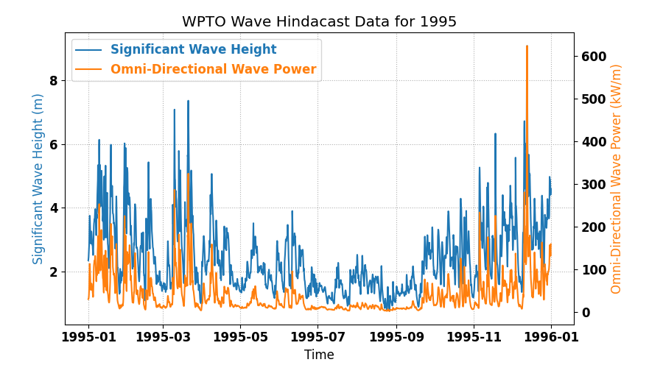
Easily Accessible Time Series Datasets
Fast Comparisons and Yearly Averages
Using rex with python allows for quick and simple visualizations of all dataset parameters.
Several Data Access and Visualization examples are available
They can be easily used as a starting point for more advanced analysis in python

Slide 8
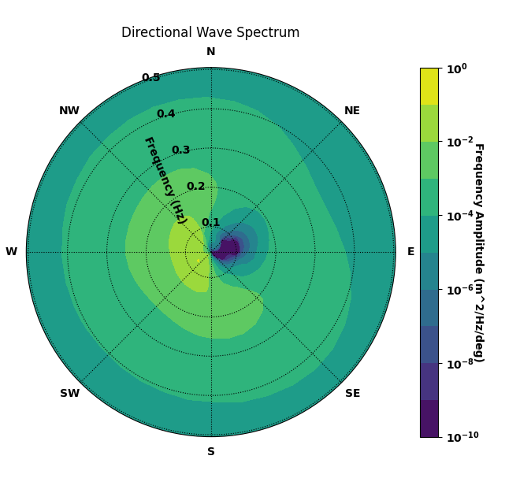
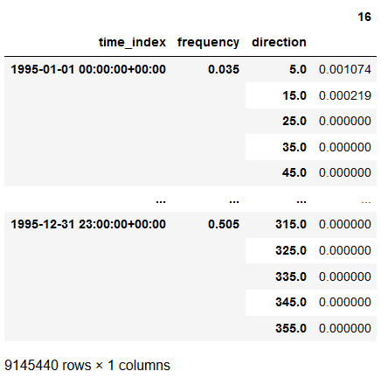
Directional Wave Spectrum
Virtual Buoy Directional Wave Spectrum have the extra dimensionality
rex can handle this and provides ‘flattened’ data, usable in many post-processing platforms

Slide 9
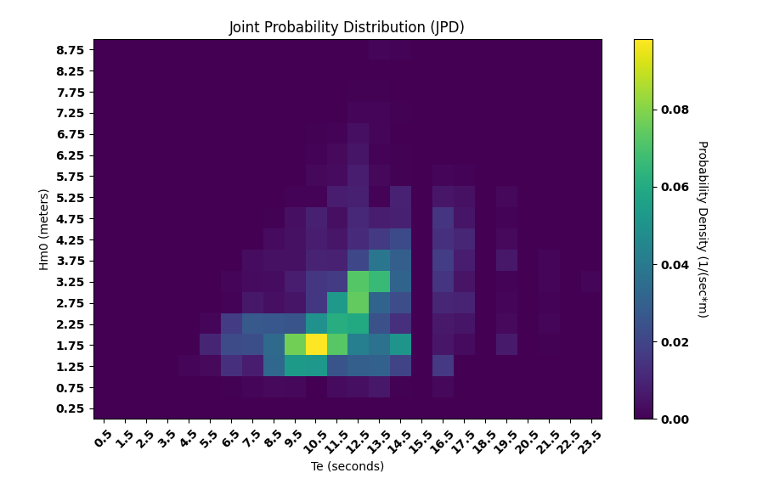
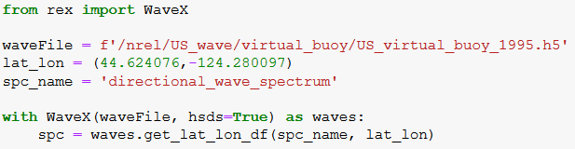
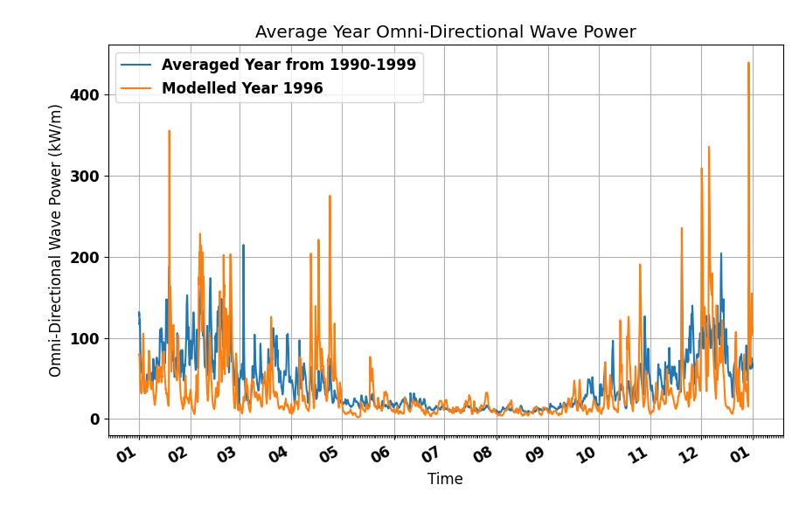
Building Workflows Based on Existing Frameworks
With rex, simple scripts can be used to incorporate the new datasets into existing post-processing workflows
Many examples for analyzing the data are given in an accompanying example script
Much of this will be available through MHKiT and the SAM tool in future iterations

Slide 10
Accessing the Data on EAGLE
The entire dataset is available on EAGLE.
“/datasets/US_wave/v1.0.0/”
Accessing the data directly can be done with rex by activating a pre-configured “conda” environment:
With the data on EAGLE it will be more feasible to analyze large pieces of the dataset

Slide 11
Future Plans for the Dataset
The West Coast Region will be of hindcast data for all US Coastal Waters:
Atlantic Coast
US Pacific Islands
Alaska
Hawaiian Islands
Gulf of Mexico
Timeseries expanded up to 42 years (ending 2020)
The number of Virtual Buoys will be expanded to include key sites for MRE development
Will be accessible on the MHK Atlas mid-2021
Functionality for accessing and processing the data will be build into MHKiT and the SAMs Tool

