Slide 1
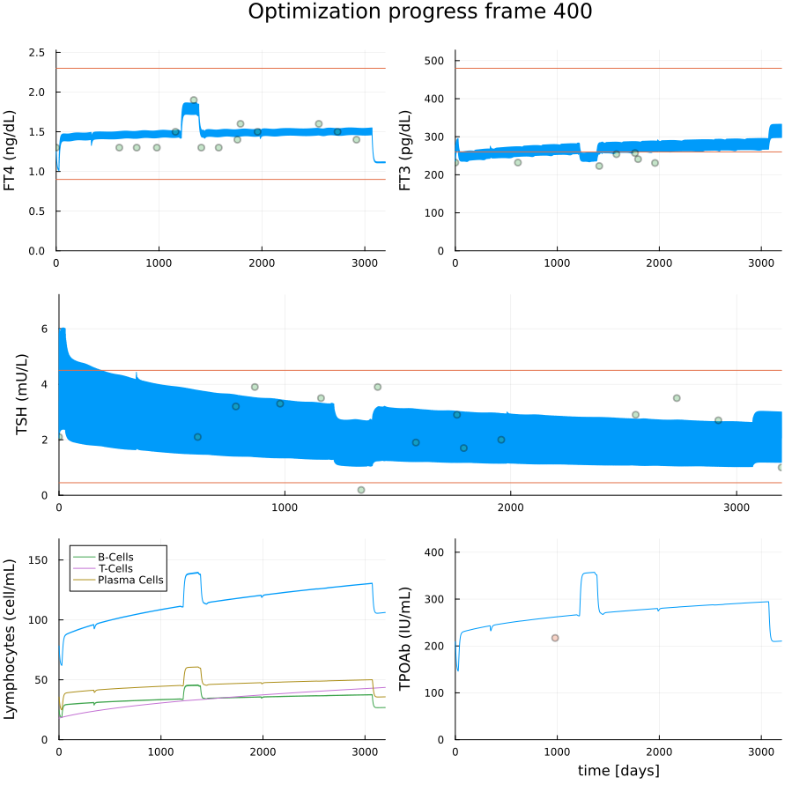
Patient 78490026: Female, 70yo
Hashimoto's diagnosis date: 3/12/2014
First recorded lab: 11/16/2015
Last recorded lab: 12/14/2022
BMI Statistics: Min 16.13, Mean 16.13, Max 16.13

Slide 2
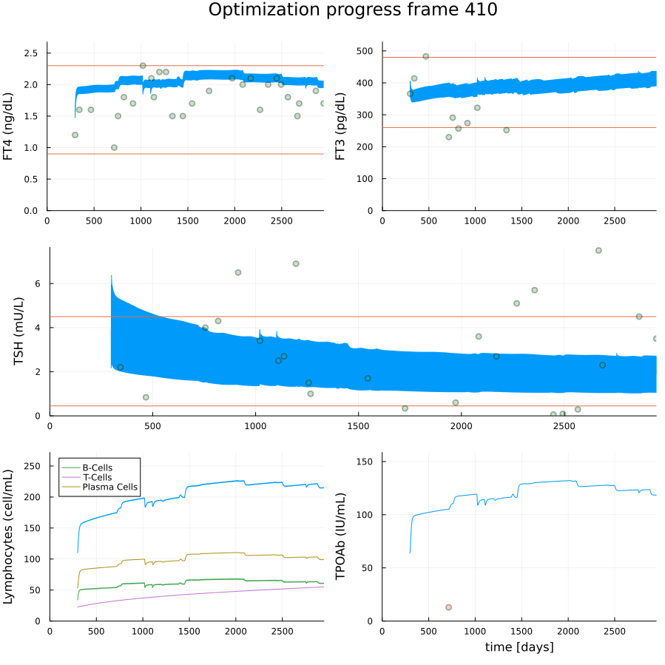
Available information for patient 7228995, Male, 42yo
Hashimoto's diagnosis date: 2/5/2018
First recorded lab: 11/15/2015
Last recorded lab: 2/15/2023
BMI Statistics: NaN

