Slide 1
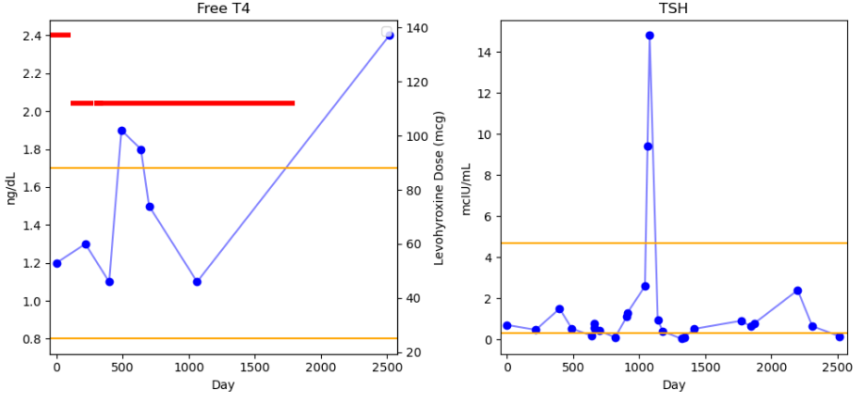
Dose is listed as ending around 1800 days in database, but T4 is recorded even higher around day 2500 (700 days after end of prescription). TSH also stays low throughout period…
LT4 dose
Lab Measurements

