Slide 1
CV Epilepsy Results

Slide 2
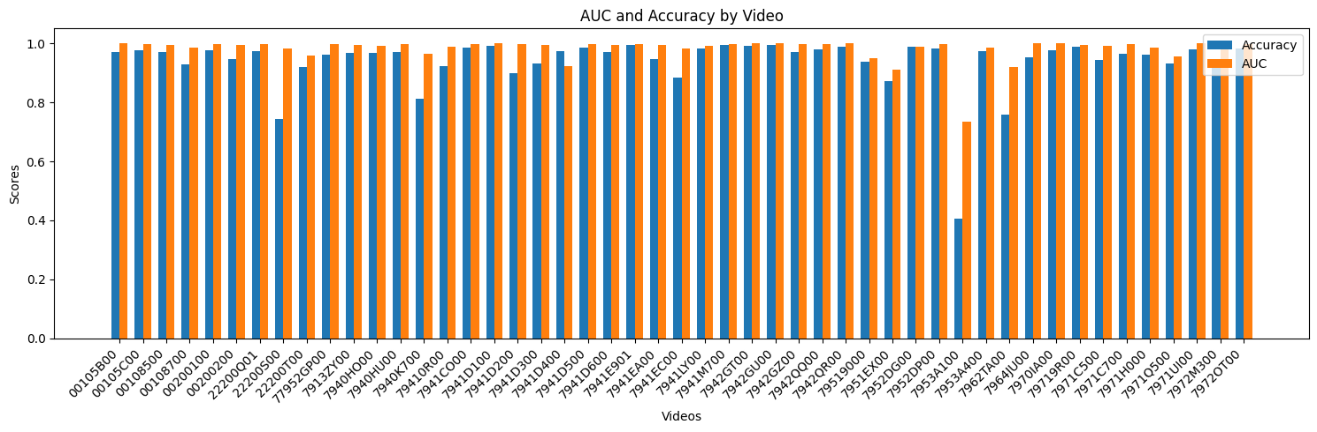
AUC and Accuracy (TEST)
Average accuracy: 0.939
Average AUC: 0.981

Slide 3
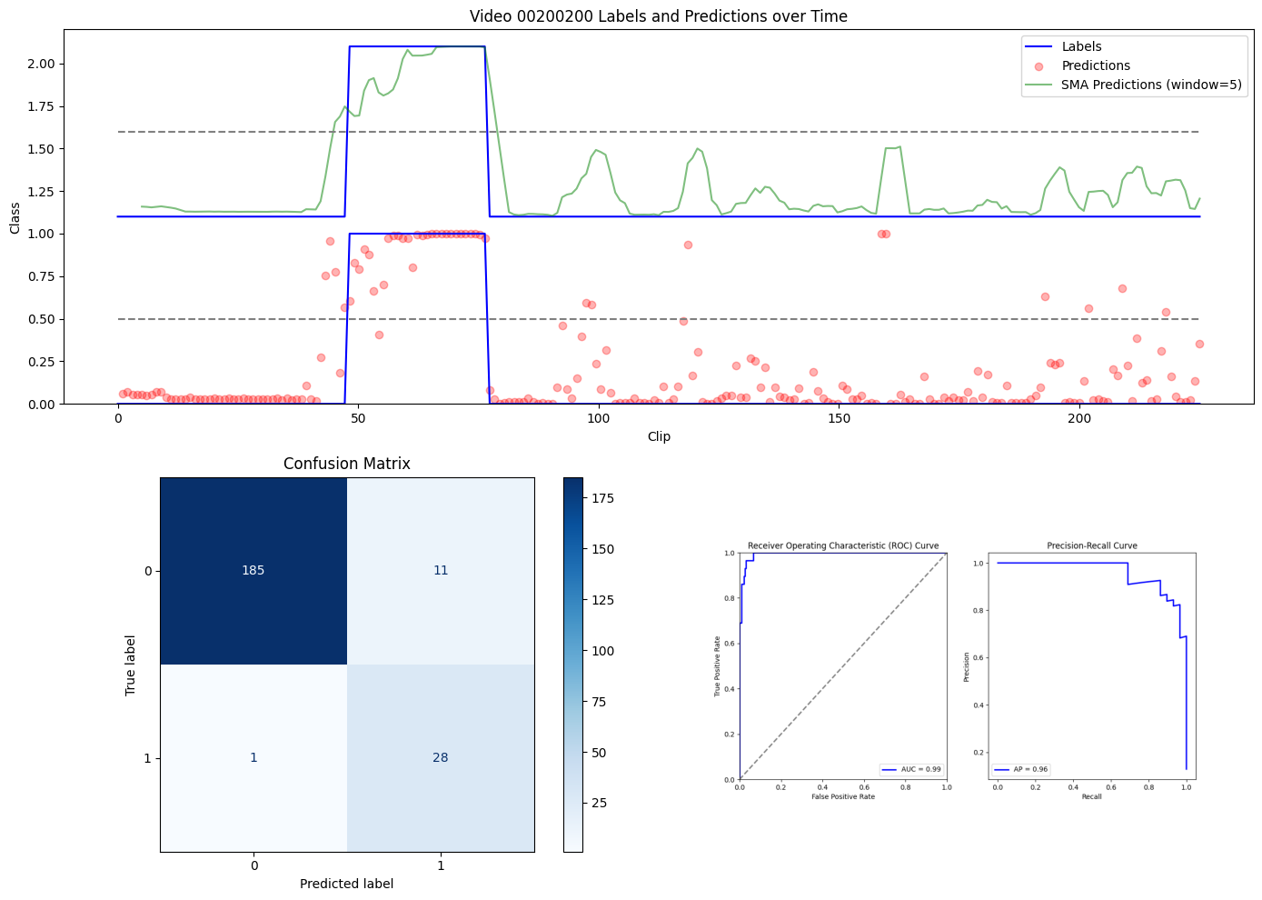
Precision: 0.7179
Recall: 0.9655
F1 Score: 0.8235
Accuracy: 0.9467
AUC: 0.9933

Slide 4
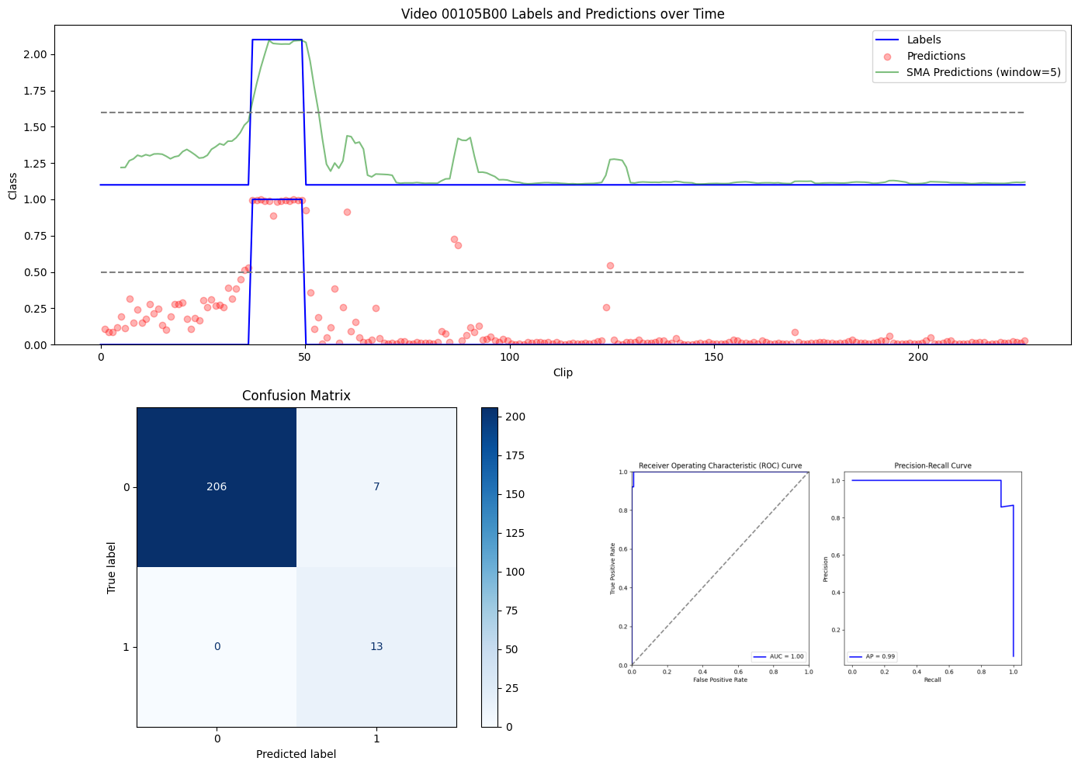
Precision: 0.6500
Recall: 1.0000
F1 Score: 0.7879
Accuracy: 0.9690
AUC: 0.9993

Slide 5
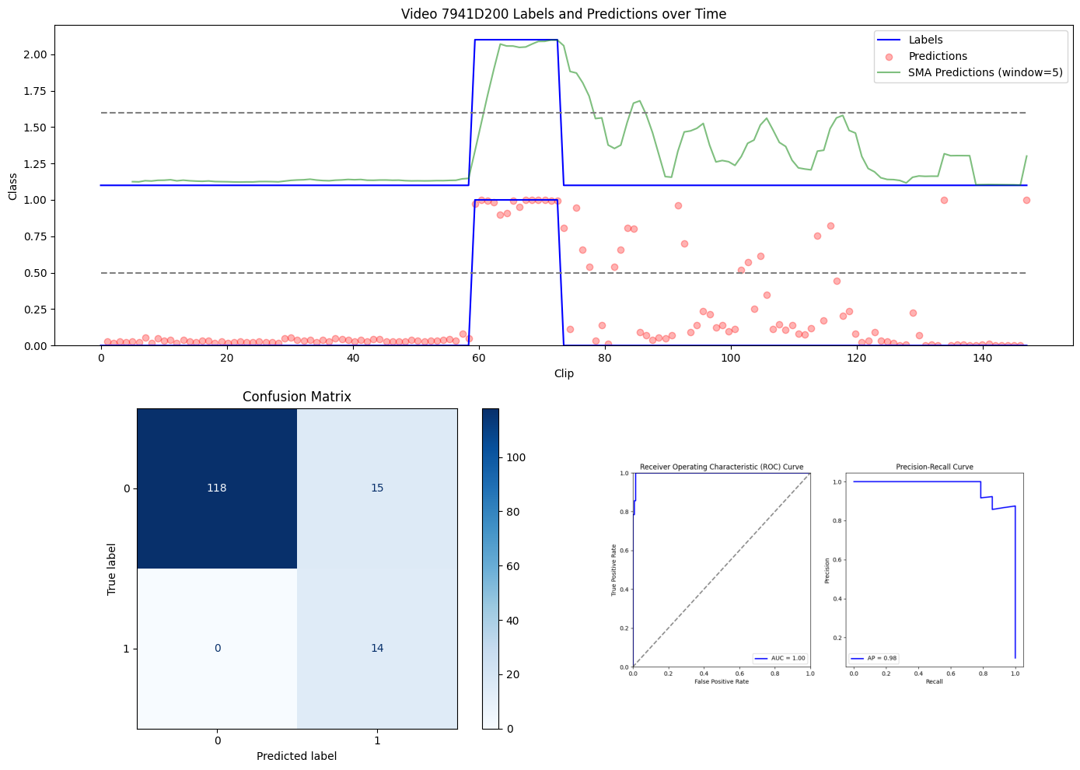
Precision: 0.4828
Recall: 1.0000
F1 Score: 0.6512
Accuracy: 0.8980
AUC: 0.9973
With this one, get lots of noise after seizure. If we look at video, there are nurses/staff moving around. They come in around clip 70

Slide 6
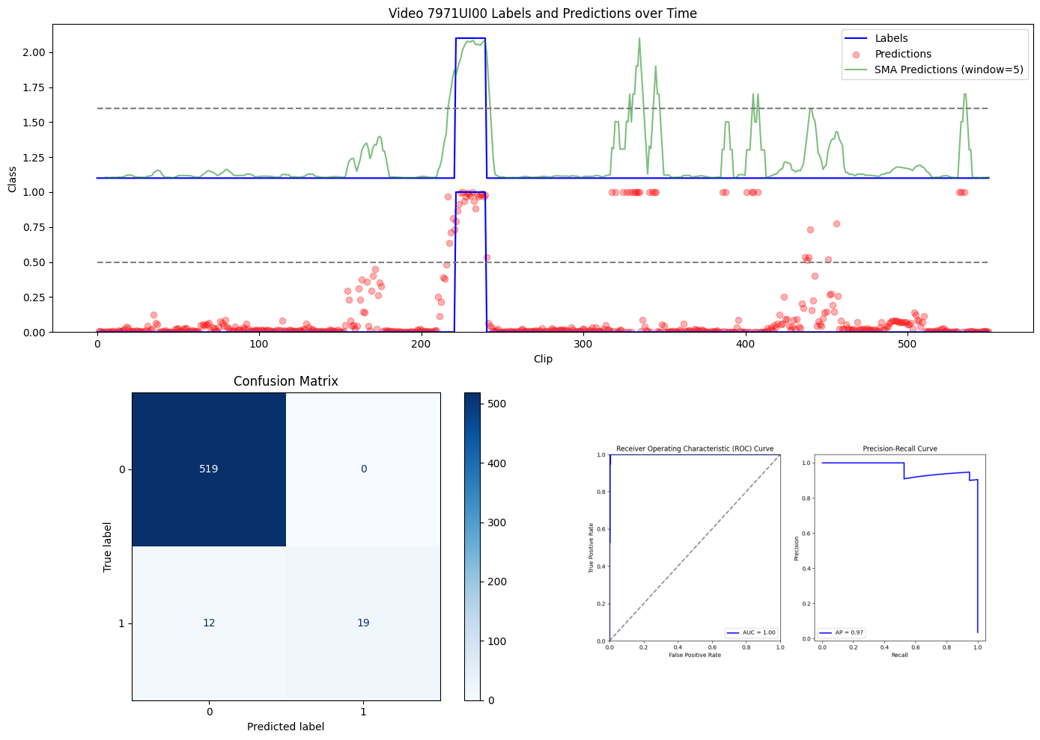
Precision: 0.6129
Recall: 1.0000
F1 Score: 0.7600
Accuracy: 0.9782
AUC: 0.9990

Slide 7
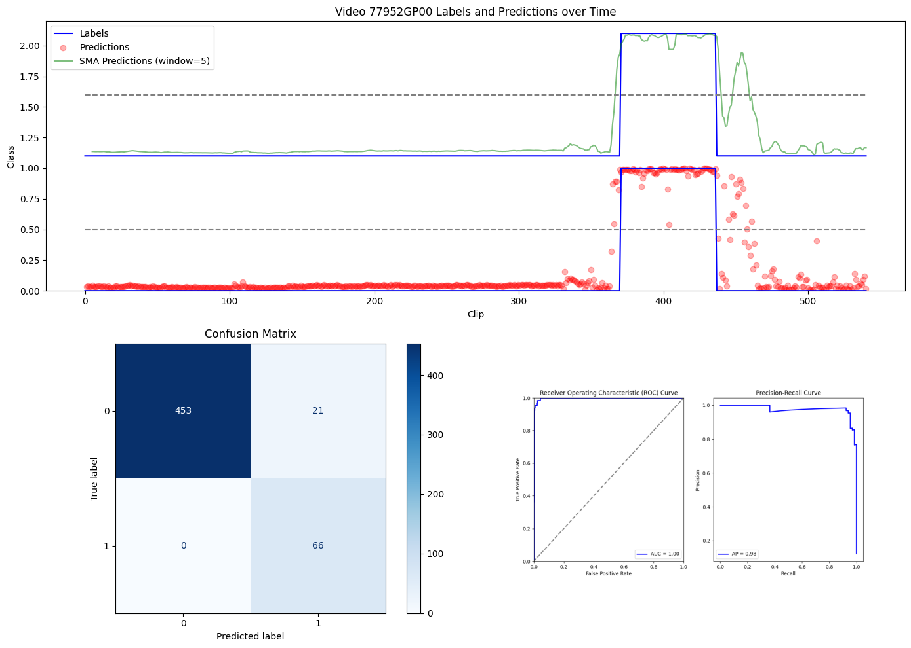
Precision: 0.7586
Recall: 1.0000
F1 Score: 0.8627
Accuracy: 0.9611
AUC: 0.9973
Performs well even when seizure late in long videos

Slide 8
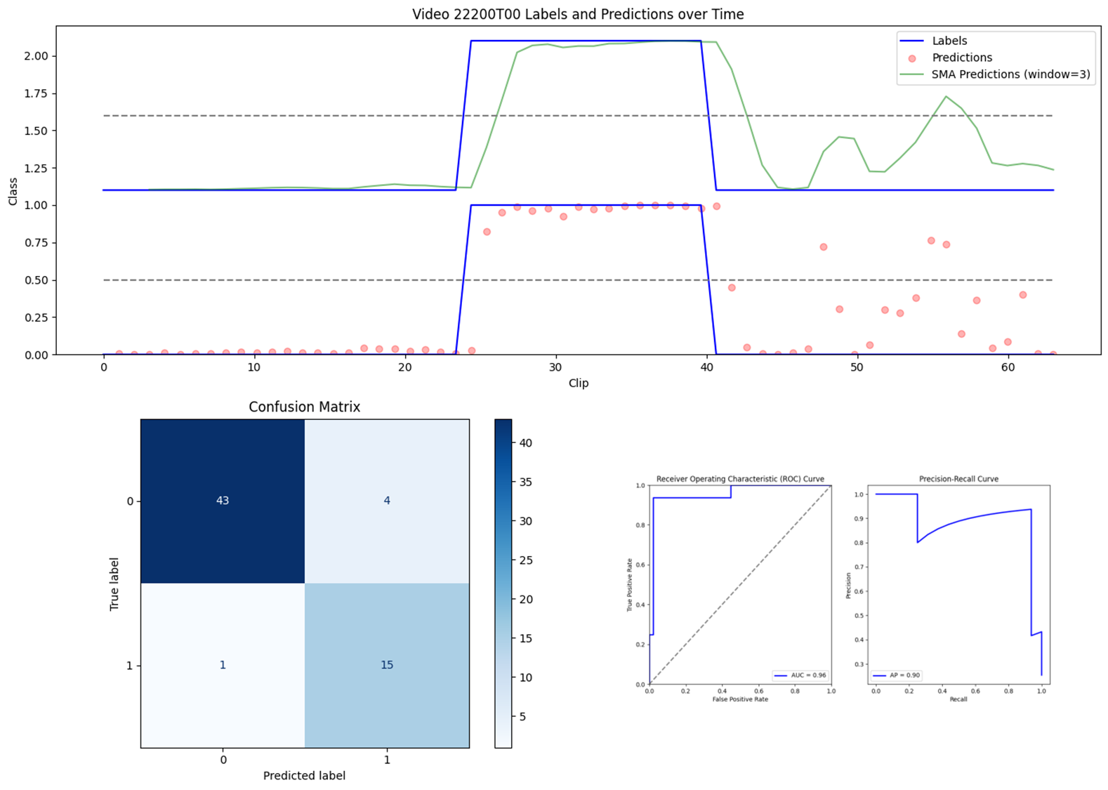
Precision: 0.7895
Recall: 0.9375
F1 Score: 0.8571
Accuracy: 0.9206
AUC: 0.9574
Works pretty well on very short videos too.

Slide 9
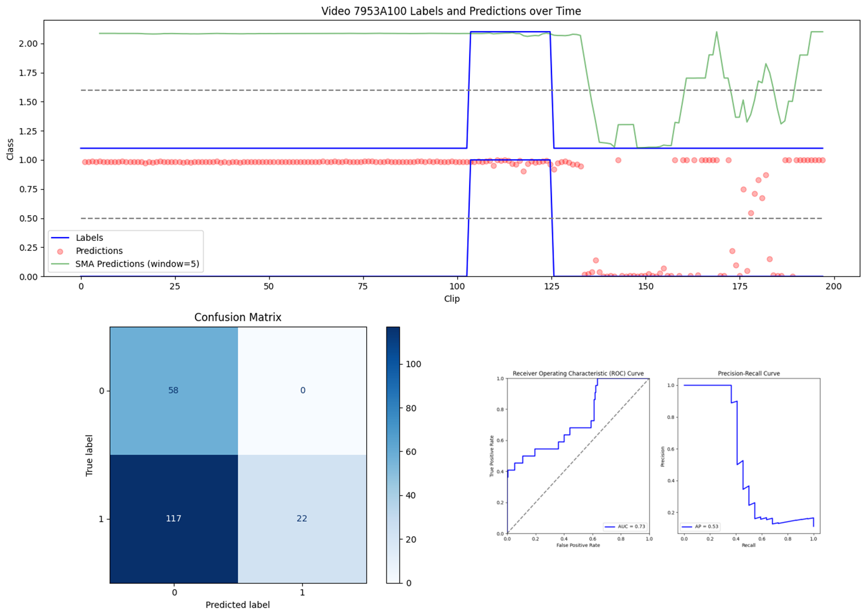
Precision: 0.1583
Recall: 1.0000
F1 Score: 0.2733
Accuracy: 0.4061
AUC: 0.7338
By far the worst performing video. Didn’t notice anything too different but it is more blurry than the rest of the videos, likely due to cropping process.

Slide 10
Other points for paper
Runs significantly faster than real time with a 4090 (1 minute run = 60-90 minutes of footage analyzed)
Footage used for train/test is 30fps with resolution of 640x480 (cropped)

