Slide 1
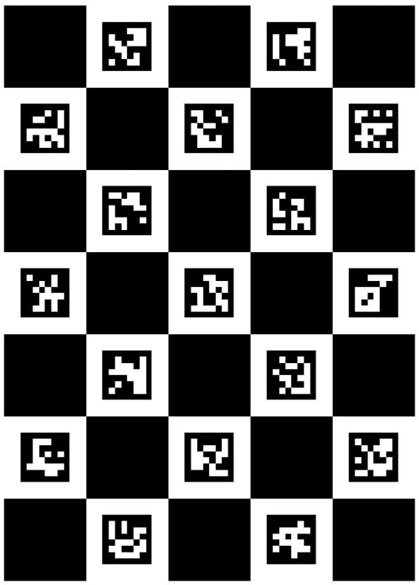
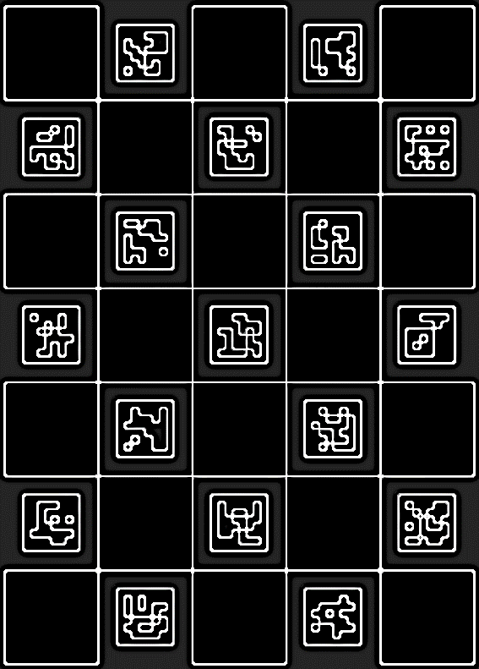

Slide 2
Frame::Frame(Mat im)
{
imCap = im;
cvtColor(im, imGray, COLOR_BGR2GRAY);
cvtColor(imGray, imScan, COLOR_GRAY2BGR);
cvtColor(imGray, imPose, COLOR_GRAY2BGR);
scanSingleMarkers(imCap);
displayPose();
}
void Frame::scanSingleMarkers(Mat im)
{
Ptr<aruco::Dictionary> markerDictionary = aruco::getPredefinedDictionary(aruco::PREDEFINED_DICTIONARY_NAME::DICT_4X4_50);
aruco::detectMarkers(im, markerDictionary, singleMarkerCorners, singleMarkerIDs);
aruco::drawDetectedMarkers(imScan, singleMarkerCorners, singleMarkerIDs);
aruco::estimatePoseSingleMarkers(singleMarkerCorners, singleMarkerSideLength, cameraIntrinsics, distortionCoeffs, rVecs, tVecs);
computeEuclidianDistances();
}
void Frame::displayPose()
{
system("CLS");
cout << "--------------------------------------------------" << endl;
cout << "\tDetected Markers = " << singleMarkerIDs.size() << endl;
cout << "--------------------------------------------------" << endl;
// Display Pose Estimation Values and Axes
for (int i = 0; i < singleMarkerIDs.size(); i++)
{
aruco::drawAxis(imPose, cameraIntrinsics, distortionCoeffs, rVecs[i], tVecs[i], 0.1f);
cout << " ID = " << singleMarkerIDs[i] << endl;
cout << " Rot Vec = " << rVecs[i] << endl;
cout << " Trans Vec = " << tVecs[i] << endl;
cout << " Euclidian = " << euclidianDistances[i] << endl;
cout << "--------------------------------------------------" << endl;
}
}
void Frame::computeEuclidianDistances()
{
for (int i = 0; i < singleMarkerIDs.size(); i++)
{
euclidianDistances.push_back(sqrt(pow(tVecs[i][0], 2) + pow(tVecs[i][1], 2) + pow(tVecs[i][2], 2)));
}
}

