Slide 1





Introduction to LINUX command line
EMBO Practical Course on
Computational analysis of protein-protein interactions: Sequences, networks and diseases
30th May - 4th June 2016 Budapest, Hungary
Allegra Via
IBBE, National Research Council, Italy
Sapienza Università di Roma, Italy
Monday, 30th May 2016

Slide 2
What is Unix/Linux?

Slide 3
What operating system(s) do you know?

Slide 4
What is the computer shell?

Slide 5

The shell
The shell is an interpreter (a program) that lets you interact with the operating system
graphical shell
command-line shell
graphical interface
command-line interface

Slide 6
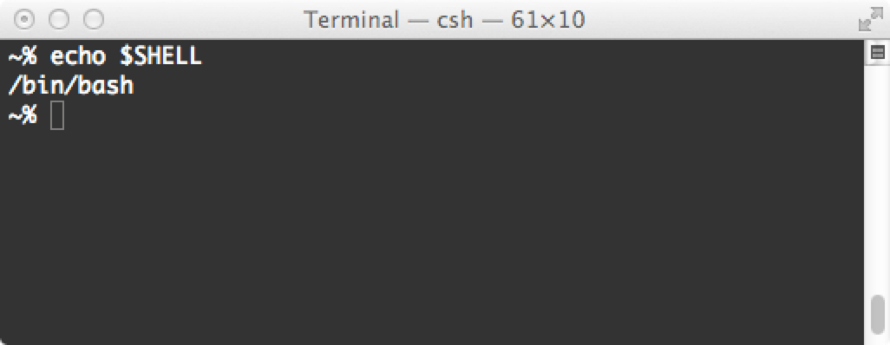
The Linux shell
The shell is a command-line interpreter that lets you interact with Linux
The shell takes what you type and "decides" what to do with it
The shell is actually a scripting language somewhat like Python
It is always possible to change shell (either temporarily or permanently)

Slide 7
What is the graphical interface?

Slide 8
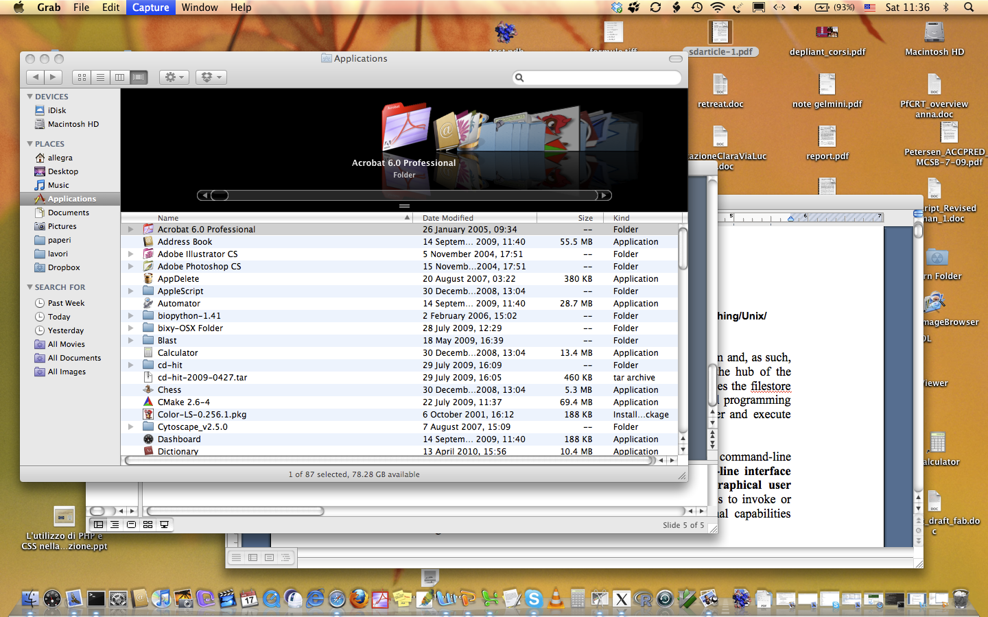
graphical interface

Slide 9
What is the command line interface (or Terminal)?

Slide 10
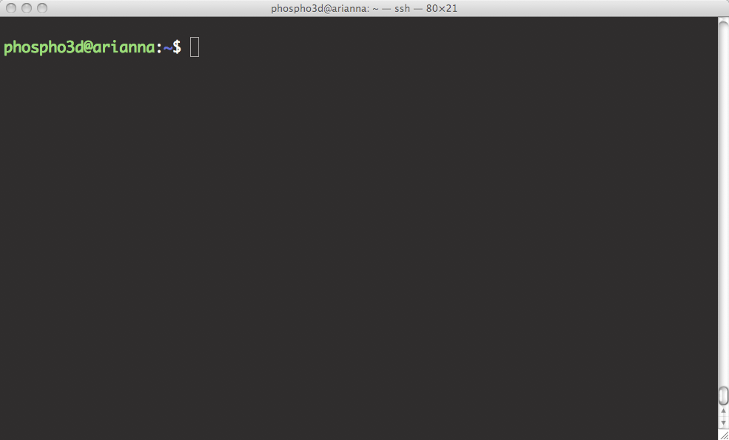
command-line interface
prompt
Here you write the command

Slide 11


What happens when you double click on the icon of an application?

Slide 12

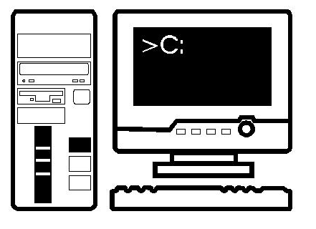
What happens when you double click on the icon of an application?
command (shell)

Slide 13
Open a command-line terminal on your computer

Slide 14
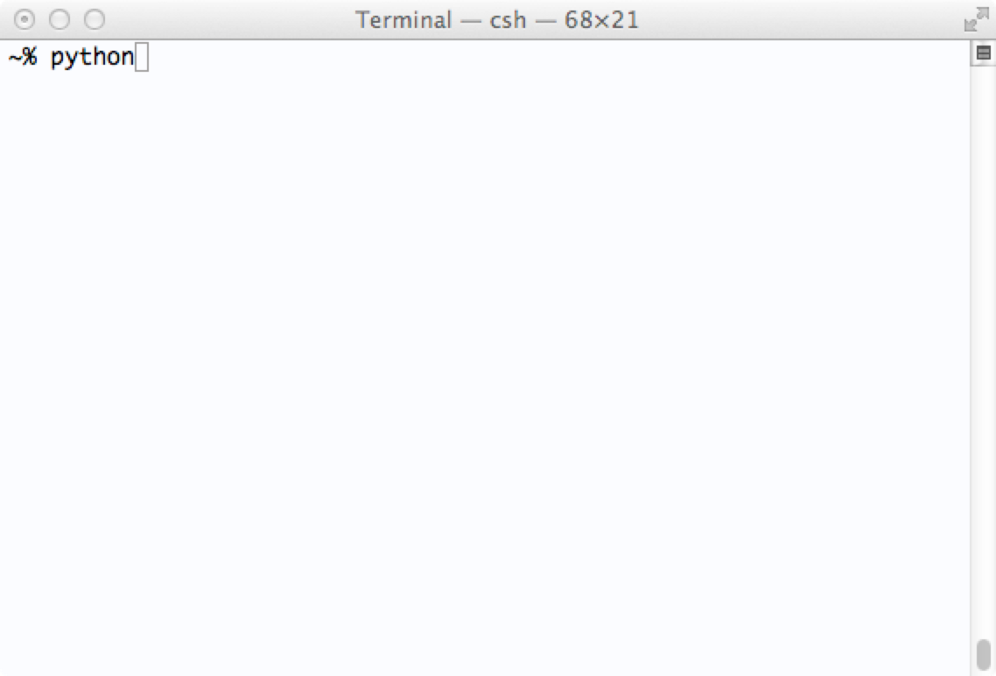
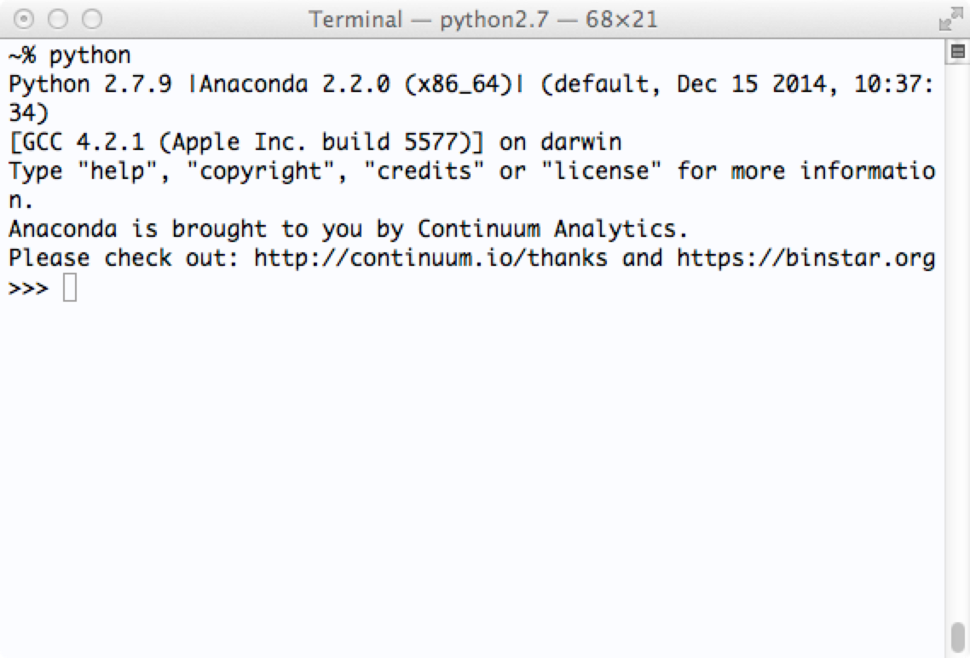
You can type a program name at the terminal prompt and then type [Return]
command

Slide 15
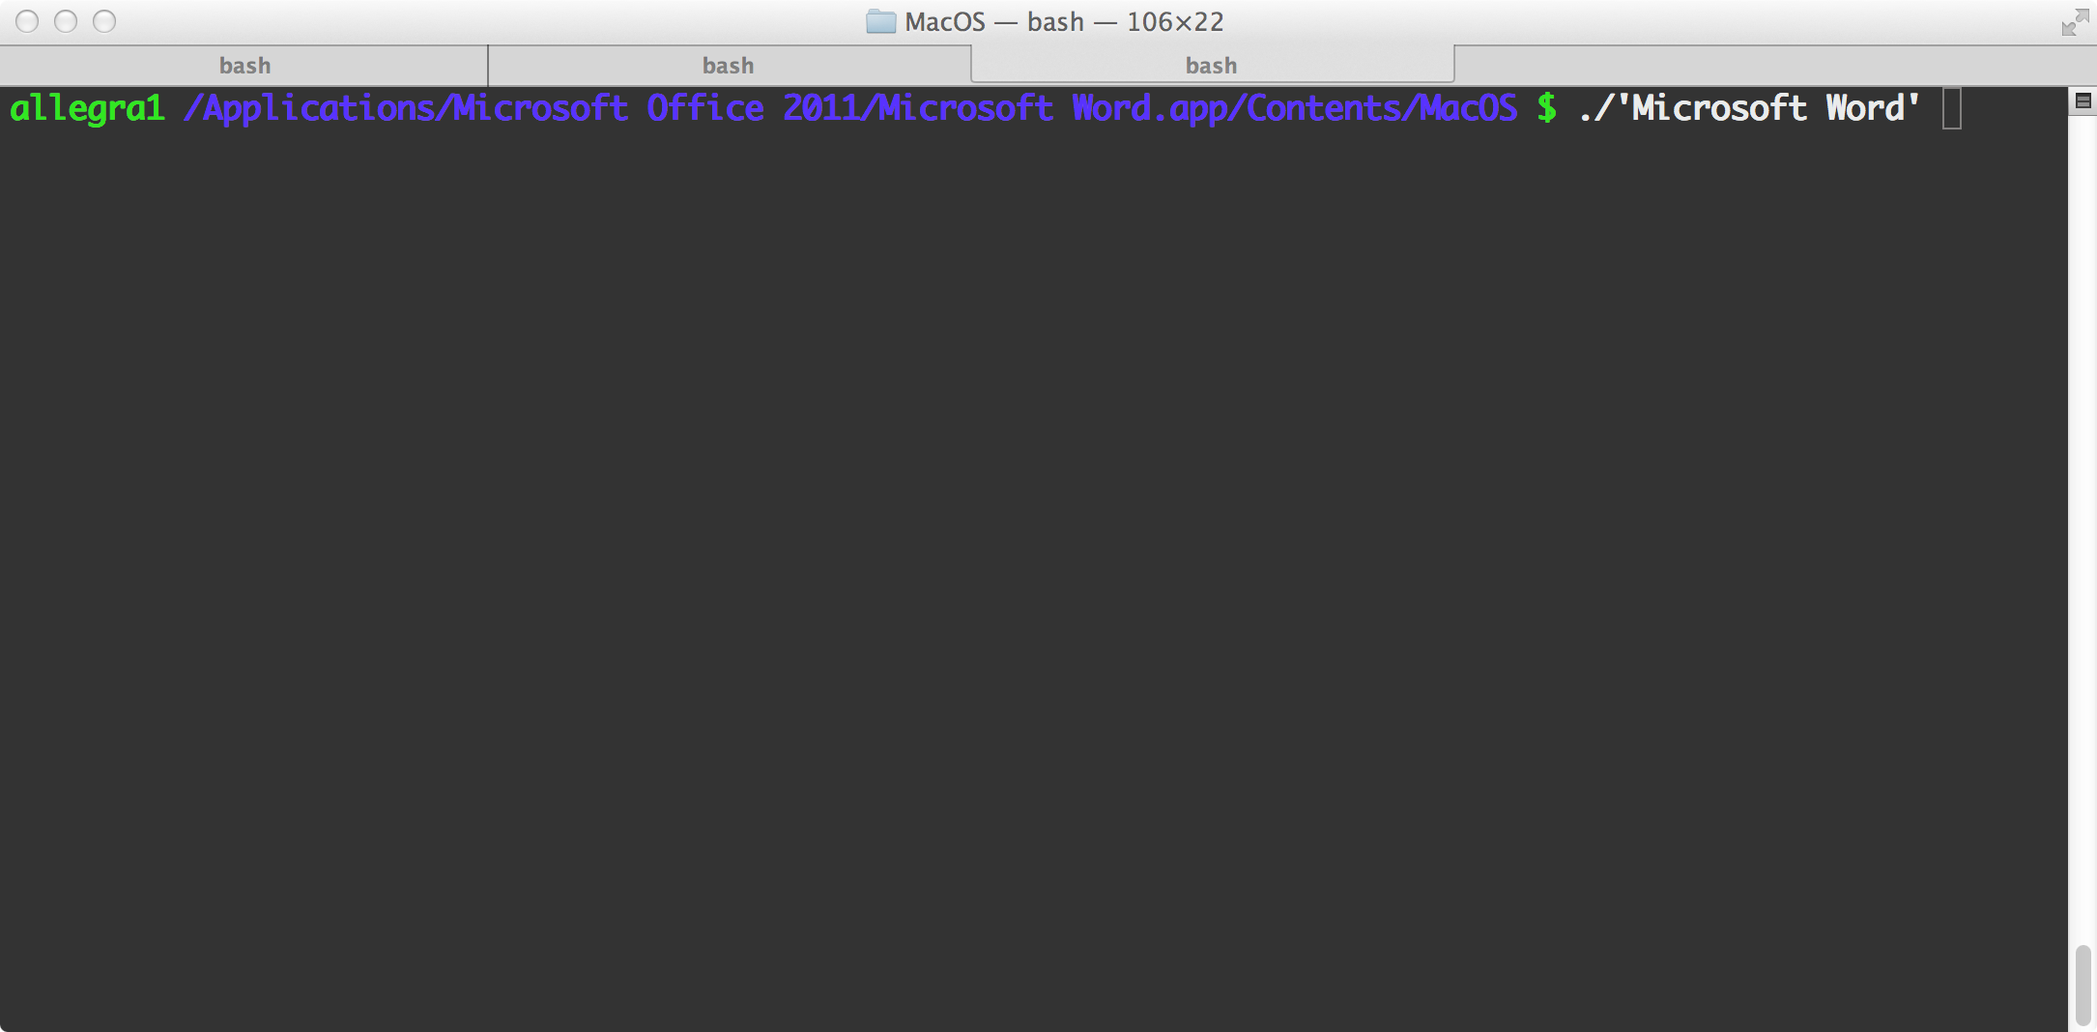

Slide 16
The Terminal can be customised
Change default bg color
Change text size, colour and font
Increase/decrease transparency
Resize it
Have multiple windows open side by side
Have multiple "tabs" open at the same time
Change the command prompt (most commonly a $ or % sign)
Make the cursor blinking

Slide 17
The command-line interface (terminal) allows you:
to send typed instructions to the computer (i.e., run programs, move/view files, etc.)
to see the output that results from those instructions.
Every time you type any Unix command and press enter, the computer will attempt to follow your instructions and then, when finished, return you to the command prompt.

Slide 18
Type the Unix command ‘ls’ at the command prompt
What happens?

Slide 19
What is the filesystem tree?

Slide 20
The directory structure
The file-system is arranged in a hierarchical structure, like an inverted tree
Root (/)
usr
home
bin
etc
var
tmp
kristian
allegra
phospho
courses
tmp
data
applications
The top of the hierarchy is traditionally called root
When you first login, the current working directory is your home directory (containing files and directories that only you can modify)

Slide 21
How can you navigate the filesystem?

Slide 22
What do you need to be able to do in order to navigate the filesystem?
Example: Change directory
Root (/)
usr
home
bin
etc
var
tmp
kristian
allegra
phospho
courses
tmp
data
applications
In groups

Slide 23
What do you need to be able to do to navigate the filesystem?
Find out where you are in the filesystem
Change directory
Find your way home
Identify the location of a file/directory
Move one directory up

Slide 24
What is the path of a file or a directory?

Slide 25
Slashes separate parts of the directory path:
/home/allegra/Documents/Training/materials/Unix/Academis_Linux.pdf

Slide 26
What do you need to be able to do in order to do/manage stuff in the filesystem?
Think of what you need in, e.g., Windows or Mac OSX
Example: Make a new directory
In groups

Slide 27
What do you need to be able to do in order to do/manage stuff in the filesystem?
Think of what you need in, e.g., Windows or Mac OSX
Make a new directory
Remove a directory
Copy a file to another file
Rename a file/directory
Create a file
Open/close a file
Remove a file
Run programs

Slide 28
Before talking about Linux commands, we need to answer a question
What is a computer program?
Which ones do you know?

Slide 29
A text file
Word
OS
The shell
An Excel data file
A database
Power point
The Linux Terminal
A Linux command

Slide 30
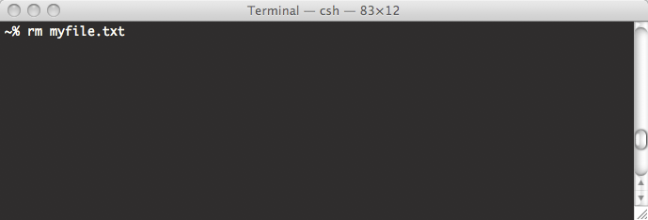
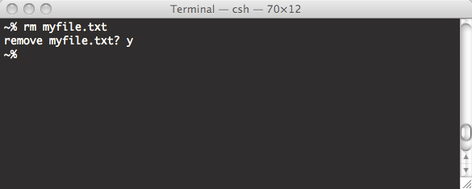
About Unix commands
Commands are themselves programs
%rm myfile.txt [Return]
  • The shell searches the file containing the program rm
  • executes the program rm on myfile.txt
  • After the process rm myfile.txt has finished running,
  the shell returns the prompt % to you, indicating that it is waiting for
  further commands.
Here you can type a new command

Slide 31
• command_name -options <file> [Return]
• %ls [Return]
• %ls –l [Return]
• %ls -l <dirname> [Return]
• %ls -ltr <dirname> [Return]
• man <command name> [Return]
• whatis <command name> [Return]

Slide 32
OPTIONS and ARGUMENTS
• There are commands that can take XXX
• Commands may also take XXX
• XXX change the behaviour of the command
• XXX are the objects on which commands act
• You will specify XXX using a XXX
• The command name, XXX and XXX must be separated by XXX

Slide 33
Replace the XXX
• If you've made a typo: Ctrl-XXX to cancel the whole line
• Unix is XXX-sensitive
• Ctrl-XXX sets the cursor at the beginning of the line
• Ctrl-XXX sets the cursor at the end of the line
• You can use up and down XXX to recall commands
• You can use the XXX to complete a command or file name
• The command XXX tells you where is a given program
• You can use a XXX to write programs

Slide 34
Did you know that…
…everything in Linux is either a file or a process?
A process is an executing program identified by a unique PID
(PID = Process IDentifier)
A file is a collection of data

Slide 35
Writing and running programs in Linux

Slide 36
Where can we write programs?

Slide 37
What is a text editor?
Which ones do you know?

Slide 38
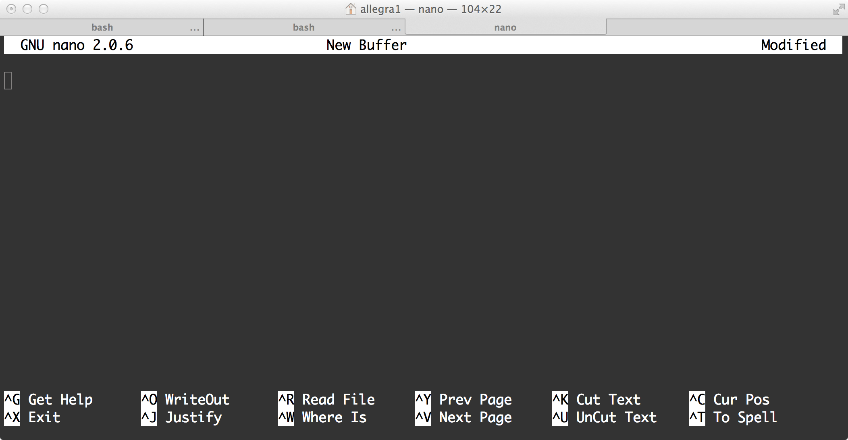
Access your home directory using the command-line interface
Start the nano text editor
Create a text file “my_first_shell_script.sh”

Slide 39
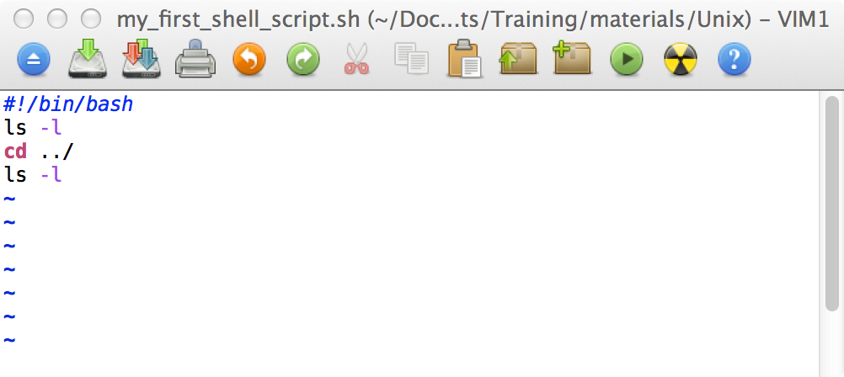
My first shell script
Write the commands in a file, save and exit
Go to the command-line interface and type “ls” at the prompt

Slide 40
How can we run programs on Linux?

Slide 41
Prerequisites to run a program
The program must be somewhere on your computer
The program must be executable
You have to tell the shell which "interpreter" will read and execute the program AND where it will find it
You must be in the same directory as the program you want to run OR….
….you can prefix its name with a path OR…
…the path to your program must in the PATH environment variable

Slide 42
Is my script executable?
File system security (access rights)
Each file (and directory) has associated access rights, which may
be found by typing ls -l
permissions
owner
size in bytes
-rwxr-xr-- 1 gould admin 2541 2009-08-19 16:57 new_scop.txt
d
number of links
group owner
date and time of the
last modification
file's name
Access rights on directories
    r allows users to list files in the directory
    w allows users to delete files from the directory or move files into it
    x allow users to access files in the directory

Slide 43
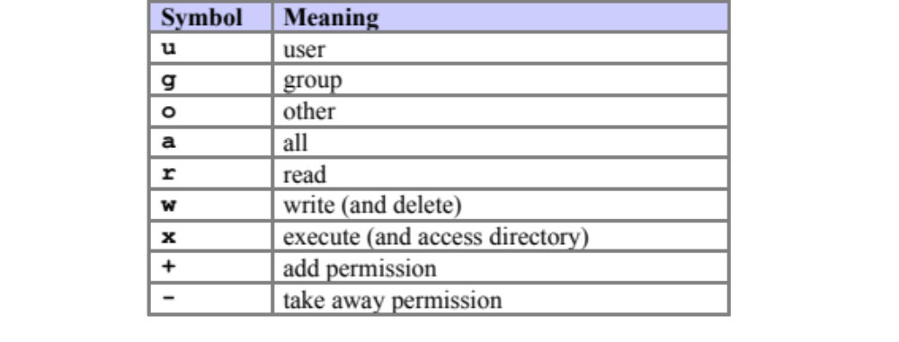
How can I make my script executable?
Changing access rights: chmod
%chmod go-rwx myfile.txt
%chmod a+x my_script

Slide 44
You have to tell the shell which "interpreter" will read and execute the program AND where it will find it

Slide 45
#!/bin/bash
"Aha, you want to use the program located at /bin/bash to interpret all the instructions that follow"
Bradnam&Korf - Unix and Perl to the Rescue

Slide 46
Now you want to execute the script
You have to tell Linux where it can find it
Where Linux searches for programs?

Slide 47
Where Linux searches for programs?
You can always run a program by prefixing its name with a path:
~allegra/Documents/shell_commands.sh
Or you have to be in the same directory as the one of the program and type:
./shell_commands.sh

Slide 48
Where Linux searches for programs?
If you simply type (at the prompt):
shell_commands.sh
Linux will check through a list of predefined directories to see if that program exists in any of those locations.
If it finds a match, it will try to run the program and stop looking in any other directory.
If it cannot find a match, it will print "command not found"

Slide 49
UNIX environment variables
Linux keeps track of several special variables that are associated with your account
Written in upper-case letters
Start with a $
echo $SHELL
printenv SHELL
echo $PATH

Slide 50
If the system returns a message saying "command: Command not found", this indicates that either the command doesn't exist at all on the system or it is simply not in your path.
Any program in ~/allegra/my_scripts can be run from anywhere in the filesystem (as long as the program file is executable)
You can use tab-completion
Your scripts will be treated like any Linux command

Slide 51
# for shells in the bash family
export PATH=$PATH:~/allegra/my_scripts
# for shells in the csh family
setenv PATH $PATH\:~/allegra/my_scripts

Slide 52
A few more questions…
• What is command-line completion?
• What is a default argument?

Slide 53
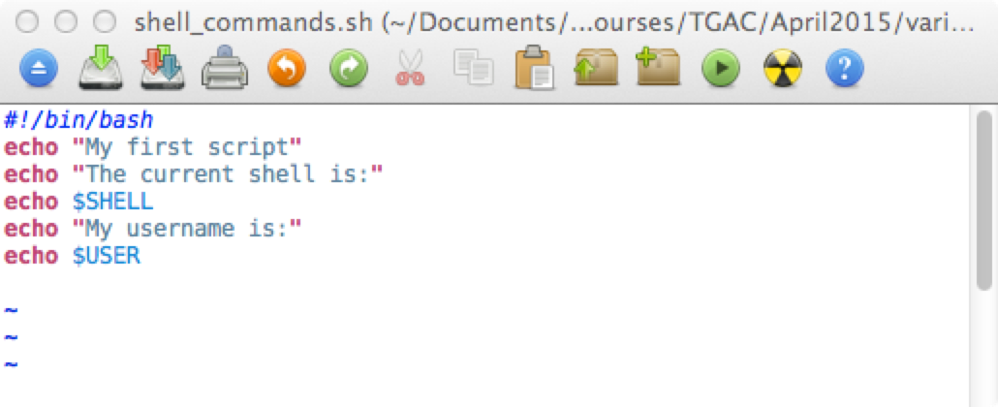
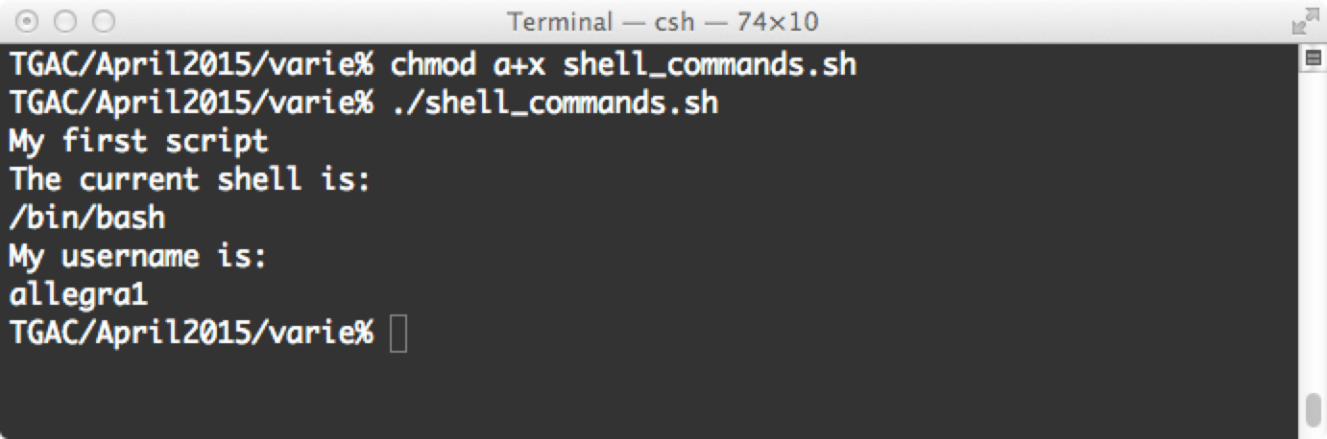
Exercise: use a text editor to write commands into a file, save, exit, make it executable and run it

Slide 55
Connecting to a remote computer
ssh remote_host
The remote_host is the IP address or domain name that you are trying to connect to.
If your username is different on the remote system:
ssh remote_username@remote_host
Once you have connected to the server, you will probably be asked to verify your identity by providing a password.
ssh -x remote_username@remote_host

Slide 56
Transferring files to/from a remote computer
sftp username@host
Enter your password when prompted
Several Unix commands do work
get → Copy a file from the remote computer to the local computer.
put → Copy a file from the local computer to the remote computer.

Slide 57
Transferring files to/from a remote computer
scp copies files over a secure, encrypted network connection.
scp /home/image*.jpg allegra@myhost.com:/home/images
scp allegra@myhost.com:/home/image*.jpg /home/allegra/downloads
scp [-12346BCpqrv] [-c cipher] [-F ssh_config] [-i identity_file]
[-l limit] [-o ssh_option] [-P port] [-S program]
[[user@]host1:]file1 ... [[user@]host2:]file2
Enter your password when prompted

Slide 58
Non-interactive download of files from the Web
wget [option]... [URL]...
Non-interactive means that it can work in the background, while the user is not logged on.
This allows you to start a retrieval and disconnect from the system, letting Wget finish the work.
By contrast, most of the Web browsers require constant user's presence, which can be a great hindrance when transferring a lot of data.

Slide 59
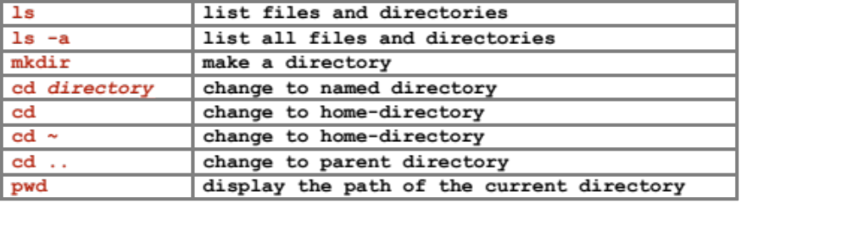
Listing files and directories
The directories ‘.’, ‘..’, and ‘~’
% ls -a [Enter]
% cd . [Enter]
% cd .. [Enter]
% ls ~/oeiras

Slide 60
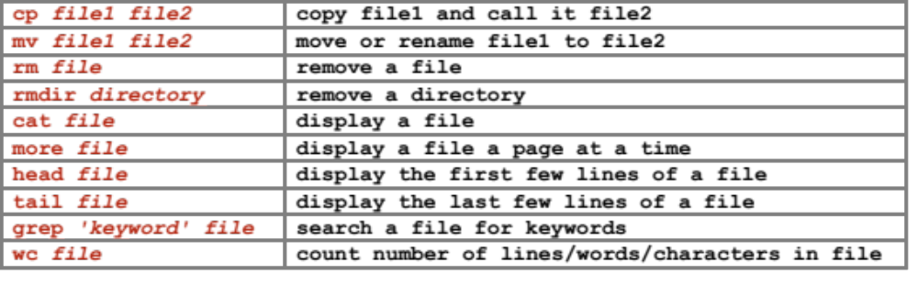
Handling files and directories
more
less
clear

Slide 61
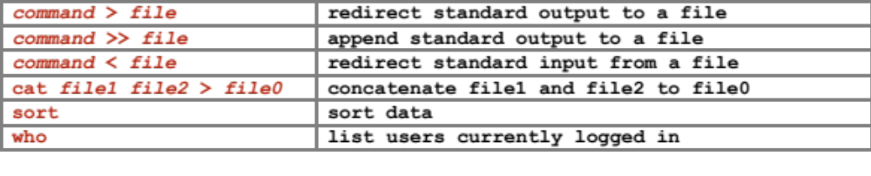
Redirection

