Slide 1

Homology 3D modeling and effect of mutations
Miguel Andrade
Faculty of Biology,
Johannes Gutenberg University
Institute of Molecular Biology
Mainz, Germany
andrade@uni-mainz.de

Slide 2
Determination of protein structure
X-ray crystallography (103,988 in PDB)
need crystals
Nuclear Magnetic Resonance (NMR) (11,212)
proteins in solution
lower size limit (600 aa)
Electron microscopy (973)
Low resolution (>5A)

Slide 3

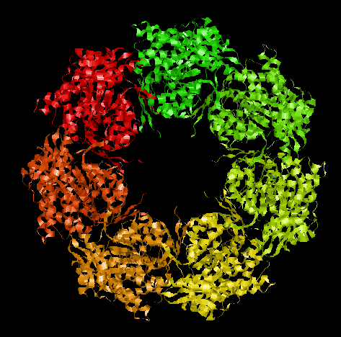
Determination of protein structure
resolution 2.4 A

Slide 4
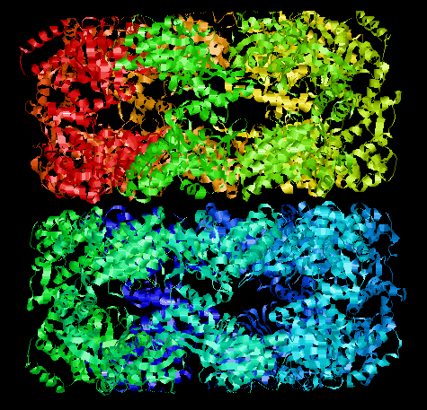
Determination of protein structure
resolution 2.4 A

Slide 5
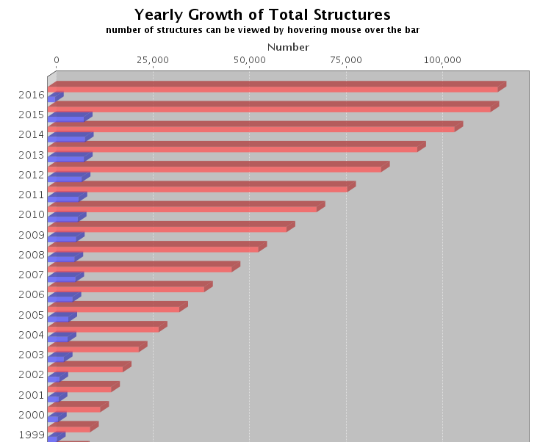

Structural genomics
Currently: 116K 3D structures
from around 38K sequences in UniProt (how do I know?)
61M sequences in UniProt
only 0.06%!
Notes:
PDB > Search > PDB Statistics / UniProt > Advanced search > Keyword 3D-structure

Slide 6
Structural genomics
Currently: 116K 3D structures
from around 38K sequences in UniProt (how do I know?)
61M sequences in UniProt
only 0.06%!
50% sequences covered (25% in 1995)

Slide 7
3D structure prediction
Applications: target design
Query sequence
G
K
similar to
L
G
+
Leu
Gly
Lys
Gly
catalytic center
known 3D
model 3D by homology

Slide 8
3D structure prediction
Applications: fit to low res 3D
Query sequence 1
Query sequence 2
low resolution 3D (electron microscopy)

Slide 9
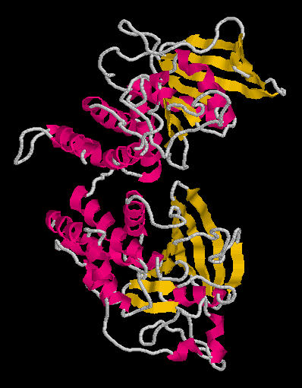
Domains
Protein domains are structural units (average 160 aa) that share:
Function
Folding
Evolution
Proteins normally are multidomain
(average 300 aa)

Slide 10
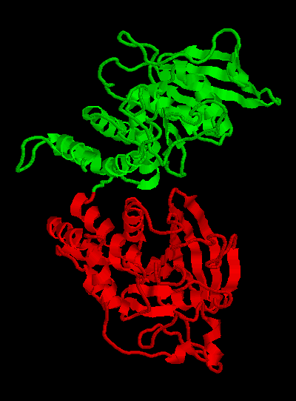
Domains
Protein domains are structural units (average 160 aa) that share:
Function
Folding
Evolution
Proteins normally are multidomain
(average 300 aa)

Slide 11
Domains
Query Sequence
Predict domains
Cut
Similar to PDB
sequence?
No
2D Prediction
3D Ab initio
3D Threading
Yes
3D Modeling by homology

Slide 12
3D structure prediction
Ab initio
Explore conformational space
Limit the number of atoms
Break the problem into fragments of sequence
Optimize hydrophobic residue burial and pairing of beta-strands
Limited success

Slide 13
3D structure prediction
Threading
I-Tasser: Jeffrey Skolnick & Yang Zhang
Fold 66% sequences <200 aa long of low homology to PDB
Just submit your sequence and wait… (some days)
Output are predicted structures (PDB format)
Lee and Skolnick (2008) Biophysical Journal
Roy et al (2010) Nature Methods
Yang et al (2015) Nature Methods

Slide 14
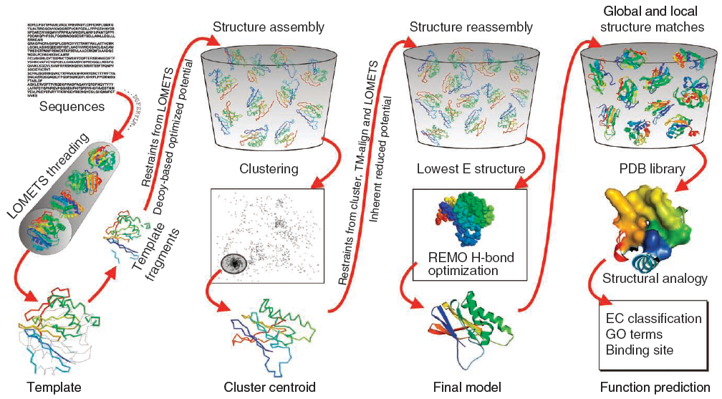
3D structure prediction
I-Tasser
Roy et al (2010) Nature Methods

Slide 15
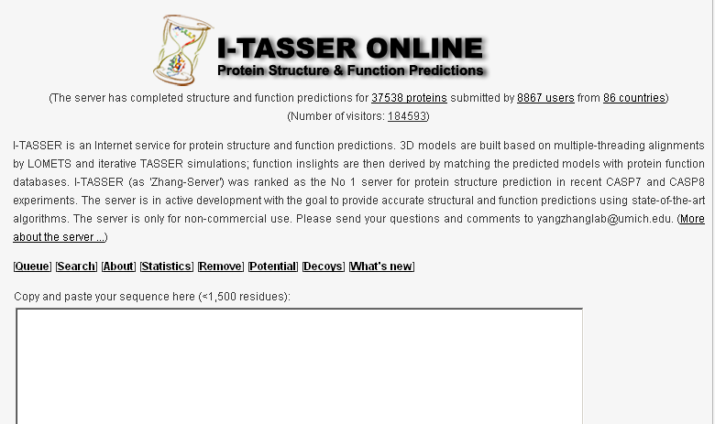
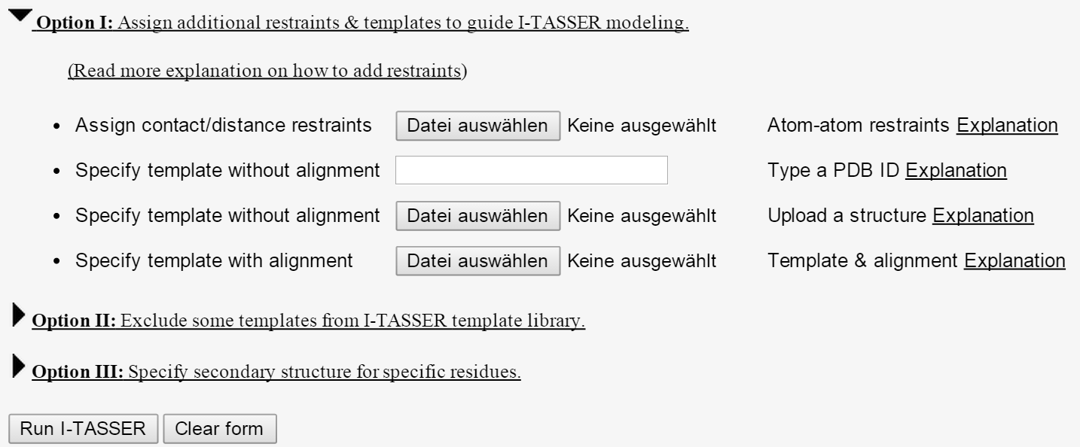
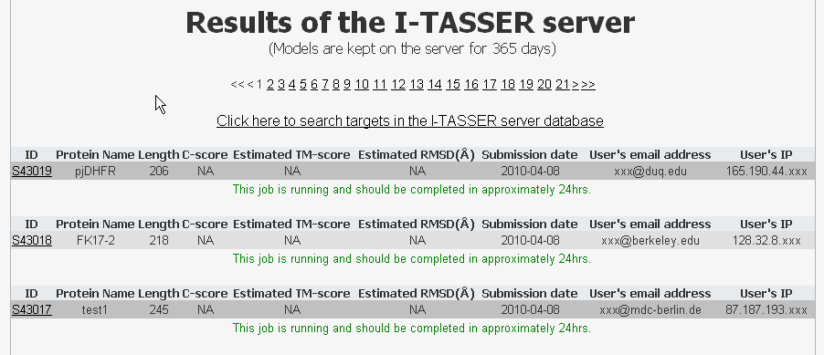
3D structure prediction
I-Tasser
http://zhanglab.ccmb.med.umich.edu/I-TASSER/

Slide 16
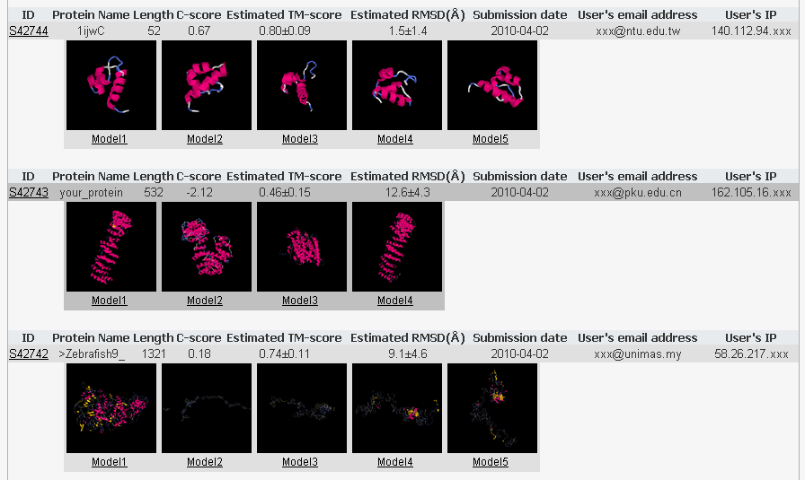
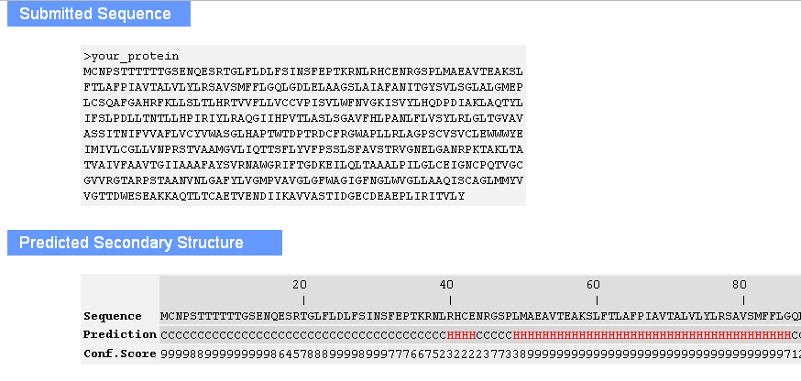
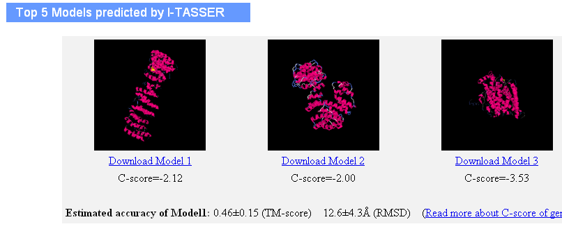
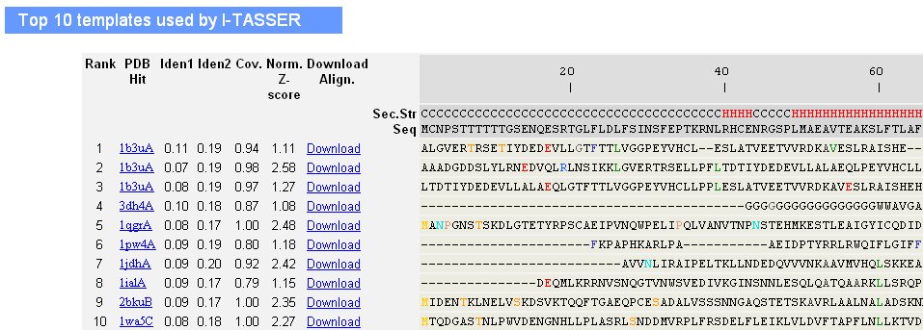
3D structure prediction
I-Tasser

Slide 17
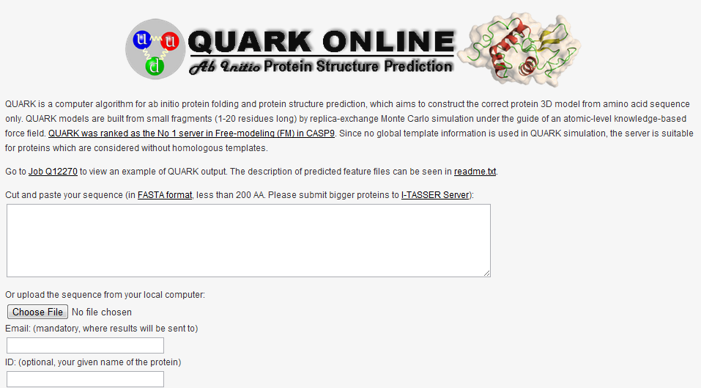
3D structure prediction
QUARK
http://zhanglab.ccmb.med.umich.edu/QUARK/

Slide 18
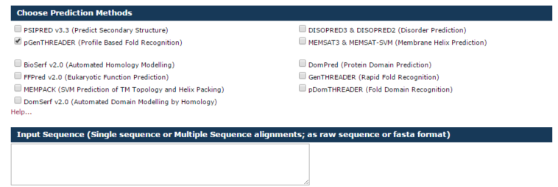
3D structure prediction
GenTHREADER
David Jones http://bioinf.cs.ucl.ac.uk/psipred/
Input sequence or MSA
Typically 30 minutes, up to two hours
GenTHREADER Jones (1999) J Mol Biol

Slide 19
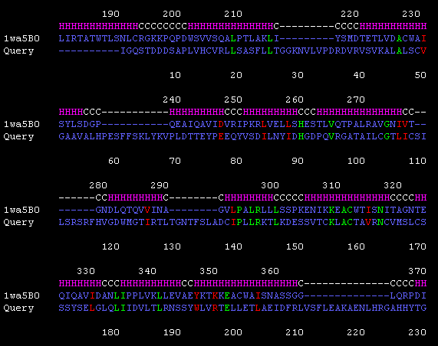
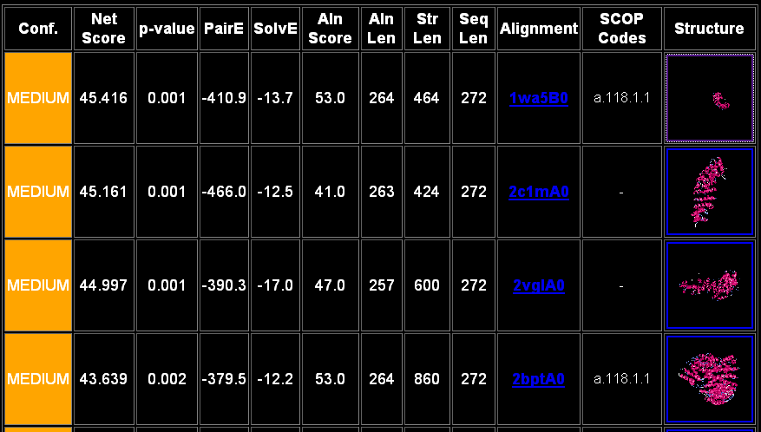
3D structure prediction
GenTHREADER
Output GenTHREADER

Slide 20
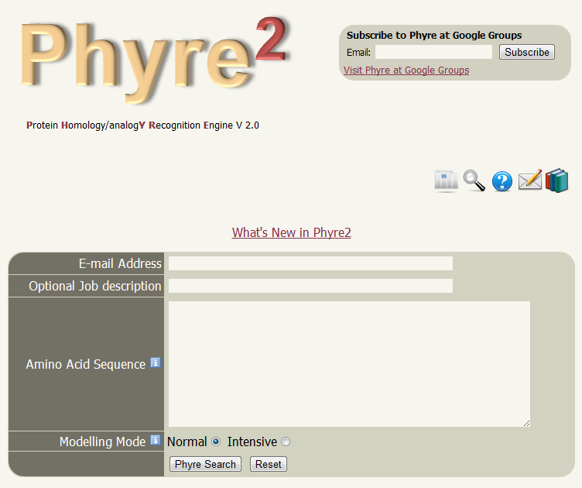
3D structure prediction
Phyre
http://www.sbg.bio.ic.ac.uk/phyre2/
Kelley et al (2000) J Mol Biol
Kelley et al (2015)
Nature Protocols
Processing time can be hours

Slide 21
3D structure prediction
Static solutions
Datasets of precomputed models / computations
Not flexible
Variable coverage
But you don’t have to wait

Slide 22
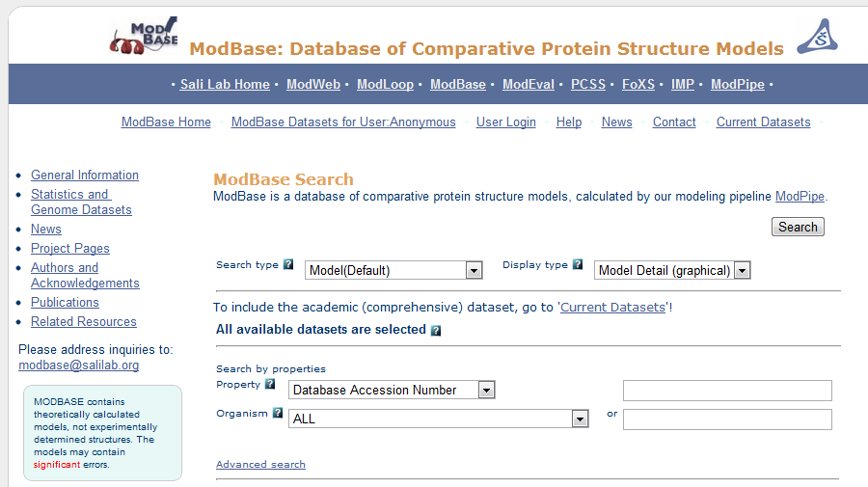
3D structure prediction
MODbase
Andrej Sali http://modbase.compbio.ucsf.edu/
Pieper et al (2014) Nucleic Acids Research

Slide 23
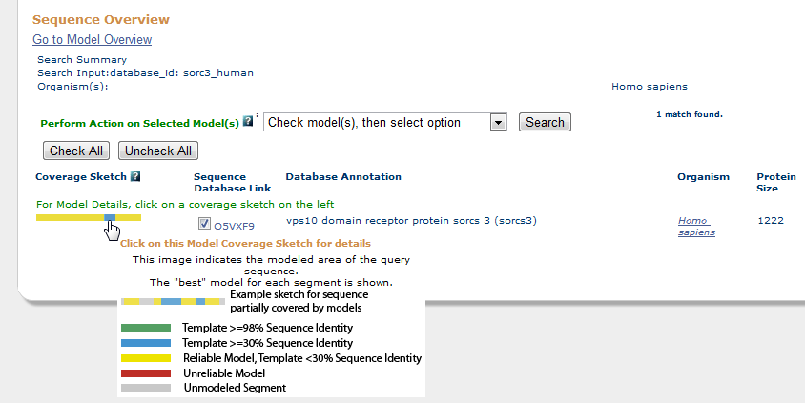
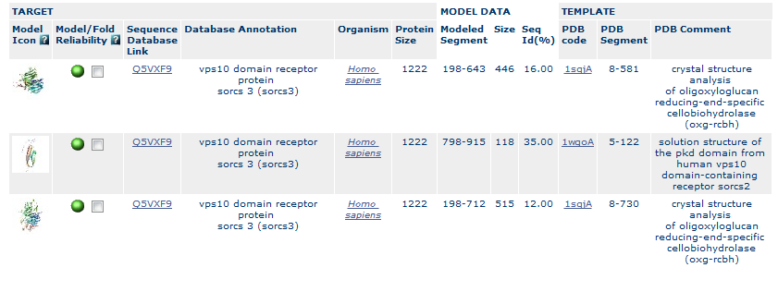
3D structure prediction
MODbase

Slide 24
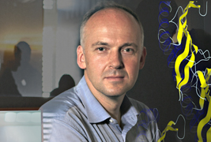
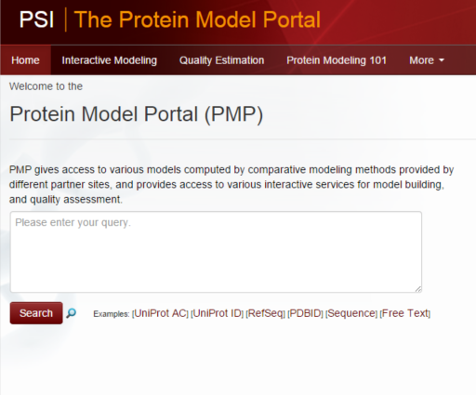
3D structure prediction
Protein Model Portal
Torsten Schwede
Haas et al. (2013) Database

Slide 25
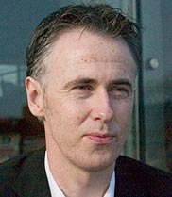
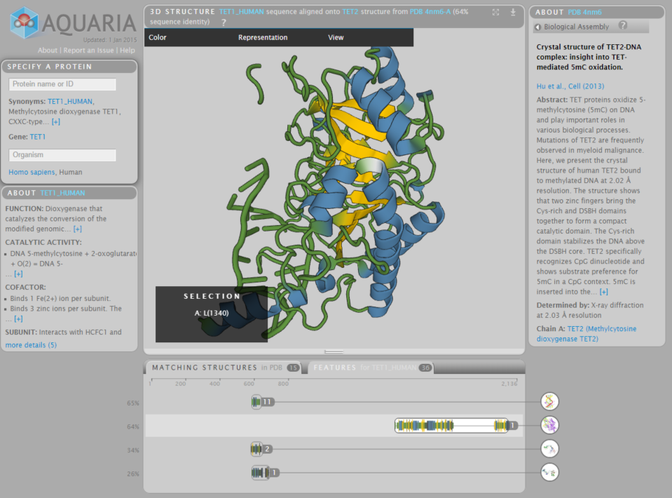
Aquaria
Sean O’Donoghue http://aquaria.ws/
O’Donoghue et al (2015) Nature Methods

Slide 26
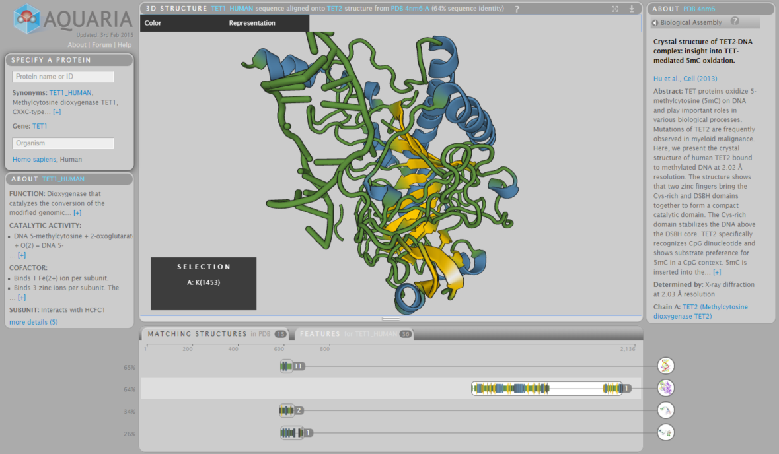
Aquaria

Slide 27
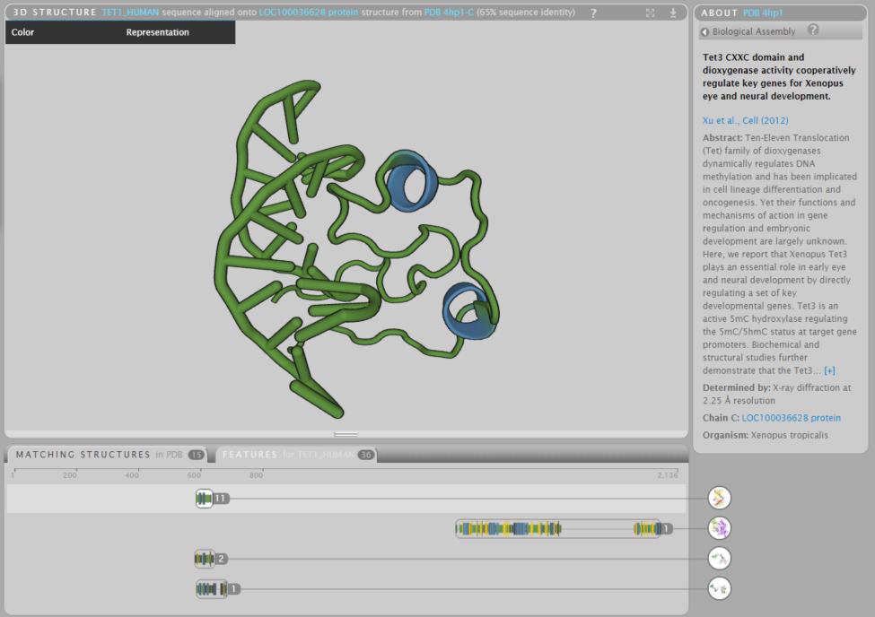
Aquaria

Slide 28
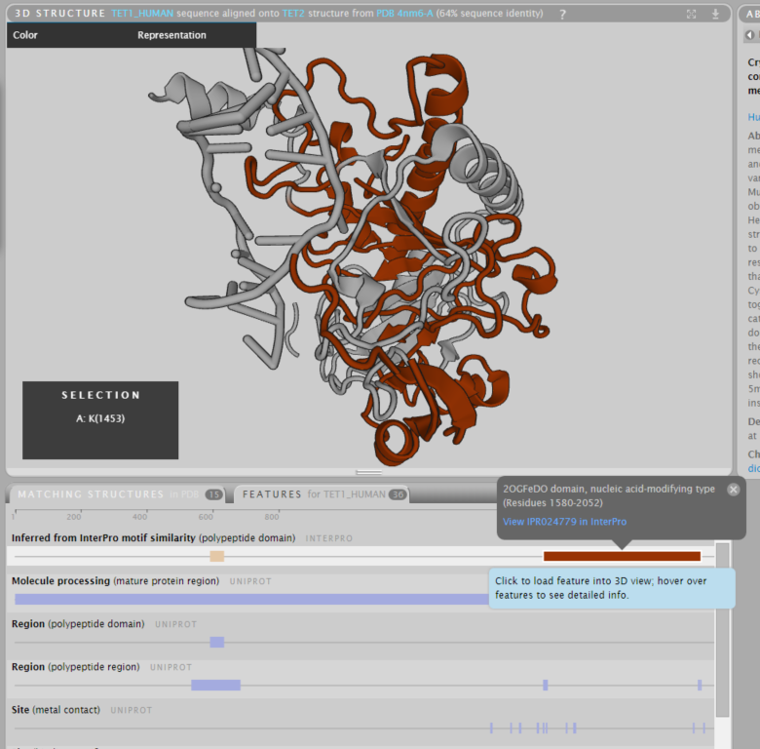
Aquaria

Slide 29
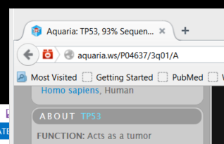
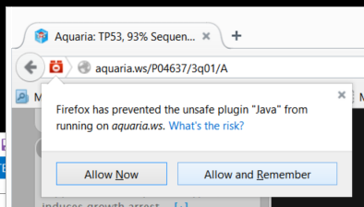
Exercise 1/5
Starting aquaria
Works best in Firefox (in Chrome with reduced functionality)
Open Firefox with JRE
Go to http://aquaria.ws
Run an example. If JAVA blocked unblock it at the plugin icon

Slide 30
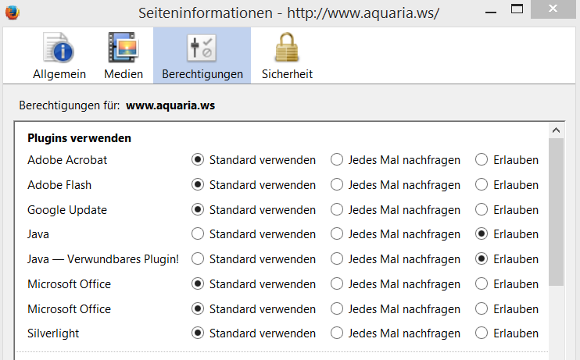
Exercise 1/5
Starting aquaria
Note that aquaria.ws requires that two java plug-ins that need to be allowed to run

Slide 31
Exercise 2/5
Comparing different matches in Myosin X
You can load a protein by its UniProt ID
Try Myosin X: http://aquaria.ws/Q9HD67/
Zoom in and out using the mouse wheel (or with shift and drag up and down).
Rotate by click and drag
Click on a residue to select. Shift + Click selects a range. Esc clears the selection.
Double click on a residue centers the molecule on it.
Right click and drag moves the molecule laterally
Compare the different hits with domain annotations using the feature view

Slide 32
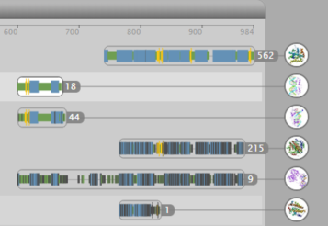
Exercise 3/5
Comparing different matches in the human MR
Type NR3C2 in protein name (human mineralocorticoid receptor)
Note and compare the multiple hits.
Which proteins are those?
What do they match in the human mineralocorticoid receptor?
(Use the Features view)
The further down the less similar are the proteins compared. This is represented by a darker color.

Slide 33
Exercise 4/5
Post-translational modifications in CTNNB1
Load the human protein CTNNB1 (Catenin beta-1) (P35222)
Click on the 'Features' tab (bottom of the window)
Double click on the feature lane titled “Modified residue” (post-translational modification). This will highlight the residues in the structure. Then you can click on the residues to see their position and amino acid.
Which two amino acid modifications are close in structure, but not in sequence? Which type of modifications are those?
Change representation to ball and stick to see the side chains.
Do the side chains of the modified residues look like they could interact?
Try this in Chimera (PDB:2Z6H). Represent the two residues using spheres.
Notes:
:619 :654 Chimera

Slide 34
Exercise 4/5
Post-translational modifications in CTNNB1
Load the human protein CTNNB1 (Catenin beta-1) (P35222)
Click on the 'Features' tab (bottom of the window)
Double click on the feature lane titled “Modified residue” (post-translational modification). This will highlight the residues in the structure. Then you can click on the residues to see their position and amino acid.
Which two amino acid modifications are close in structure, but not in sequence? Which type of modifications are those?
Change representation to ball and stick to see the side chains.
Do the side chains of the modified residues look like they could interact?
Try this in Chimera (PDB:2Z6H). Represent the two residues using spheres. Select > Atom specifier > :619 :654
Notes:
:619 :654 Chimera

Slide 35
Effect of mutations

Slide 36
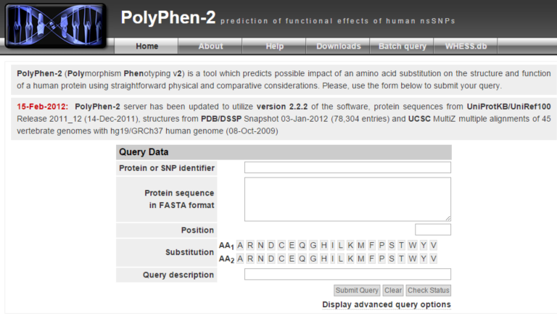
Polyphen2
http://genetics.bwh.harvard.edu/pph2/

Slide 37
Polyphen2
Training
3,155 mutations causing Mendelian disease
6,321 mutations versus mammalian homologs
Disease protein
MSDFGARDFG...
Human protein
MSDFGASDFG...
Mouse protein
MSDFGATDFG...
13,032 mutations causing disease
(UniProt)
8,946 mutations not causing disease
Disease protein
MSDFGARDFG...
Human protein
MSDFGASDFG...
Human variant
MSDFGAADFG...
mildly deleterious

Slide 38
Polyphen2
PSIC Score
Low score
High score
Reference
EGKLQVQQGTGRFISR
DGNLHVNQGMGRFIPR
DGNLHVNKGMGRFIPR
DGNISVSKGMGRFIPR
DGNISVSKGMGRFIPR
EGTLHTTEGSGRFISR
EGTLHATEGSGRYIPR
DGNLHVTEGSGRYIPR
DGTLHVTEGSGRYIPR
DGTLHVTEGSGRYIPR
DGTLHVTEGSGRYIPR
DGNLHVSQGSGRFVPR
DGNLFVTEGSGRFVPR
DGKMFVTPGAGRFVPR
DGNLLVTPGAGRFIPR
DGNLLVTPGAGRFIPR
DGTLSVMEGSGRFIPR
DGNLHATSGTGRFIPC
Likelihood of an amino acid to occupy a specific position in the protein sequence given the pattern of amino acid substitutions observed in the multiple sequence alignment
Homologs

Slide 39
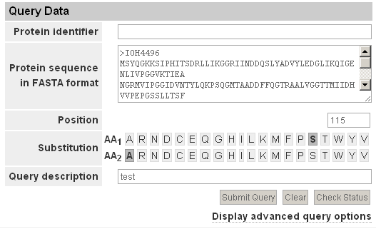
Polyphen2
Usage

Slide 40
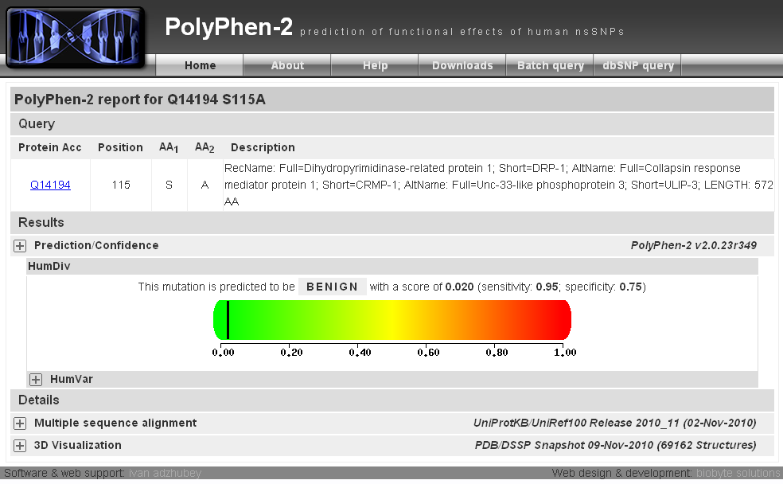
Polyphen2

Slide 41
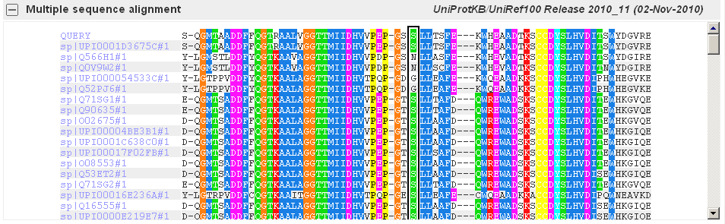
Polyphen2

Slide 42
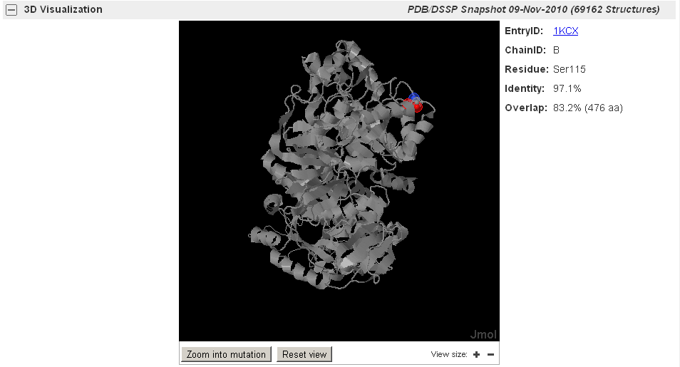
Polyphen2

Slide 43
Exercise 5/5
Study the effect of mutants with Polyphen2
Let’s see if you can design a damaging and a benign mutation for human myosin X (open in chimera PDB 3PZD to view and select candidate mutations).
Go to the Polyphen2 home page: http://genetics.bwh.harvard.edu/pph2/
Type the UniProt id of the protein sequence “Q9HD67” in the Protein Identifier window. Type the position of your candidate for a damaging mutation. Select in AA1 the type of amino acid at that position. Now, select an amino acid to mutate to. May be try one with a large side chain, or if the wild type one was hydrophobic, try a hydrophilic one. Be nasty! Then hit Submit Query.
What result did you get? Is it close to one?
Try your benign mutation in the same way. This time may be choose to mutate to a similar residue to the wild type one. Be gentle! Then hit Submit Query.
What result did you get? Is it close to zero?

