Slide 1

Secondary structure prediction
Miguel Andrade
Faculty of Biology,
Johannes Gutenberg University
Institute of Molecular Biology
Mainz, Germany
andrade@uni-mainz.de

Slide 2
Secondary structure prediction
Amino acid sequence -> Secondary structure
Alpha helix
Beta strand
Disordered/coil
70% accuracy 1991, 81% accuracy in 2009

Slide 3
Secondary structure prediction
Limits:
Limited to globular proteins
Not for membrane proteins

Slide 4
Secondary structure prediction
Applications
Site directed mutagenesis
Locate functionally important residues
Find structural units / domains

Slide 5
Secondary structure prediction
Techniques
Linear statistics
Physicochemical properties
Linear discrimination
Machine learning
Neural Networks
K-nearest neighbours
Evolutionary trees
Residue substitution matrices
Using evolutionary information = Multiple sequence alignments.

Slide 6
Secondary structure prediction
Jnet
Cuff and Barton (2000)
Neural Network
Training set: 480 proteins (non homologous)
Construction of MSA for each using BLAST

Slide 7
Secondary structure prediction
Jnet
Neural network
Ni Neuron i, Nj neuron j
Wij weight from Ni to Nj
Wij
Ni
Nj
Signal forward propagation
Output from Ni * Weight Ni to Nj
Input to Nj is Ij = Oi * Wij

Slide 8
Secondary structure prediction
Jnet
Neural network
Ni Neuron i, Nj neuron j
Wij weight from Ni to Nj
Wij
Ni
Nj
Nz
Output layer
Nk
Input layer

Slide 9
Secondary structure prediction
Jnet
Neural network
The network receives input values
Ii
Ni
Wiz
Ij
Wjz
Nz
Nj
Output layer
Ik
Wkz
Nk
Input layer

Slide 10
Secondary structure prediction
Jnet
Neural network
Signal forward propagation
Ii
Ni
Wiz
Ij
Wjz
Nz
Oz
Nj
Ik
Wkz
Nk
Sum of outputs from Ni, Nj, Nk

Slide 11
Secondary structure prediction
Jnet
Neural network
Compute the error
Ii
Ni
Wiz
Ij
Wjz
Nz
Oz
Nj
Ik
Wkz
Nk
Desired value is 1, Oz is 0.8
Error is = Oz – desired value = 1-0.8 =0.2

Slide 12
Secondary structure prediction
Jnet
Neural network
Error backpropagation
Ni
Wiz
Wjz
Nz
Oz
Nj
Wkz
Nk
Weights are modified so that the result is a bit closer to what we wanted

Slide 13
Secondary structure prediction
Jnet
Neural network
Hidden layer
Ni
Np
Nj
Nz
Nq
Output layer
Nk
Input layer

Slide 14
Secondary structure prediction
Jnet
Neural network
A
C
D
…
Y
Input layer: read a sequence
CTEIL...

Slide 15
Secondary structure prediction
Jnet
Neural network
A
0
C
1
D
0
…
CDEKL...
0
Y
Input layer: read a sequence
CDEKL...

Slide 16
Secondary structure prediction
Jnet
Neural network
A
0
C
0
D
1
CDEKL...
…
Y
0
Input layer: read a sequence
CDEKL...

Slide 17
Secondary structure prediction
Jnet
Neural network
A
C
D
CDEKL...
…
Y
Input layer: read a sequence
CDEKL...

Slide 18
Secondary structure prediction
Jnet
Neural network
A
a
1
C
b
0
Alpha-helix
D
…
c
0
CDEKL...
Y
Output layer: structure
Desired output: known structure

Slide 19
Secondary structure prediction
Jnet
Neural network
A
a
0.4
1
C
b
0.6
0
Alpha-helix
D
…
c
0.1
0
CDEKL...
Y
Output layer: structure
Desired output: known structure

Slide 20
Secondary structure prediction
Jnet
Neural network
A
a
0.4
1
C
b
0.6
0
Alpha-helix
D
…
c
0.1
0
CDEKL...
Y
Error backpropagation = weights are modified

Slide 21
Secondary structure prediction
Jnet
Jnet architecture
Sequence to structure network
a
b
LAPEDCDEKLKLEPNAC
c
Input layer = window of 17 residues
Hidden layer = 9 neurons
Output layer = 3 neurons

Slide 22
Secondary structure prediction
Jnet
Jnet architecture
a
b
FLAPEDCDEKLKLEPNACW
ccaacaaccbbbbbcbbbc
c

Slide 23
Secondary structure prediction
Jnet
Jnet architecture
Structure to structure network
a
a
b
b
FLAPEDCDEKLKLEPNACW
ccaacaaccbbbbbcbbbc
ccaaaaacccbbbbbbbbc
c
c
Input layer = window of 19 residues
Hidden layer = 9 neurons
Output layer = 3 neurons

Slide 24
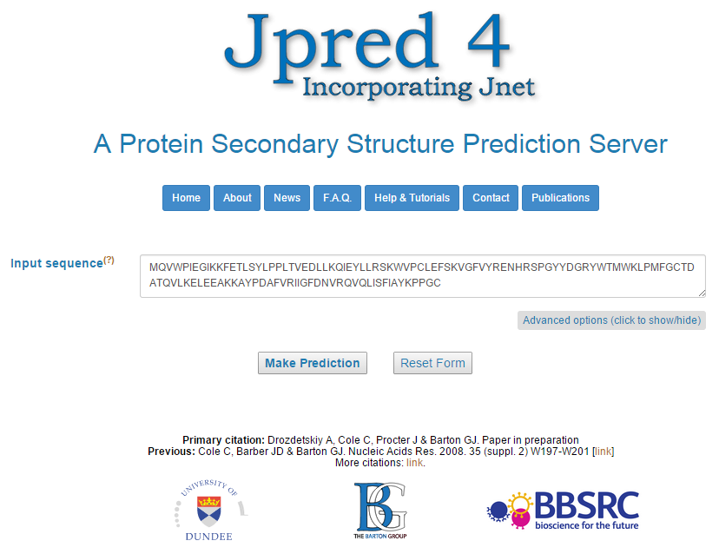
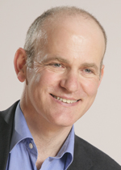
Secondary structure prediction
Geoff Barton, University of Dundee
Drozdetskiy et al. (2015) Nucleic Acids Research

Slide 25
Secondary structure prediction
Jpred
Uses algorithm Jnet2.0
Three state prediction
Alpha, beta, coil
Accuracy 82.0% (2015); 81.5% (2008)
But if no homolog (orphan sequence) 65.9%!

Slide 26
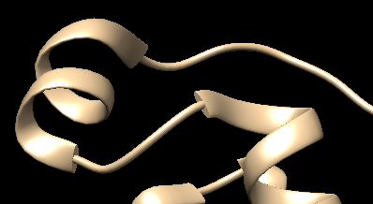
Secondary structure prediction

Slide 27
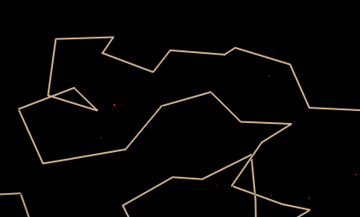
Secondary structure prediction

Slide 28
Secondary structure prediction
Jpred
Uses algorithm Jnet2.0
Three state prediction
Alpha, beta, coil
Accuracy 82.0% (20015); 81.5% (2008)
But if no homolog (orphan sequence) 65.9%!
PSIBLAST PSSM matrix
HMMer profiles (instead of aa frequencies)
Multiple neural networks
100 hidden layer units

Slide 29
Secondary structure prediction
Jpred
First, search against PDB sequences using BLAST (but only for warning)
PSIBLAST search of UniRef90, 3 iterations, Alignment of hits (filtered at 75% id)
Profiles from alignment (PSSM and HMMer)
Profiles are input to JNet
Alternative: user provides alignment (faster)

Slide 30
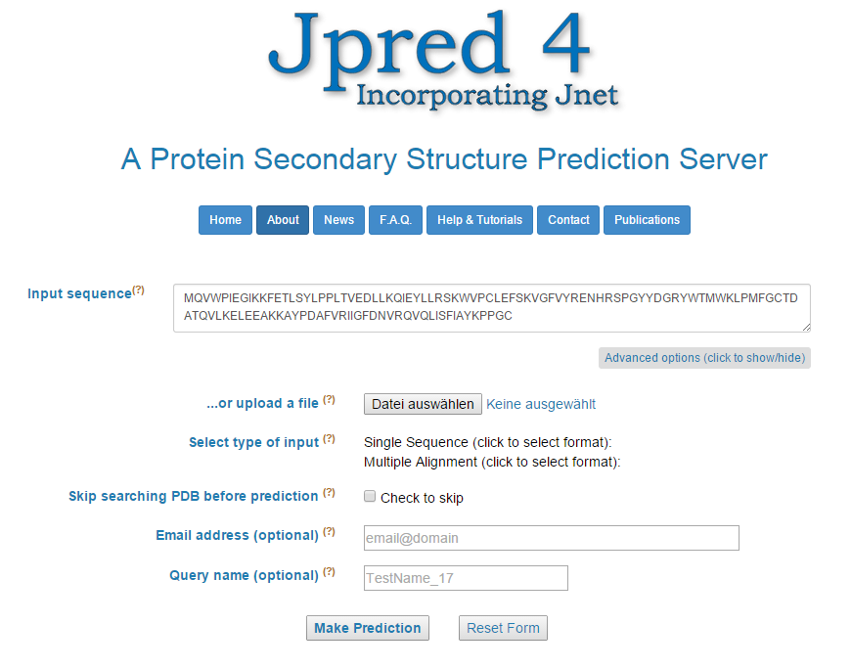
Secondary structure prediction
Advanced Jpred4 usage

Slide 31
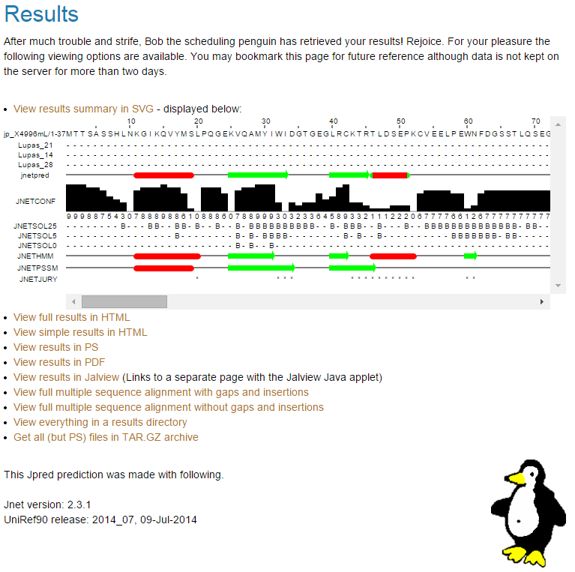
Secondary structure prediction
Jpred output

Slide 32
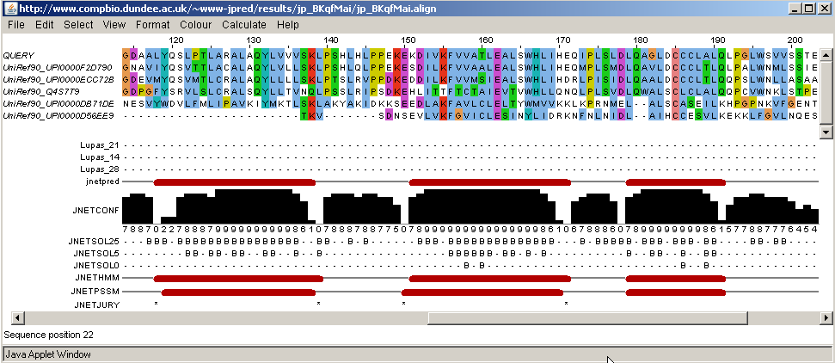
Secondary structure prediction
JPred
Jpred output / Jalview

Slide 33
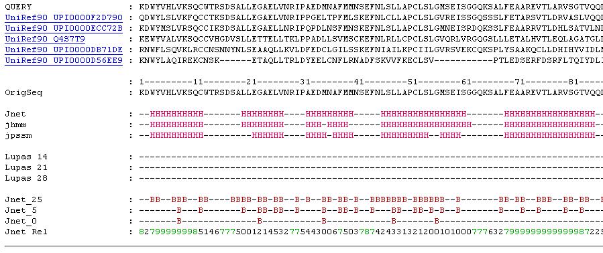
Secondary structure prediction
JPred
Jpred output / view all

Slide 34
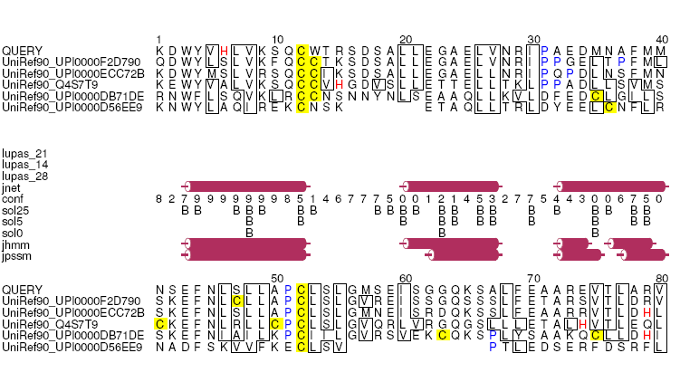
Secondary structure prediction
JPred
Jpred output / PDF output

Slide 35
Installing Jalview 1/2
Go to http://www.jalview.org
Click the Download link
Click the InstallAnywhere Jalview Installer page
Click the button under “Recommended installer for your platform” (InstallAnywhere should download and start)
Execute install-jalview.exe

Slide 36
Installing Jalview 2/2
First step is “Choose Install Folder”: Click the Choose button, select the folder “Desktop” and click the button “Neuen Ordner erstellen” (name it something like “jalview”).
The installation folder should look like:
\\uni-mainz.de\dfs\profiles\settings\andrade\Desktop\jalview
Then follow the installation (button Next).
At the end you should have a folder “jalview” in your desktop with a Jalview.exe inside.
Run Jalview.exe. Many annoying windows appear and we want to get rid of them: Select menu option “Tools” -> “Preferences” -> “Visual”
Tick out there the option “Open file”.
Close and open again Jalview and there should be no windows.

Slide 37
Exercise 1/4
Jalview 2D prediction
Load an alignment
Use MR1_fasta.txt
This is an alignment of a fragment of the mineralocorticoid receptor
Open it from File > Input alignment > From file
(Hint: You can load it directly as an URL, e.g. https://cbdm.uni-mainz.de/files/2015/02/MR1_fasta.txt)
The alignment has its own Menu tabs
Try Colour > Clustalx
to see conservation

Slide 38
Exercise 2/4
Jalview 2D prediction
Build a phylogenetic tree
Also using MR1_fasta.txt
Try Calculate > Calculate tree > Neighbour joining using PAM 250
Hint: We used identifiers indicating species names
Try now Calculate > Calculate tree > Average distance using PAM 250
Compare results. Which one is better?

Slide 39
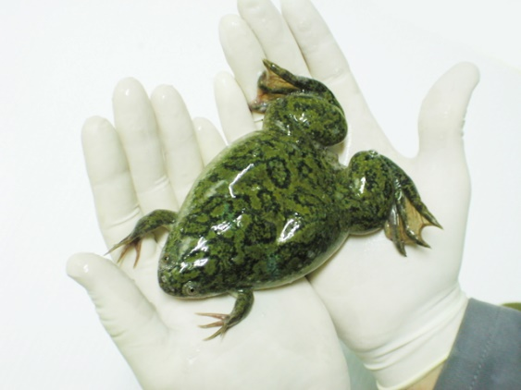
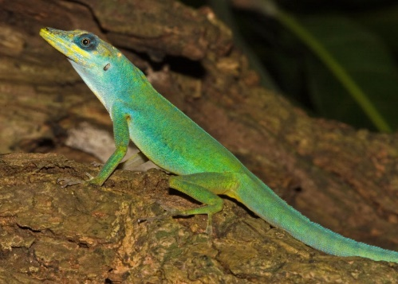
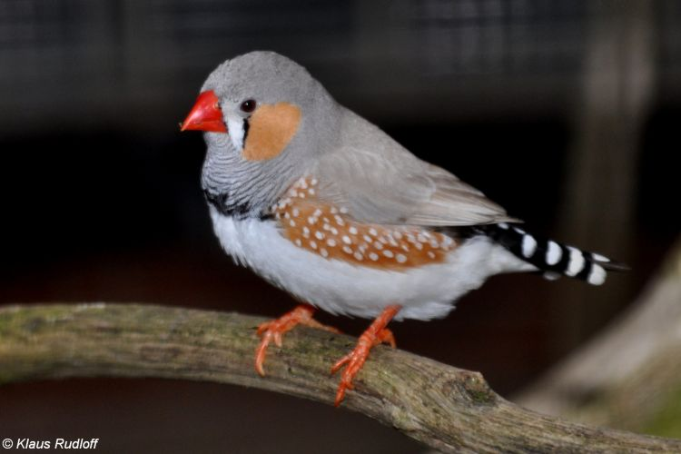
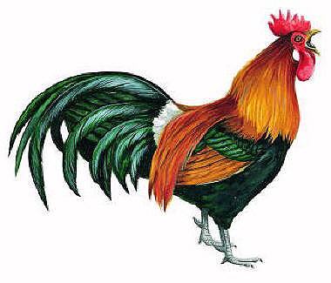
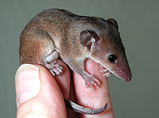
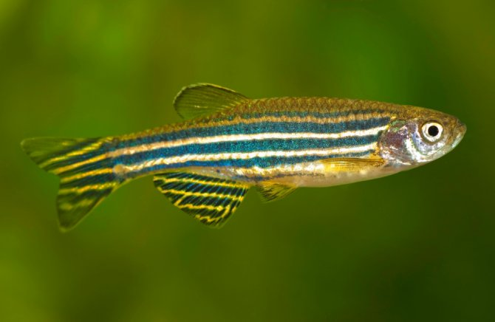
Exercise 2/4
Jalview 2D prediction
Anolis
Xenopus
Taeniopygia
Monodelphis
Danio
Gallus

Slide 40
Exercise 3/4
Jalview 2D prediction
Web service -> Secondary Structure Prediction -> Jnet secondary str pred
No selection (or all sequences selected) = Jnet runs on top sequence using the alignment (fast)
One sequence (or region) selected = Jnet runs on that sequence using homologs (slow)
Some sequences selected = Jnet runs on top one using homologs (slow)
Try with all sequences selected

Slide 41
Exercise 3/4
Jalview 2D prediction
If previous didn’t work you can run directly MR1_fasta.txt on jpred4 like this:
Use the advanced option
Upload a file option
Select type of input = Multiple alignment (use format FASTA)
Tick the skip PDB search option
There is an option to view output in Jalview

Slide 42
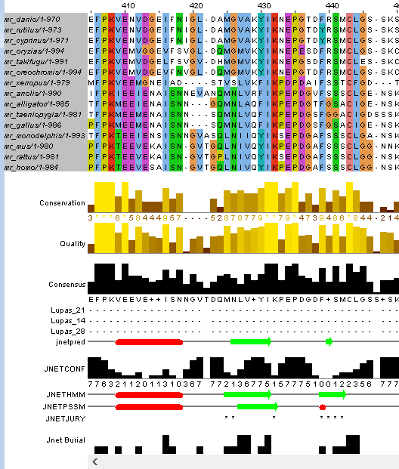
Exercise 3/4
Jalview 2D prediction
Annotations:
JNETHMM, JNETPSSM: predictions using diff profiles
Jnetpred: Consensus prediction.
JNETCONF
Confidence in the prediction.
Beta sheets: green arrows.
Alpha helices: red tubes.

Slide 43
Exercise 3/4
Jalview 2D prediction
Annotations:
Lupas_21, Lupas_14, Lupas_28:
Coiled-coil predictions for the sequence. 21, 14 and 28 are windows used.

Slide 44
Exercise 3/4
Jalview 2D prediction
Annotations:
Janet Burial Solvent accessibility predictions – bars indicate buried with four values:
From 0 = exposed
to 3 = buried

Slide 45
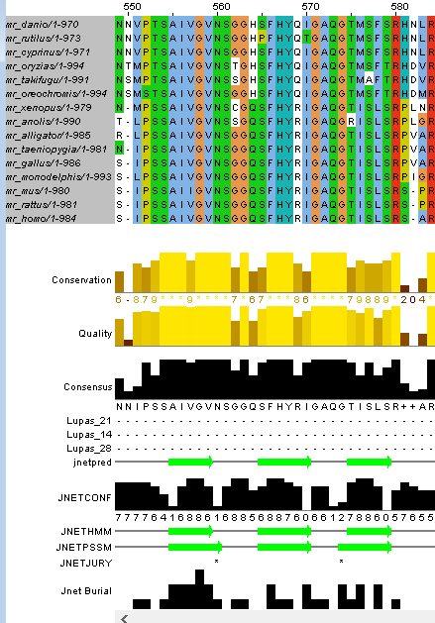
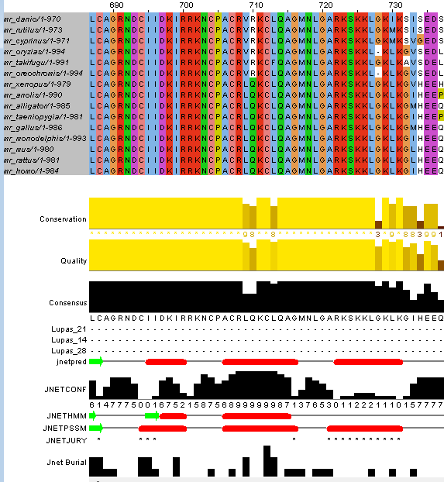
Exercise 3/4
Jalview 2D prediction

Slide 46
Exercise 4/4
2D prediction of known 3D
Obtain the sequence of the human glutamine synthetase.
Run BLAST with the human sequence against: 1) the archaea Methanosarcina
2) the bacteria Escherichia coli
3) the fungi Pseudozyma Antarctica
Get the best homolog, align the sequences (including the human protein, on top) and use the input in Jalview.
Notes:
Human glutamine synthetase is GLUL Gene ID 2752 glutamate ammonia ligase

Slide 47
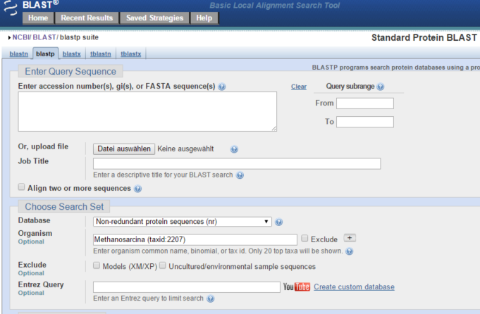

Exercise 4/4
2D prediction of known 3D
NCBI BLAST against single species is faster!

Slide 48
Exercise 4/4
2D prediction of known 3D
Obtain the sequence of the human glutamine synthetase.
Run BLAST with the human sequence against: 1) the archaea Methanosarcina
2) the bacteria Escherichia coli
3) the fungi Pseudozima Antarctica
Get the best homolog from each, align the sequences and use the input in Jalview. Put the human protein on top.

Slide 49
Exercise 4/4
2D prediction of known 3D
Load the alignment in Jalview and run web prediction.
Alternative. Run the alignment in the Jpred4 server. (Hint: You could run the human sequence alone but that will search for homologs and will take very long)
Compare the prediction with the known 3D of the human protein (open it in Chimera, File > Fetch by ID > PDB 2QC8)

Slide 50
Exercise 4/4
2D prediction of known 3D
We need to hide all chains except one.
Select one of the chains (ctrl + click on a residue, then arrow up). Invert selection (press arrow right).
Actions > Ribbon > Hide
Actions > Atoms/bonds > Hide
Select the chain and focus on it
Actions > Focus

Slide 51
Exercise 4/4
2D prediction of known 3D
Compare the output of jpred/jalview 2D pref with the 3D structure of this protein.
For example, locate a predicted helix or beta-strand in Jalview. Find out the start and end positions hovering over the human sequence with the mouse (the numbers on top of the alignment are different from the amino acid positions in each sequence).
Color the corresponding residues it in the 3D view using
Select > Atom specifier
And ranges: e.g. :113-126 (predicted as helix)
Actions > color > red
Apply color some helices red and strands in green.
Do you see differences? Where are they?
Would you say that the 2D prediction was reasonable?
Notes:
129-141 is different (beta vs helix)

