Slide 1

Prediction of protein features. Beyond protein structure
Miguel Andrade
Faculty of Biology,
Johannes Gutenberg University
Institute of Molecular Biology
Mainz, Germany
andrade@uni-mainz.de

Slide 2
N-terminal signals
Transmembrane helices
Solvent accessibility
Coiled coils

Slide 3
N-terminal signals
Transmembrane helices
Solvent accessibility
Coiled coils

Slide 4
N-terminal signals
Signal peptide
3-60 aa long
Direct the transport of a protein
From cytoplasm to: nucleus, nucleolus, mitochondrial matrix, endoplasmic reticulum, chloroplast, apoplast, peroxisome.
Often N-terminal
Nuclear localization signal is internal (K/R)
N-terminal are often cleaved by a peptidase

Slide 5
N-terminal signals
Secretory signal peptide 15-30 aa
Cleaved off after translocation
n-region: positive charge
h-region: hydrophobic region
c-region: polar region
(some conserved residues at pos -3 and -1 of cleavage site)

Slide 6
N-terminal signals
Secretory signal peptide 15-30 aa
Prokaryotes
Transport across plasma membrane
Gram-negative: Periplasmic space (extra mechanism needed for extracellular)
Gram-positive: extracellular
Eukaryotes
Transport across ER membrane. By default to the Golgi then to vesicles and secreted.
(but there are signals for ER retention)
(and there are alternative pathways without signal peptide)
Notes:
Gram negative have cell membrane / periplasm / outer membrane. E. coli. Gram positive. S aureus. Thick peptidoglycan layer takes the staining.

Slide 7
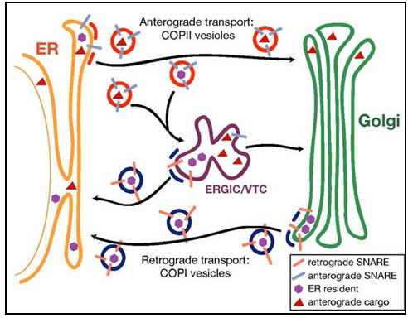
N-terminal signals
VTC: vesicular tubular clusters
(ER-Golgi intermediate compartment)
From Randy Schekman http://mcb.berkeley.edu/labs/schekman/

Slide 8
N-terminal signals
Targeting peptides
Cleaved off after translocation
cTP chloroplast transit peptide
mTP mitochondrial targeting peptide
Some proteins are dually targeted to both chloroplasts and mitochondria using the same targeting sequence

Slide 9
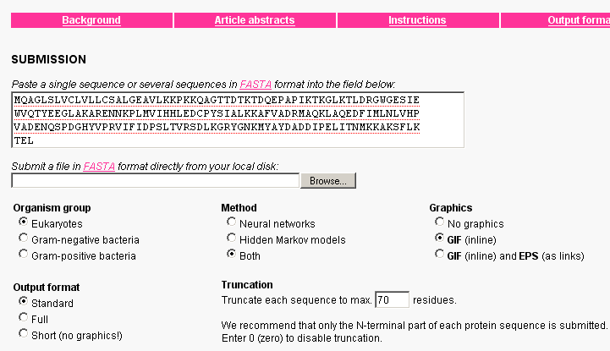
N-terminal signals
Søren Brunak http://www.cbs.dtu.dk/services/SignalP/

Slide 10
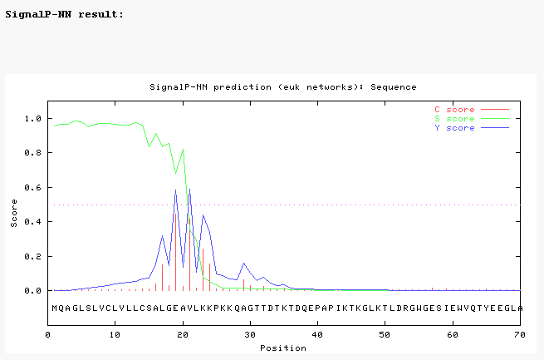
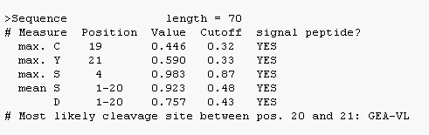
N-terminal signals

Slide 11
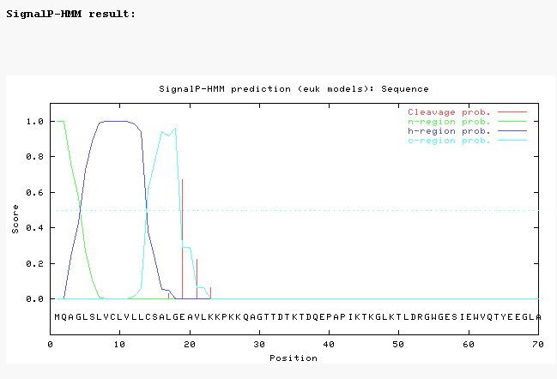
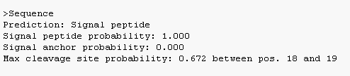
N-terminal signals

Slide 12
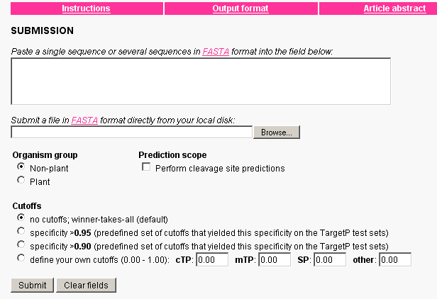
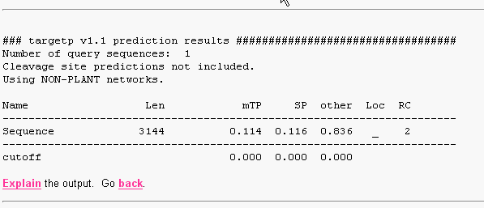
N-terminal signals
Soren Brunak http://www.cbs.dtu.dk/services/TargetP/
Mostly based on signal peptides

Slide 13
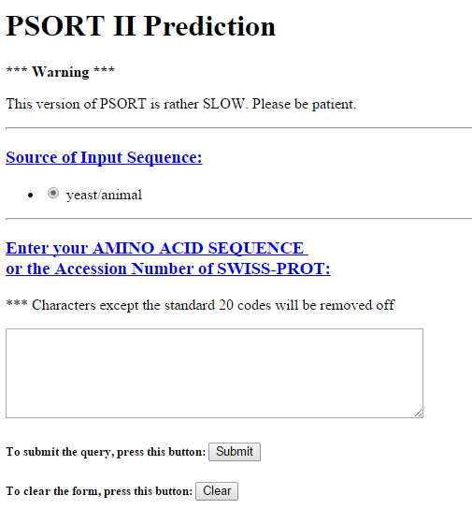
PSORT
Prediction of subcellular location
http://psort.hgc.jp/form2.html

Slide 14
N-terminal signals
Transmembrane helices
Solvent accessibility
Coiled coils

Slide 15
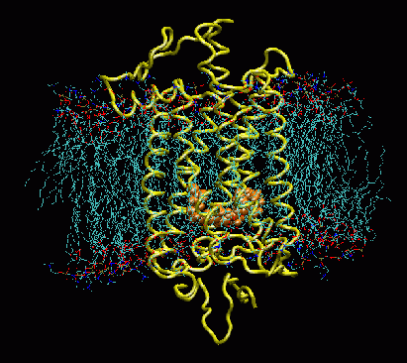
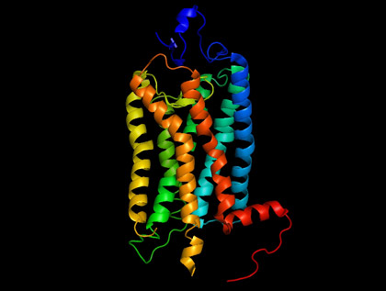
Transmembrane helices
Rhodopsin: sensitive to light
7 TM helices
Left from http://www.ks.uiuc.edu/Research/rhodopsin/
Right from http://ocw.mit.edu/

Slide 16
Transmembrane helices
Hydrophobic helices of approx. 20 residues that traverse the cell membrane perpendicular to its surface

Slide 17
Transmembrane helices
Methods for prediction use:
hydrophobicity analyses
the preponderance of positively charged residues on the cytoplasmic side of the transmembrane segment (positive inside rule)
multiple sequence alignments

Slide 18
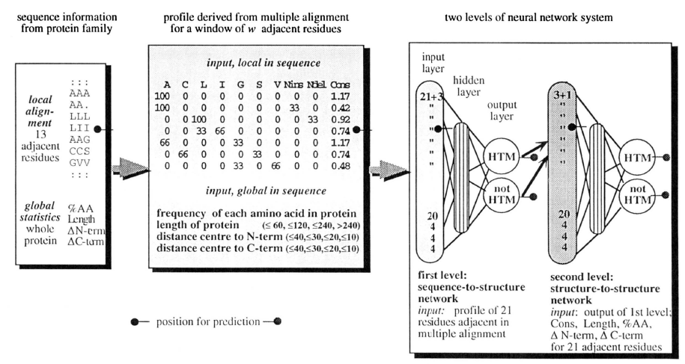
Transmembrane helices
3 hidden units
15 hidden units
Filter to keep helix length in 17-25 range
Rost et al (1995) Protein Science

Slide 19
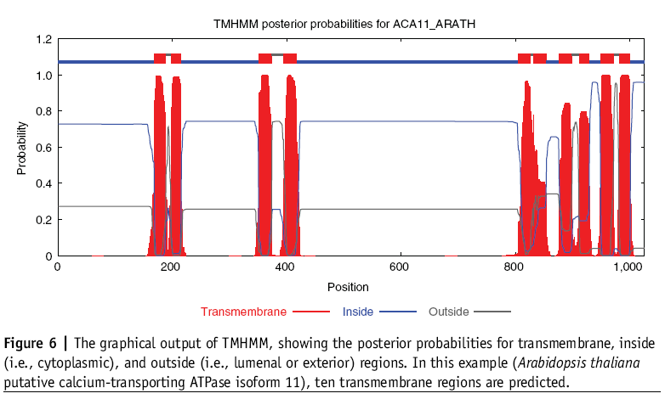
Transmembrane helices
TMHMM
Søren Brunak http://www.cbs.dtu.dk/services/TMHMM/

Slide 20
N-terminal signals
Transmembrane helices
Solvent accessibility
Coiled coils

Slide 21
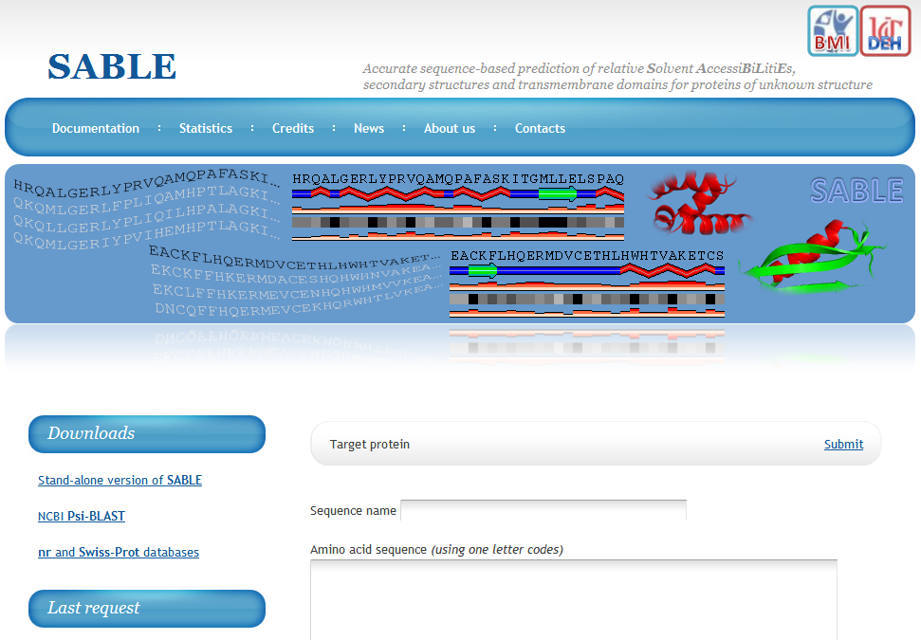
Solvent accessibility
http://sable.cchmc.org
Adaczak et al (2005) Proteins

Slide 22
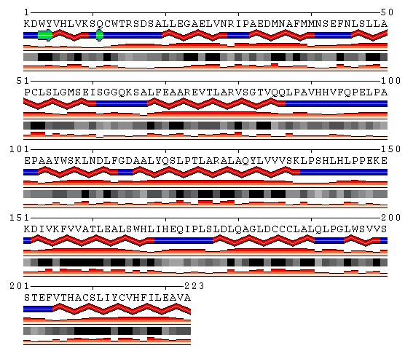
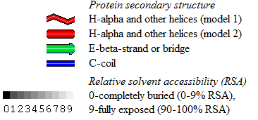
accuracy up to 88.9%
Amphipathic alpha helix
Buried element

Slide 23
N-terminal signals
Transmembrane helices
Solvent accessibility
Coiled coils

Slide 24
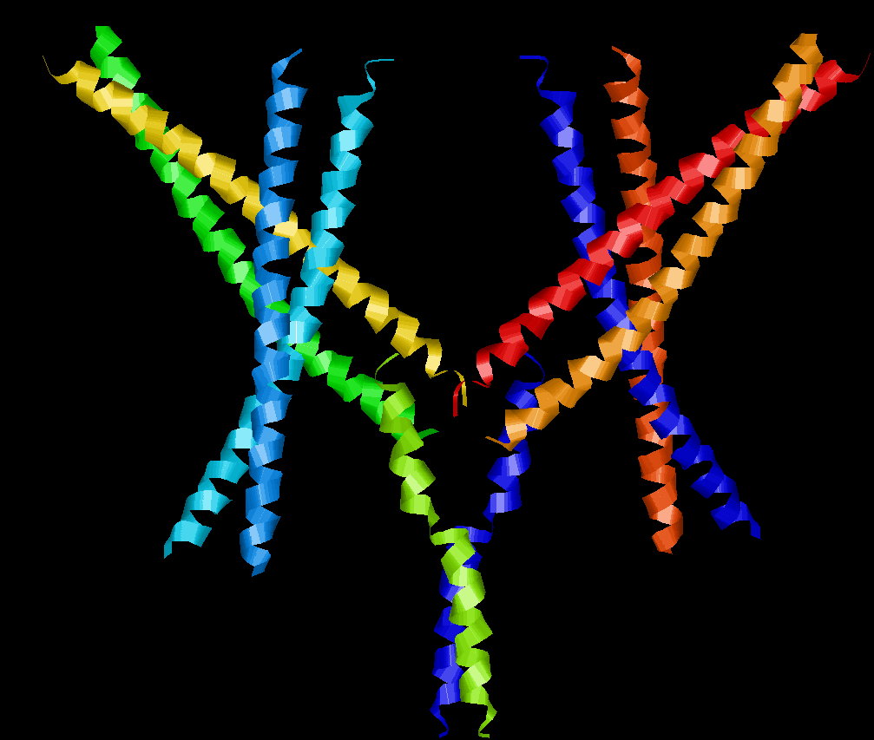
Coiled coils
dimers
trimers
Tropomyosin PDB:2Z5I

Slide 25
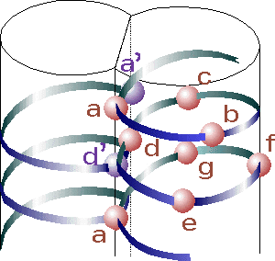
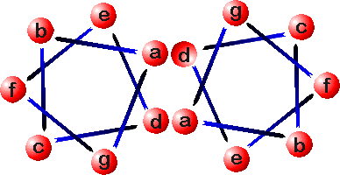
Coiled coils
Heptad repeat:
a – b – c – d – e – f – g
H P P H C P C
H = hydrophobic; P = polar; C = charged
Source: http://cis.poly.edu/~jps/coilcoil.html

Slide 26
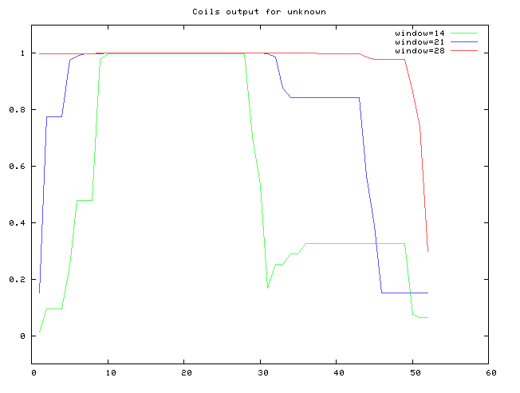
Coiled coils
Andrei Lupas http://www.ch.embnet.org/software/COILS_form.html
Lupas et al (1991) Science

Slide 27
Exercise 1/4
Predict TM alpha-helices with TMHMM
Here you can see the entry in the UniProt database for a short fly protein of unknown function: http://www.uniprot.org/uniprot/Q28WW9
Obtain the sequence of this protein from here:
http://www.uniprot.org/uniprot/Q28WW9.fasta
Run the sequence in TMHMM (http://www.cbs.dtu.dk/services/TMHMM/) and check the output.
How many TM helices are predicted for this protein? What is the predicted orientation of the protein?

Slide 28
Exercise 2/4
Predict secondary structure with Jpred
Let’s predict the secondary structure of the little transmembrane protein using a multiple sequence alignment with homologs.
Load littleMSA_fasta.txt on JalView
Calculate secondary structure prediction using Web Service > Secondary Structure Prediction > Jnet
(Do not select any sequences when doing this so that the alignment is used)
Select the menu Colour and option Clustalx to view the amino acids by property.
Can you see the TM region (hydrophobic residues are coloured blue)?
What type of structure was predicted for that region? There is a C-terminal proline rich region. Is that region predicted to be structured? Is that region conserved?

Slide 29
Exercise 3/4
Sequence conservation on 3D
Load in JalView a multiple sequence alignment of plant ferredoxins ferredoxins2_fasta.txt.
Select FER1_SPIOL. Right click on FER1_SPIOL. Select structure > Associate structure with sequences > discover PDB ids.
Now again, right click on FER1_SPIOL. Select “3D structure data…” > View structure of FER1_SPIOL. This will open a window where you can view its structure (PDB 1A70). The viewer is Jmol. Try rotating the structure.
The sequence is connected to the structure. Mouse over the sequence and see how the corresponding amino acid is highlighted in the 3D view. Click on the 3D view and the amino acid will be highlighted in the alignment.
Apply color (BLOSUM62) in the alignment window. Then in the 3D view option View > color by, then choose the option that uses the alignment.
Hint: If in the structure window you apply colour then you will loose the interactivity. You have to go to the view option and apply Color by… option.

Slide 30
Exercise 4/4
Overlap a 2nd structure
Now do the same with FER1_MAIZE. Say that you want to add it to the view. Use 3B2F. The two 3Ds will be overlapped.
Use view in the 3D view to select and deselect chains to view. View > Select chain > click out 3B2F:B
Are any significant differences between these two structures?
What is the most conserved region of ferredoxin? Is it structured?
In the alignment apply Colour > Zappo. This will colour all residues according to residue type. Find a position in a loop where these two ferredoxins have a different amino acid.
(Hint: you can clear the labels by deselecting a chain to view and selecting it again in the jmol window)
Notes:
E.g. Thr 76 in SPIOL and Glu 80 in MAIZE

