Slide 1


SOAR: Synthesis for Open-Source API Refactoring
Aidan Z.H. Yang

Slide 2
Motivation
As software evolves, the API calls it depends on may become obsolete [1].
No existing work that takes an enumerative program synthesis approach towards API refactoring.
Existing work learns and recommends potential API mappings [1,2], or migrates APIs based on a large dataset of existing migrations [3].
[1] Perkins, Jeff H. "Automatically generating refactorings to support API evolution." Proceedings of the 6th ACM SIGPLAN-SIGSOFT workshop on Program analysis for software tools and engineering. 2005.
[2] Bui, Nghi. "Towards zero knowledge learning for cross language API mappings." 2019 IEEE/ACM 41st International Conference on Software Engineering: Companion Proceedings (ICSE-Companion). IEEE, 2019.
[3] Bui, Nghi DQ, Yijun Yu, and Lingxiao Jiang. "SAR: learning cross-language API mappings with little knowledge." Proceedings of the 2019 27th ACM Joint Meeting on European Software Engineering Conference and Symposium on the Foundations of Software Engineering. 2019.
[4] Phan, Hung Dang, et al. "Statistical migration of API usages." 2017 IEEE/ACM 39th International Conference on Software Engineering Companion (ICSE-C). IEEE, 2017.

Slide 3
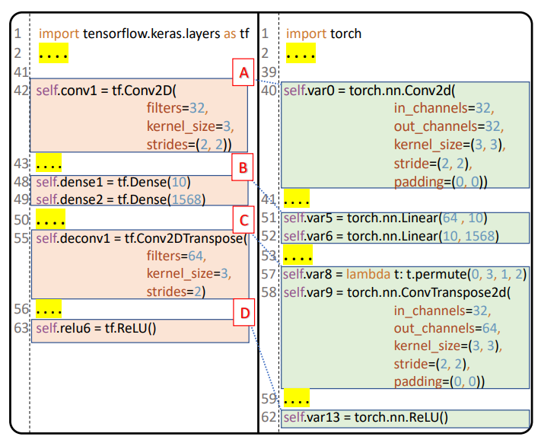
Motivation
A: tf.Conv2d parameter filters has no corresponding name parameter.
B: tf.Dense has no torch function of the same name.
C: Two functions from torch are required to perform the same task as tf.Conv2DTranspose.

Slide 4
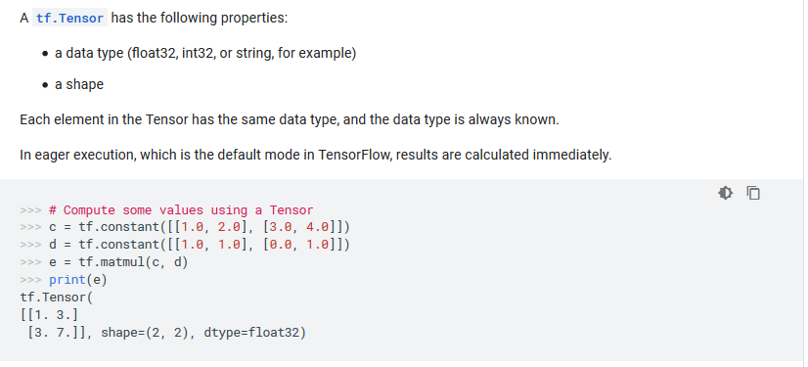
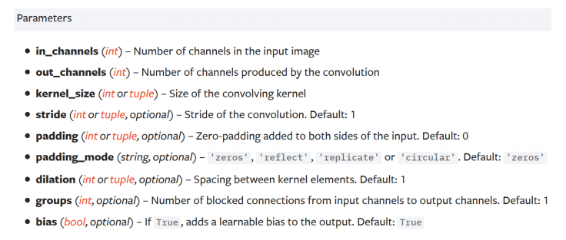
Key Insights
Documentation on data science APIs have description on parameters, as well as call examples.

Slide 5
Key Insights
Error messages contain information on the input matrix.
Trying to create tensor with negative dimension -2: [40, -2, 3, 3].
embedding(): argument weight (position 1) must be Tensor, not int.
Expected 3-dimensional input for 3- dimensional weight [2, 2, 3], but got 4- dimensional input of size [100, 50, 40, 1] instead.

Slide 6
General Framework
Program
API1(args)
…
APIm(args)
API Matching Model
Input:
A program written with source API.
Documentation of APIs.
Some test cases for the original program.
Output:
Program with the same functionality written with the target library.
API1
…
APIm
Program Synthesis Model
Testcases
API1(args)
API2(args)
…
APIn(args)
SMT Constraints
Python Interpreter
Error Message Understanding Model
Pass all tests?
No
Error Message
Yes
Migrated Program

Slide 7
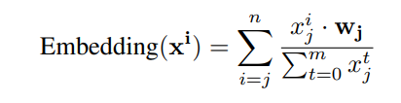

API Matching
Output:
A probability distribution over all target APIs
-> Top 10 most similar APIs by cosine-similarity.
Model:
API representation learning, represent each API in a continuous vector space.
Learned with the API documentation (page title, code example etc…) and GloVe pre-trained NLP data.
API(args)
API Matching Model
0.1
0.6
0.1
…
0.2
API
API
API
…
API

Slide 8
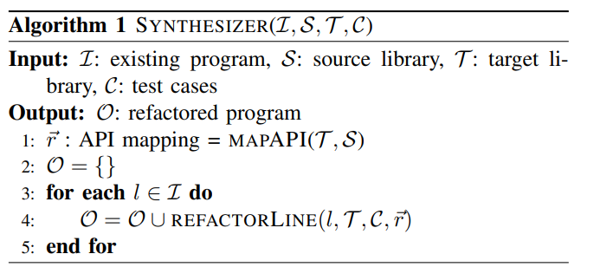
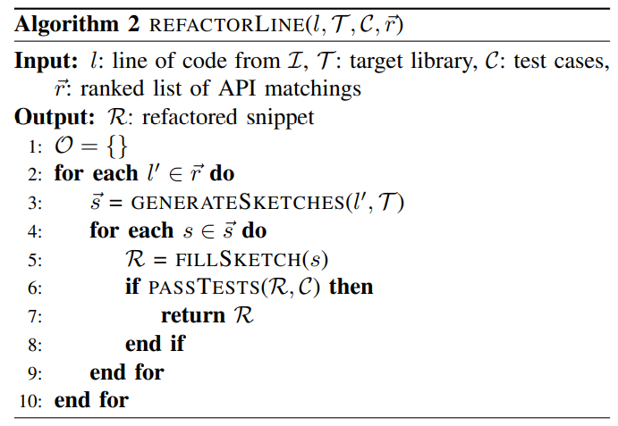
Program Synthesis
Program Sketching:
Sketch a new program with holes based on the original program template.
Program Enumeration
Enumerate through all likely target calls with all likely parameters.

Slide 9


Pruning the Search Space
Synthesizer before and after the SMT constraints
Specification inferred from documentation.
Constraints from Error messages.

Slide 10
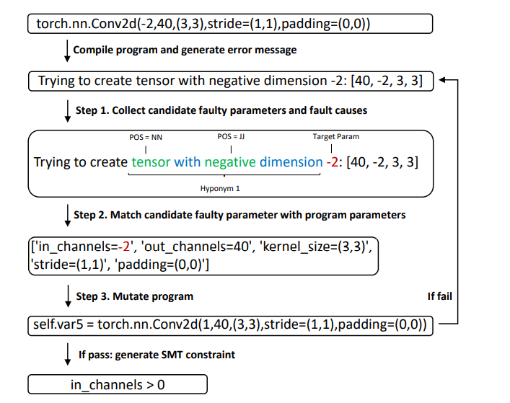
Error Message Understanding
Generate SMT constraints from run-time errors.

Slide 11
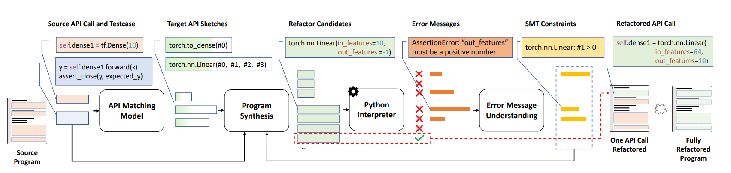
Example Pipeline

Slide 12
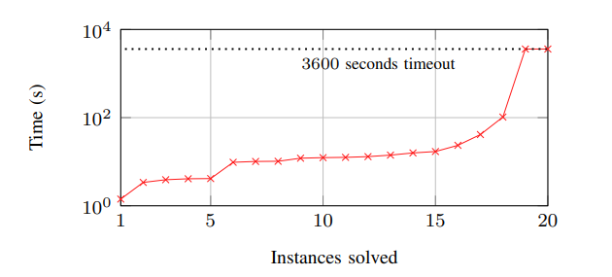



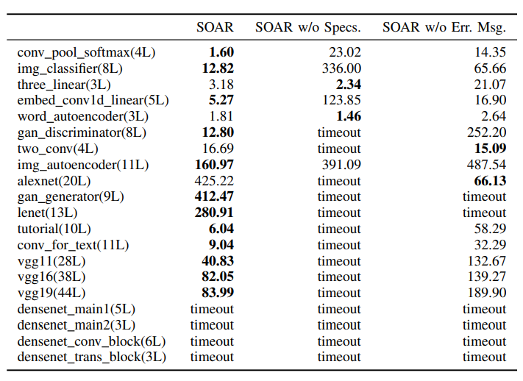
Results
Collected the top 1015 starred repositories that have TensorFlow as a topic tag.
Over 8 million lines of code and over 500K TensorFlow API calls.
76% of the repositories use API calls included in our benchmarks at least once.

Slide 13
Conclusion
SOAR is the first to use NLP and synthesis for automatic API refactoring.
SOAR requires no existing migration as training data.
SOAR can successfully migrate 80% of neural network programs composed by 3 to 44 layers in with an average time of 97.23 seconds.
For Dplyr to Pandas migration, 90% of benchmarks are solved on average in 17.31 seconds.
With ablation studies, we show that the use of specifications from API documents and learning from error messages can improve synthesis performance.

Slide 14

Hire Me ☺
I am applying for PhD positions for Fall 2021!
a.yang@queensu.ca
https://aidanby.github.io/
@AidanYang5

