Slide 1



An Empirical Study on Release Notes Patterns of Popular Apps in the Google Play Store
Aidan Yang · Safwat Hassan · Ying Zou · Ahmed E. Hassan
Notes:
say it was published in emse, give full citation
also talk about my affiliation
impress people

Slide 2
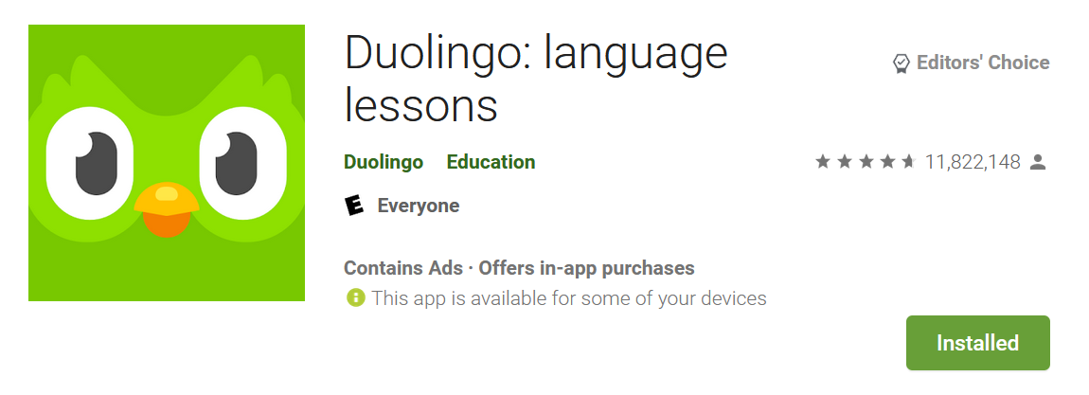
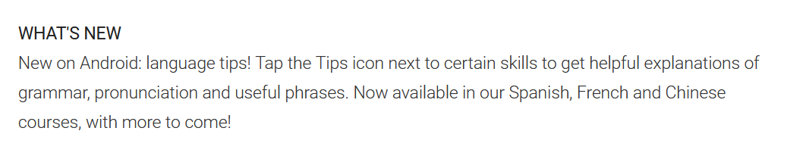

Release Notes are Imperfect
“Setting up fingerprint login should have been announced in the release notes not hidden in the options!"
User
Notes:
release notes describe new features
a popular app i really like is duolingo
a pittsburgh native company
release notes are useful for both developers and users but are imperfect
they are all quotes, change background
put user reviews above
list out reasons why release notes are not good based on example

Slide 3
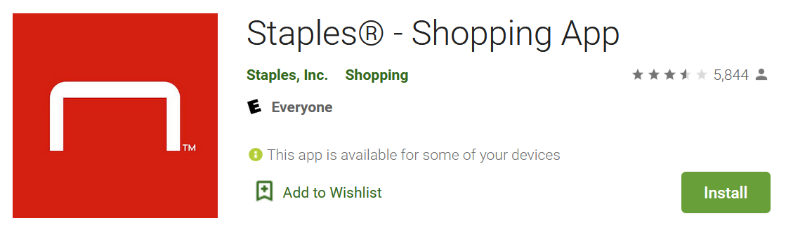

User – Developer Dialogue
Your app has fallen back into a nearly terrible category. Rewards section rarely works, and can never fetch order statuses … Best buy’s app is leaps and bounds better
User
Release Note
We made some tweaks for this release that address the following issues: Redesigned account page so you can check your rewards more easily
Hi we have made some recent updates to the app. Thank you for reaching out. If you update your app version the performance should be improved
App
Notes:
read these out
animate in the dialogue
we are not sure

Slide 4
Do Developers Care about Release Notes?

Slide 5
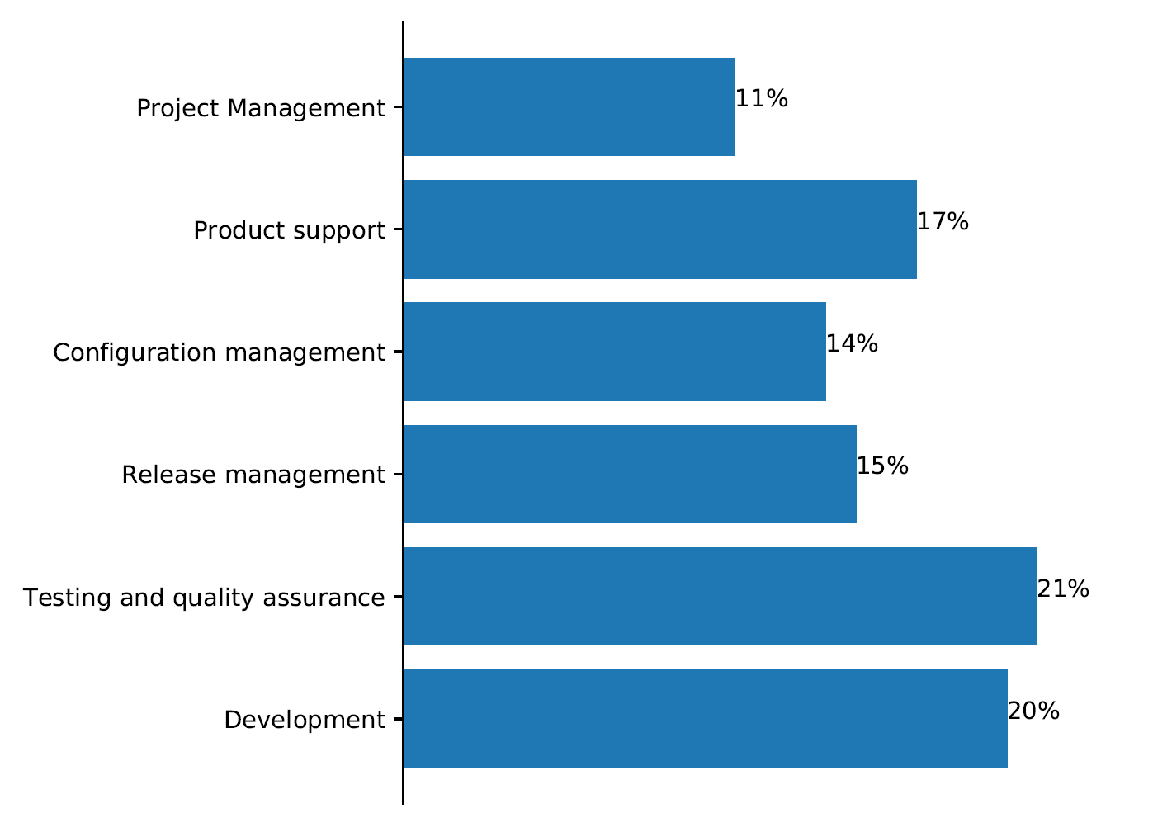
We 102 Developers
The distribution of the job roles of the surveyed developers.
Notes:
how did i select them and what did I ask them.
slide between 3 and 4 for motivating why i did survey: do devs care about release notes. tell a story.

Slide 6
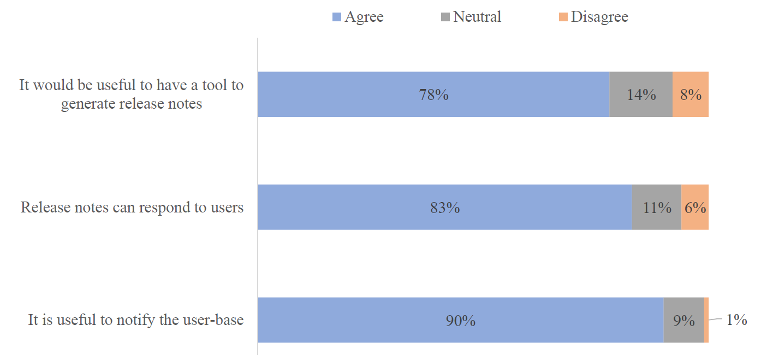
We Surveyed 102 Developers
67% of the surveyed developers frequently update their release notes
Are release notes useful?
Notes:
put the question instead of the developers answers for uptop.
make texts bigger

Slide 7
We collected data of the studied 2,232 apps over the period of three years (April 2016 - April 2019) 70 thousand releases 67 million user reviews 2.9 million developer responses to users.
Data Collection
Notes:
another slide on why i do data collection. emphasize the 3 year thing. I should release dataset.

Slide 8
Research Questions
RQ1: What are the release notes update patterns?
RQ2: What are the characteristics of the apps that follow a certain release notes pattern?
RQ3: What causes developers to shift their release notes pattern?
Notes:
rephrase the rqs without data collection details. have higher level goal. describe update pattern.

Slide 9
Research Questions
RQ1: What are the release notes update patterns?
RQ2: What are the characteristics of the apps that follow a certain release notes pattern?
RQ3: What causes developers to shift their release notes pattern?
Notes:
rq2 do

Slide 10
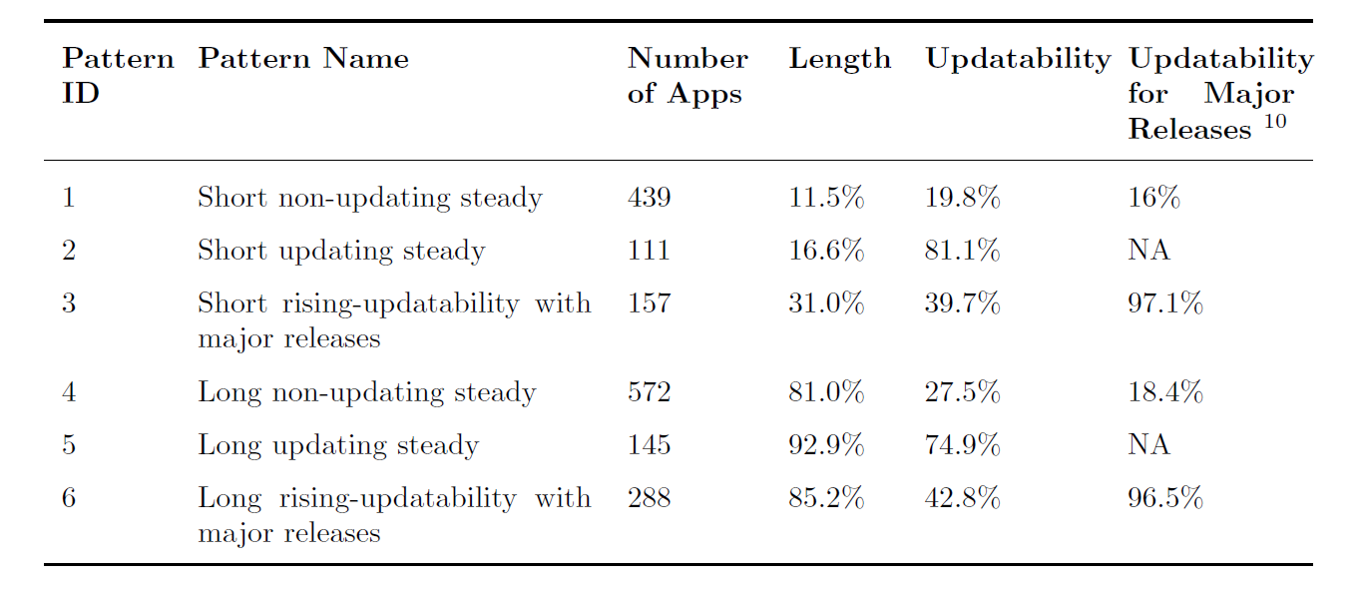
We Observe 6 Release Note Patterns
Example release notes:
GUI enhancements and minor fixes
Fix a bug of the grouping separator. Improved calculation precision
Notes:
rising vs steady, talk about the axis.
introduce the terminology better. another slide for
make graphs to help with pattern names
place them into different columns.

Slide 11
Research Questions
RQ1: What are the release notes update patterns?
RQ2: What are the characteristics of the apps that follow a certain release notes pattern?
RQ3: What causes developers to shift their release notes pattern?

Slide 12
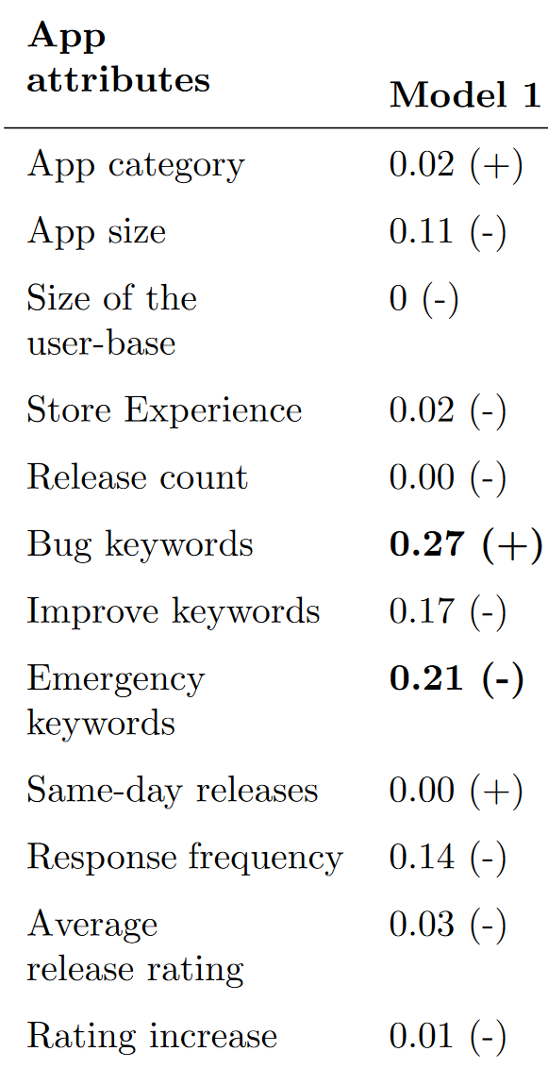
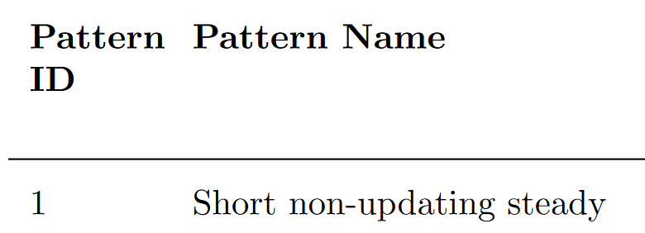
RQ2 Approach: Regression Models
We build 6 logistic regression models on each of the 6 patterns to observe if certain app attributes are correlated with release note patterns.
Significant

Slide 13
Models Results
Apps in patterns 2 and 5 with updating release notes tend to have a lower number of releases.
Apps in pattern 6 that have long, rising-updatability release notes tend to have a higher user response rate than other apps.
Apps in pattern 5 that have long and updating release notes have higher perceived quality releases compared to other apps.

Slide 14
Research Questions
RQ1: What are the release notes update patterns?
RQ2: What are the characteristics of the apps that follow a certain release notes pattern?
RQ3: What causes developers to shift their release notes pattern?
Notes:
what is correlated with a shift in release notes. we wanted to formalize and learn about the apps.
we took a natural science approach to see if release patterns change at all. we observe they follow different patterns and have characteristics.

Slide 15
RQ3 Approach
For all the studied apps, we treat each of the clustering metrics (e.g., length and updatability) as a time series
We use the mean and variance of each time series to determine stationarity.
Notes:
why is this important, do a motivation on all 3 of these.
show a graphical representation of the time series.
we use the mean and variance of the windows.
we study how much things change based on time series analysis

Slide 16
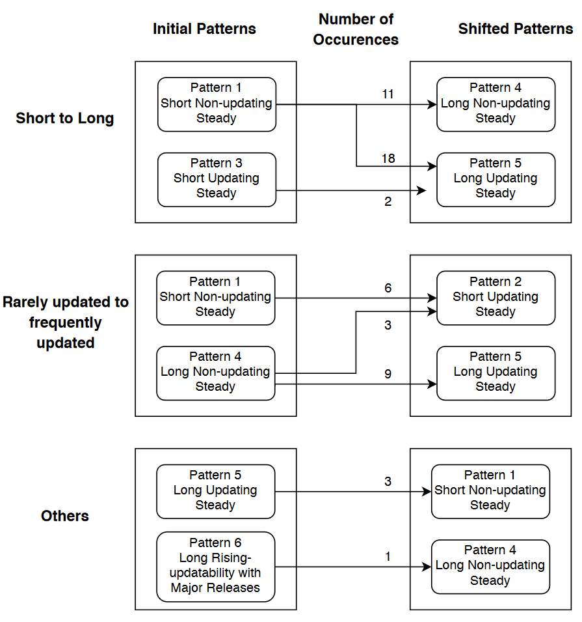
Summary of Shifts
92% of the studied apps shift either from short to long release notes or from rarely updated to frequently updated release notes.
Developers shift their release notes patterns to provide detailed guidance to their users and spot the importance of the new release.
Notes:
thickness of the arrow
skip a lot of this slide

Slide 17
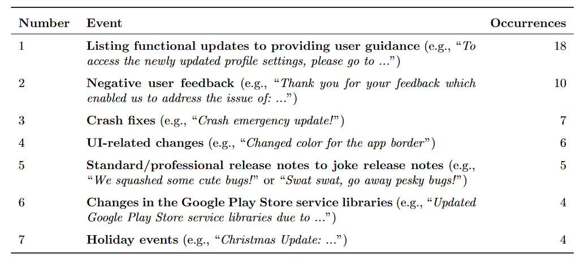
Reasons for Shifts
Of the apps that shift from pattern 1 (short non-updating) to pattern 5 (long updating), 94% show a higher average rating after the shift.
Notes:
go into this point more
tables are very small make bigger for all figures
bolding more texts

Slide 18
Contributions
We identify six patterns of release notes.
Apps with long and updating release notes have high perceived quality releases, an increase in user ratings, and informative release notes.
Our work shows potential directions for developers to improve the release notes mechanisms in app stores.
Notes:
make more clear imperfect release notes. there is something interesting with release notes. no-one has done this before dig into it.
it seems there are correlations with updated

