Slide 1



An Empirical Study on Release Notes Patterns of Popular Apps in the Google Play Store
Aidan Yang · Safwat Hassan · Ying Zou · Ahmed E. Hassan
Notes:
Hello everyone, and welcome to my ICSE journal first talk.
This paper is titled An Empirical Study on Release Notes Patterns of Popular Apps in the Google Play Store, and it is published under EMSE in 2022.
My name is Aidan Yang, and I am a phd student at Carnegie mellon university, where my research is focused on software engineering and machine learning.
The main motivation behind this paper is that developers on app stores write a release note at every update of their app, and prior to this work, no one has done an empirical, longitudinal study on release notes.

Slide 2
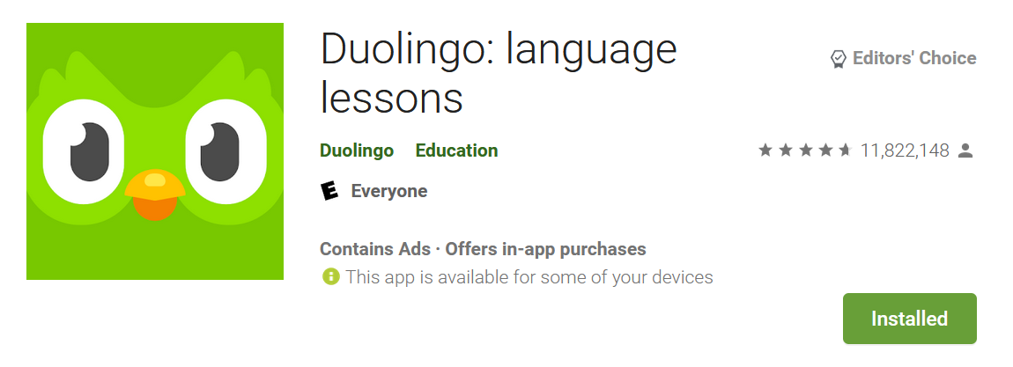
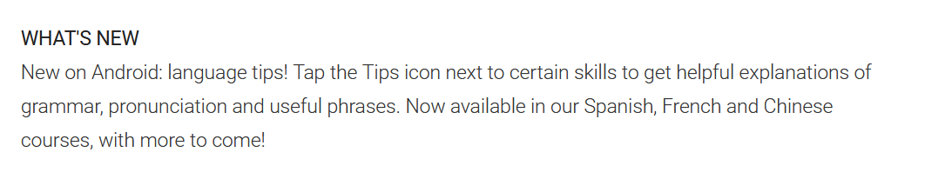

Release Notes are Imperfect
“Setting up fingerprint login should have been announced in the release notes not hidden in the options!"
User
Notes:
release notes describe new features and fixes in an app’s update.
Here is an example of a release note, from a popular app that i really like: duolingo, a pittsburgh native company.
In their release note, duolingo developers describe their new language tip icon. On first glance, this seems like a descriptive, and well written release note.
But what we don’t know is: is this release note updated from the last one? Or does this release note adequately describe the most current release?
We can see from a corresponding user review to this release that the release note does not provide all the details of the app update. One thing they missed is the finger print login set up.
From this example, we see that release notes are imperfect, and users sometimes complain about them. But now we want to ask, do developers care about release note complaints?

Slide 3
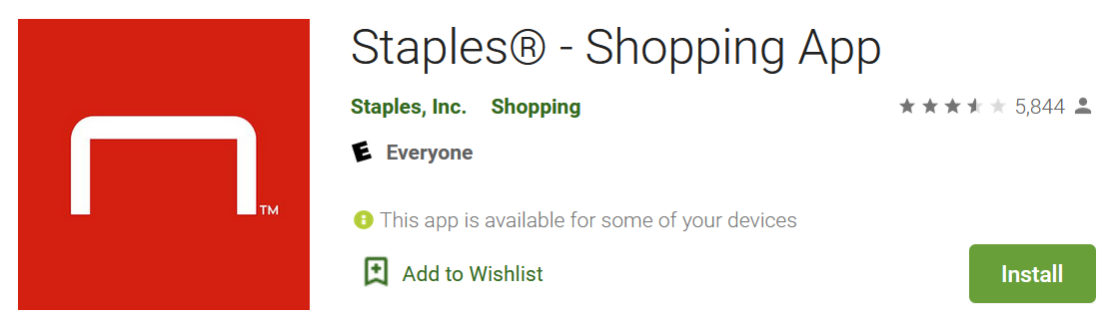

User – Developer Dialogue
Your app has fallen back into a nearly terrible category. Rewards section rarely works, and can never fetch order statuses … Best buy’s app is leaps and bounds better
User
Release Note
We made some tweaks for this release that address the following issues: Redesigned account page so you can check your rewards more easily
Hi we have made some recent updates to the app. Thank you for reaching out. If you update your app version the performance should be improved
App
Notes:
As I dig around to answer my previous question, I come across a case where developers actually use a release note to directly address user concerns.
An app that I use is the staples shopping app, which has recently been seeing a decline in user ratings. I was curious to see why that was the case.
So I found a negative user review for a release.
I observed that the very next staples release note talks about the complaint, and another developer response to the user shortly after, asking them to update the app.
So in this example, I see that developers are using release notes as more than just an update placeholder.
At this point, I can see that both users and developers care about release notes, but these are specific examples.

Slide 4
Do Developers Care about Release Notes?
We survey 102 developers from various sites:
reddit.com/r/androiddev
reddit.com/r/appdev
https://f-droid.org/en/
Notes:
Now I want to ask if developers really care about release notes. We sent out survey invitations on multiple discuss platforms for app developers, and asked them questions about how they write release notes.

Slide 5
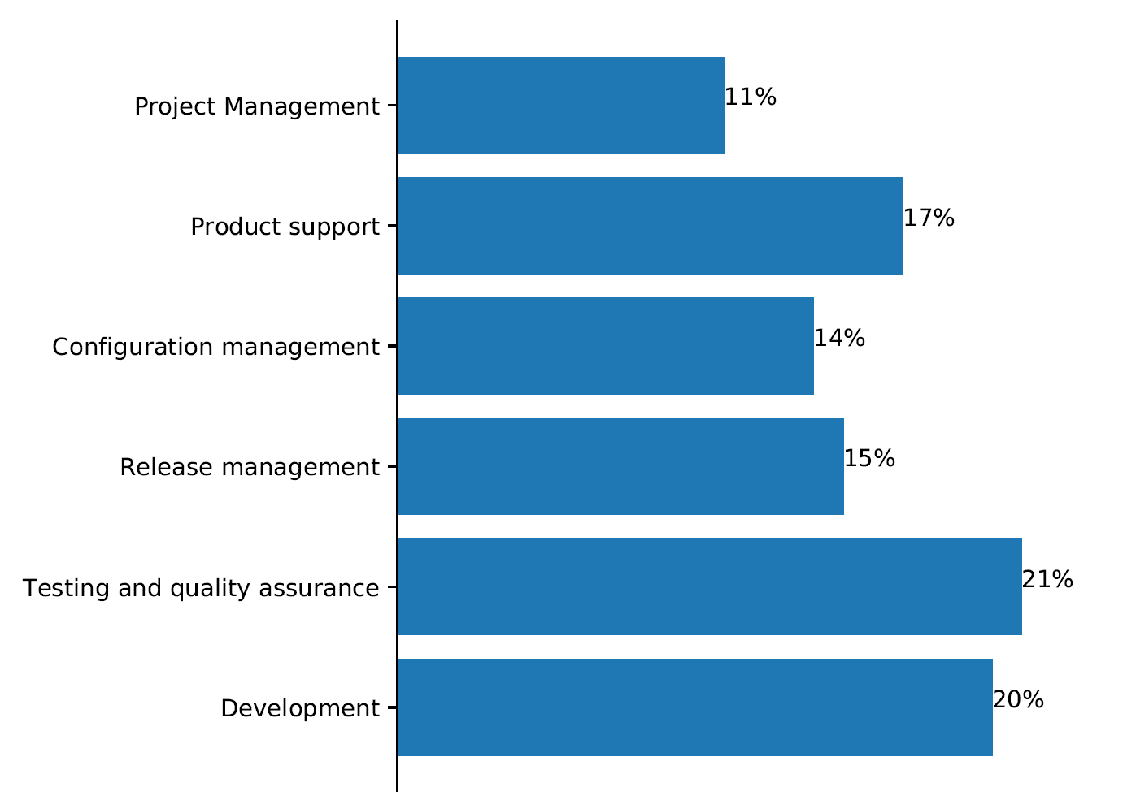
Background of Surveyed Developers
The distribution of the job roles of the surveyed developers.
Notes:
We first want to see some of the background of the surveyed developers. We find a variety of specific roles they perform within their organization, such as project management, testing and QA, or configuration management. We see that release notes are written by all types of devs in a team. Specifically, we find 15% of the surveyed developers say they work mostly on release management, and keeping release notes up to date is an important aspect of their job. So we know that at least 15% of our surveyed developers care about release notes writing. But what about the rest?

Slide 6
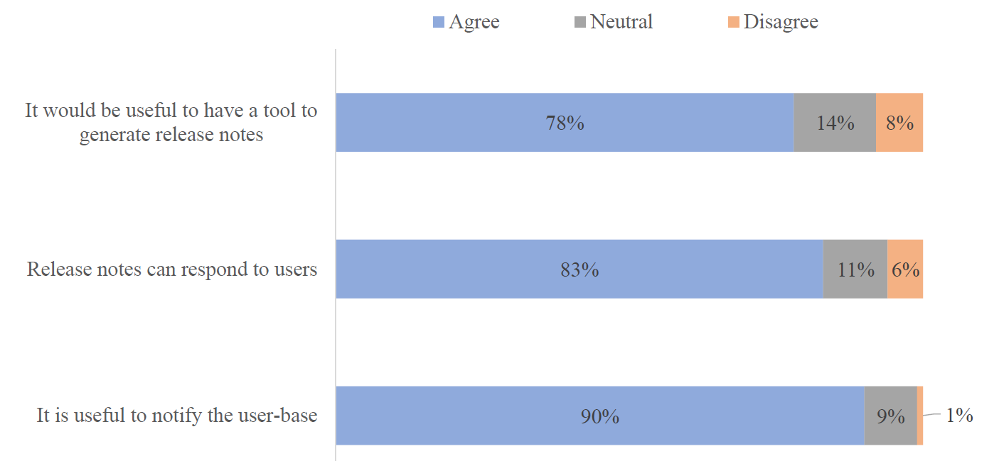
Are release notes important to you? How so?
67% of the survey developers frequently update their release notes
Notes:
When asked about if they update release notes, 67% of the surveyed developers say they try to update them at every release.
78% of them would like a tool to help them generate release notes. 83% of the developers also think that release notes can directly respond to users, and
90% of the developers say that they are important for notifying the userbase about recent updates to their app. Only 1% think that release notes are not useful for
updating the user-base.

Slide 7
Quantitative Study
We want to see if the release notes from popular apps on the Google Play Store reinforce our survey results
If we can find patterns from these release notes, can we use these patterns to learn more about their app behaviors?
Notes:
Now that we have some survey results, we want to see if data from the top 2000 apps on the google play store support the surveyed developers’ responses. We also want to use the data available from existing apps to see if we can identify patterns from release notes. If there are patterns, maybe we can use these patterns to identify app behaviors correlated to those patterns.

Slide 8
We collected data of the studied 2,232 apps over the period of three years (April 2016 - April 2019)
Data Collection
70 thousand releases 67 million user reviews 2.9 million developer responses to users.
Notes:
To collect data, we use release notes, user reviews, and developer responses to those user reviews on the top 2232 apps the google play store. By the end of our 3 year data collection process, we have 70 thousand release notes, 67 million user reviews, and 2.9 million developer responses.

Slide 9
Research Questions
RQ1: What are the release notes update patterns?
RQ2: What are the characteristics of the apps that follow a certain release notes pattern?
RQ3: Do developers ever change their release notes pattern?
Notes:
From our collected data, we ask 3 research questions.
The first question is, we want to know if apps write release notes under certain patterns. As a start to the possible types of patterns, we look at how often release notes are updated, and how much content they contain.
We then ask if apps that follow certain patterns show certain app characteristics, such as size of the app, frequency of updates, or user reviews.
Finally, assuming we can identify patterns, and those patterns do correlate with app characteristics, we aim to figure out if apps ever change their release note patterns and if that change is correlated with any app characteristics changes too.

Slide 10
Research Questions
RQ1: What are the release notes update patterns?
RQ2: What are the characteristics of the apps that follow a certain release notes pattern?
RQ3: Do developers ever change their release notes pattern?
Notes:
To answer Rq1, we first measure the updatability of every release note, which we compare its cosine similarity distance to all prior release notes. We then measure how much content the release note contains by the string length.

Slide 11
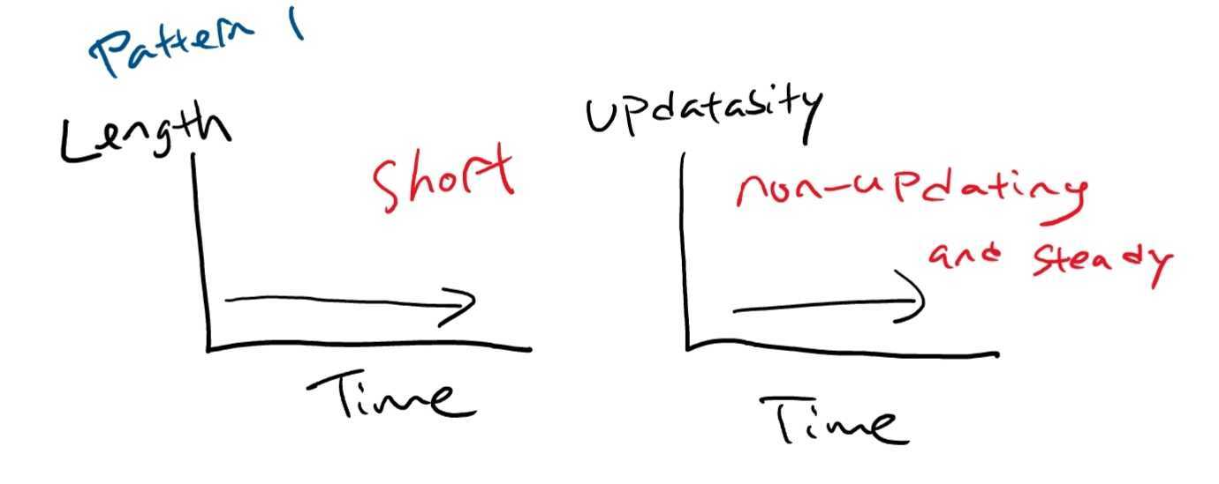
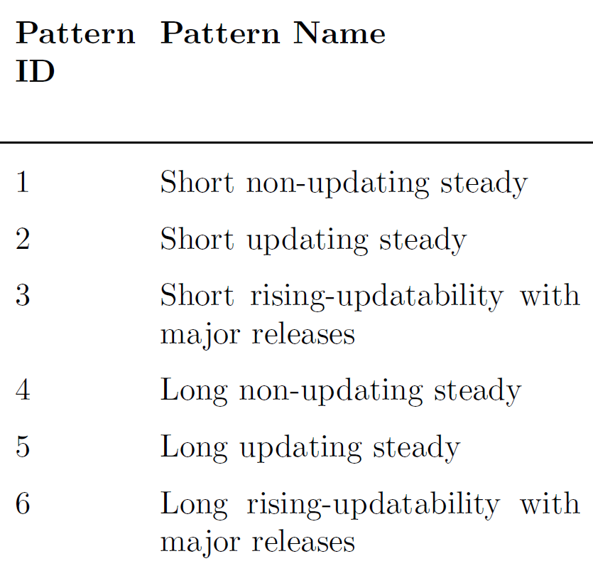
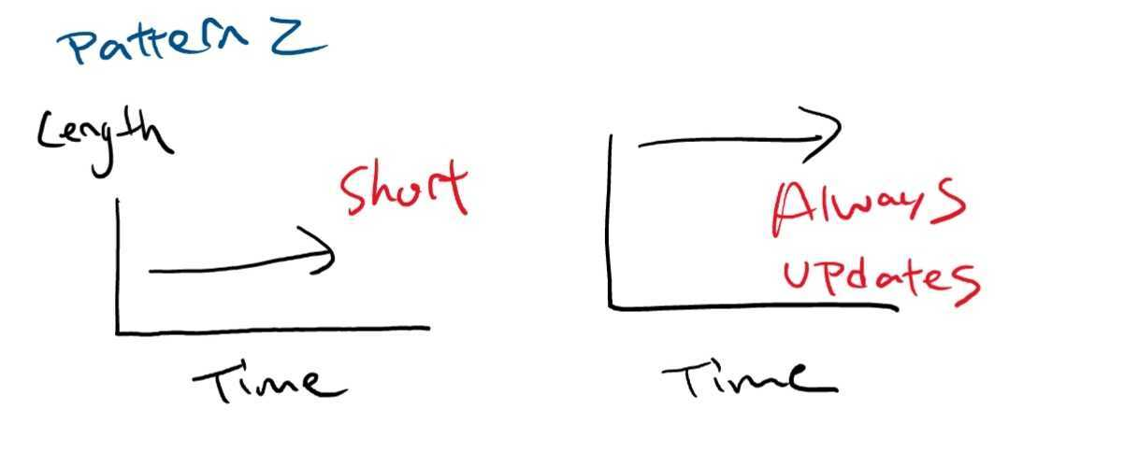
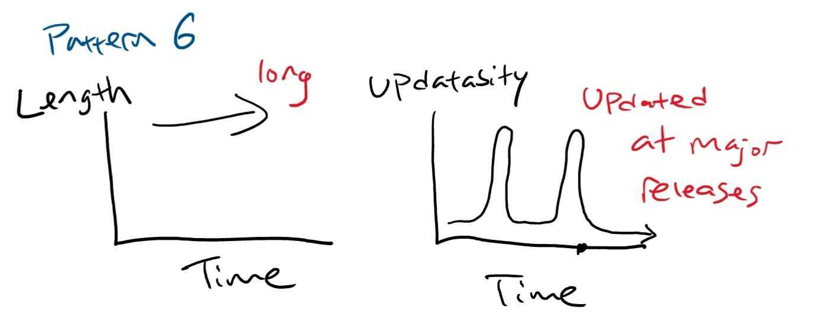
We Observe 6 Release Note Patterns
Notes:
We find 6 different release note patterns based on the release note features, which we use the string length of release note, and cosine similarity of each release note to its previous version, which we call updatability.
For example, pattern 1, short non-updating steady, has short and always low updating release notes. These types of release notes will always say something like “bug fixes”, or “minor improvements”. Of our dataset, we find that 439 of the apps exhibit these kinds of release notes.
Pattern 2 is short updating and steady. That means that release notes are short but always update at each release. We find only 111 apps that writes these kinds of release notes.
We also find another type of pattern, where apps don’t change their release notes, until a major release. We sometimes see apps that have much more descriptive release notes when the app undergoes a big change. For example, pattern 6, long rising-updatability with major releases. Of this type, we find 288 apps within our dataset.

Slide 12
Research Questions
RQ1: What are the release notes update patterns?
RQ2: What are the characteristics of the apps that follow a certain release notes pattern?
RQ3: Do developers ever change their release notes pattern?
Notes:
Now we want to know if these release note patterns have anything to do with how other app characteristics. Think back to the staples app example, I wonder if it is just that one user who really didn’t like the staples release notes, giving a negative review. Or, maybe the way release notes are written actually have correlation with other app qualities as a general trend on the google play store.
To answer that question, we use statistical and machine learning tools to find characteristics of apps that correlate with any of our identified release note patterns.

Slide 13
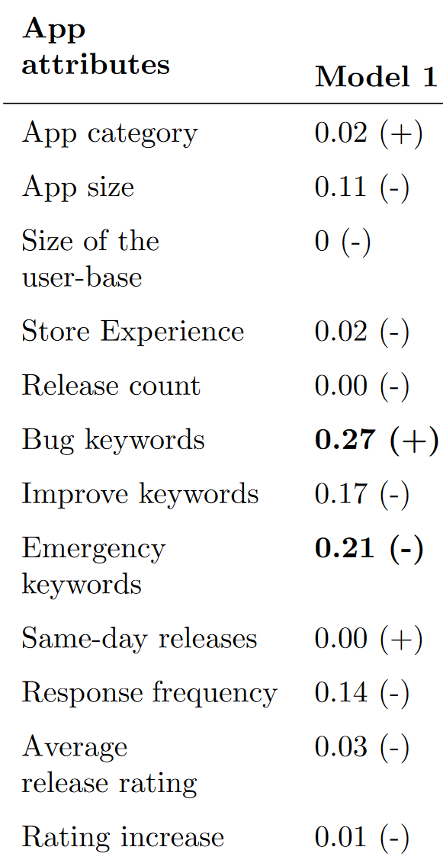
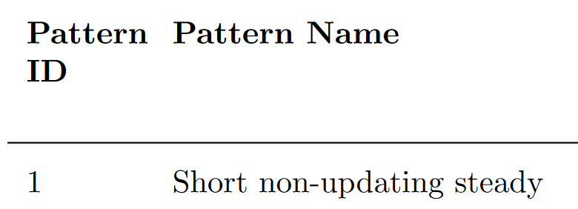
RQ2 Approach: Regression Models
We build 6 logistic regression models on each of the 6 patterns to observe if certain app attributes are correlated with release note patterns.
Significant
Notes:
We build 6 logistic regression models on each of the 6 patterns to observe if certain app attributes are correlated with release note patterns. For example, we find that apps that write short and non-updating release notes often include a lot of bug keywords, and very rarely use emergency keywords.

Slide 14
Models Results
Apps in patterns 2 and 5 with updating release notes tend to have a lower number of releases.
Apps in pattern 6 that have long, rising-updatability release notes tend to have a higher user response rate than other apps.
Apps in pattern 5 that have long and updating release notes have higher perceived quality releases compared to other apps.
Notes:
After building 6 models on the 6 identified patterns, we find some interesting results for each pattern.

Slide 15
Research Questions
RQ1: What are the release notes update patterns?
RQ2: What are the characteristics of the apps that follow a certain release notes pattern?
RQ3: Do developers ever change their release notes pattern?
Notes:
what is correlated with a shift in release notes. we wanted to formalize and learn about the apps.
we took a natural science approach to see if release patterns change at all. we observe they follow different patterns and have characteristics.

Slide 16
RQ3 Approach
For all the studied apps, we treat each of the clustering metrics (e.g., length and updatability) as a time series
We use stationarity as a measure for each app. If an app exhibits a significant change in its clustering metric, we call it non-stationarity
Notes:
we study how much a release note pattern changes based on time series analysis

Slide 17
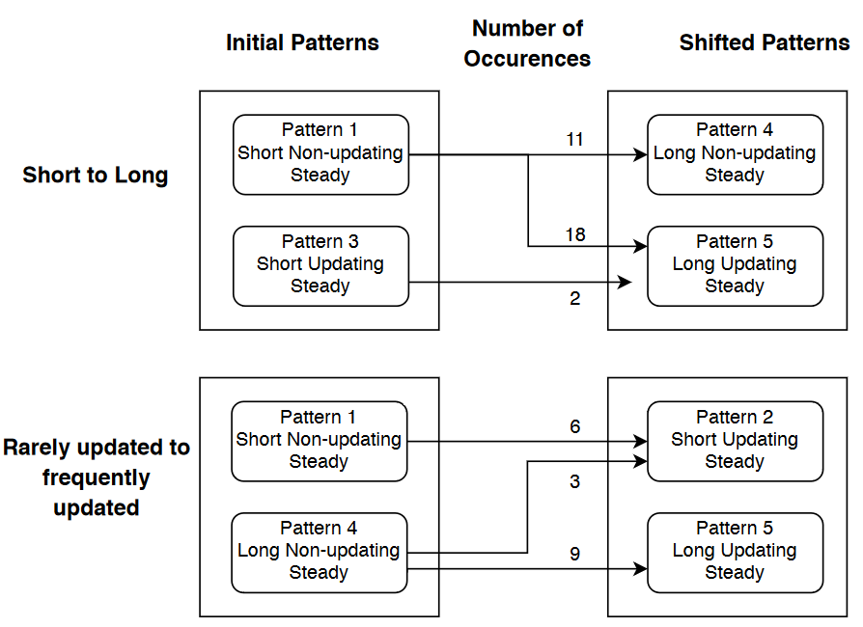
Summary of Shifts
92% of the shifts are either from short to long release notes or from rarely updated to frequently updated release notes.
Notes:
We observe that 92% of the identified shifts are either from short to long or non-updating to updating release notes. As you can see from the figure on the right, 16 of the 54 shifting apps go from using short non-updating release notes to long and updating release notes.

Slide 18
Reasons for Shifts
We manually analyze the release notes of the 54 apps that shift patterns.
We found 7 reasons for why these apps shifted
Provide guides for new features
Negative user feedback
Crash fix
Big UI-changes
Google Play Store service changes
Tone change (e.g., “squashed some pesky bugs!!”)
Holiday events
Of one particular shift, pattern 1 (short non-updating) to pattern 5 (long updating),
94% show a higher average rating after the shift.
Notes:
For all the 54 apps that show a pattern shift, we read the release notes before and after its shift to see why the release notes are different.
We saw that some shifts are because of apps need to teach users how to use a new feature
Address a particularly negative user feedback, talk about a big fixes or UI changes that might confuse users.
Sometimes they change patterns because google play store has a service update so they have to mention it in subsequent release notes.
And the last two are fun! Sometimes devs just include a fun holiday release note or make jokes about the new updates.
One important finding we saw was that in one particular shift, pattern 1 to pattern 5, which goes from short and never updating release notes to long and updating release notes show a 94% higher average rating AFTER the shift. So developers writing descriptive and updating release notes does see a correlation with users enjoying the app more!

Slide 19
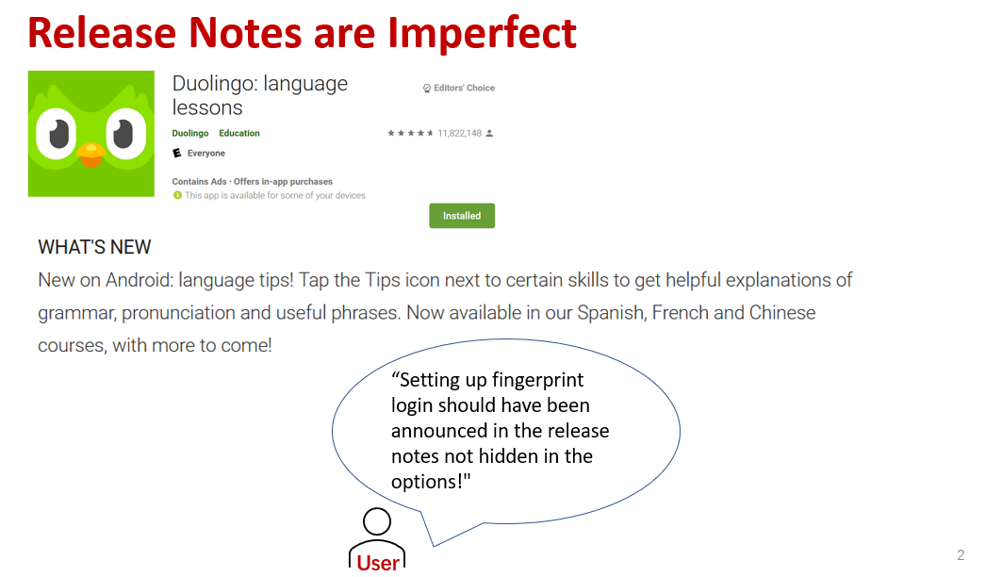
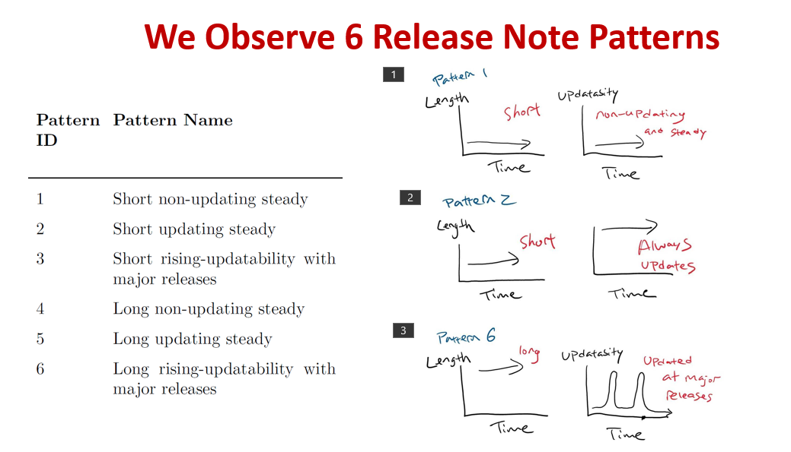
Contributions
We identify six patterns of release notes.
Apps with long and updating release notes have high perceived quality releases, an increase in user ratings, and informative release notes.
Notes:
To summarize this talk, we found that release notes are imperfect, and users often write negative reviews because of them. We use a developer survey study as well as a quantitative study on 3 years of google play store data to find out how release notes are written and how they can be improved. To the best of our knowledge, our work is the first to include both a qualitative study and a longitudinal study on 3 years worth of release note date. Our main contributions are the 6 identified release note patterns, and the classification model identified app characteristics correlated to these patterns. In particular, we find that apps that write long and updating release notes often have higher perceive releases, and apps that shift into writing more informative release notes often observe an increase in user ratings.

