Slide 1


An Empirical Study on Release Notes Patterns of Popular Apps in the Google Play Store
Aidan Yang · Safwat Hassan · Ying Zou · Ahmed E. Hassan
Notes:
say it was published in emse, give full citation
also talk about my affiliation
impress people

Slide 2
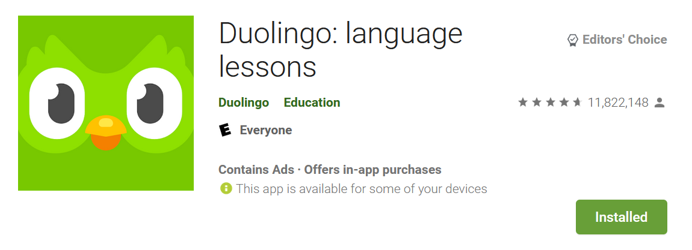
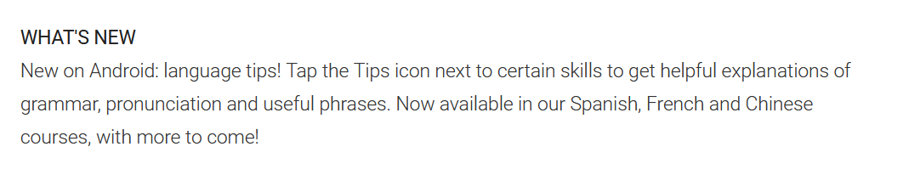
Motivation
When you publish release notes instead of saying the blanket bug fixes, maybe you should try to make a useful statement instead.
Setting up fingerprint login should have been announced in the release
notes not hidden in the options!"
User Reviews
Notes:
release notes describe new features
a popular app i really like is duolingo
a pittsburgh native company
release notes are useful for both developers and users but are imperfect
they are all quotes, change background
put user reviews above
list out reasons why release notes are not good based on example

Slide 3

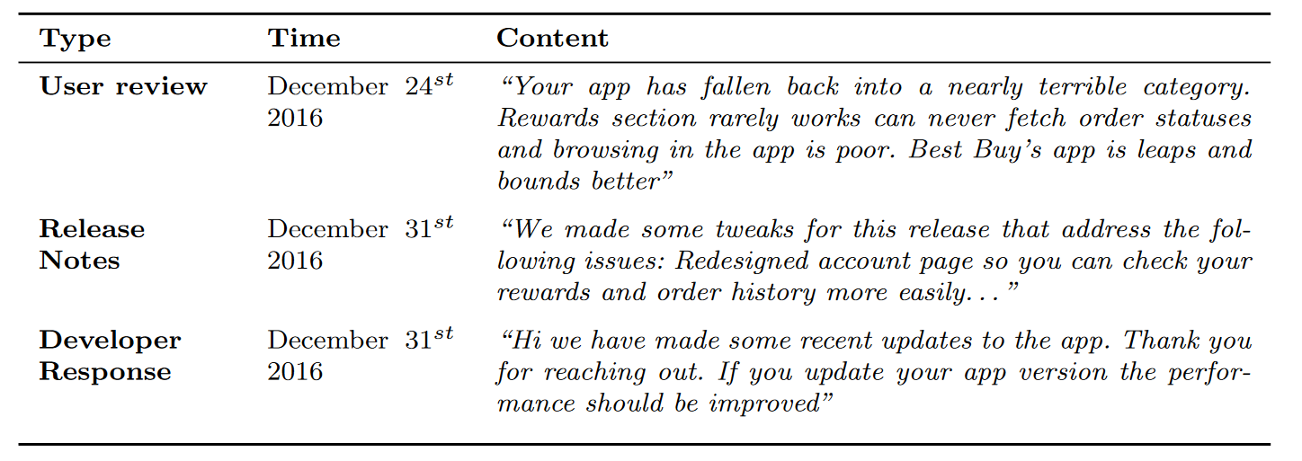
User – Developer Dialogue
Notes:
read these out
animate in the dialogue
we are not sure

Slide 4
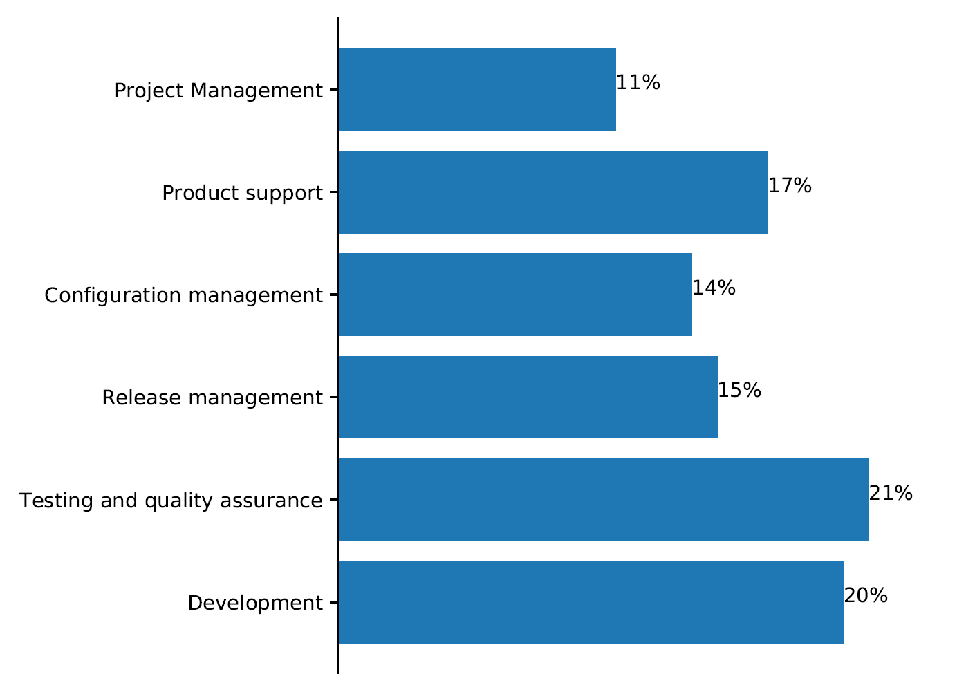
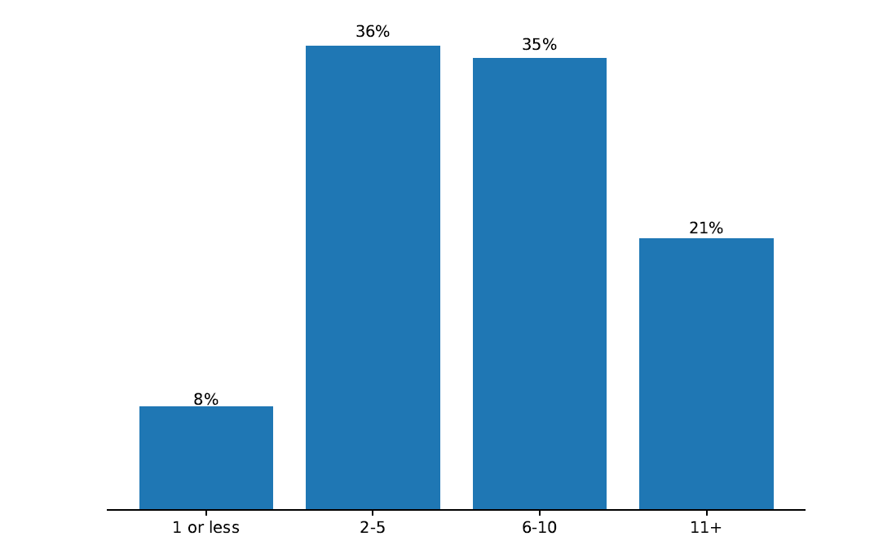
We Surveyed 102 Developers
The distribution of the years of experience of the surveyed developers
The distribution of the job roles of the surveyed developers.
Notes:
how did i select them and what did I ask them.
slide between 3 and 4 for motivating why i did survey: do devs care about release notes. tell a story.

Slide 5
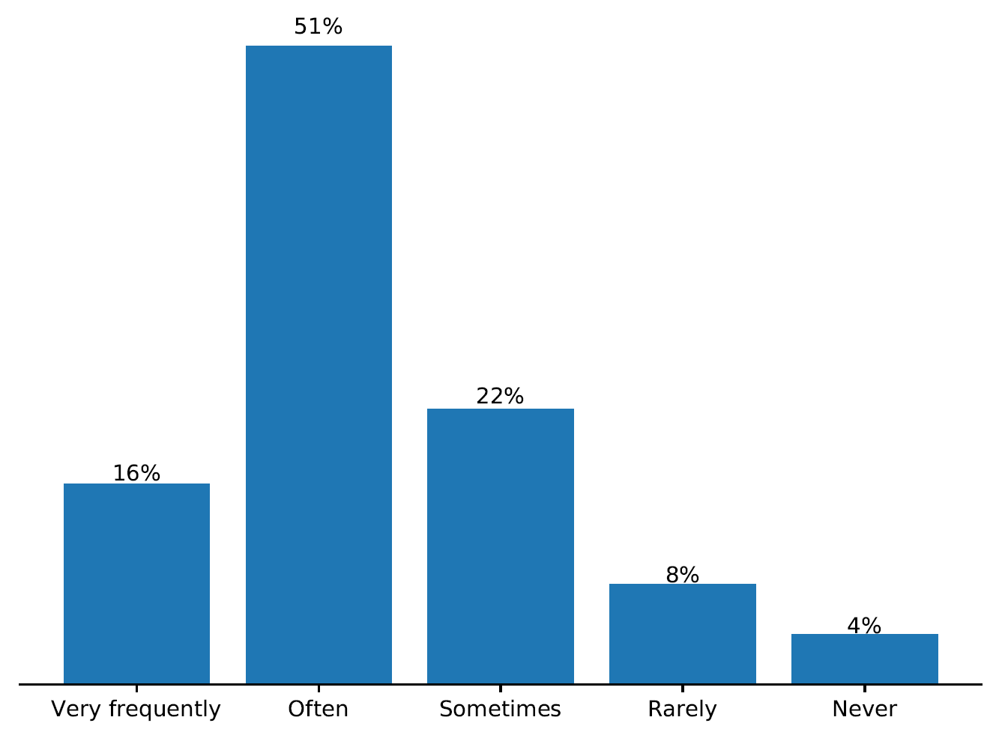
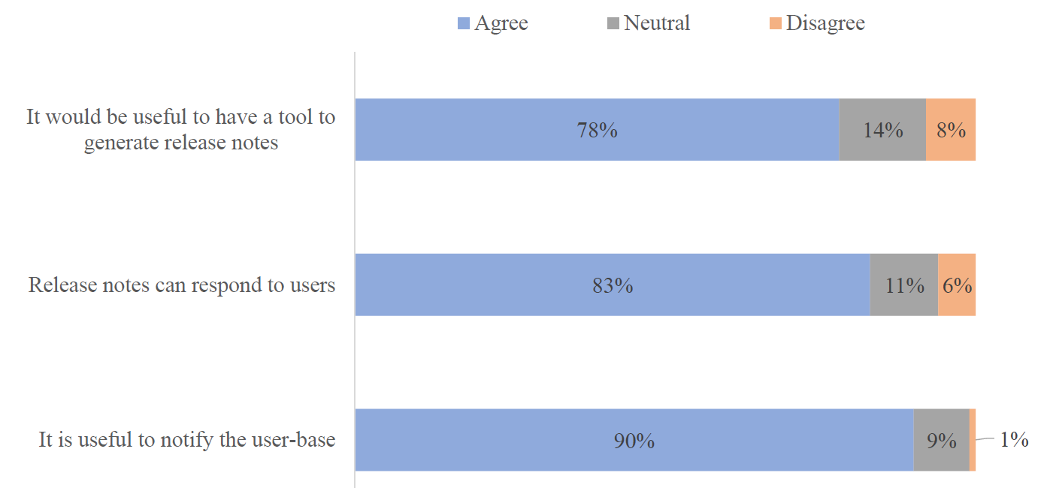
We Surveyed 102 Developers
Developers' answers for frequency of release note update.
Developers' answers for release note uses.
Notes:
put the question instead of the developers answers for uptop.
make texts bigger

Slide 6
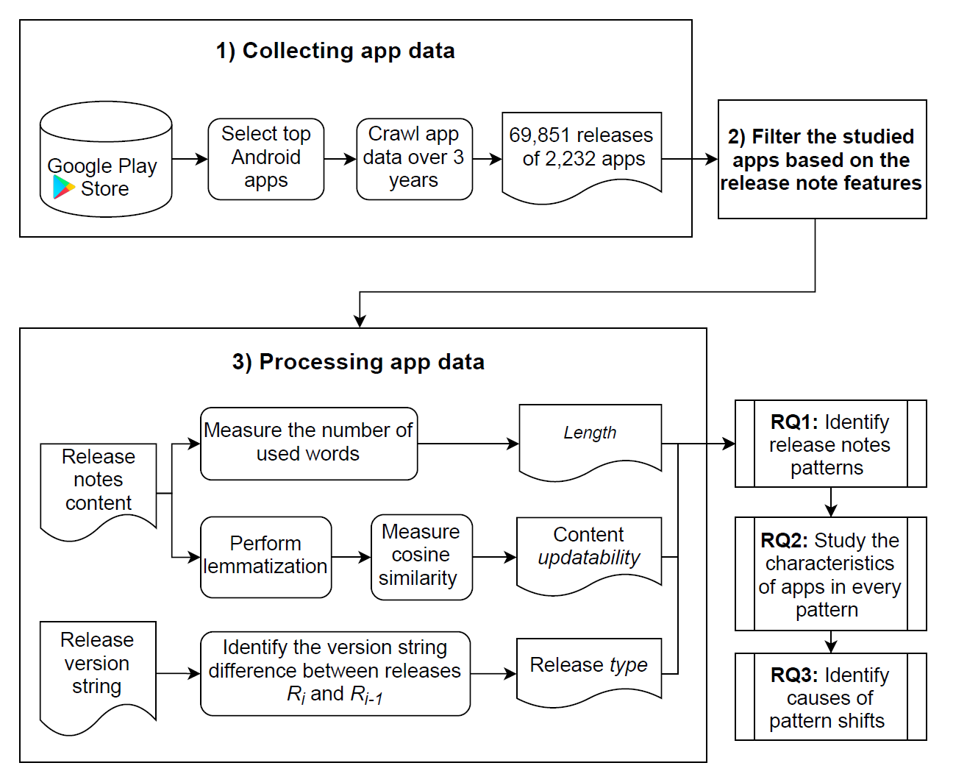
We collected data of the studied 2,232 apps over the period of three years (April 2016 - April 2019) 70 thousand releases 67 million user reviews 2.9 million developer responses to users.
Data Collection
Notes:
another slide on why i do data collection. emphasize the 3 year thing. I should release dataset.

Slide 7
Research Questions
RQ1: What are the release notes update patterns?
RQ2: What are the characteristics of the apps that follow a certain release notes pattern?
RQ3: What causes developers to shift their release notes pattern?
Notes:
rephrase the rqs without data collection details. have higher level goal. describe update pattern.

Slide 8
Research Questions
RQ1: What are the release notes update patterns?
RQ2: What are the characteristics of the apps that follow a certain release notes pattern?
RQ3: What causes developers to shift their release notes pattern?
Notes:
rq2 do

Slide 9
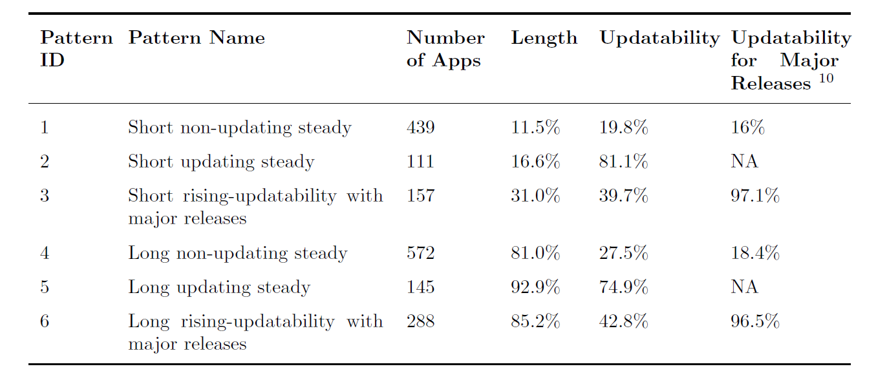
We Observe 6 Release Note Patterns
Example release notes:
GUI enhancements and minor fixes
Fix a bug of the grouping separator. Improved calculation precision
Notes:
rising vs steady, talk about the axis.
introduce the terminology better. another slide for
make graphs to help with pattern names
place them into different columns.

Slide 10
Research Questions
RQ1: What are the release notes update patterns?
RQ2: What are the characteristics of the apps that follow a certain release notes pattern?
RQ3: What causes developers to shift their release notes pattern?

Slide 11
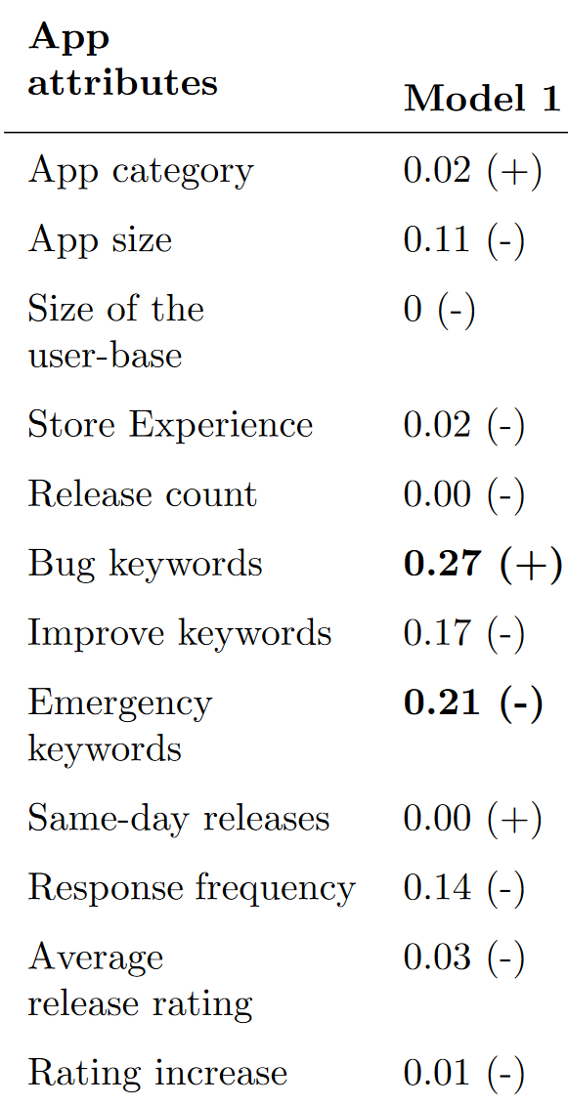
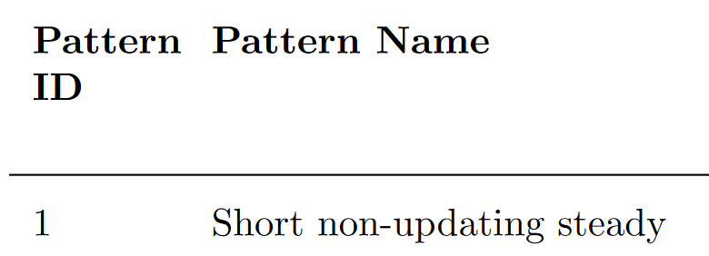
RQ2 Approach: Regression Models
We build 6 logistic regression models on each of the 6 patterns to observe if certain app attributes are correlated with release note patterns.
Significant

Slide 12
Models Results
Apps in patterns 2 and 5 with updating release notes tend to have a lower number of releases.
Apps in pattern 6 that have long, rising-updatability release notes tend to have a higher user response rate than other apps.
Apps in pattern 5 that have long and updating release notes have higher perceived quality releases compared to other apps.

Slide 13
Research Questions
RQ1: What are the release notes update patterns?
RQ2: What are the characteristics of the apps that follow a certain release notes pattern?
RQ3: What causes developers to shift their release notes pattern?
Notes:
what is correlated with a shift in release notes. we wanted to formalize and learn about the apps.
we took a natural science approach to see if release patterns change at all. we observe they follow different patterns and have characteristics.

Slide 14
RQ3 Approach
For all the studied apps, we treat each of the clustering metrics (e.g., length and updatability) as a time series
We use the mean and variance of each time series to determine stationarity.
Notes:
why is this important, do a motivation on all 3 of these.
show a graphical representation of the time series.
we use the mean and variance of the windows.
we study how much things change based on time series analysis

Slide 15
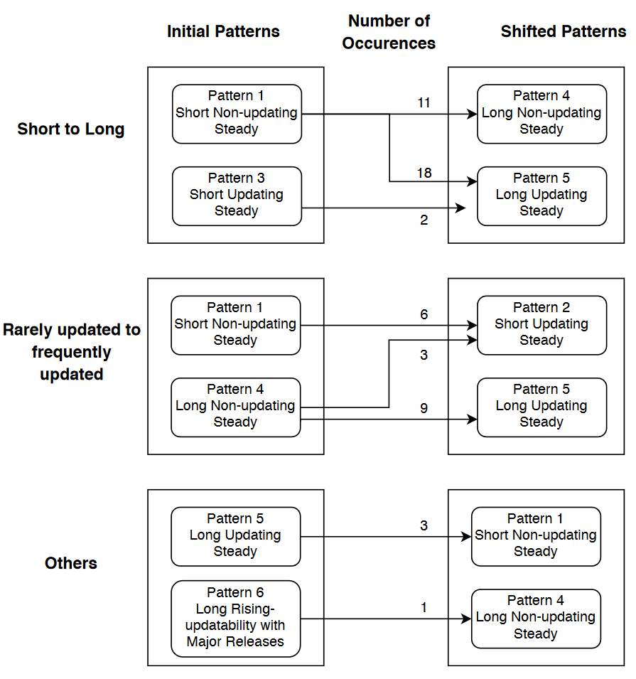
Summary of Shifts
92% of the studied apps shift either from short to long release notes or from rarely updated to frequently updated release notes.
Developers shift their release notes patterns to provide detailed guidance to their users and spot the importance of the new release.
Notes:
thickness of the arrow
skip a lot of this slide

Slide 16
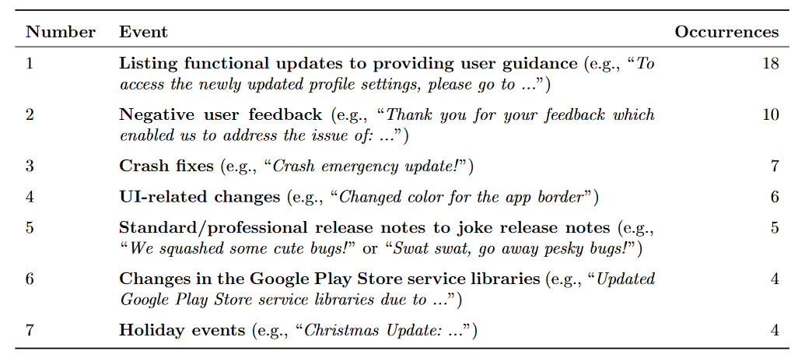
Reasons for Shifts
Of the apps that shift from pattern 1 (short non-updating) to pattern 5 (long updating), 94% show a higher average rating after the shift.
Notes:
go into this point more
tables are very small make bigger for all figures
bolding more texts

Slide 17
Contributions
We identify six patterns of release notes.
Apps with long and updating release notes have high perceived quality releases, an increase in user ratings, and informative release notes.
Our work shows potential directions for developers to improve the release notes mechanisms in app stores.
Notes:
make more clear imperfect release notes. there is something interesting with release notes. no-one has done this before dig into it.
it seems there are correlations with updated

