Slide 1





Predicting Co-Changes between Functionality Specifications and Source Code in Behavior Driven Development
Aidan Yang
Daniel A. da Costa
Ying (Jenny) Zou
Queen’s University
University of Otago
Queen’s University

Slide 2






Behavior Driven Development (BDD) is a New Style of Testing Strategy Based on Test Driven Development
Traditional Testing Strategies
Behavior Driven Development
Test suites
.Feature Files
Execute tests
Fix bugs
Combine behaviors
Construct scenarios
Test suites
Source code
Step def. files

Slide 3
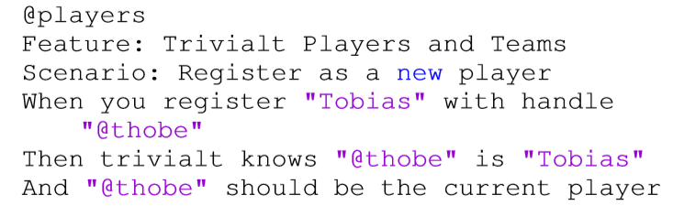
Example .Feature File
.Feature

Slide 4
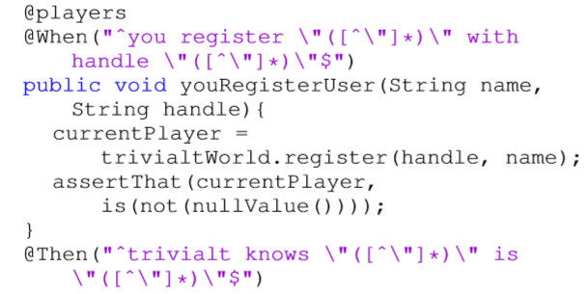
Example Step Definition File
.Feature
Step Definition

Slide 5
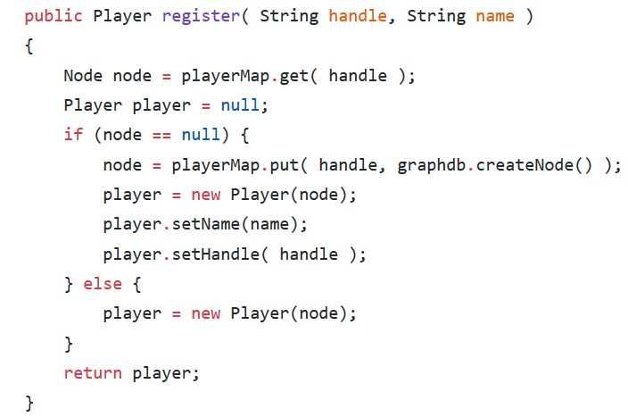
Step Definition File Linkage to Source Code
Step Definition
Source Code

Slide 6

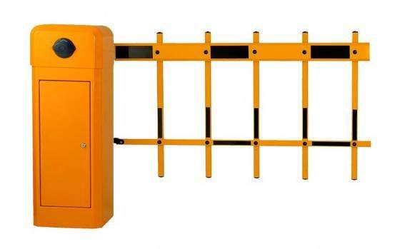


Motivation
Out-of-synch co-change reduces benefits of BDD
New developers entering a project struggle to understand requirements
BDD

Slide 7
Motivation
Out-of-synch co-change reduces benefits of BDD
New developers entering a project struggle to understand requirements
BDD
Identify code characteristics that can predict co-changes between .feature files and source code files (BDD co-changes) to help developers reduce out-of-sync BDD co-changes

Slide 8

We Selected 133 BDD Projects for Analysis
GitHub Open Repositories
Select Java projects
Select projects with .feature files
Eliminate BDD commit projects
Select projects with English logs
1,005,247 Projects
59,933 Projects
927
Projects
890
Projects
133
Projects

Slide 9
Research Questions
(RQ1): Can we accurately identify co-changes between .feature files and source code ﬁles?
(RQ2): Can we accurately predict when co-changes between .feature files and source code ﬁles are necessary?
(RQ3): What are the most signiﬁcant characteristics for predicting co-changes between .feature files and source code files?

Slide 10
Link .Feature Files and Source Code Using Semantic Similarity
Characteristics of .Feature Files
Characteristics of Source Code Files
Method Name
Key
Variable Name
Noun
Verb
Proposition
Java Terms

Slide 11
Our Analysis Obtained Over 60,000 Links Within 133 BDD Projects
.Feature Files
Source Code Files
Nouns & Verbs
Nouns & Verbs
Cosine Similarity
NLP analysis obtained 60,203 links within the same commit and 1,815 cross commit links.

Slide 12
We then Perform Manual Analysis to Check the Accuracy of Our Approach
1,815 cross commit links. Too many to check in detail
Conﬁdence level of 95% and conﬁdence interval of 5%
Sample size of 451

Slide 13
Analysis of Links in the Sample
Sample size of 451.
Our Approach Yields
79% Accuracy
360 co-changing work items actually linked together.
80% agreement rate after inspection by another author.

Slide 14
Episode 2: The RQs Strike Back
(RQ1): Can we accurately identify co-changes between .feature files and source code ﬁles?
(RQ2): Can we accurately predict when co-changes between .feature files and source code ﬁles are necessary?
(RQ3): What are the most signiﬁcant characteristics for predicting co-changes between .feature files and source code files?

Slide 15
19 Characteristics for Prediction
Source files added
Author Experience with BDD
Test files renamed
Other files deleted
Dependencies added (libraries imported)
Source files renamed
…

Slide 16


We Approach Our Question as a Binary Classification Problem
Source files added
Test files changed
Dependencies added
Source files renamed
Author Experience with BDD
….

Slide 17
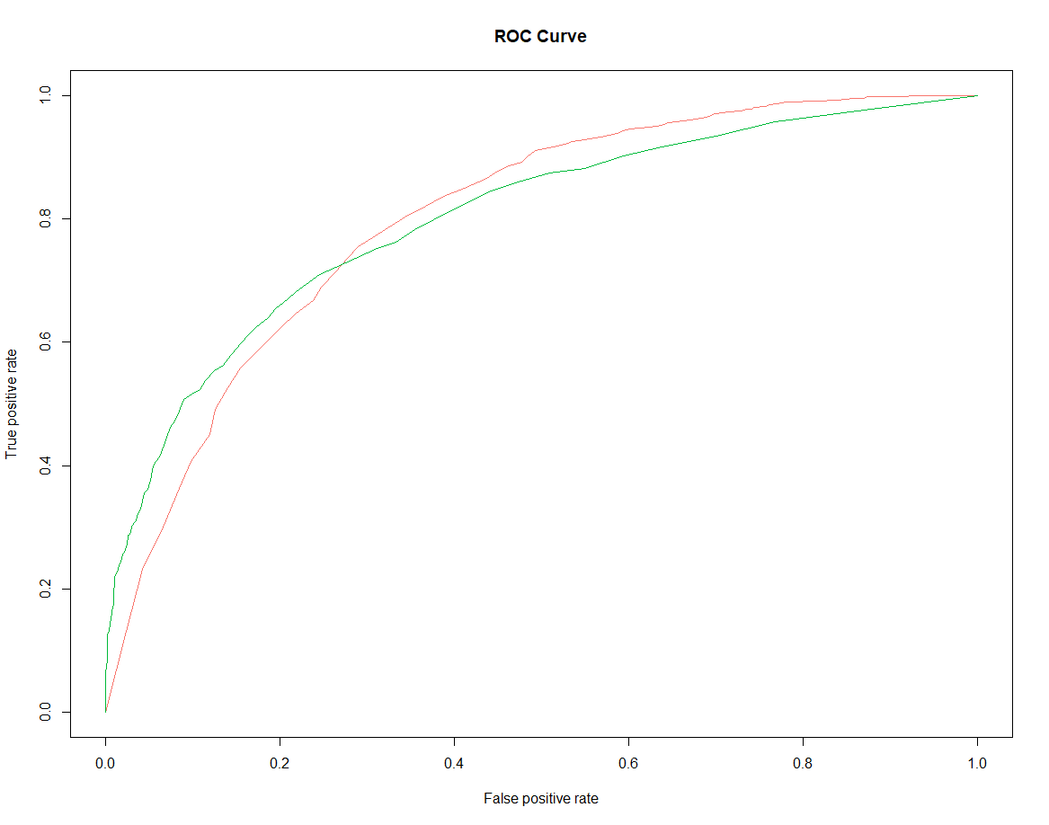
Our Top Performing Model Has 0.76 AUC
Area under the random forest ROC curve is AUC
Random Forest (0.76)
Naïve Bayes (0.74)
Logistic Regression (0.70)

Slide 18
Episode 3: Return of the RQs
(RQ1): Can we accurately identify co-changes between .feature files and source code ﬁles?
(RQ2): Can we accurately predict when co-changes between .feature files and source code ﬁles are necessary?
(RQ3): What are the most signiﬁcant characteristics for predicting co-changes between .feature files and source code files?

Slide 19




Obtain an AUC Value after Eliminating an Attribute
Source file added
Test file added
Other file added
Source file modified
Test file modified
AUC Decrease?

Slide 20
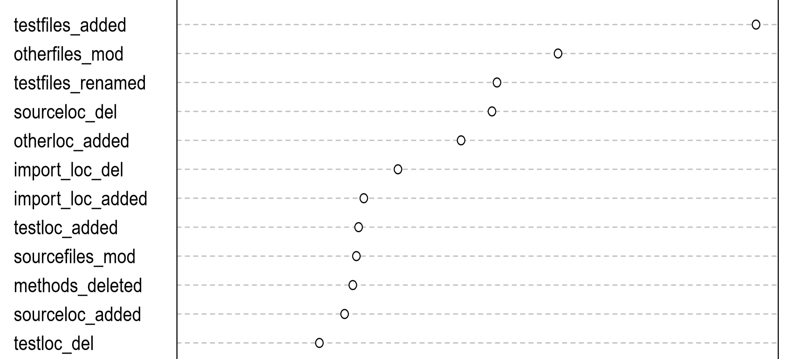
Test Files and All Other Files Changes Are the Strongest Predictors
Test files added
Other files modified
Test files re-named

Slide 21



Co-changes Can Be Detected and Predicted!
RQ1: We can detect BDD co-changes with 79% accuracy
RQ2: Our top classification technique yields a 0.76 AUC
RQ3: Test files added and renamed, and other files modified are strongest predictors
0.76 AUC
79%
Other Files Changed
Tests Renamed
Test Added

Slide 22






Modify .Feature Files to Maximize BDD Advantages When…
Adding and renaming test files
Modifying all other files
Modify .feature files!
Deleting source code

Slide 23
