Slide 1





Predicting Co-Changes between Functionality Specifications and Source Code in Behavior Driven Development
Aidan Yang
Daniel A. da Costa
Ying (Jenny) Zou
Queen’s University
University of Otago
Queen’s University
Notes:
My name is Aidan Yang, I am a third year undergraduate student at Queen’s Uni. my co-authors are Daniel Da Costa and Ying Zou.
I entered Dr. Zou’s software engineering lab near the end of my second year
The project I worked on under the guidance of Dr. da Costa and dr Zou resulted in the paper predicting co-changes between functionality specifications and source code in behavior driven department.

Slide 2






Behavior Driven Development (BDD) is a New Style of Testing Strategy Based on Test Driven Development
Traditional Testing Strategies
Behavior Driven Development
Test suites
.Feature Files
Execute tests
Fix bugs
Combine behaviors
Construct scenarios
Test suites
Source code
Step def. files
Notes:
Traditional Testing strategies involves a developer or a testing engineer to create test suites to test source code and find bug. However, if a client or business personnel with no programming experience wants to directly change code requirements or tests, then theyre out of luck. That’s where BDD comes in.
Unlike traditional testing strategies, requirement files, which are called .feature in BDD, can be written by all stakeholders. Combined with step definition files, which are used to link .feature to source code, they can automatically construct test suites..

Slide 3
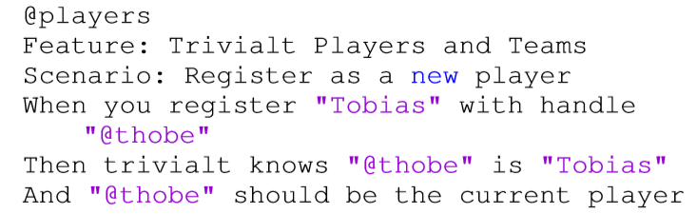
Example .Feature File
.Feature
Notes:
.feature files are specification files in BDD.
We can see that natural language is used to write .feature files. For example, thobe should be the current player is a phrase that can be written by any stakeholder of a project, regardless of programming ability.

Slide 4
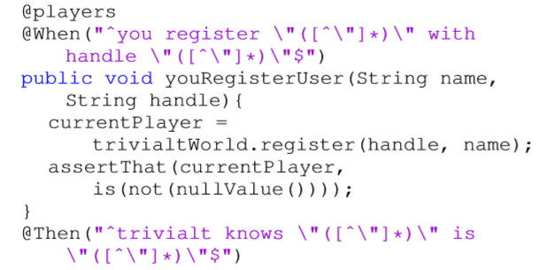
Example Step Definition File
.Feature
Step Definition
Notes:
Step definition files are the glue code between .feature files and source code, they are used for automatically generating test cases.
Links between .feature and steps are established by @symbols followed by BDD key words.

Slide 5
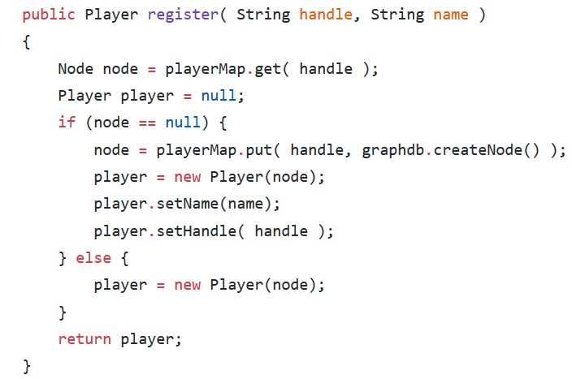
Step Definition File Linkage to Source Code
Step Definition
Source Code
Notes:
After step definition files have been made, they are linked to source code by method names. In this case, the key word is register.

Slide 6




Motivation
Out-of-synch co-change reduces benefits of BDD
New developers entering a project struggle to understand requirements
BDD
Notes:
The benfit of BDD is that BDD removes the barrier between developers and customers.
However, we notice in open projects that developers often commit .feature files and associating source code files in separate commits.
Out of synch BDD files reduce the benefits of BDD. We propose a recommendation system that reduces the traceability problem in BDD development and maximizes BDD benefits.

Slide 7
Motivation
Out-of-synch co-change reduces benefits of BDD
New developers entering a project struggle to understand requirements
BDD
Identify code characteristics that can predict co-changes between .feature files and source code files (BDD co-changes) to help developers reduce out-of-sync BDD co-changes
Notes:
That is why we focus on code characteristics that can predict .feature and source code co-changes. Helping developers recognize when .feature files are required can improve traceability.

Slide 8

We Selected 133 BDD Projects for Analysis
GitHub Open Repositories
Select Java projects
Select projects with .feature files
Eliminate BDD commit projects
Select projects with English logs
1,005,247 Projects
59,933 Projects
927
Projects
890
Projects
133
Projects
Notes:
We only investigate Java projects for this research because Java’s BDD framework cucumber is currently the most popular framework.
We then select projects with at least one .feature file so we know it uses BDD
However, only 1 BDD commit is not enough, so we eliminate projects with only 1 BDD commit, and also select projects with commit and status log in English for us to understand the purpose of each commit.

Slide 9
Research Questions
(RQ1): Can we accurately identify co-changes between .feature files and source code ﬁles?
(RQ2): Can we accurately predict when co-changes between .feature files and source code ﬁles are necessary?
(RQ3): What are the most signiﬁcant characteristics for predicting co-changes between .feature files and source code files?
Notes:
Our first research question involves identifying BDD co-changes.

Slide 10
Link .Feature Files and Source Code Using Semantic Similarity
Characteristics of .Feature Files
Characteristics of Source Code Files
Method Name
Key
Variable Name
Noun
Verb
Proposition
Java Terms
Notes:
Since .feature file uses natural language, we customized a semantic similarity algorithm using Stanford’s CoreNLP as a starting point.
All words in .feature and source code files are identified, for example:…
Here is an example of our linking process. The verb register is linked to the method name register between the two files. Similarly for the word player.
However, .feature key words and java key words were not used for linking. Words other than nouns and verbs, such as adjectives or propositions were also not used, because they had a low chance of being used in source code files.

Slide 11
Our Analysis Obtained Over 60,000 Links Within 133 BDD Projects
.Feature Files
Source Code Files
Nouns & Verbs
Nouns & Verbs
Cosine Similarity
NLP analysis obtained 60,203 links within the same commit and 1,815 cross commit links.
Notes:
More than 60 thousand links within the same commit and 1800 links across different commits.
Our threshold was 0.9 on cosine similarity, so only files that had a large number of similarities were linked.

Slide 12
We then Perform Manual Analysis to Check the Accuracy of Our Approach
1,815 cross commit links. Too many to check in detail
Conﬁdence level of 95% and conﬁdence interval of 5%
Sample size of 451
Notes:
1815 too high, need to use a sample

Slide 13
Analysis of Links in the Sample
Sample size of 451.
Our Approach Yields
79% Accuracy
360 co-changing work items actually linked together.
80% agreement rate after inspection by another author.
Notes:
Finally, we observed a 79% accuracy for our co-change detection technique. Agreement rate was 80% between 2 authors.

Slide 14
Episode 2: The RQs Strike Back
(RQ1): Can we accurately identify co-changes between .feature files and source code ﬁles?
(RQ2): Can we accurately predict when co-changes between .feature files and source code ﬁles are necessary?
(RQ3): What are the most signiﬁcant characteristics for predicting co-changes between .feature files and source code files?
Notes:
After finding a method that is able to detect BDD co-changes with relatively high accuracy, we move onto asking if development and code characteristics can predict those co-changes.

Slide 15
19 Characteristics for Prediction
Source files added
Author Experience with BDD
Test files renamed
Other files deleted
Dependencies added (libraries imported)
Source files renamed
…
Notes:
We used 19 characteristics for prediction, these were decided upon because they were all publically available information on all Github open projects.
All of these characteristics are changes made within a single commit.

Slide 16
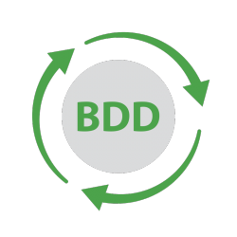

We Approach Our Question as a Binary Classification Problem
Source files added
Test files changed
Dependencies added
Source files renamed
Author Experience with BDD
….
Notes:
If a commit contains a .feature file, we say that the commit is a BDD commit. All our code characteristics are predicting whether a commit is a BDD commit or not. Therefore, we can approach this RQ as a binary classification problem.

Slide 17
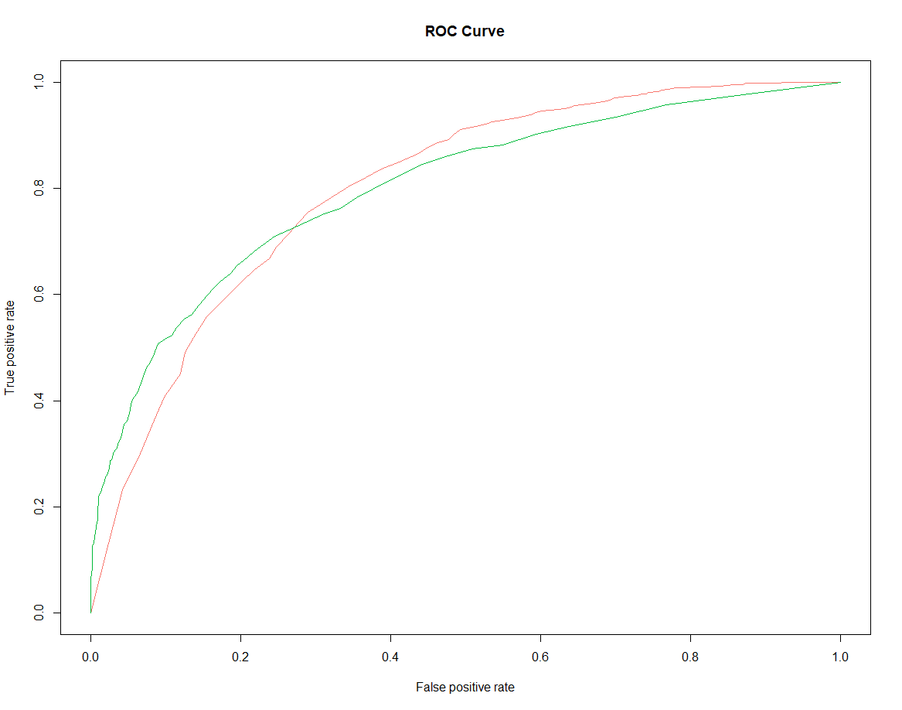
Our Top Performing Model Has 0.76 AUC
Area under the random forest ROC curve is AUC
Random Forest (0.76)
Naïve Bayes (0.74)
Logistic Regression (0.70)
Notes:
We choose 3 commonly used binary classification models, and AUC to judge their performance.
AUC is a number between 0 and 1, in which a number closer to 1 shows that our 19 characteristics can strongly predict BDD co-changes.
We observe that all our model yield AUC values higher than 0.7, and our random forest model yields a 0.76 AUC.

Slide 18
Episode 3: Return of the RQs
(RQ1): Can we accurately identify co-changes between .feature files and source code ﬁles?
(RQ2): Can we accurately predict when co-changes between .feature files and source code ﬁles are necessary?
(RQ3): What are the most signiﬁcant characteristics for predicting co-changes between .feature files and source code files?
Notes:
Finally, we wanted to pin down the top attributes that lead to BDD co-changes, this is to give recommendations to BDD developers

Slide 19




Obtain an AUC Value after Eliminating an Attribute
Source file added
Test file added
Other file added
Source file modified
Test file modified
AUC Decrease?
Notes:
We determine the predictive power of each attribute by removing it from the collection, and running our top performing model again to find the AUC decrease from the original.

Slide 20
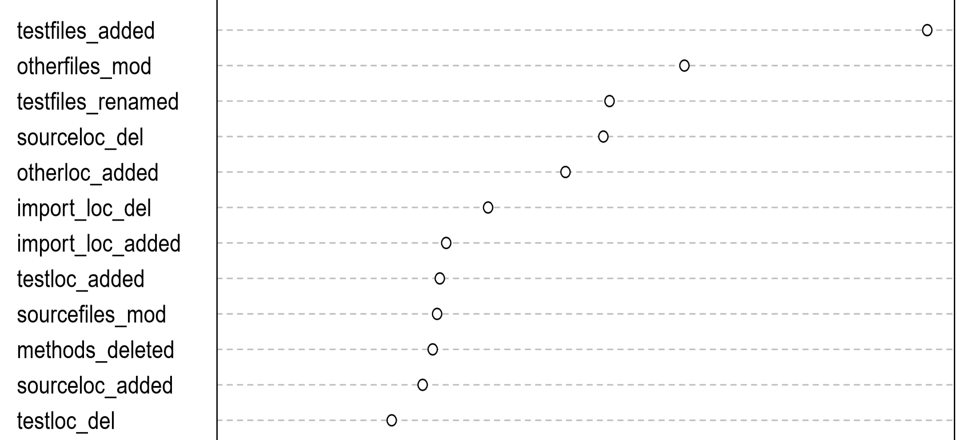
Test Files and All Other Files Changes Are the Strongest Predictors
Test files added
Other files modified
Test files re-named
Notes:
After repeating the process for every attribute, we observe that test files added, other files modified, test files renamed, and source code deleted are the most significant predictors for BDD co-changes.

Slide 21



Co-changes Can Be Detected and Predicted!
RQ1: We can detect BDD co-changes with 79% accuracy
RQ2: Our top classification technique yields a 0.76 AUC
RQ3: Test files added and renamed, and other files modified are strongest predictors
0.76 AUC
79%
Other Files Changed
Tests Renamed
Test Added
Notes:
To conclude, we found that our approach can detect BDD co-changes with a 79% accuracy. In my perspective, as an undergrad, is a A- grade if you round up, which I highly recommend to all professors.
Code characteristics can also be used to predict BDD co-changes with 0.76 AUC, with test files added and renamed, and other files modified being the strongest predictors.

Slide 22






Modify .Feature Files to Maximize BDD Advantages When…
Adding and renaming test files
Modifying all other files
Modify .feature files!
Deleting source code
Notes:
So here is our final recommendation:
For a BDD developer, keep a check list!

Slide 23
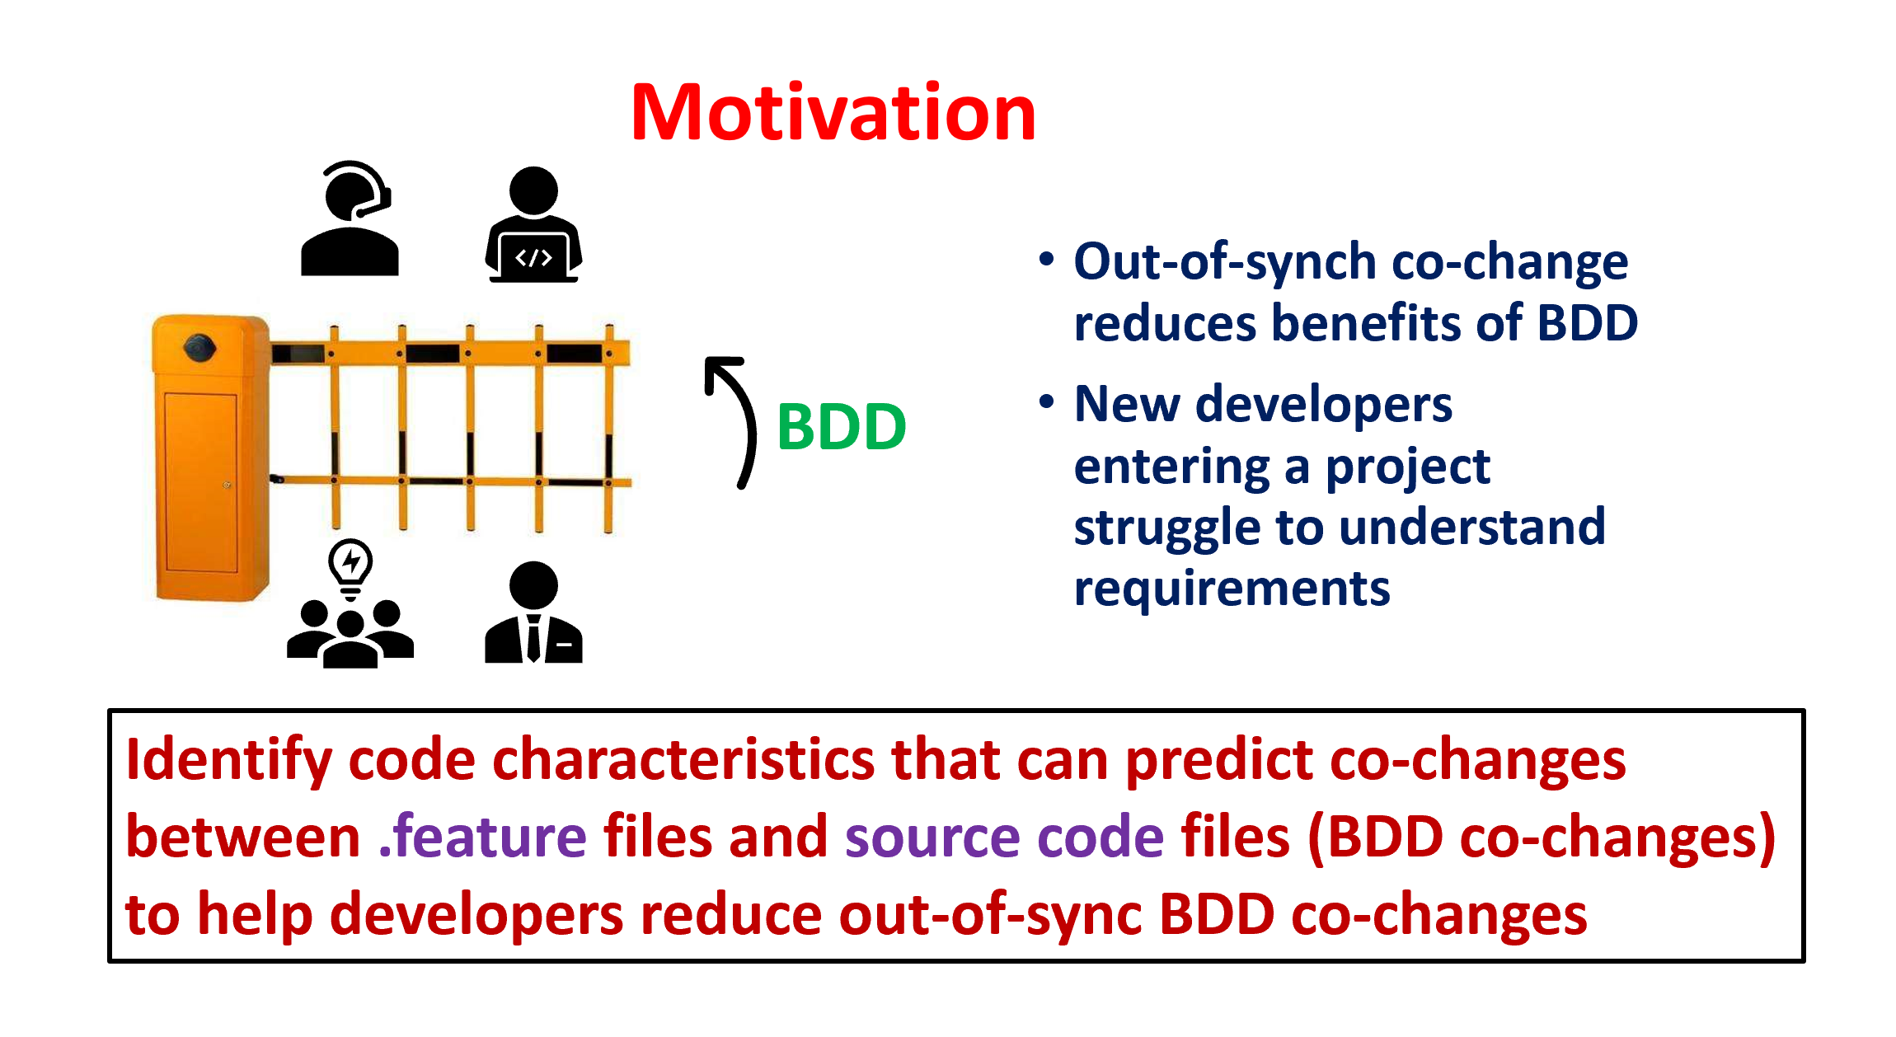
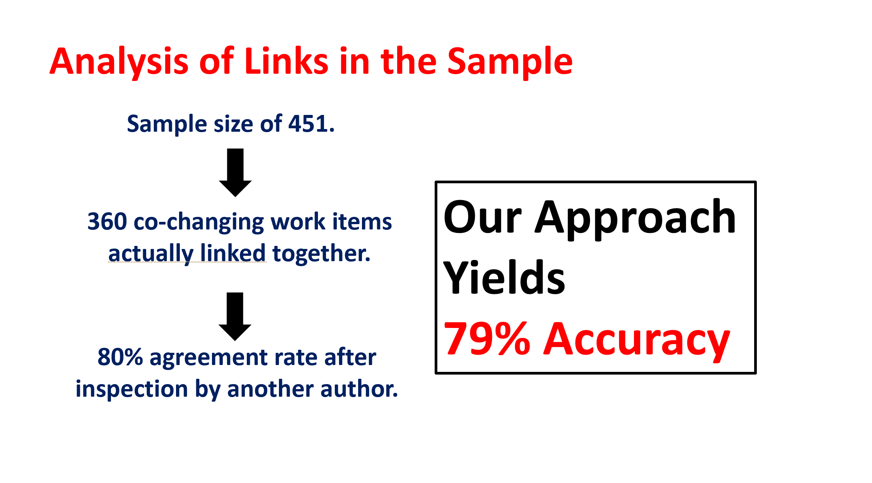
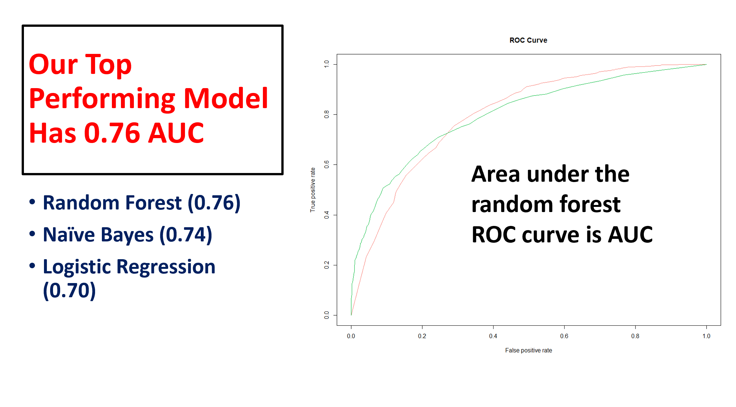
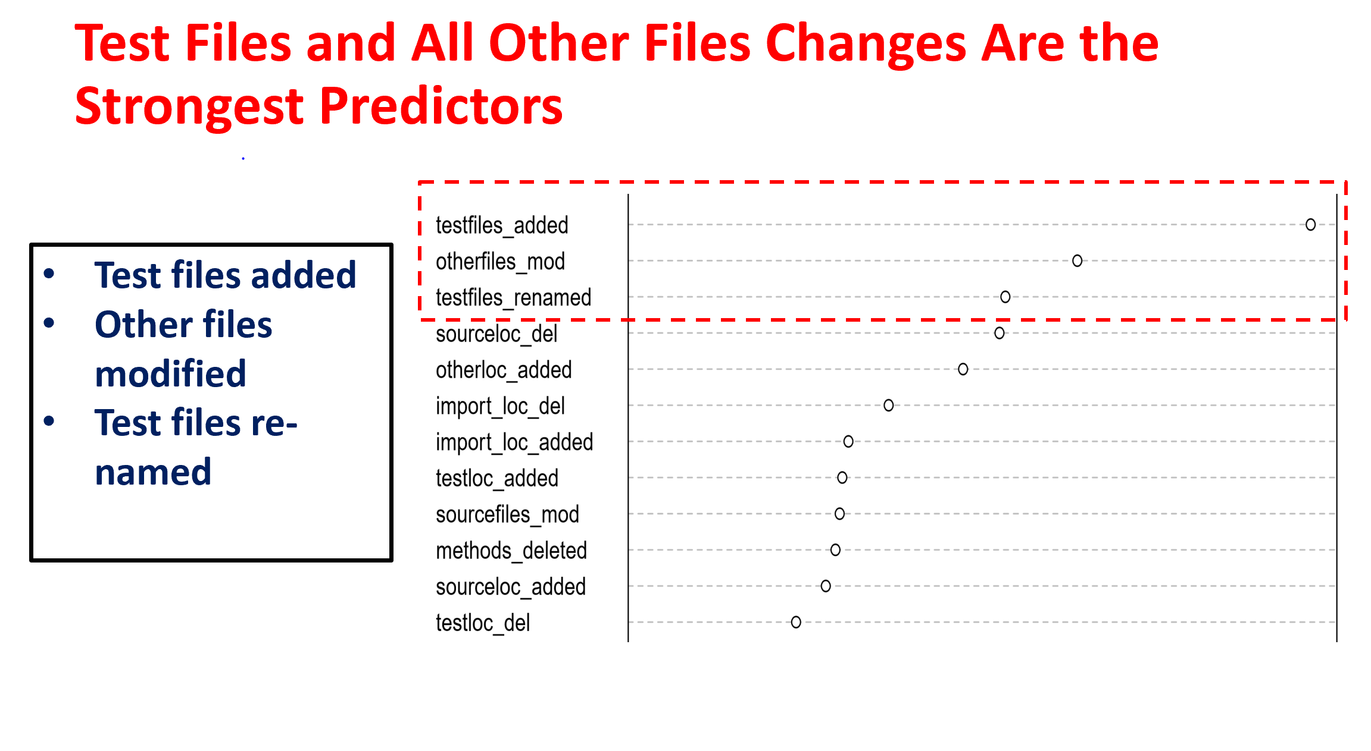
Notes:
Thank you for listening!

