Slide 1

Kodi: Architectural Enhancement
Presented By: Mahir Khandokar
Video: https://youtu.be/YF_8nHTLFDs

Slide 2
Group Member Roles
Aidan Gardner (Team Leader): Provided content to major sections and helped with overall formatting of the report
Mahir Khandokar (Presenter): Created the presentation slides, script, video, and did the voiceover for the presentation
Gavin Chin: Completed and modified major sections of content on the report
Daniel Garami: Helped review and modify slides as well as develop major report content
Barkev Keyork Sarkis: Contributed to the completion and modification of major sections on the report
Adrian Putz-Preyra: Nothing

Slide 3
Overview
01
02
03
04
05
06
07
08
09
Proposed Enhancement
Impacted Subsystems
Approaches and Analysis
Use Cases
Plans for Testing
Potential Risks
Concurrency and Team Issues
Lessons Learned and Limitations
Summary

Slide 4

Proposed Enhancement
Kodi's current subtitle download feature relies on add-ons from web sources
Limitations include dependency on internet availability and the availability of desired subtitles in the desired language
Our proposal aims to integrate artificial intelligence for real-time Speech To Text (STT) generation for subtitles and lyrics
This enhancement reduces dependence on internet sources, offering broader language support and increased program compatibility, including live TV
Key benefits include enhanced multilingual support, improved accessibility, inclusivity, and real-time interaction advantages

Slide 5
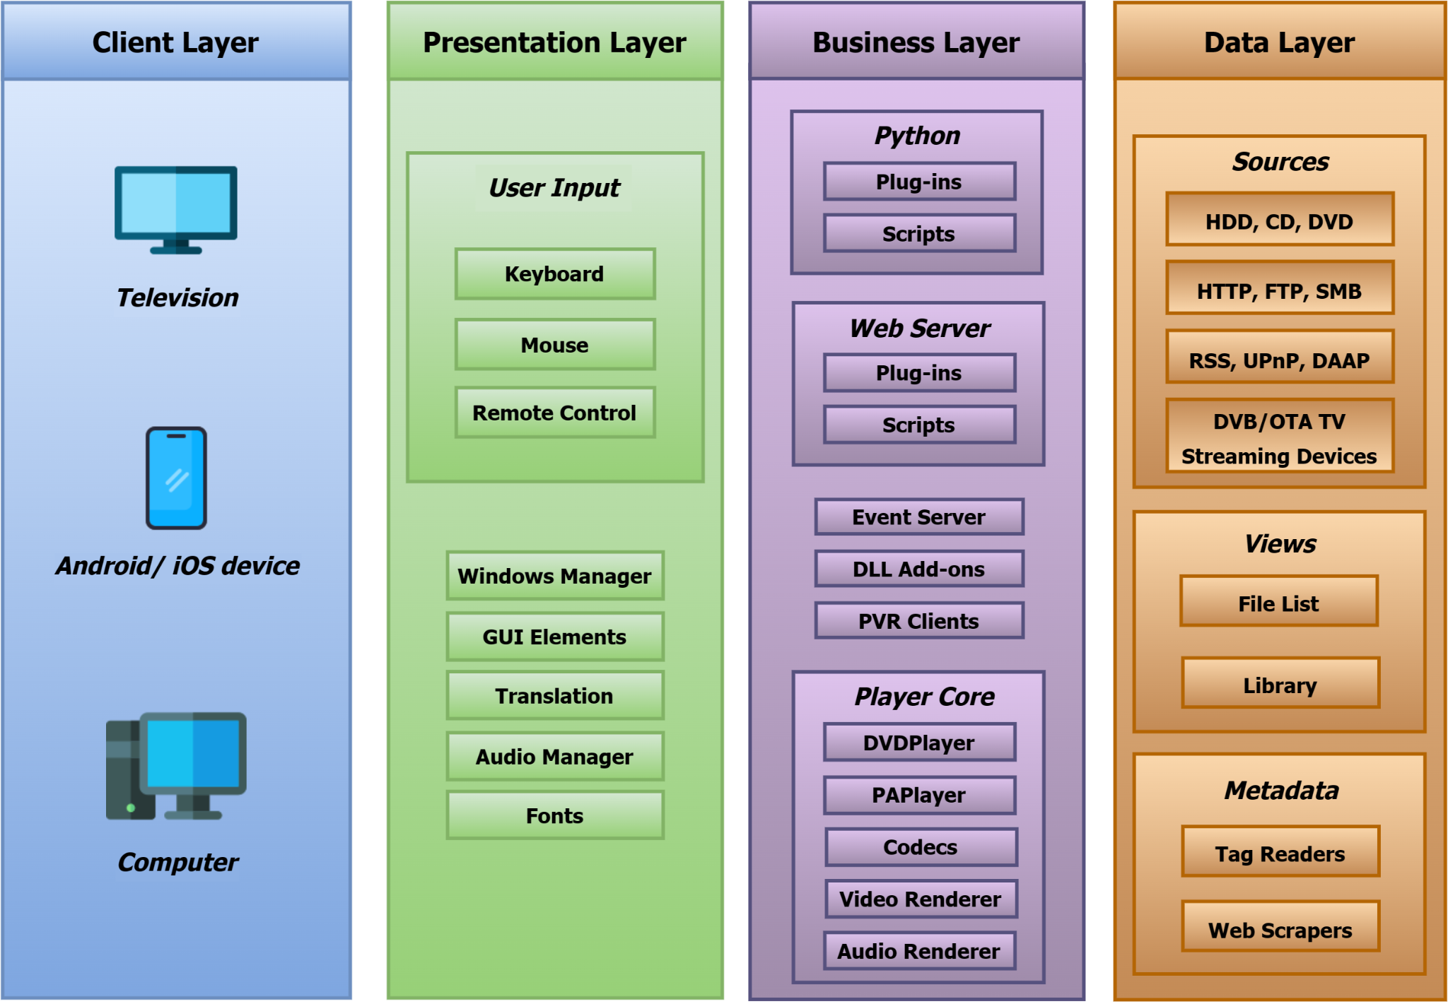
Impacted Subsystems
New interactions from real-time STT implementation:
STT translation communicates with PlayerCore Module
Chosen implementation method handles translation information and data
Display subtitles in real-time by hooking into Player
Core Module for synchronization
Interaction with Presentation Layer sends subtitle and language settings for proper GUI display
Changes primarily in Player Core Module and GUI Settings:
GUIInfoManager.cpp: GUI Language/Subtitle Settings
LangInfo.h: Language Information
\cores\VideoPlayer\: VideoPlayer Subtitle Settings
\cores\AudioPlayer\: AudioPlayer Settings
\utils\: Language Based Utilities
\video\dialogs\: GUI Dialog Subtitles
MusicInfoTag.h: Music Information
\interfaces\: API-related Information

Slide 6
Approaches: Localized Implementation Using Deep Learning Models
Advantages:
Self Sufficiency: Reduces dependency on external third-party services to allow for more control
Reduced Latency: Processing locally can lead to lower subtitle generation latency
Privacy: User and content data stays local, addressing potential privacy concerns with cloud services
Future Use : A localized approach can open new opportunities within Kodi, and supports reuse and expansion
Disadvantages:
Resource Intensive: Training and running local deep learning models demand substantial computing power and storage
Scalability: Scaling for a growing user base may be more challenging than cloud-based approaches
Development Cost/Time: Creating the model is complex and expensive, requiring expertise and ongoing efforts and may take a significant amount of time until ready

Slide 7
Approaches: Cloud Based Implementation Using Third-Party ASR Systems
Advantages:
Scalability: Offers high scalability, handling a significant number of users.
Diverse Training Data: Utilizes an already developed and extensive dataset for better handling of accents, languages, and nuances.
Faster Implementation: Integrating with an existing API reduces development time for quicker implementation.
Disadvantages:
Dependency: Relies on an external service, making Kodi dependent on availability, functionality and updates
Cost: Involves ongoing expenses, potentially a significant financial burden based on usage volume
Privacy Concerns: External services may raise privacy concerns as user and content data could be processed externally
Latency: Dependency on external services may introduce latency if there are delays in communication with the cloud

Slide 8
Analysis: Major Stakeholders and NFRs
Stakeholders | Non-Functional Requirements (NFRs)
Kodi Foundation | Performance, Reliability, Maintainability, Affordability
Board Members | Compliance, Strategic Alignment
Developers and Contributors | Documentation, Modularity, Testing
Add-Ons Developers | Documentation, Compatibility
User Community | Usability, Accessibility, Customization
Content Providers | Content Protection, Broad Language Support
Hardware Manufacturers | Resource Efficiency, Compatibility

Slide 9
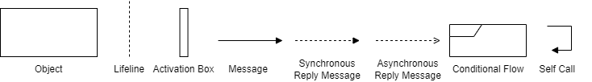
Use Cases
Two use cases stemming from our enhancement include:
Real-Time Subtitle Generation
Real-Time Lyric Generation/Display
Figure 1: Sequence Diagram Legend

Slide 10
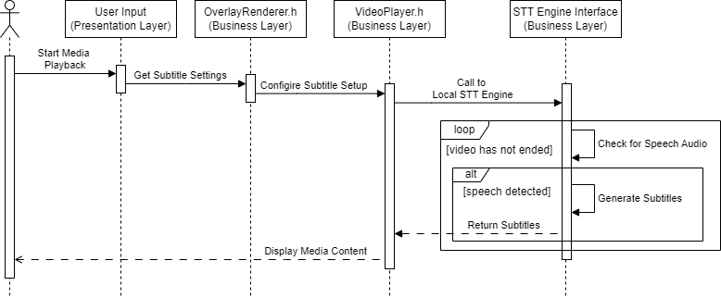
Use Case: Real-Time Subtitle Generation
Figure 2: Sequence Diagram for Real-Time Subtitle Generation

Slide 11
Plans for Testing
Testing ensures functionality, reliability, and adherence to requirements (functional, non-functional, usability, security)
Integration testing focuses on seamless interactions between all layers
End-to-end testing confirms accurate real-time subtitle generation and integration into media
Unit testing examines specific functionalities (subtitle requests, speech recognition, incorporation)
Usability testing ensures UI changes suit diverse platforms
Security testing scrutinizes secure subtitle request handling
Performance testing measures system responsiveness under varying conditions
Regression testing ensures no negative impact on existing features
Scalability testing assesses system handling of increased subtitle requests
User Acceptance Testing gathers real user insights for usability and improvement
Validate the STT Engine’s interaction and compatibility across platforms
Independent testing and training of STT Engine for accurate results across a variety of data

Slide 12


Potential Risks
Proposed localized implementation has potential risks and concerns
Resource-intensive nature of training and running ML models locally may impact system
performance, especially on devices with limited computational resources
Localized approach may face difficulties in recognizing diverse accents and languages due to potentially limited datasets
Developing a custom model for STT tasks demands high expertise, requiring specialized personnel and resources
Intricacies of training and optimizing the model lead to substantial upfront financial expenses
Ongoing maintenance efforts, including updates and improvements, contribute to overall implementation costs

Slide 13
Concurrency and Team Issues
Concurrency Significance: Key for real-time subtitle generation and display
Critical Tasks: Simultaneous processing of video/audio, speech transcription, and synchronization
Challenges: Resource-intensive models, latency control, and error handling
Strategies: Implement multithreading and asynchronous I/O in the Business Layer
Team Issues:
Collaboration: Coordinating STT feature development
Dependency Management: Integrating STT code seamlessly
Knowledge Transfer: Ensuring STT expertise sharing
Testing Coordination: Syncing STT testing efforts
Code Integration: Resolving STT-specific integration challenges
Resource Allocation: Allocating resources for STT development

Slide 14
Lessons Learned
Maintenance considerations highlight tradeoffs between third-party API ease and localized ML model flexibility
Testing AI poses unique challenges, examining various languages, tones, and linguistic nuances
Balancing system performance optimization with introducing new features requires careful adjustments
Stakeholder priorities, especially regarding NFRs like privacy, cost predictability, and platform performance, influence the chosen localized implementation
Prioritizing cost predictability over scalability reflects the strategic choices developers and companies must make

Slide 15
Limitations
System-Related Limitations:
Development cost and resource constraints may lead to a prolonged time for enhancement implementation
Possibility of using a paid model to recover investment costs.
Poorly sourced data can result in a poorly trained model and unsatisfactory outcomes
Result-Related Limitations:
No guarantee of accurate subtitle display due to the inherent complexity of the task.
Increased overhead from a local engine may render the feature unavailable on certain devices or software
Group Understanding Limitations:
Lack of expertise in ML systems implementation within the group.
Despite this, a collaborative effort was made to estimate the necessary requirements based on combined knowledge

Slide 16
Summary
Proposed Enhancement in Kodi:
Aims to improve user experience and accessibility for broader language support
Chosen approach: Localized Implementation
Considerations include stakeholder priorities and values:
Cost predictability
Platform performance
Self-sufficiency
Development Potential
Lessons learned emphasize the importance of:
Maintenance
Testing
Performance optimizations
Stakeholder considerations

Slide 17
Thanks For Listening!

