Slide 1

Kodi:
Concrete Architecture
Presented By: Mahir Khandokar
Video: https://youtu.be/IRyt7JHjpgY

Slide 2
Group Member Roles
Aidan Gardner (Team Leader): Provided content within the report, outlining the architecture of Kodi and assisted with the report’s overall formatting
Mahir Khandokar (Presenter): Created the presentation slides, script, video, and did the voiceover for the presentation
Gavin Chin: ?
Daniel Garami (Presenter): Provided reviewal, diagrams and main additions to the report, as well as maintained consistent formatting across diagrams and text. Additionally, helped review and modify the slides
Barkev Keyork Sarkis: ?
Adrian Putz-Preyra: Nothing

Slide 3
Overview
01
02
03
04
05
06
07
08
09
Derivation Process
Conceptual Architecture
High-Level Concrete Architecture
Reflexion Analysis
2nd Level Subsystem
Concurrency
Use Case
Lessons Learned and Limitations
Summary

Slide 4

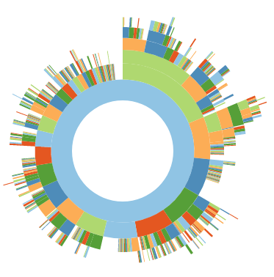
Derivation Process
Kodi Architecture Process:
Used SciTools Understand to develop concrete architecture.
Imported code, and inspected dependencies, names, and comments.
Conceptual Model Alignment:
Modular, layered structure based on previous analysis.
Four main layers: Client, Presentation, Business, Data.
Code Alignment and Adjustment:
Mapped files to created conceptual architecture in Understand.
Created new subsystems for code alignment.
Dependency Analysis:
Generated dependency diagram for concrete architecture.
Examined unexpected dependencies, adjusted architecture accordingly.
Optimization Reflection:
Assessed unexpected dependencies.
Moved files for the most appropriate subsystem alignment.
Alternative Architectures Considered:
Emphasis on modular design, with many two-way dependencies
OOP and Pipe-and-Filter do not follow code layout
Repository style may be too expensive for open-source
Implicit Invocation for add-on and presentation use
xbmc directory structure

Slide 5
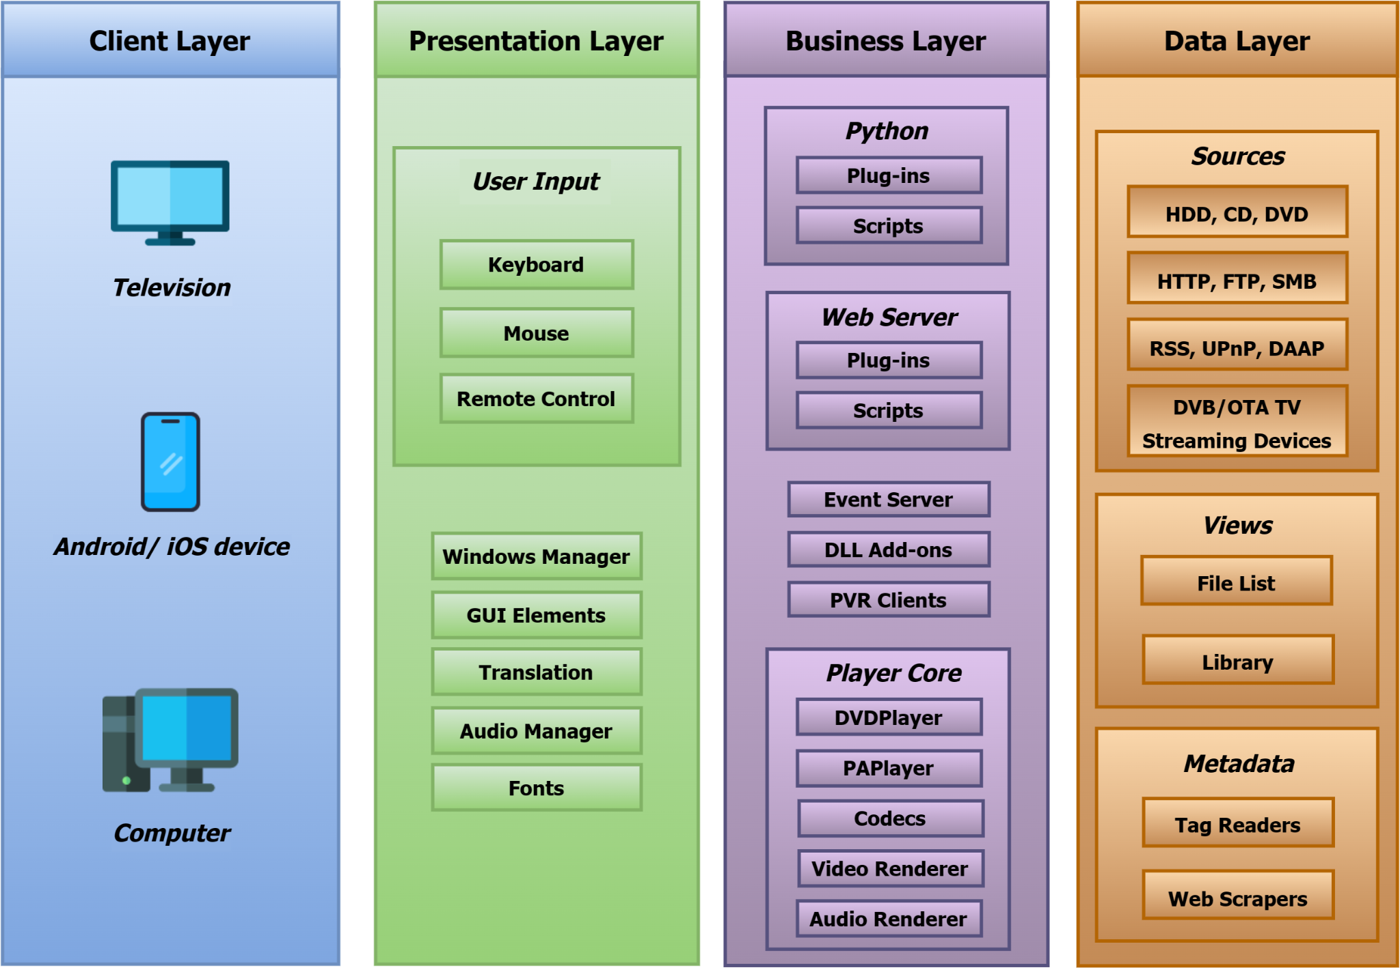
Conceptual Architecture
Layered Architecture:
Original Kodi design: layered approach.
Independent layers allow versatile interactions.
Modularity and Independence:
Influenced by Kodi Wiki and development.
Layers designed independently for flexibility.
Four Main Layers:
Client Layer: Platform-specific execution.
Presentation Layer: Manages UI and display.
Business Layer: Core functionality, event handling.
Data Layer: Deals with files: save, store, stream, transform.
High Modularity:
Kodi's focus on modularity.
Conceptual architecture stays functional without non-essential modules.
Figure 1: Conceptual Architecture Overview

Slide 6
High-Level Concrete Architecture
Concrete Architecture Overview:
Layered structure, mirroring proposed design.
Interactions across subsystems.
Client Layer:
Consistent with design.
Manages platform and OS.
Addition of power management subsystem.
Interacts with utilities, mutual relations with Presentation and Business Layers.
Presentation Layer:
Overall matches the layer from the conceptual architecture.
More generalized organization of files.
Distribution of interactions, significant Business Layer dependency.
Business Layer:
Player Core, add-ons, PVR Clients, interfaces.
Heavy interaction with utility and logging, features mostly outgoing dependencies.
Data Layer:
Views (filesystem, storage), Sources (cdrip, network).
Interacts with all layers, focuses on storage and formats.

Slide 7
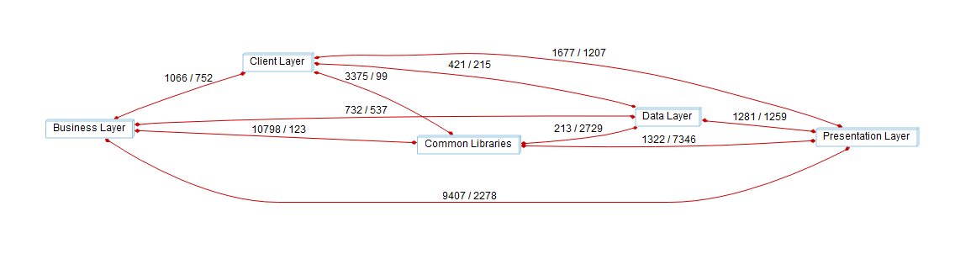
High-Level Concrete Architecture (Continued)
Common Libraries:
Added to architecture.
Houses components for common tasks.
Enhances modularity and maintainability.
Figure 2: Dependency graph of Kodi concrete architecture

Slide 8
Reflexion Analysis
Player Core (Business) <-> windowing (Client):
Graphic and resolution configuration for seamless display.
Demonstrates Kodi’s versatility across platforms.
platform (Client) -> dbwrappers (Commons):
Ensures proper user platform information storage and retrieval.
Essential for efficient database interaction.
powermanagement (Client) <-> utils (Commons):
Close association for power management and utilities.
Leverages utility functions for efficiency and standardized operations.
Tracks events based on different PowerState types.
threads (Client) -> commons (Commons):
Relies on files like Buffer.h, Exception.h, ilog.h for correct OS processes management.

Slide 9
Reflexion Analysis (Continued)
events (Commons) <-> Playback Settings (Business):
Balanced two-way dependency, mutual influence on functionalities.
Addons (Business) -> dbwrappers (Commons):
Ensures efficient database interactions for seamless add-on integration.
PVR Clients (Business) -> dbwrappers (Commons):
Significant dependency for storing recorded videos effectively.
Player Core Module (Business) <-> utils (Commons):
Substantial two-way dependency for robust Kodi operations.
Sources (Data Layer) -> commons (Commons):
Relies on commons for logging, crucial for network connection.
Views (Data Layer) -> commons (Commons):
Significant dependency for logging and catching unchecked exceptions.

Slide 10
2nd Level Subsystem: Player Core Module
Concrete Architecture Overview:
Player Core Module manages media playback.
Subsystems contribute to the playback pipeline.
Subsystems:
External Player: Integrates with external players.
Audio Player: Manages audio playback, decoding, and synchronization.
Video Player: Handles video playback, decoding, and rendering.
Retro Player: Specialized for retro gaming.
Rendering: Manages audio, video, and graphics rendering.
Player Core General: Houses general functionalities.
Figure 3: Player Core Module Conceptual Architecture

Slide 11
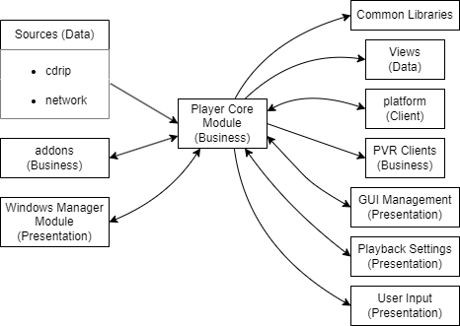
2nd Level Subsystem: Player Core Module (Continued)
Unexpected Dependencies:
RetroPlayer (Player Core) -> Views (Data Layer):
Fetches files from online game repositories.
Audio (Player Core) -> utils (Common Libraries):
Heavy dependencies for logging and communication.
VideoPlayer (Player Core) -> utils (Common Libraries):
Significant dependency for handling and extracting video stream details.
Figure 4: Dependency graph for Player Core Module

Slide 12
Concurrency
Concurrency in Kodi:
Performs multiple tasks simultaneously for enhanced performance.
Player Core Module utilizes extensive multithreading for media playback.
Example:
Audio and Video player subsystems operate concurrently for synchronized playback.
Background Tasks:
Handles concurrent background tasks like media library updates.
Maintains user experience by running tasks seamlessly during interaction or playback.
How?
Common Libraries promotes code reuse and efficient resource distribution

Slide 13
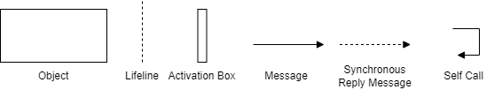
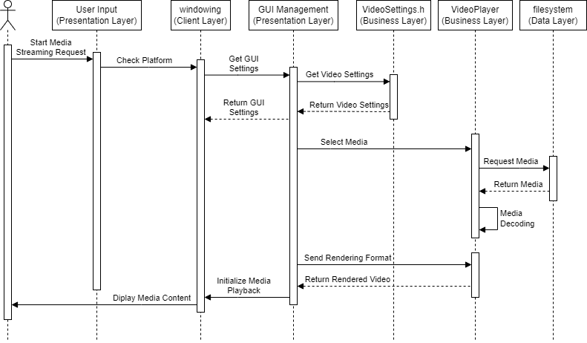
Use Case: Media Playback
Sequence diagram adjusted based on concrete architecture insights.
Divergences identified in the User Input to Player Core Module flow.
Steps:
User input selects media.
Check in Client Layer's windowing directory identifies platform.
Client Layer updates GUI settings for Kodi visuals.
Request and return video settings for proper media display.
Retrieve media files from Data Layer's filesystem directory.
Codecs in VideoPlayer subsystem decode media.
Rendering occurs through two-way dependency with VideoPlayer.
Media is ready for display and user enjoyment.
Legend:
Figure 5: Sequence Diagram for Media Playback

Slide 14
Lessons Learned and Limitations
Analysis Key Points:
Reflection analysis crucial for aligning architectures in Kodi.
Flexibility in Derivation:
Adjustments needed for proposed architecture and source code alignment.
Dependency Diagrams' Role:
Visualized subsystem relationships and dependencies for concrete architecture.
Limitations:
Possible inaccuracies due to incomplete or inaccurate conceptual understanding.
Challenge in grasping dynamic runtime behaviors through static analysis.
Valuable Insights:
Despite limitations, gained valuable lessons for future software system analyses.

Slide 15
Summary
Analysis Overview:
Examined Kodi’s concrete architecture for a thorough understanding.
Flexibility Lesson:
Identified unexpected dependencies, highlighting the need for adaptability.
Key Takeaways:
Stressed the importance of reflection analysis and flexible derivation.
Significance of dependency diagrams in analysis.
Acknowledged limitations:
Incomplete conceptual understanding, reliance on static analysis.
Insights Gain:
Despite limits, gained valuable insights for a deeper understanding of Kodi’s architecture.

Slide 16
Thanks For Listening!

