Slide 1

Kodi:
Conceptual Architecture
Presented By: Mahir Khandokar
Video: https://youtu.be/GAf7P6nEZ-I

Slide 2
Group Member Roles
Aidan Gardner (Team Leader): Provided content within the report, outlining the architecture of Kodi and assisted with the report’s overall formatting.
Mahir Khandokar (Presenter): Created the presentation slides, script, video, and did the voiceover for the presentation
Gavin Chin: Worked on content within the report, detailing use cases and diagram figures, as well as providing review and feedback to sections of the report
Daniel Garami: Provided reviewal and additions to the report, as well as maintained consistent formatting across diagrams and text
Barkev Keyork Sarkis: Provided content within report, and assisted with overall formatting and style of the document
Adrian Putz-Preyra: Worked on content within the report

Slide 3
Overview
01
02
03
04
05
06
07
What is Kodi?
Architectural Style
Subsystem Functionalities
Control and Data Flow
Use Cases
Lessons Learned and Limitations
Summary

Slide 4
What is Kodi?
Formerly known as XBMC Player
Open-source multimedia center developed by the XBMC Foundation
User-friendly design
Access to movies, music, and pictures
Integration with living room setups
Support for various add-ons
Originated as "XBOX Media Center (XBMC)" for Xbox
Expanded to Windows, OSX, iOS, Android, and Linux
Renamed to "Kodi" Entertainment Center in 2014.
Kodi has always been open-source
Available for free to all users

Slide 5
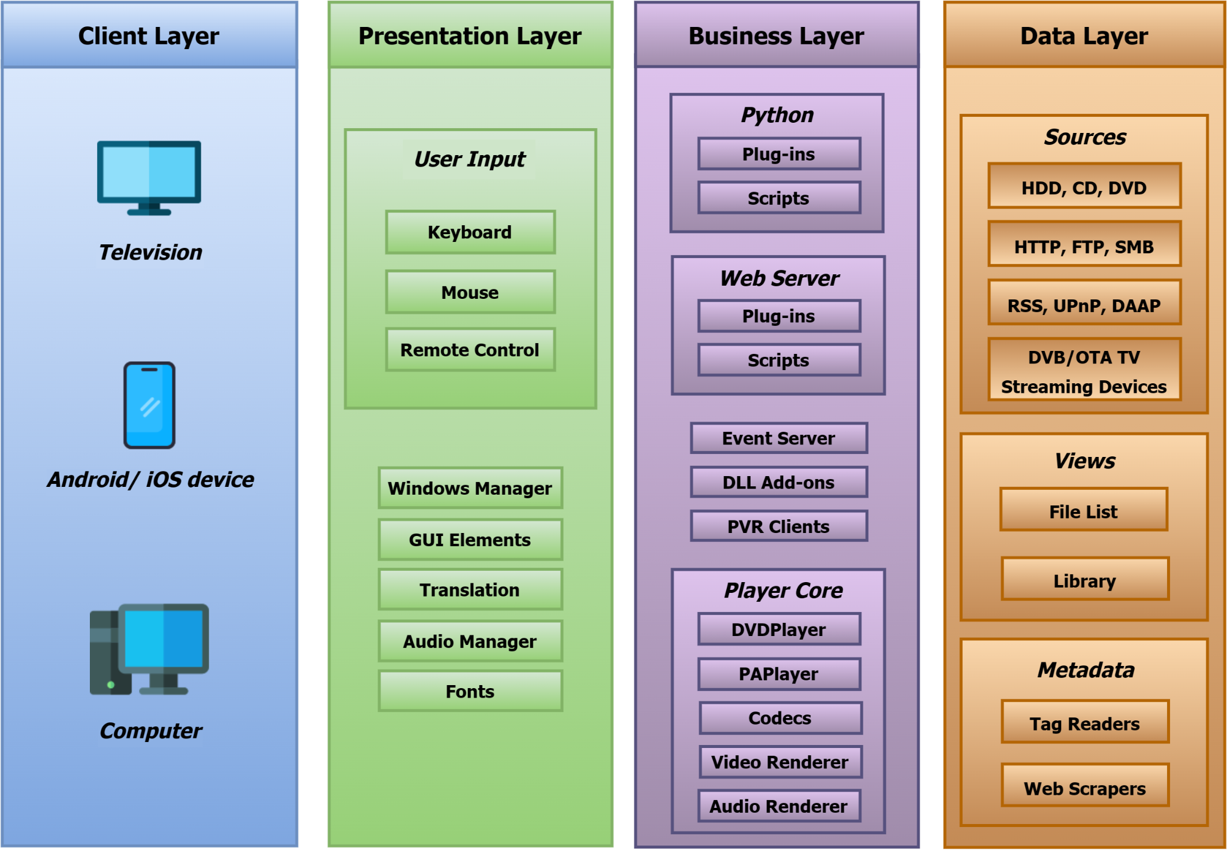
Architectural Style
Layered architecture
Multiple component layers
Layers are largely independent
Supports extensive interactions between components
Employs a multi-threaded architecture for concurrent execution of tasks

Slide 6
Subsystem Functionalities:
Client Layer
Ensures accessibility and performance across multiple systems
Key role in iOS, Android, Linux, Windows, macOS, and more
Interface Between Kodi and Devices:
Bridges Kodi with hardware and software components
Manages resource access and compatibility
Handles device-specific features and hardware interactions
Consistency in User Experience:
Ensures consistent user experience across platforms
Leverages OS capabilities for usability and accessibility
Seamless interaction with multimedia content on various devices

Slide 7
Subsystem Functionalities: Presentation Layer
Drives the user experience
Key components include:
User Input Module: Handles input from devices like remotes and keyboards, facilitating user interaction
Window Manager Module: Utilizes host OS libraries for seamless window management, navigation, and display
GUI Elements: Provides visual components (windows, buttons, etc.) for intuitive navigation and content interaction
Translation Module: Offers language support, allowing users to select their preferred language
Audio Manager Module: Manages audio settings, from output devices to volume control, ensuring optimal sound
Fonts Module: Allows users to customize fonts for improved text readability and appearance throughout the Kodi interface

Slide 8
Subsystem Functionalities:
Business Layer
Manages essential files, packages, and functionalities
Responsible for content delivery and server access
Acts as the bridge between backend data and the presentation layer for correct content processing and display
Key Modules:
Python Module: Manages custom add-ons for user enhancement and customization
Web Server Module: Allows remote content management and encourages secure practices
Player Core Module: Controls multimedia playback, ensuring high quality and reliable performance

Slide 9
Subsystem Functionalities:
Data Layer
Manages multimedia files, functions, and content
Key functionalities include:
File Management: Stores and organizes multimedia files on local storage disks
Streaming Management: Enables seamless streaming from external servers (FTP, RSS, HTTP)
Data Transformation: Converts media files into compatible formats for efficient transmission
Content Management Packages: Organizes multimedia content, metadata, and related information within Kodi

Slide 10
Control and Data Flow
Client Layer: Kodi operates on the user's OS, forming the foundation of the architecture
Presentation Layer: Manages the user interface and interactions, ensuring a user-friendly experience
Business Layer: Core functionality and request handling, where operations like media playback occur
Data Layer: Provides resources and processes data for various functions
Response to User: Displays the outcome of the user's input. The modular approach enhances efficiency and user experience

Slide 11
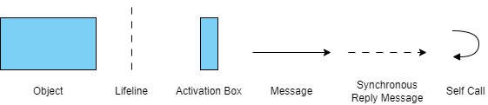
Use Cases
The two main features of Kodi are:
Media Playback
Media Downloading
These specific use cases will be demonstrated using sequence diagrams to model the flow of execution. The legend for the diagrams is below.

Slide 12
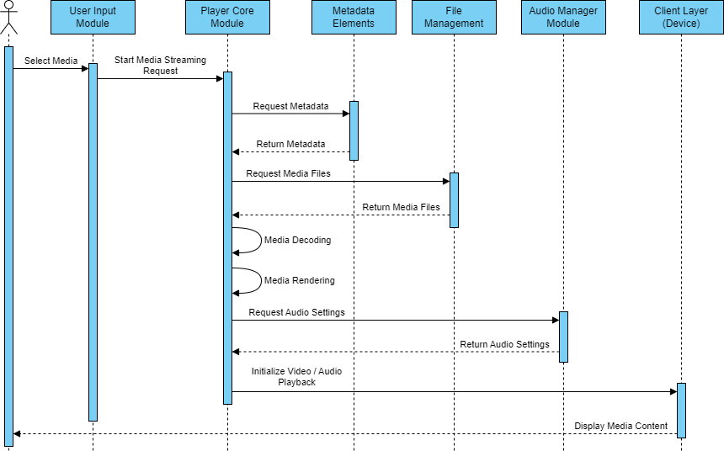
Use Cases: Media Playback
User initiates media playback via the Kodi UI
User Input Module: Allows user interaction with Kodi's interface to start playback
Player Core Module: Does majority of media management
Serves as an interface between media files and playback components.
Retrieves media data from the data layer (metadata and source elements)
Decodes data for user viewing.
Initializes audio playback (Audio Manager Module) and video playback (Client Layer)

Slide 13
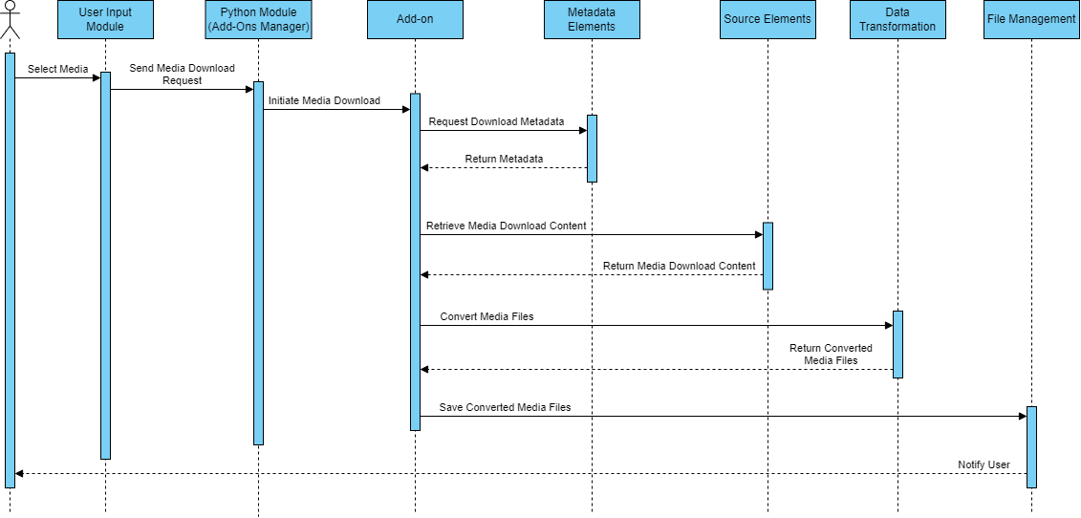
Use Cases: Media Downloading
User selects media for download
User Input Module: Initiates the download process
Python Module: Manages custom add-ons for downloading functionality
Add-ons retrieve media download content, including metadata and source elements
Transform multimedia files into suitable formats for transmission and storage

Slide 14
Lessons Learned and Limitations
Kodi's Conceptual Architecture Insights:
Reveals multifaceted layers and components
Provides a comprehensive understanding of Kodi's architecture
Key Conclusions and Lessons:
Versatility Across Platforms: Kodi adapts seamlessly to various platforms, ensuring consistent multimedia access
Security Considerations: Emphasize secure practices, such as password protection, especially when using the Web Server Module
The Importance of Add-Ons: Enhances functionality and code refactoring and avoids recompilation and dependency concerns
Tradeoffs in Kodi's Evolution
Developers must balance supporting a wide range of devices for a larger audience with code maintenance and adding new features
This exploration sheds light on Kodi's architecture, emphasizing adaptability and security

Slide 15
Summary
Key Kodi Architecture Insights:
User-friendly design and adaptability across devices
Extensive support for multiple operating systems
Modular architecture for ease of functionality expansion
Kodi's strength in layered architecture with dynamic interaction between components
An ever-evolving open-source project, poised for growth and improvement

Slide 16
Thanks For Listening!

