Slide 1
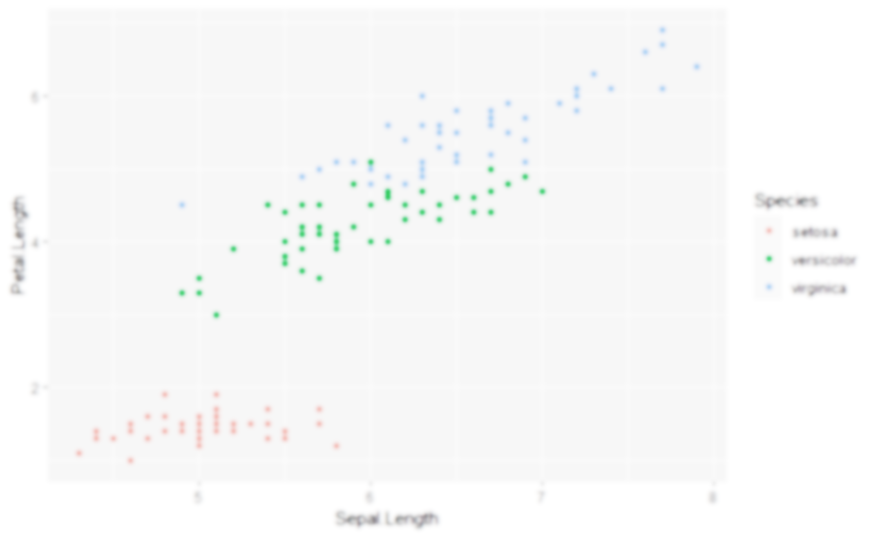
Data Visualisation using {ggplot2}
Jack Davison & Will Drysdale

Slide 2
Why use {ggplot2}?
The package allows you to quicky, easily and flexibly create graphs.
Legends, axis labels, colour scales, etc., are all dealt with automatically…
…but you still have a great deal of control!
It is not prescriptive – you build your graph from the ground up.
{ggplot2} uses a “paint on canvas” approach that lets you build almost any visualisation you want
There are many, many extension packages that extend its functionality.
Correlation matrices, maps, distributions…

Slide 3
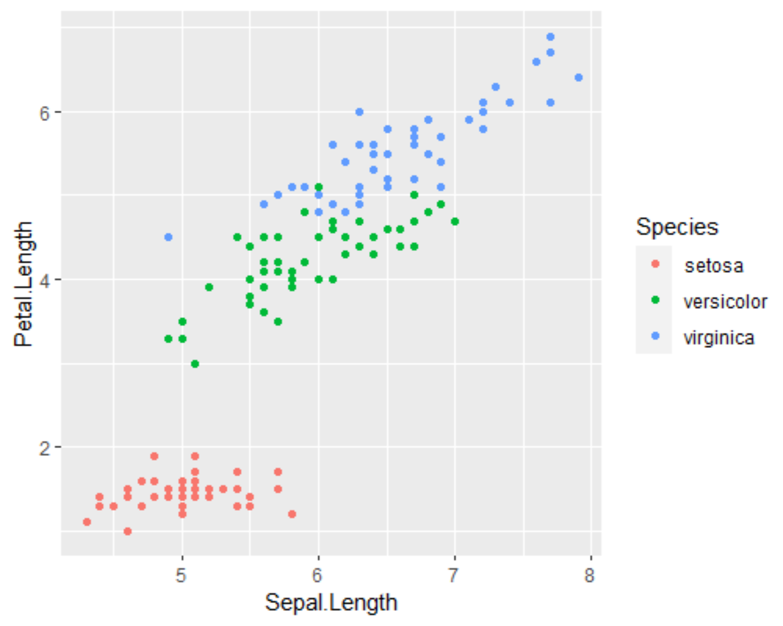
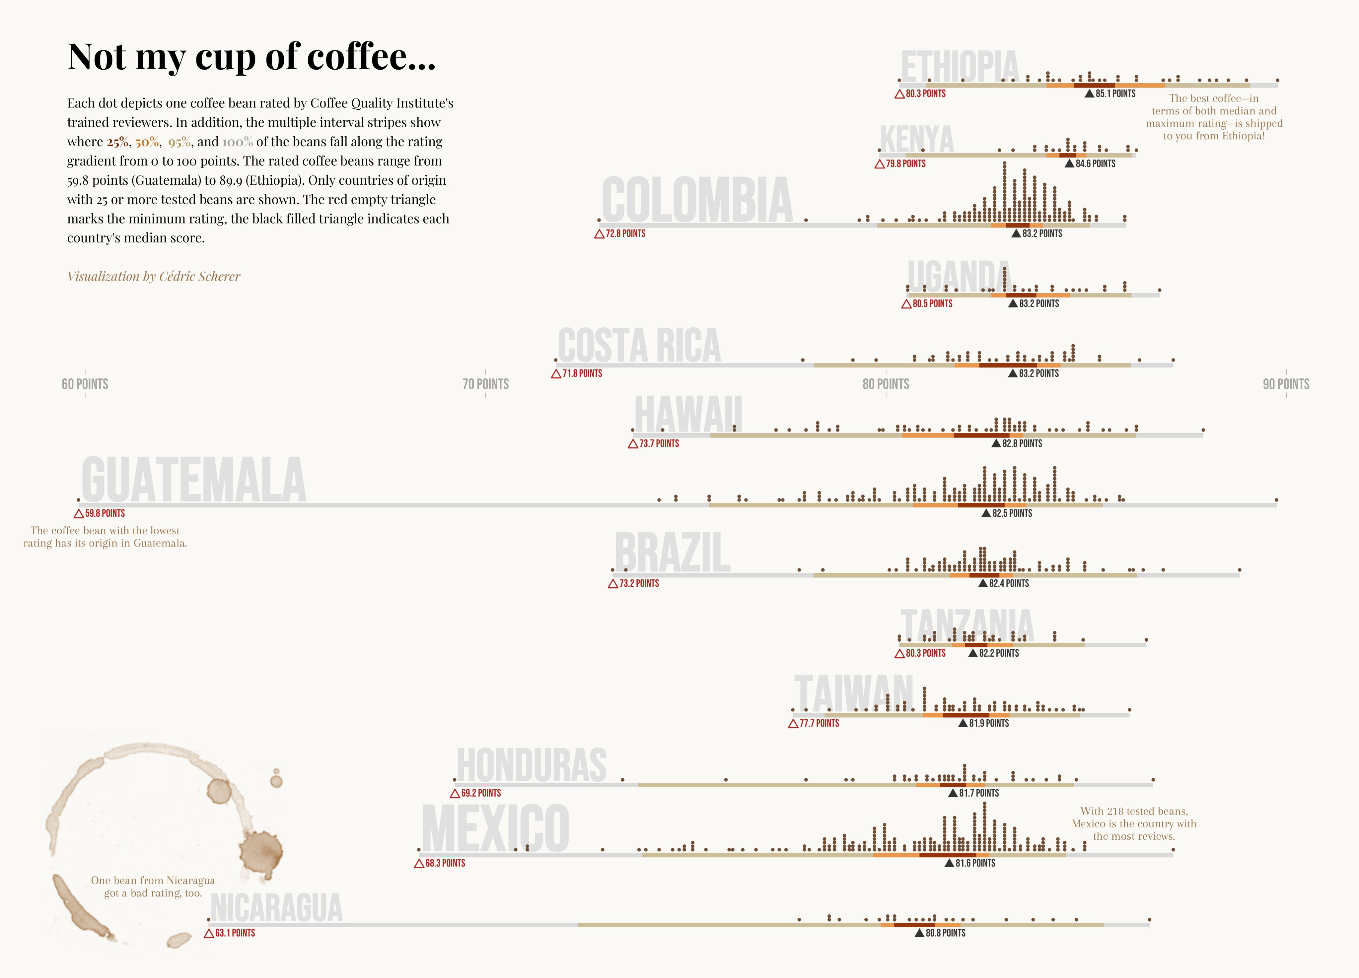
What does a {ggplot2} look like?
Like this…
…or like this!

Slide 4
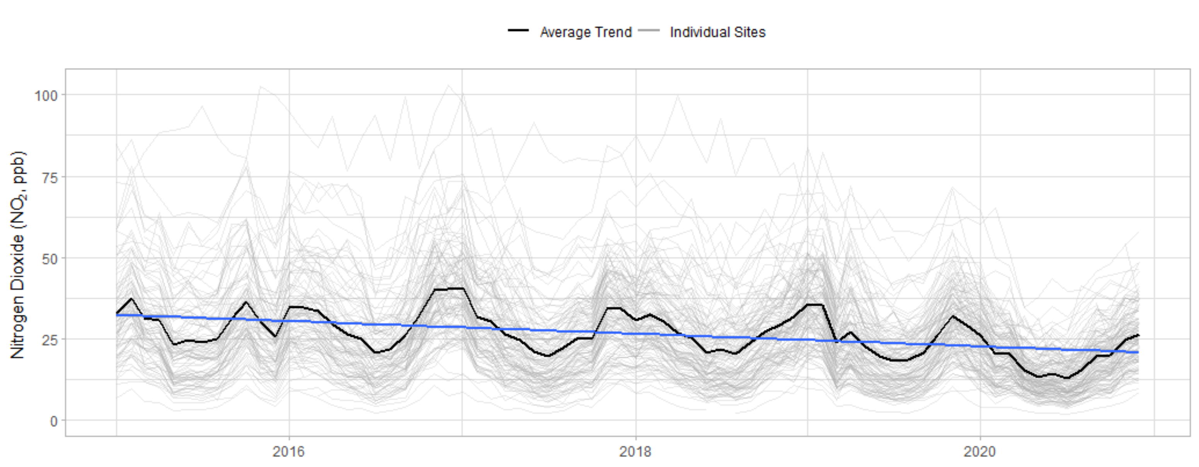
What does a {ggplot2} look like?
But we’re aiming for something like this!

Slide 5
Activities: Building a {ggplot2}

Slide 6
Some simple plots
Scatter Plot
Plot a scatter of O₃ to NO₂ just for Marylebone Road (code == “MY1”) and fit a smooth through it.
Density Plot
Plot a density function of NO2, just for the UK.
Bar Chart
Plot a bar chart showing the average NO₂ in the UK before and after 2020.

