Slide 1
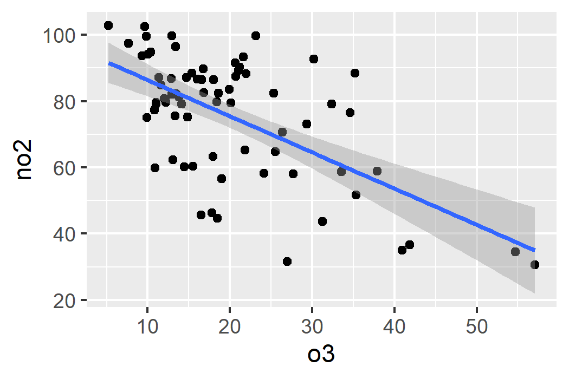
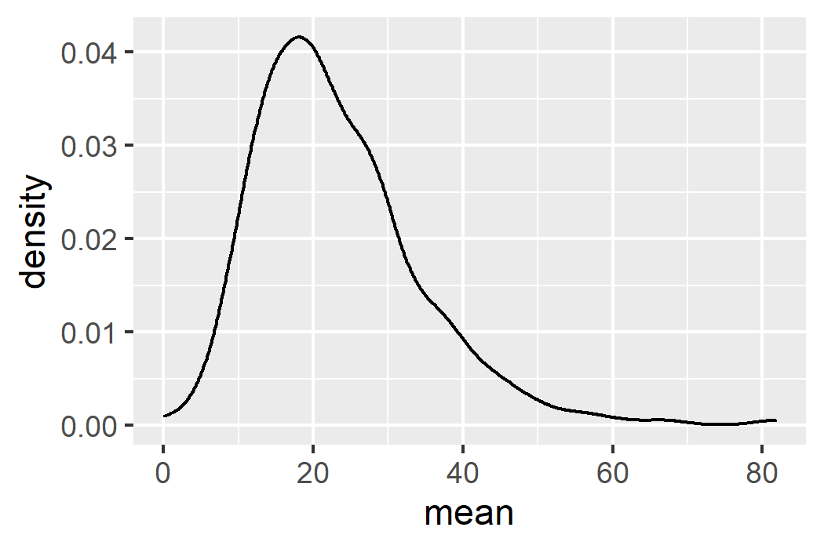
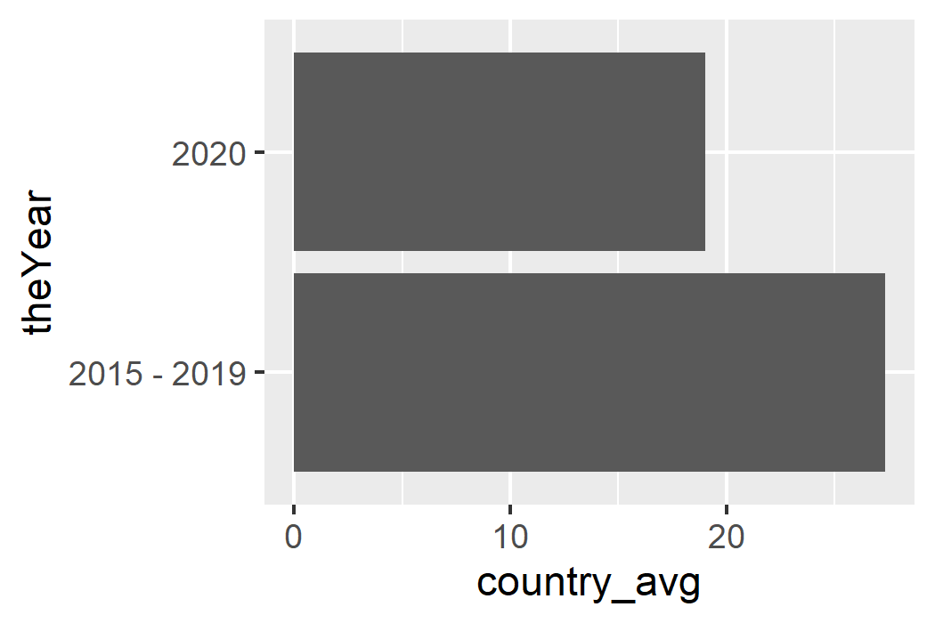
Some simple plots
tsdata %>%
filter(code == "MY1") %>%
select(-median) %>%
pivot_wider(names_from = name,
values_from = mean) %>%
ggplot(aes(x = o3, y = no2)) +
geom_point() +
geom_smooth(method = "lm")
avgdata %>%
group_by(country, theYear, name) %>%
summarise(country_avg = mean(mean)) %>%
filter(name == "no2“,
country == "united_kingdom") %>%
ggplot(aes(y = theYear, x = country_avg)) +
geom_col()
avgdata %>%
filter(country == "united_kingdom",
name == "no2") %>%
ggplot(aes(x = mean)) +
geom_density()

Slide 2
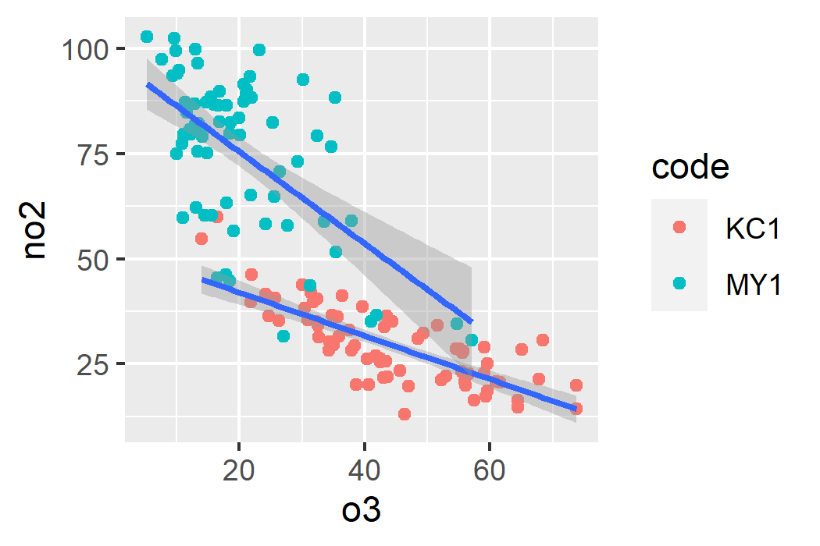
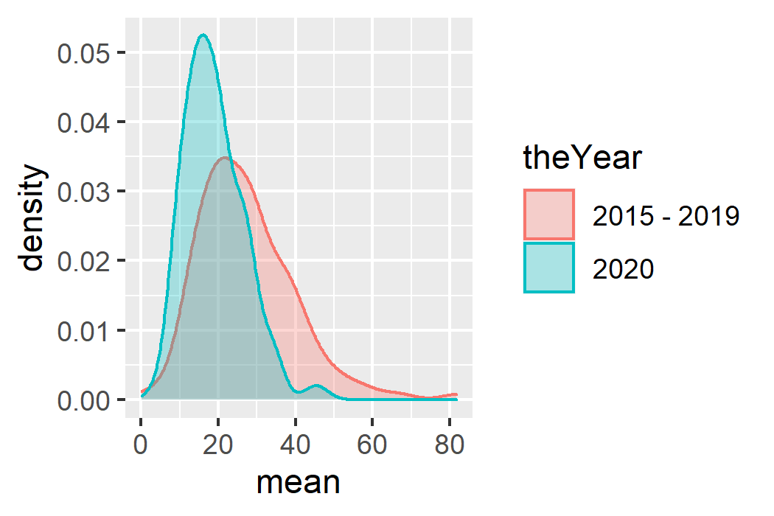
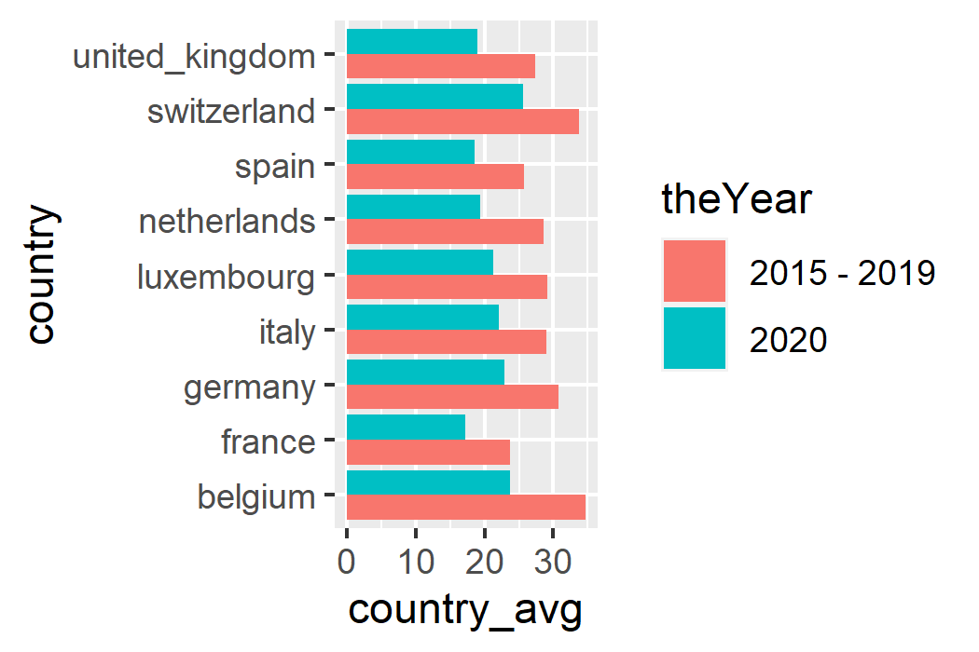
Further use of aes()
tsdata %>%
filter(code %in% c("MY1", "KC1")) %>%
select(-median) %>%
pivot_wider(names_from = name,
values_from = mean) %>%
ggplot(aes(x = o3, y = no2)) +
geom_point(aes(color = code)) +
geom_smooth(method = "lm", aes(group = code))
avgdata %>%
group_by(country, theYear, name) %>%
summarise(country_avg = mean(mean)) %>%
filter(name == "no2") %>%
ggplot(aes(y = country,
x = country_avg,
fill = theYear)) +
geom_col(position = position_dodge())
avgdata %>%
filter(country == "united_kingdom",
name == "no2") %>%
ggplot(aes(x = mean,
color = theYear,
fill = theYear)) +
geom_density(alpha = .3)

Slide 3
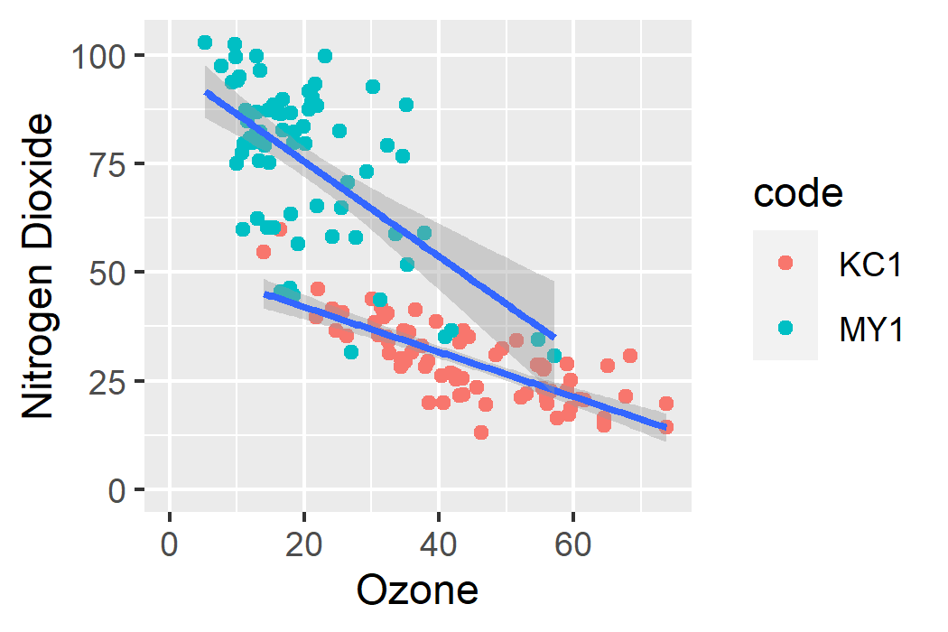
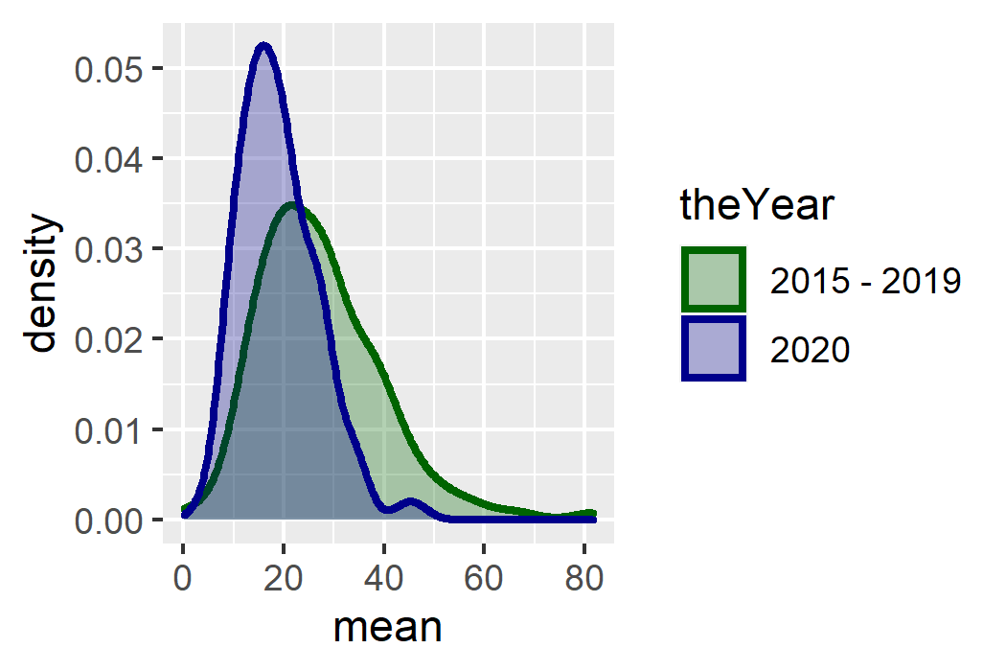
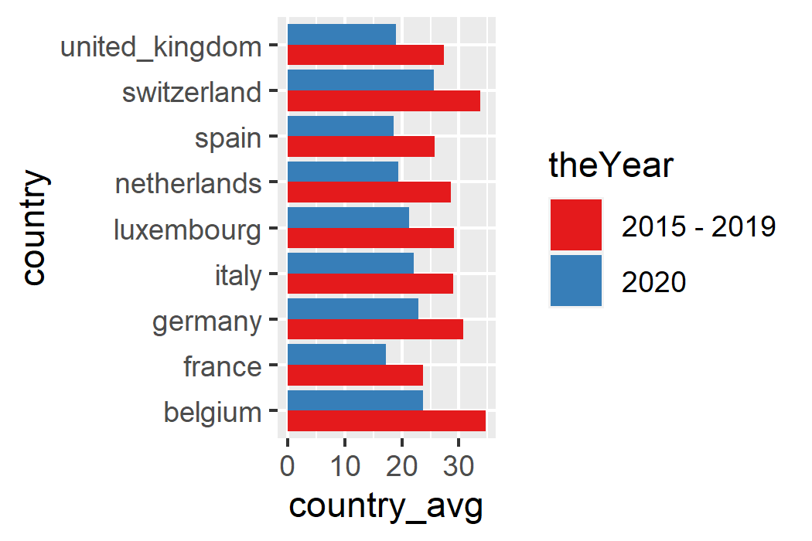
Applications of scale_*_*()
tsdata %>%
filter(code %in% c("MY1", "KC1")) %>%
select(-median) %>%
pivot_wider(names_from = name,
values_from = mean) %>%
ggplot(aes(x = o3, y = no2)) +
geom_point(aes(color = code)) +
geom_smooth(method = "lm",
aes(group = code)) +
scale_x_continuous(name = "Ozone",
limits = c(0, NA)) +
scale_y_continuous(name = "Nitrogen Dioxide",
limits = c(0, NA))
avgdata %>%
filter(country == "united_kingdom",
name == "no2") %>%
ggplot(aes(x = mean,
color = theYear, fill = theYear)) +
geom_density(alpha = .3, size = 1) +
scale_color_manual(values = c("darkgreen",
"darkblue")) +
scale_fill_manual(values = c("darkgreen",
"darkblue"))
avgdata %>%
group_by(country, theYear, name) %>%
summarise(country_avg = mean(mean)) %>%
filter(name == "no2") %>%
ggplot(aes(y = country,
x = country_avg,
fill = theYear)) +
geom_col(position = position_dodge()) +
scale_fill_brewer(palette = "Set1")

Slide 4
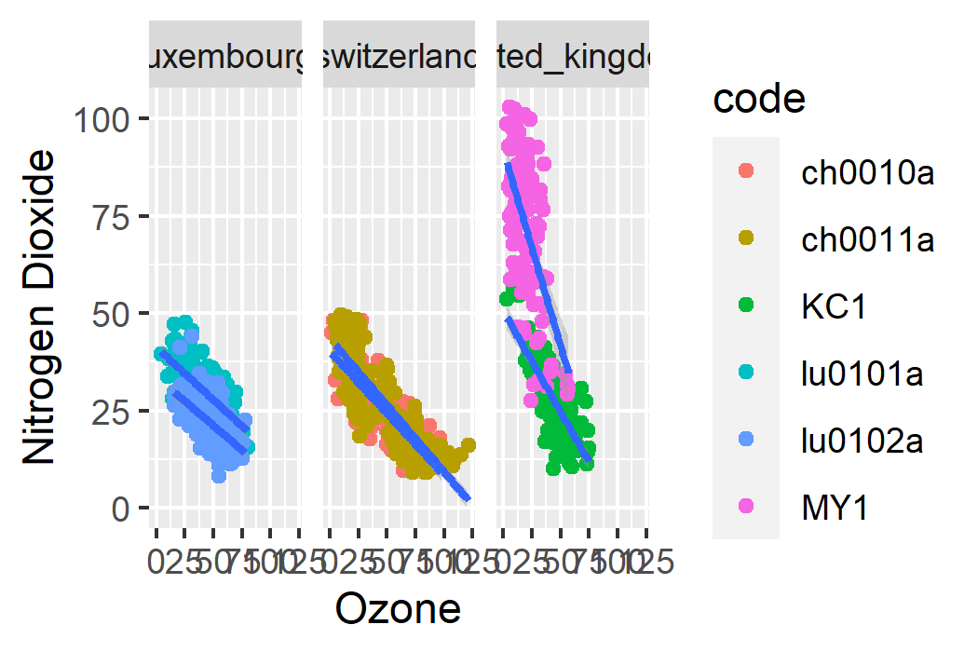
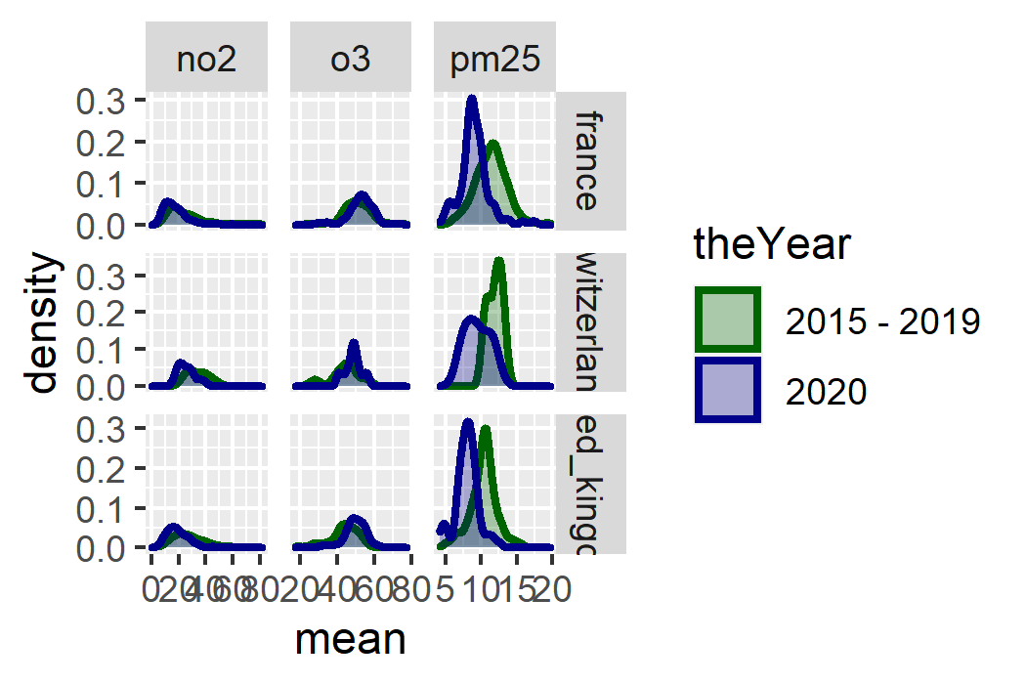
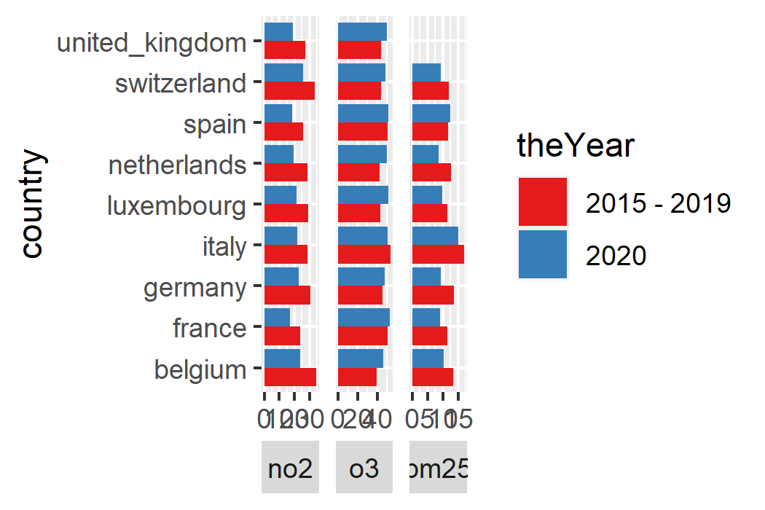
Introducing facet()
tsdata %>%
filter(code %in% c("MY1", "KC1")) %>%
select(-median) %>%
pivot_wider(names_from = name,
values_from = mean) %>%
ggplot(aes(x = o3, y = no2)) +
geom_point(aes(color = code)) +
geom_smooth(method = "lm",
aes(group = code)) +
scale_x_continuous(name = "Ozone",
limits = c(0, NA)) +
scale_y_continuous(name = "Nitrogen Dioxide",
limits = c(0, NA)) +
facet_wrap(~country)
avgdata %>%
filter(country == "united_kingdom",
name == "no2") %>%
ggplot(aes(x = mean,
color = theYear, fill = theYear)) +
geom_density(alpha = .3, size = 1) +
scale_color_manual(values = c("darkgreen",
"darkblue")) +
scale_fill_manual(values = c("darkgreen",
"darkblue")) +
facet_grid(country~name, scales = "free")
avgdata %>%
group_by(country, theYear, name) %>%
summarise(country_avg = mean(mean)) %>%
filter(name == "no2") %>%
ggplot(aes(y = country,
x = country_avg,
fill = theYear)) +
geom_col(position = position_dodge()) +
scale_fill_brewer(palette = "Set1") +
theme(strip.placement = "outside") +
facet_wrap(~name,
scales = "free_x",
strip.position = "bottom")

Slide 5
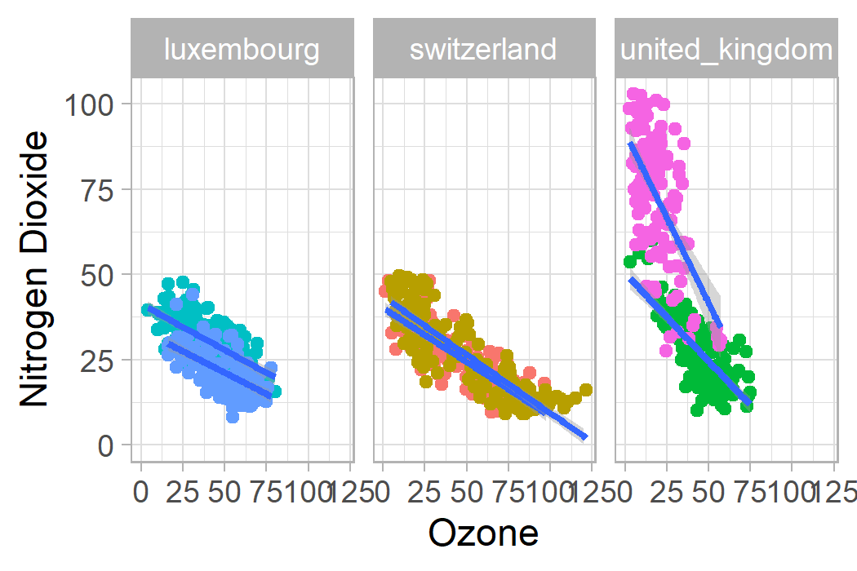
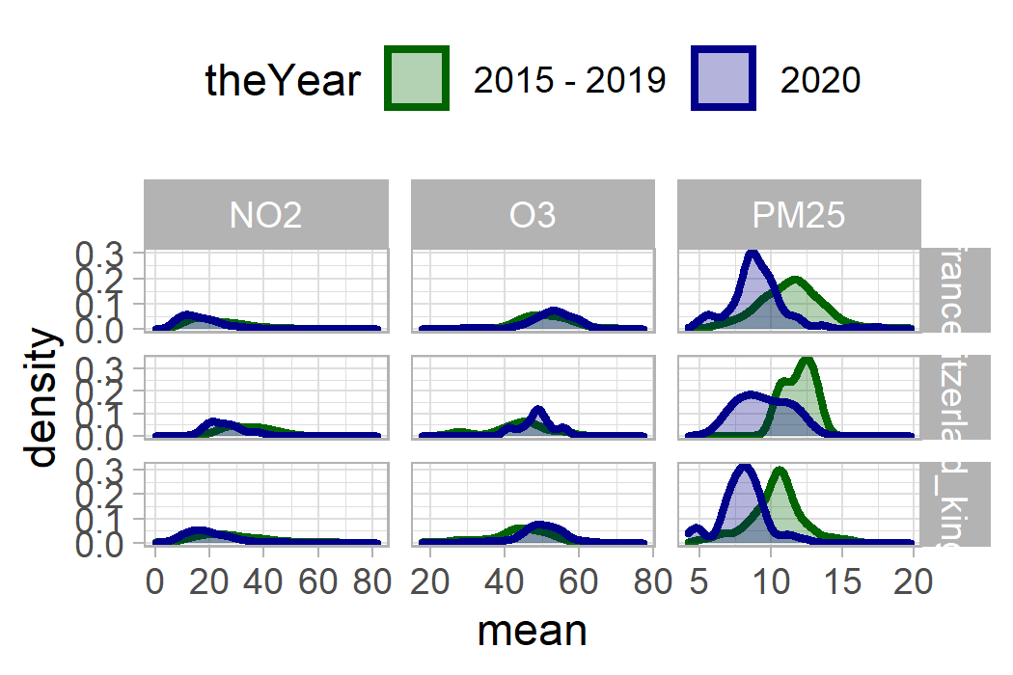
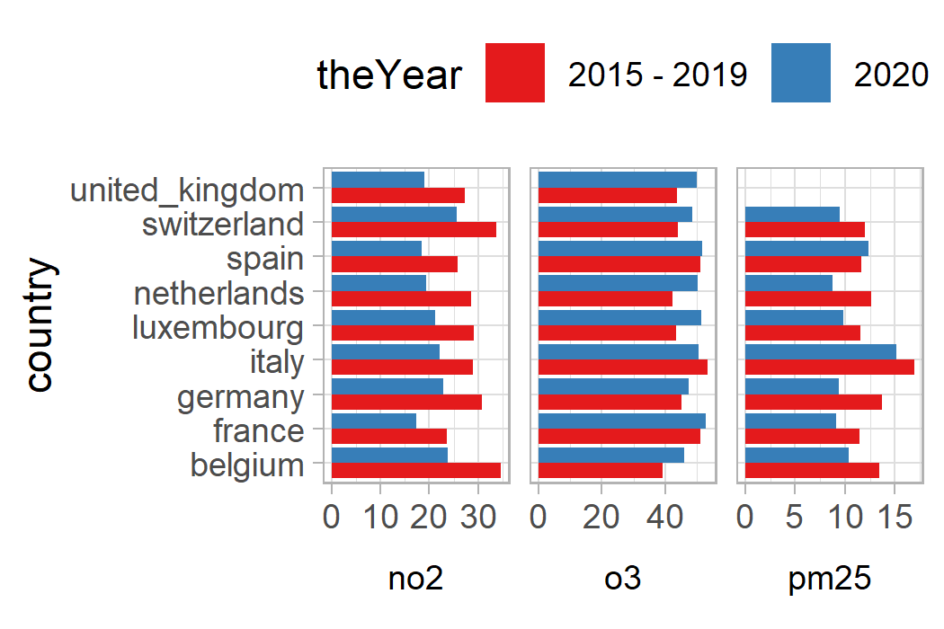
Refining with theme()
avgdata %>%
group_by(country, theYear, name) %>%
summarise(country_avg = mean(mean)) %>%
filter(name == "no2") %>%
ggplot(aes(y = country,
x = country_avg,
fill = theYear)) +
geom_col(position = position_dodge()) +
scale_fill_brewer(palette = "Set1") +
theme(strip.placement = "outside") +
facet_wrap(~name,
scales = "free_x",
strip.position = "bottom")+ theme_light() +
theme(legend.position = "top",
strip.placement = "outside",
strip.text = element_text(color =
"black"),
strip.background = element_blank())
tsdata %>%
filter(code %in% c("MY1", "KC1")) %>%
select(-median) %>%
pivot_wider(names_from = name,
values_from = mean) %>%
ggplot(aes(x = o3, y = no2)) +
geom_point(aes(color = code)) +
geom_smooth(method = "lm",
aes(group = code)) +
scale_x_continuous(name = "Ozone",
limits = c(0, NA)) +
scale_y_continuous(name = "Nitrogen Dioxide",
limits = c(0, NA)) +
facet_wrap(~country) +
theme_light() +
theme(legend.position = "none")
avgdata %>%
filter(country == "united_kingdom",
name == "no2") %>%
ggplot(aes(x = mean,
color = theYear, fill = theYear)) +
geom_density(alpha = .3, size = 1) +
scale_color_manual(values = c("darkgreen",
"darkblue")) +
scale_fill_manual(values = c("darkgreen",
"darkblue")) +
facet_grid(country~name, scales = "free") + theme_light() +
theme(legend.position = "top")

