Slide 1
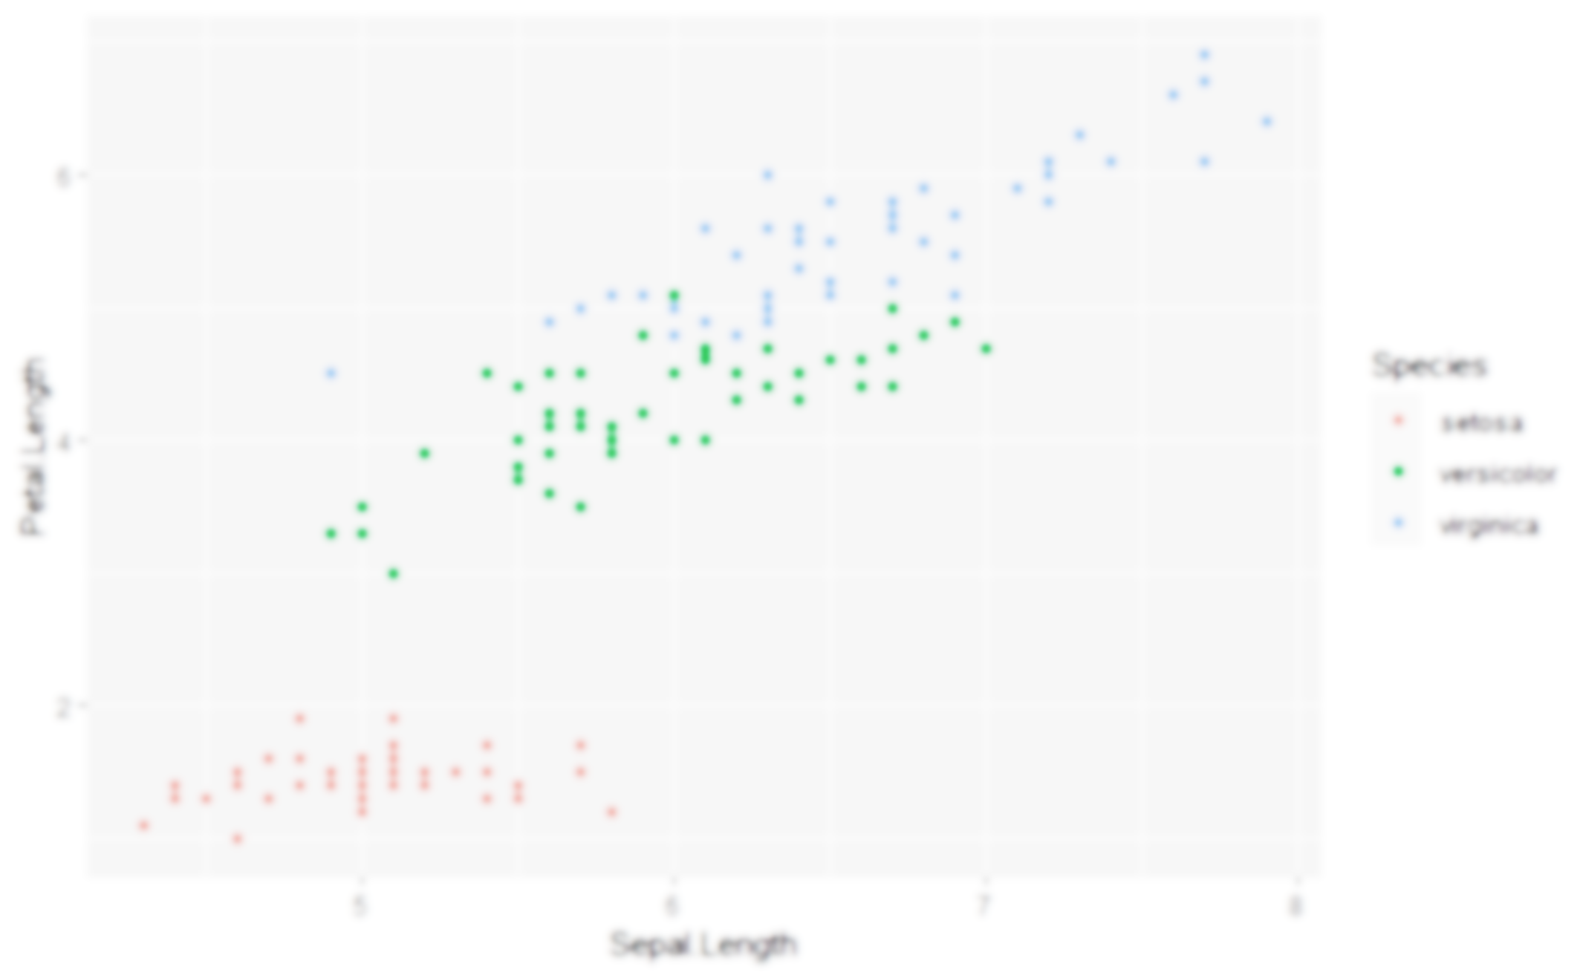
Data Visualisation using {ggplot2}
Jack Davison & Will Drysdale

Slide 2
Why use {ggplot2}?
The package allows you to quicky, easily and flexibly create graphs.
Legends, axis labels, colour scales, etc., are all dealt with automatically…
…but you still have a great deal of control!
It is not prescriptive – you build your graph from the ground up.
{ggplot2} uses a “paint on canvas” approach that lets you build almost any visualisation you want
There are many, many extension packages that extend its functionality.
Correlation matrices, maps, distributions…

Slide 3
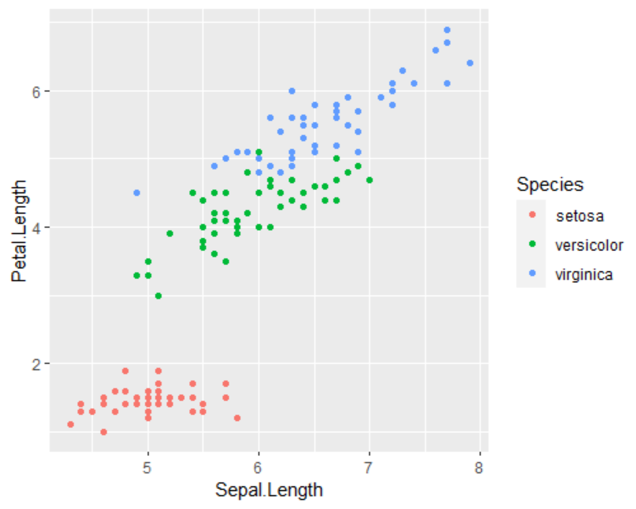
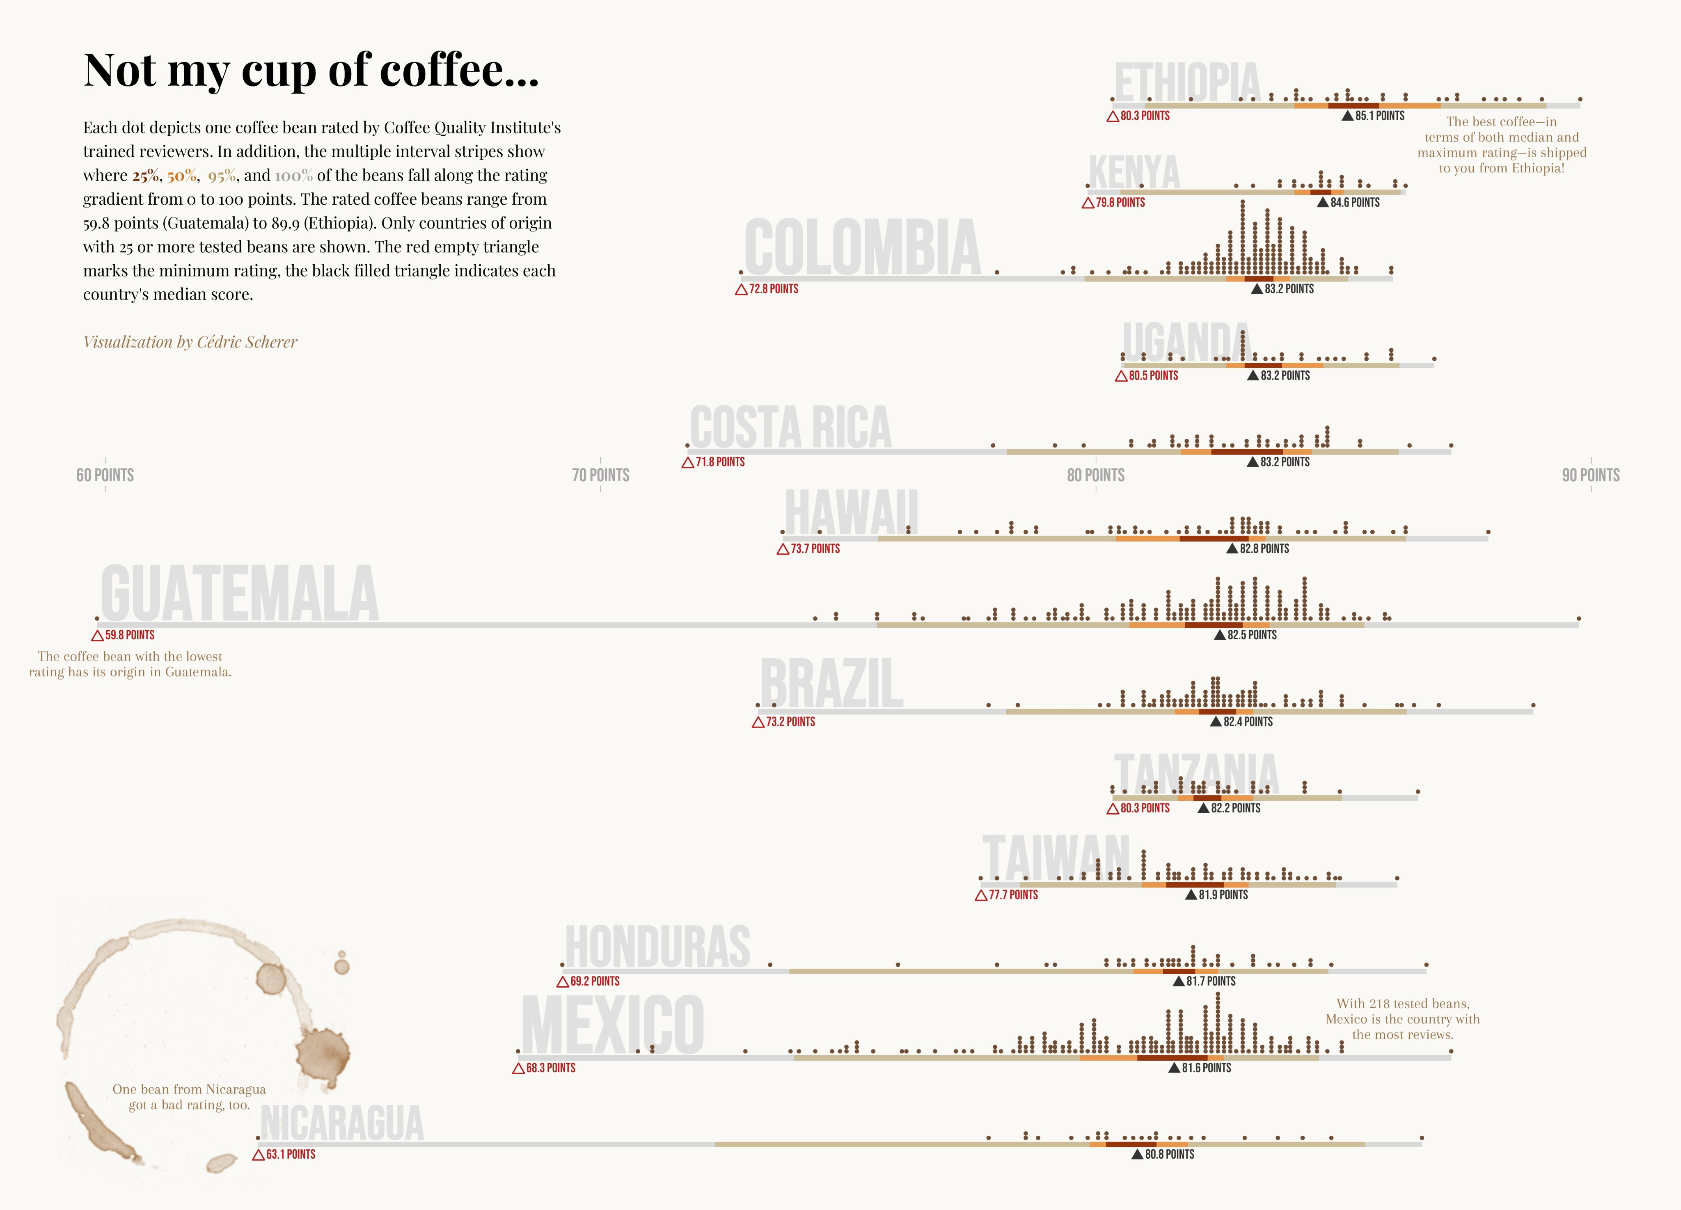
What does a {ggplot2} look like?
Like this…
…or like this!

Slide 4
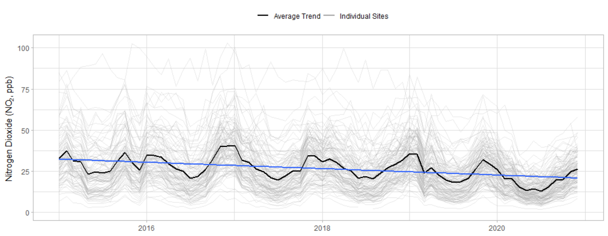
What does a {ggplot2} look like?
But we’re aiming for something like this!

Slide 5
Activities: Building a {ggplot2}

Slide 6
What are we doing?
We are going to take you through {ggplot2} syntax step by step.
Data, Aesthetics, Scales, Facets, Themes
We (Jack & Will) will be constructing a timeseries to demonstrate.
You’ll be building three plots as we go – by the end you’ll have made a scatter plot, a bar chart, and a density function.
Please find the three .R files and the data in the “activity” folder.

Slide 7
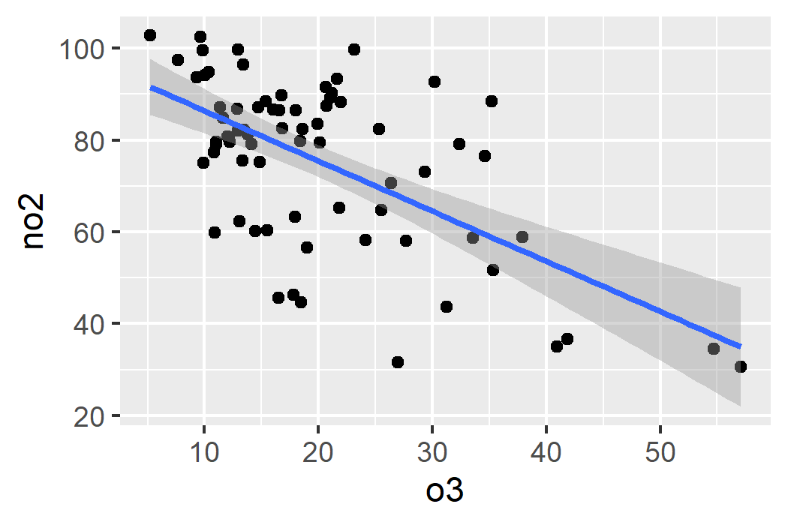
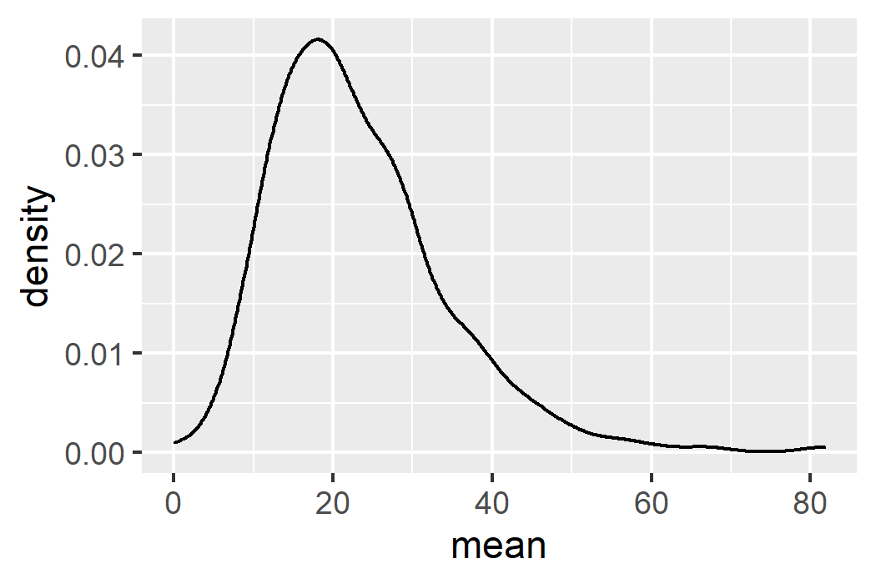
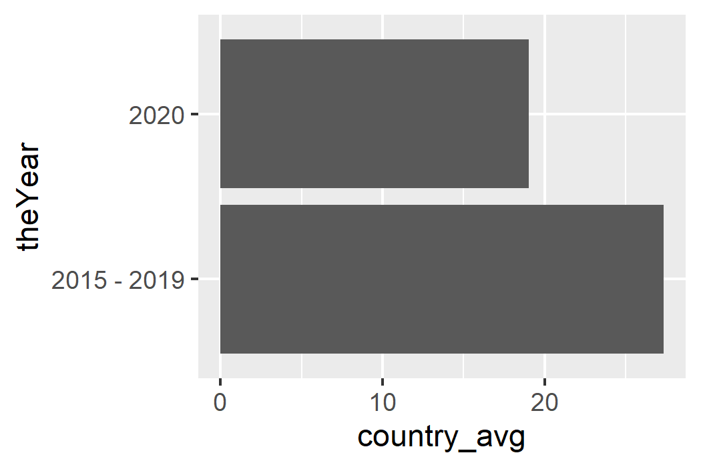
Some simple plots
scatter_data %>%
filter(code == "MY1") %>%
ggplot(aes(x = o3, y = no2)) +
geom_point() +
geom_smooth(method = "lm")
density_data %>%
filter(country == "united_kingdom",
name == "no2") %>%
ggplot(aes(x = mean)) +
geom_density()
bar_data %>%
filter(name == "no2“,
country == "united_kingdom") %>%
ggplot(aes(y = theYear, x = country_avg)) +
geom_col()

Slide 8
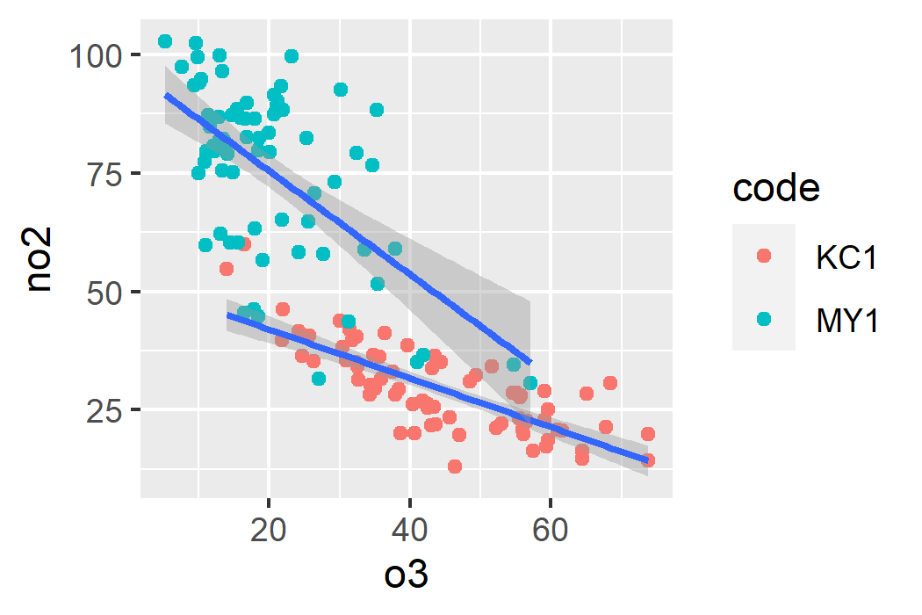
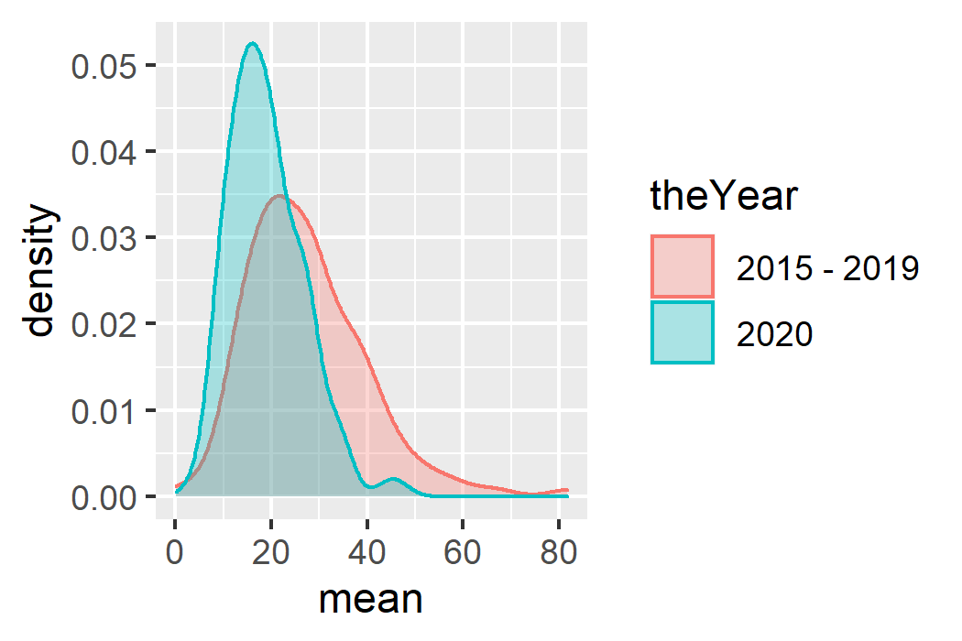
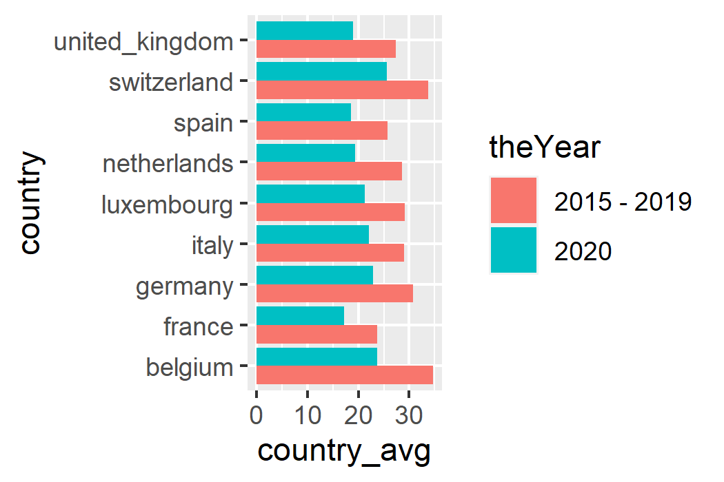
Further use of aes()
scatter_data %>%
filter(code %in% c("MY1", "KC1")) %>%
ggplot(aes(x = o3, y = no2)) +
geom_point(aes(color = code)) +
geom_smooth(method = "lm", aes(group = code))
density_data %>%
filter(country == "united_kingdom",
name == "no2") %>%
ggplot(aes(x = mean,
color = theYear,
fill = theYear)) +
geom_density(alpha = .3)
bar_data %>%
filter(name == "no2") %>%
ggplot(aes(y = country,
x = country_avg,
fill = theYear)) +
geom_col(position = position_dodge())

Slide 9
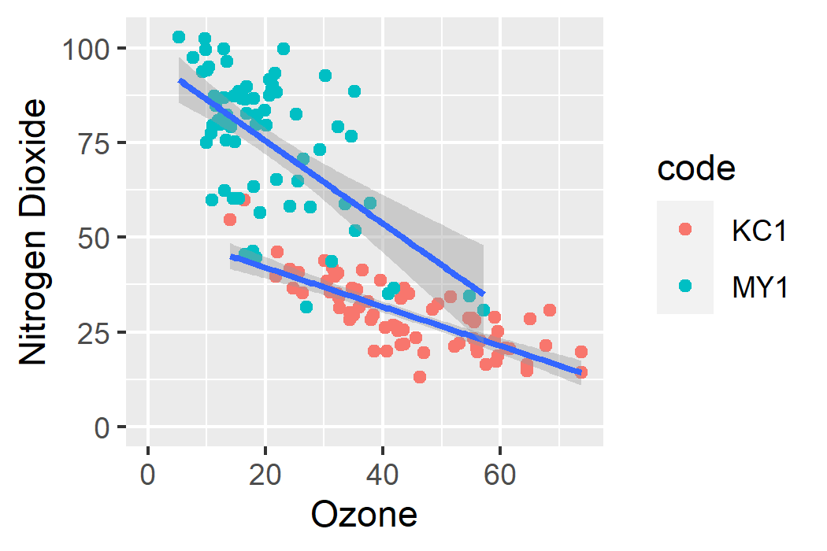
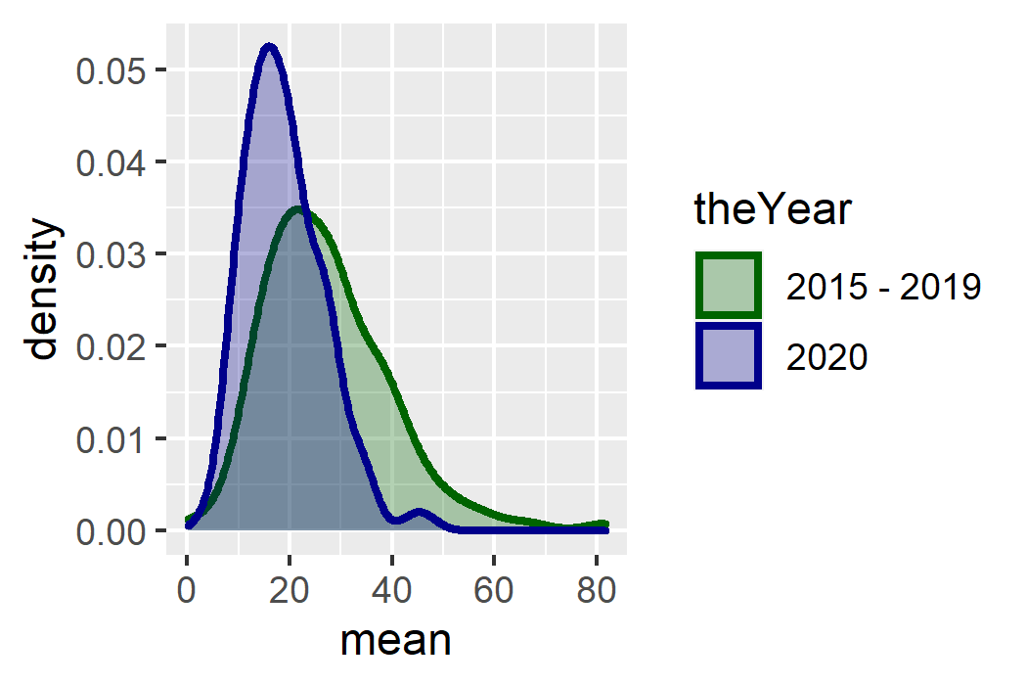
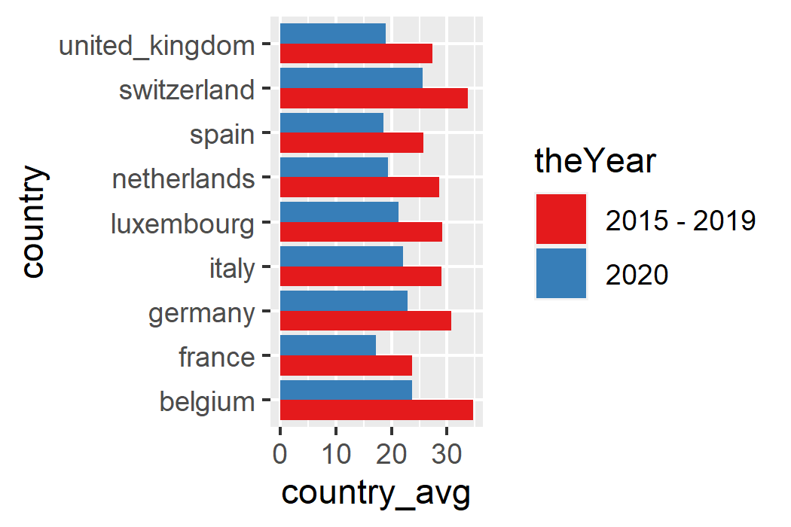
Applications of scale_*_*()
scatter_data %>%
filter(code %in% c("MY1", "KC1")) %>%
ggplot(aes(x = o3, y = no2)) +
geom_point(aes(color = code)) +
geom_smooth(method = "lm",
aes(group = code)) +
scale_x_continuous(name = "Ozone",
limits = c(0, NA)) +
scale_y_continuous(name = "Nitrogen Dioxide",
limits = c(0, NA))
density_data %>%
filter(country == "united_kingdom",
name == "no2") %>%
ggplot(aes(x = mean,
color = theYear, fill = theYear)) +
geom_density(alpha = .3, size = 1) +
scale_color_manual(values = c("darkgreen",
"darkblue")) +
scale_fill_manual(values = c("darkgreen",
"darkblue"))
bar_data %>%
filter(name == "no2") %>%
ggplot(aes(y = country,
x = country_avg,
fill = theYear)) +
geom_col(position = position_dodge()) +
scale_fill_brewer(palette = "Set1")

Slide 10
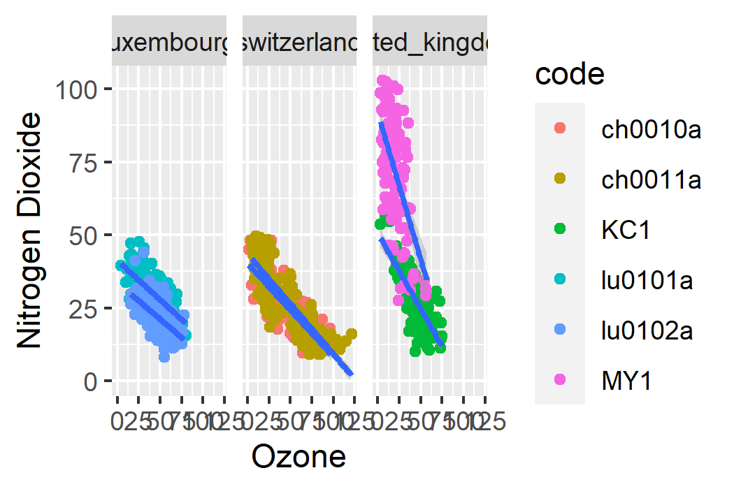
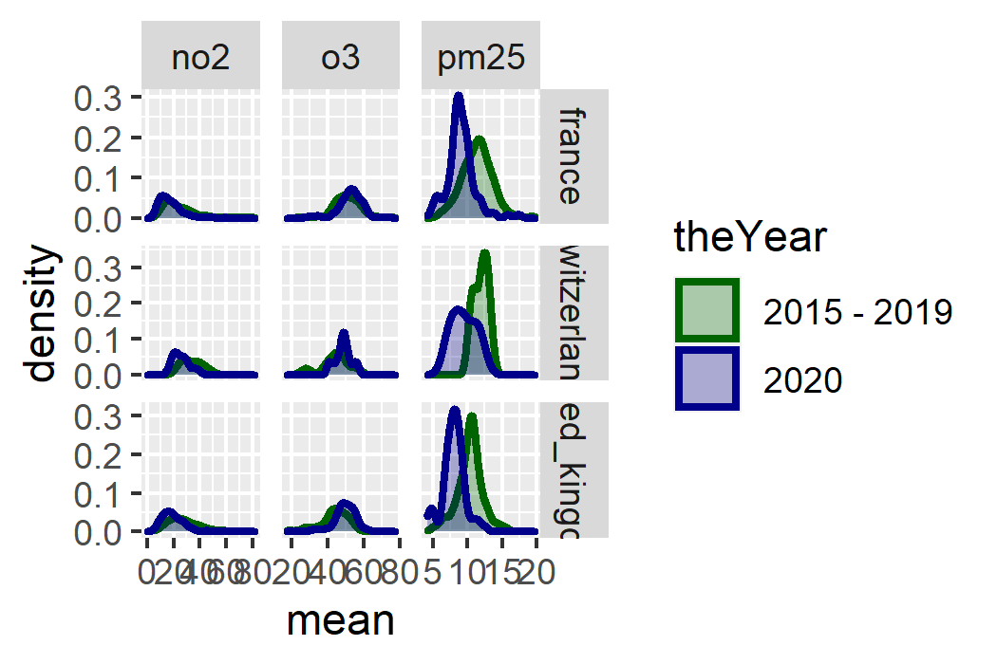
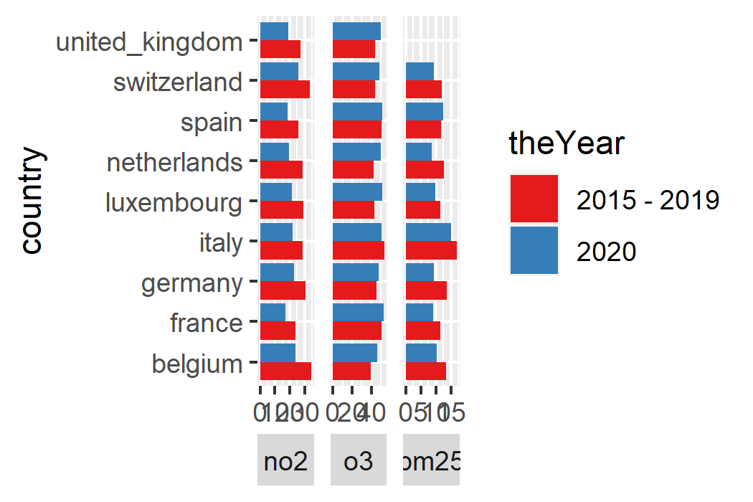
Introducing facet()
scatter_data %>%
ggplot(aes(x = o3, y = no2)) +
geom_point(aes(color = code)) +
geom_smooth(method = "lm",
aes(group = code)) +
scale_x_continuous(name = "Ozone",
limits = c(0, NA)) +
scale_y_continuous(name = "Nitrogen Dioxide",
limits = c(0, NA)) +
facet_wrap(~country)
density_data %>%
ggplot(aes(x = mean,
color = theYear, fill = theYear)) +
geom_density(alpha = .3, size = 1) +
scale_color_manual(values = c("darkgreen",
"darkblue")) +
scale_fill_manual(values = c("darkgreen",
"darkblue")) +
facet_grid(country~name, scales = "free")
bar_data %>%
ggplot(aes(y = country,
x = country_avg,
fill = theYear)) +
geom_col(position = position_dodge()) +
scale_fill_brewer(palette = "Set1") +
theme(strip.placement = "outside") +
facet_wrap(~name,
scales = "free_x",
strip.position = "bottom")

Slide 11
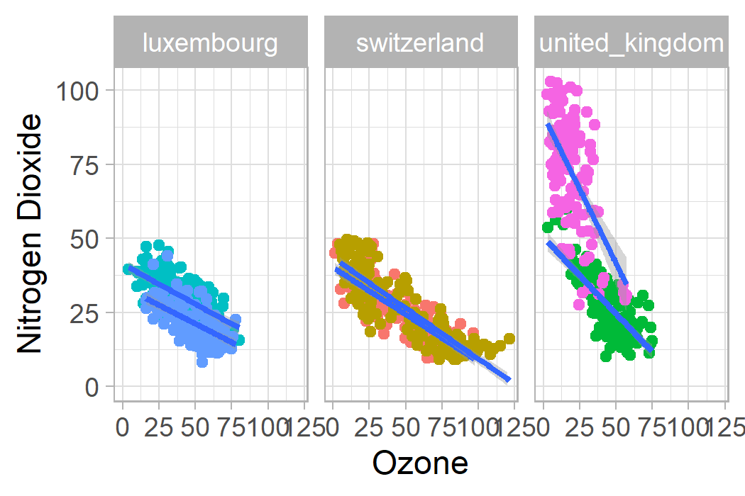
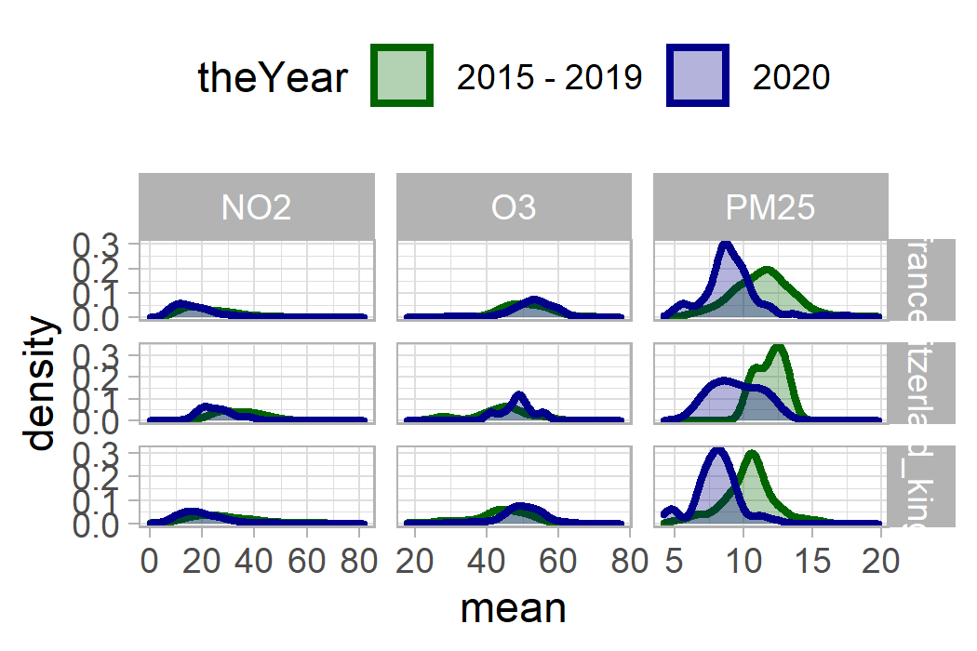
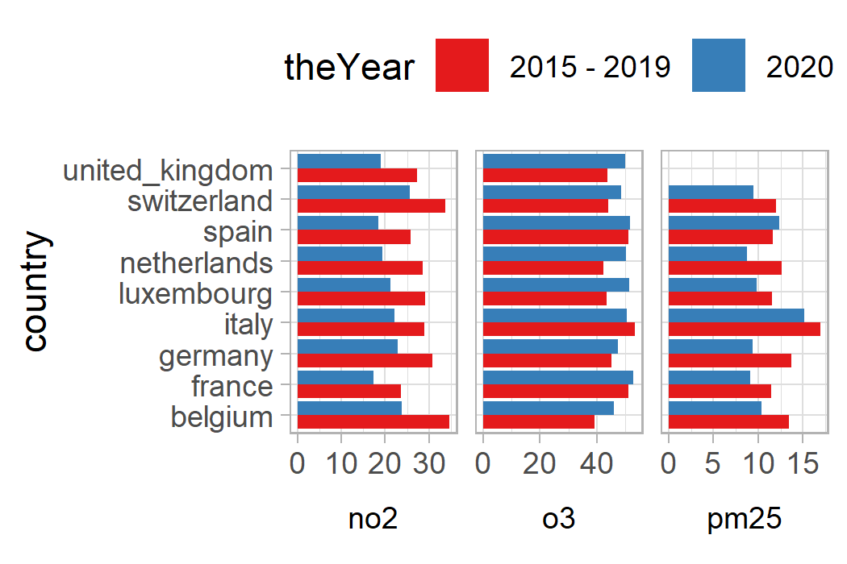
Refining with theme()
bar_data %>%
ggplot(aes(y = country,
x = country_avg,
fill = theYear)) +
geom_col(position = position_dodge()) +
scale_fill_brewer(palette = "Set1") +
theme(strip.placement = "outside") +
facet_wrap(~name,
scales = "free_x",
strip.position = "bottom")+ theme_light() +
theme(legend.position = "top",
strip.placement = "outside",
strip.text = element_text(color =
"black"),
strip.background = element_blank())
scatter_data %>%
ggplot(aes(x = o3, y = no2)) +
geom_point(aes(color = code)) +
geom_smooth(method = "lm",
aes(group = code)) +
scale_x_continuous(name = "Ozone",
limits = c(0, NA)) +
scale_y_continuous(name = "Nitrogen Dioxide",
limits = c(0, NA)) +
facet_wrap(~country) +
theme_light() +
theme(legend.position = "none")
density_data %>%
ggplot(aes(x = mean,
color = theYear, fill = theYear)) +
geom_density(alpha = .3, size = 1) +
scale_color_manual(values = c("darkgreen",
"darkblue")) +
scale_fill_manual(values = c("darkgreen",
"darkblue")) +
facet_grid(country~name, scales = "free") + theme_light() +
theme(legend.position = "top")

Slide 12
Learners’ {ggplot2} Questions

