Slide 1
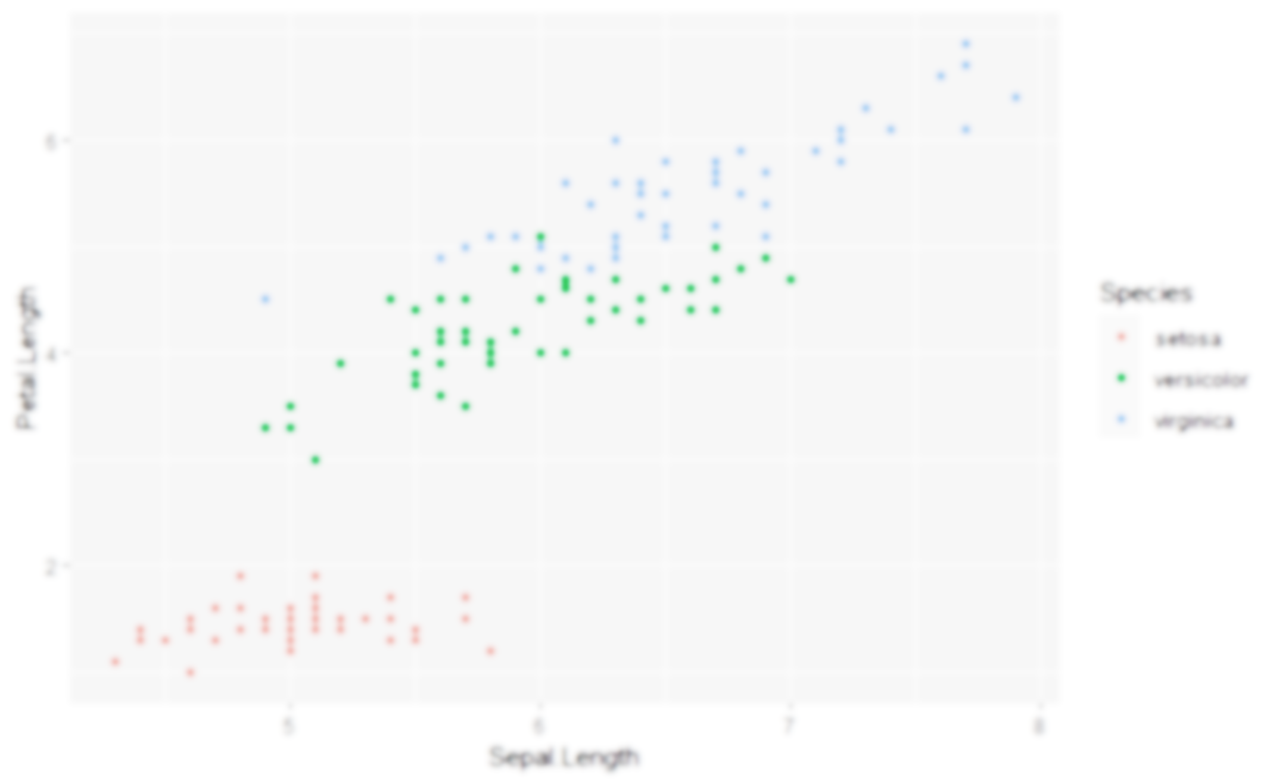
Data Visualisation using {ggplot2}
Jack Davison & Will Drysdale

Slide 2
Why use {ggplot2}?
The package allows you to quicky, easily and flexibly create graphs.
Legends, axis labels, colour scales, etc., are all dealt with automatically…
…but you still have a great deal of control!
It is not prescriptive – you build your graph from the ground up.
{ggplot2} uses a “paint on canvas” approach that lets you build almost any visualisation you want
There are many, many extension packages that extend its functionality.
Correlation matrices, maps, distributions…

Slide 3
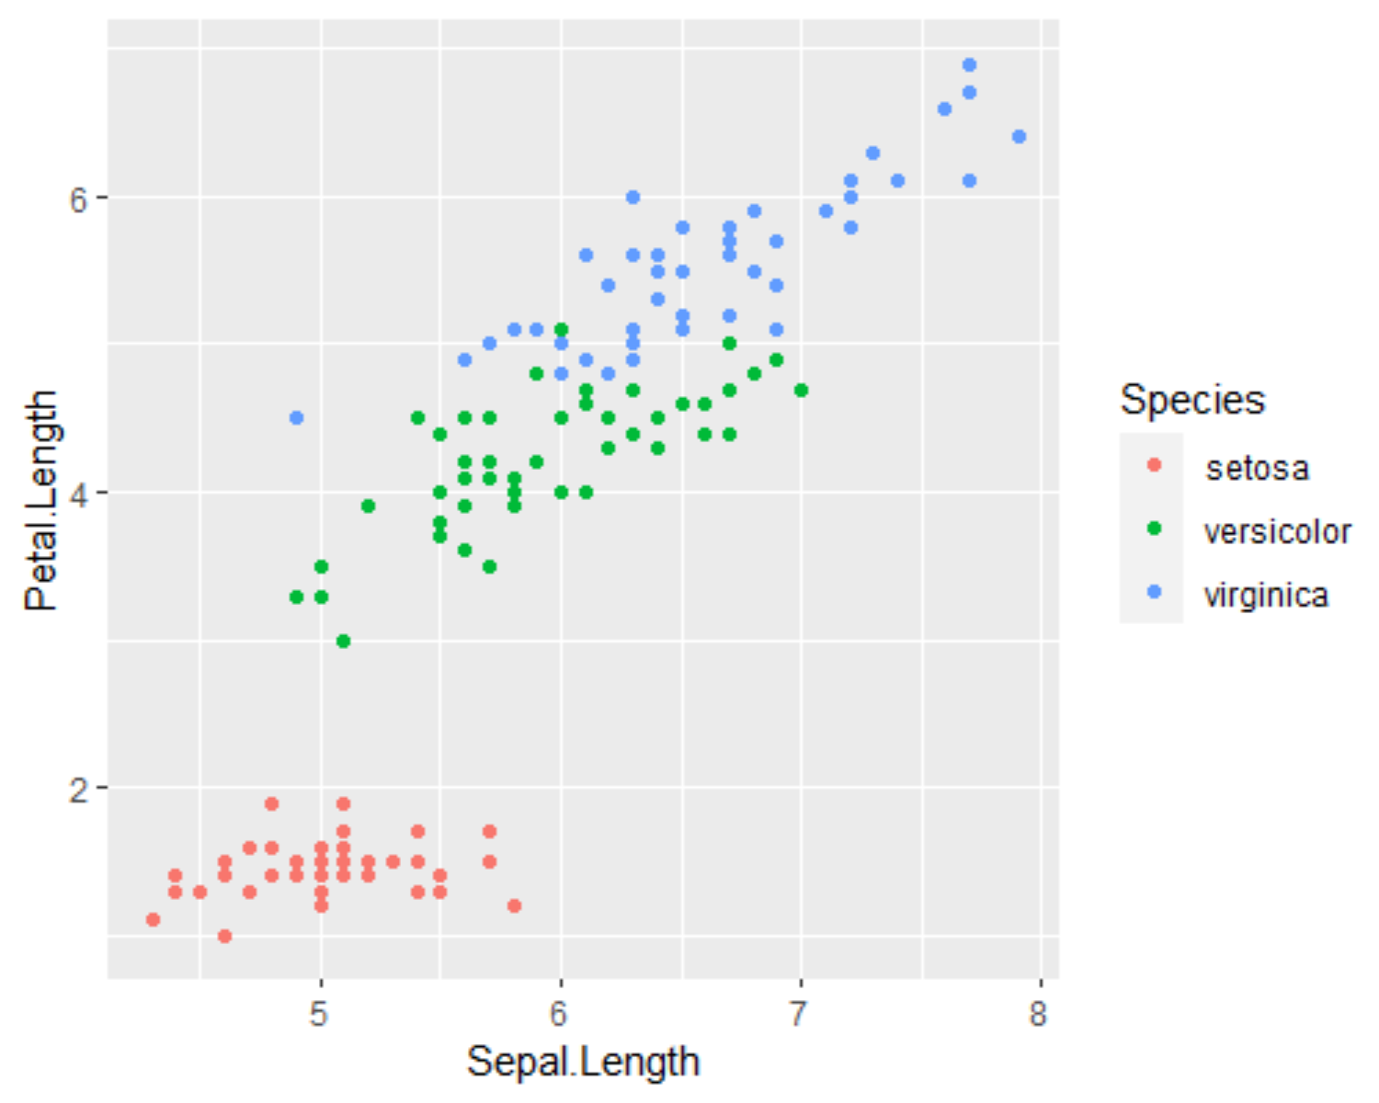
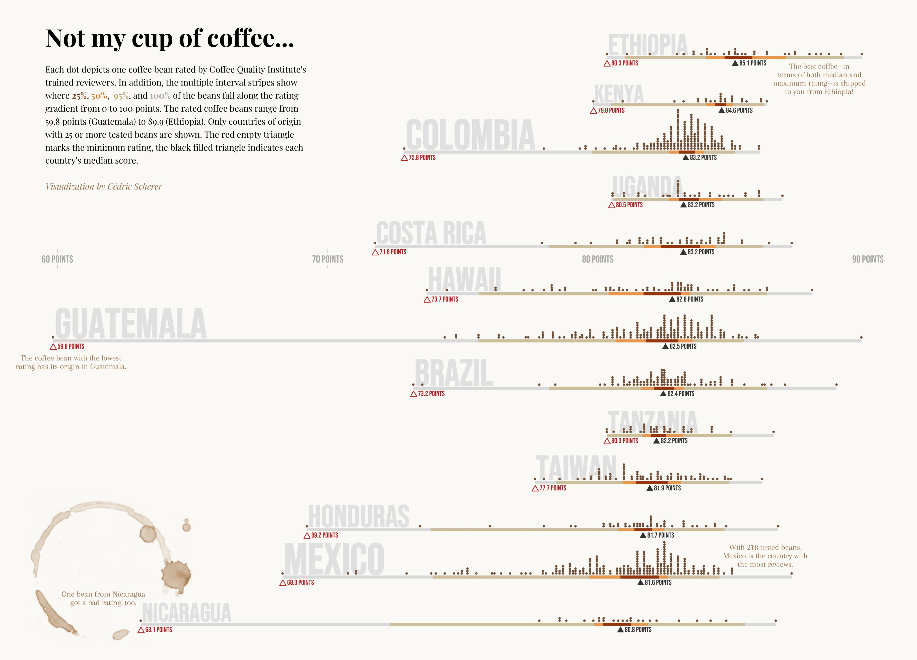
What does a {ggplot2} look like?
Like this…
…or like this!

Slide 4
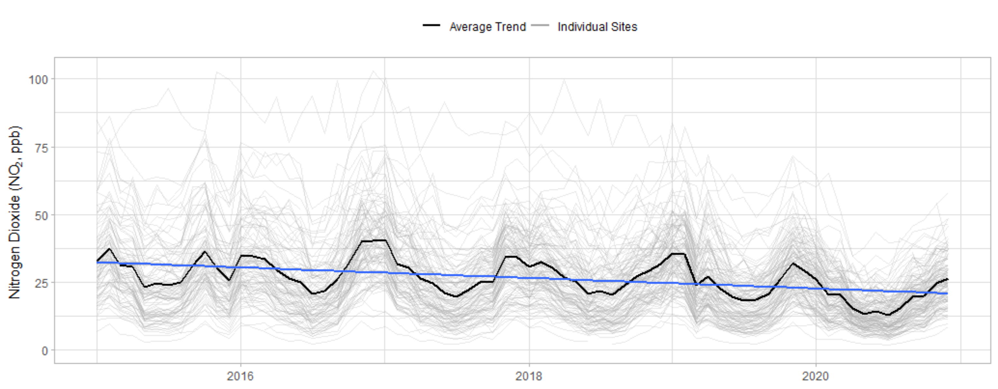
What does a {ggplot2} look like?
But we’re aiming for something like this!

Slide 5
Activities: Building a {ggplot2}

Slide 6
Some simple plots
Scatter Plot
Plot a scatter of O₃ to NO₂ just for Marylebone Road (code == “MY1”) and fit a smooth through it.
Density Plot
Plot a density function of NO2, just for the UK.
Bar Chart
Plot a bar chart showing the average NO₂ in the UK before and after 2020.

Slide 7
Further use of aes()
Scatter Plot
Add the site “KC1” to your plot, and colour by the site code. Make sure the trend lines are plotted per site and not overall.
Density Plot
Plot two density functions – one before and one after 2020. Fill them with colour, but make them transparent so they can both be seen
Bar Chart
Change your bar chart to include every country, not just the UK. Colour the bars by year instead. You may need to use a “position” argument.

Slide 8
Applications of scale_*_*()
Scatter Plot
Make the x and y axes of your plot go to zero. Also, label them “Ozone” and “Nitrogen Dioxide” in full.
Density Plot
Change the colours of your density functions from the default – “darkgreen” and “darkblue” are nice options. Also, give the legend a better name.
Bar Chart
Change the colours of your bars using a “brewer” palette.

Slide 9
Introducing facet()
Scatter Plot
Use all of the sites provided in “codes”. Facet by country to display the UK, Switzerland and Luxembourg in their own panels.
Density Plot
Include all three pollutants – NO2, O3, PM25 – and all three countries – UK, France, Switzerland. Facet by both “country” and “pollutant”. You should end up with a 3x3 grid.
Bar Chart
Include all three pollutants – NO2, O3, PM25. Facet by pollutant, and make sure they’re on appropriate scales. Switch the positions of the facet labels to look like axis labels.

Slide 10
Refining with theme()
Scatter Plot
Pick a nice theme for your scatter plot. Remove the legend.
Density Plot
Pick a nice theme for your density plot. Put the legend at the top.
Bar Chart
Pick a nice theme for your bar chart. Put the legend at the top. Try to remove the borders around the facet labels so they look more like axis labels

