Slide 1
Musical Instrument Taxonomy Classification
Aidan Johnson and Deniz Alpay

Slide 2
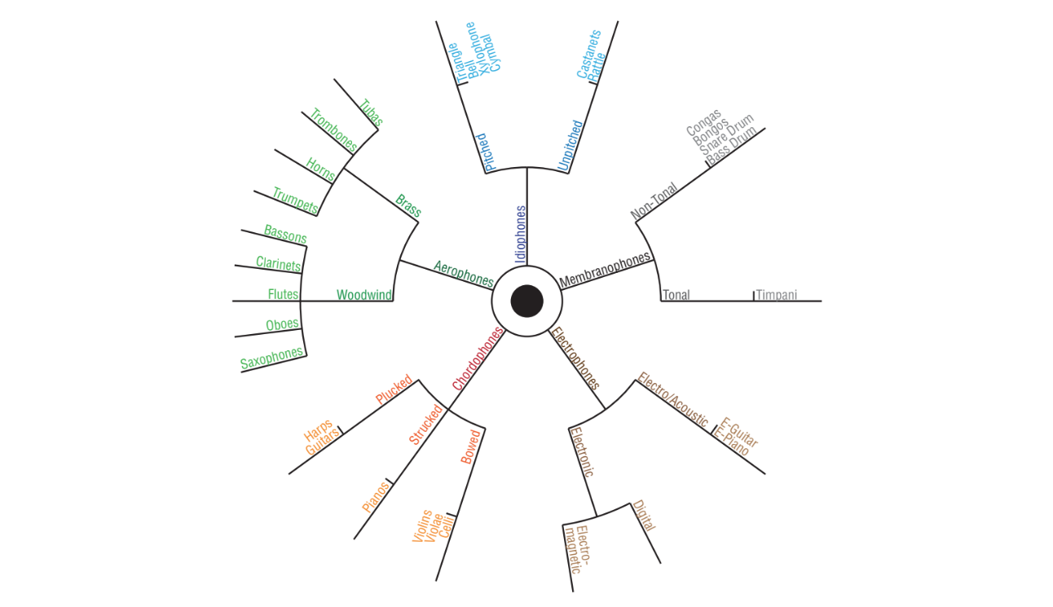
How can we distinguish these instruments by ear?

Slide 3
How can we distinguish these instruments by ear? Timbre

Slide 4
What is Timbre?
Humans can perceive difference in the sound produced by different instruments at same pitch and loudness
In music, this distinguishing characteristic is referred to as timbre—the distinguish quality/characteristic of a sound
Measurable definition of timbre: uncertain
Timbre is multidimensional but abstract
Spectral (MFCCs)
Temporal (ADSR envelope)

Slide 5
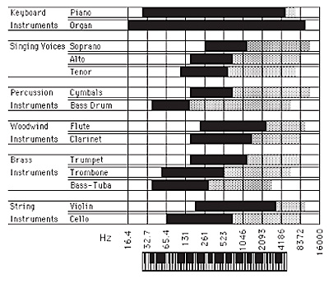
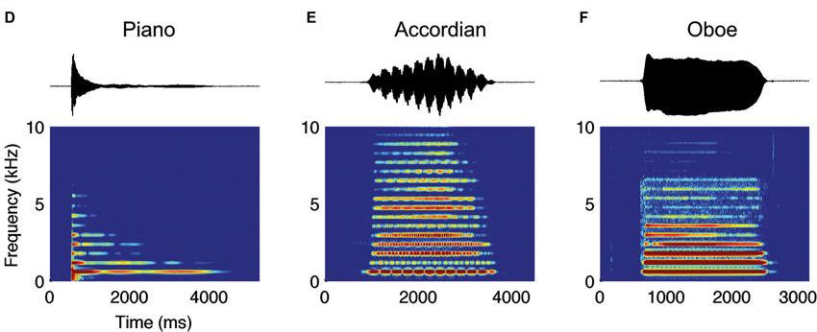
Introduction
Goal: Classify instruments in audio of a single instrument.
Notes:
Talk about the temporal and spectral differences in instruments and introduce timbre and instrument taxonomy.
10.3389/fnsys.2013.00088 (left)

Slide 6
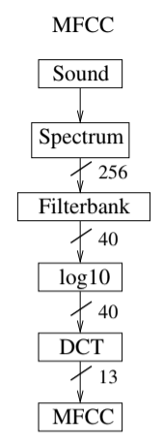
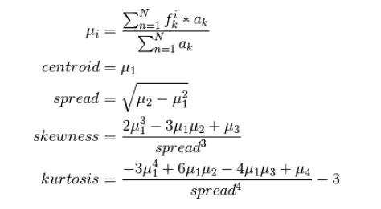
Feature Extraction
Mel-frequency cepstral coefficients (MFCCs)
Spectral shape statistics
Raw moments
Mean
Variance
Asymmetry (at mean)
Flatness (at mean)
Notes:
Describe the features used and what the spectral shape statistics actually mean.

Slide 7
Data set
IRMAS: https://www.upf.edu/web/mtg/irmas
6 instruments
Labeled by primary instrument present and genre
6705 training files, 2874 testing files
Data decisions
Only used audio with a single instrument
Manually cleaned some of the testing data
Narrowed instruments to cello, saxophone, and violin
395 training files, 75 testing files
Notes:
Just a description of the dataset and how we used it.
Universitat Pompeu Fabra, Barcelona
Bosch, J. J., Janer, J., Fuhrmann, F., & Herrera, P. “A Comparison of Sound Segregation Techniques for Predominant Instrument Recognition in Musical Audio Signals”, in Proc. ISMIR (pp. 559-564), 2012

Slide 8
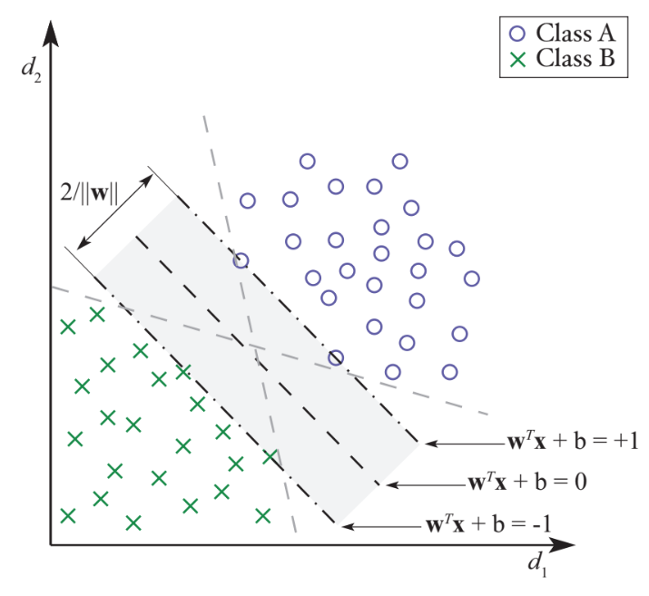
Support Vector Machine (SVM)
Training:
min (½)||w||² such that:
y_{i}(w^{T}x_{i} + b) - 1) ≥ 0 for all points
N total training points
Point x_{i}
D-dimensions
Has binary class y_{i} (either +1 or -1)
w: normal vector of hyperplane
b: offset
b/||w||: perpendicular distance hyperplane to origin

Slide 9
Classification: SVM
Support vector machine with radial basis function kernel
 | Cello | Saxophone | Violin
Accuracy | 76.2% | 82.2% | 63.7%
Type I error (false positives) | 11.2% | 17.8% | 3.36%
Type II error (false negatives) | 12.6 | 0% | 33.0%
Notes:
Discussion on classification results. Random guessing has an accuracy of 66%. Errors suggest that there’s a lot of overlap between classes and a one vs all approach would greatly help.
According to Agostini: SVM had highest performance; Marques: SVM one vs all no better than multiple binary class

Slide 10
Classification: SVM
Support vector machine with radial basis function kernel
One vs all
 | Cello | Saxophone | Violin
Misclassifications | 23.8% | 17.8% | 36.3%
Type I error (false positives) | 11.2% | 17.8% | 3.36%
Type II error (false negatives) | 12.6 | 0% | 33.0%
Number of support vectors | 25,469 | 20,799 | 31,416
Notes:
Talk about the computational cost of the SVM, how one vs all is better, number of support vectors is huge.

Slide 11
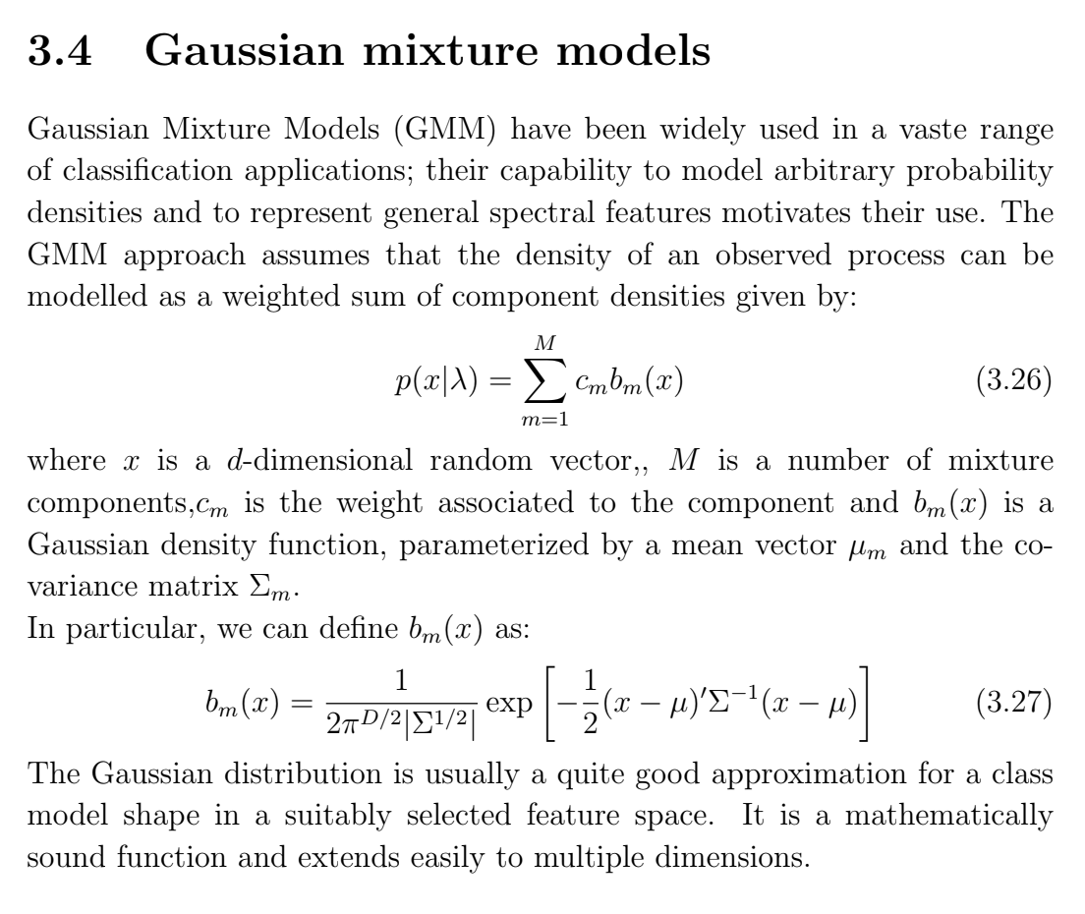
Gaussian Mixture Model (GMM)
x: d-dimensional random vector
M: no. mixture components
c_{m}: component weight
b_{m}(x): Gaussian density function with mean mu

Slide 12
Classification: GMM
GMM advantages:
Parametric
Interpretable
Computationally cheaper
Notes:
Discuss advantages of GMM: parametric model (unlike SVM), no need for one vs all, computationally cheaper
Review GMM parameters and what they mean.

Slide 13
Conclusion
SVM:
Computationally expensive for complex data and more classes, but is much more effective than GMM
Classifies with reasonable and comparable—with respect to the literature—performance
Broader implication of studying/quantifying timbre:
Human perception of sound (music, speech, etc.) using spectral and temporal acoustic features
Neural representation processing in human brain (auditory cortex)
Notes:
Review of important results/takeaways
Timbre is the attribute that distinguishes sounds of equal pitch, loudness and duration.
It contributes to our perception and discrimination of different vowels and consonants in
speech, instruments in music and environmental sounds. Here we begin by reviewing
human timbre perception and the spectral and temporal acoustic features that give rise
to timbre in speech, musical and environmental sounds. (https://doi.org/10.3389/fnsys.2013.00088)

