Slide 1

NEEDLE
Aidan Jones
AJ
Founding Forward-Deployed Engineer, Vulcan Technologies
B.S. Biology, pre-med · TCU College of Science & Engineering
The Fine Print,
found and decided.
Y Combinator S24
Series A, $300M valuation
Parker Kingsbury
PK
Finance · TCU Neeley School of Business
Healthcare analyst, Summit TX Capital (hedge fund)
EIF member
Healthcare investing
Advanced Track · Neeley AI Forward 2026
Notes:
SLIDE 1 · 20 sec
AIDAN: I'm Aidan. I'm a founding forward-deployed engineer at Vulcan Technologies, a Y Combinator company, and a pre-med biology major here at TCU. I built the system.
PARKER: I'm Parker. I'm a finance major in Neeley, and I cover healthcare as an analyst at Summit TX Capital. I pressure-tested the findings and made the call.

Slide 2
NEEDLE
PROBLEM → SOLUTION
Find what filings hide, pick one move, cite every number.
Part 1 5 hidden, material findings
Part 2 One CEO move, with math
Risk AI fabricates citations
Risk No answer key
OUR SCRAPE
SKILL 1 · FIND THE NEEDLE
7,005
10 blind readers
2 skeptics x 2
Sealed ranking
Cited findings
documents
78,392
141 candidates → 25 kept → Amgen #1 of 10
pages
118,329
SKILL 2 · THE CEO MOVE
Strategist
CFO skeptic
Decider skeptic
One move
facts
Filings
Calls
CMS
FDA labels
Deals
13 moves → 9 cut → 1 chosen
Every number links back to the page it came from.
2
Notes:
SLIDE 2 · 40 sec · AIDAN
The case asks two things: find what a drugmaker's filings hide, then make one CEO decision.
The hard part is AI. It makes up page numbers, and it will argue for any strategy.
So we scraped our own database: 7,005 documents and 78,392 pages.
Skill one sends ten blind readers through all ten companies, and two skeptic agents try to kill every finding. 141 candidates, 25 kept, Amgen came out first.
Skill two does the same for the CEO move.
And no number reaches the screen unless it links back to its page.
Hand to Parker.

Slide 3
NEEDLE
PART 1 · FIND THE NEEDLE
Five findings buried in Amgen filings
Amgen was the only one of 10 with two findings that are material, non-obvious and high-confidence.
#
Finding
Impact
Conf.
Obvious
SHARPEST NEEDLE
1
$2.4B TAVNEOS asset, 5.2x sales, facing FDA withdrawal[1]
$4.23/sh write-off
The FDA wants TAVNEOS pulled; Amgen still books it at $2.4B.
high
low
SHARPEST NEEDLE
2
Deductions hit 54% of gross; reserves flatter cash[2]
$1.07B cash flow
$2.4B carrying value[1]
high
low
$459M sales[4]
3
22% channel stocking inside TEPEZZA Q1 growth[3]
$84M, 24% of Q1 growth
med
low
Jan 16
FDA asks for withdrawal
4
IRS Puerto Rico case: at least $7.6B before interest[2]
$13.97/sh cash
Apr 27
FDA proposes withdrawal
high
high
Q2 10-Q
impairment wording softens
5
Partner profit share up $349M to $1.31B[2]
+0.99% of sales
high
high
No call or release mentions it.
[1] Amgen 10-Q Q2 2026, p. 16 [2] Amgen 10-K FY2025, pp. 77-79, F-29 [3] Amgen 10-Q Q1 2026, p. 33 [4] 10-K p. 69
3
Notes:
SLIDE 3 · 60 sec · PARKER
Amgen was the only one of the ten with two findings that are material, non-obvious and high-confidence.
Our Sharpest Needle: Amgen carries a $2.4 billion intangible for TAVNEOS, about 5.2 times its sales, and the FDA has formally proposed pulling the drug.
Between the Q1 and Q2 10-Qs the impairment wording softened, and no call or release mentions the number.
A full write-off is about $4.23 a share.
The other four back it up. We marked rows four and five obvious, because management has talked about them.

Slide 4
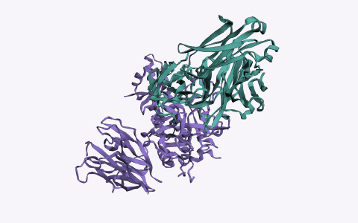
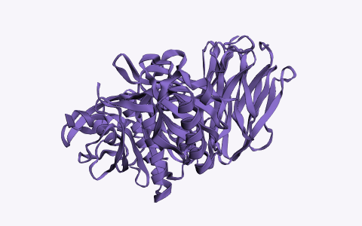
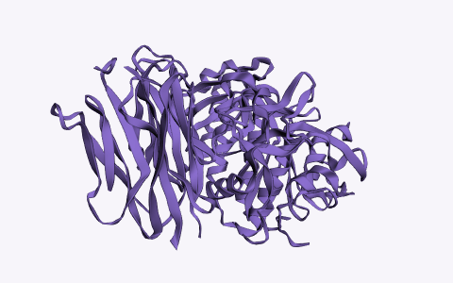
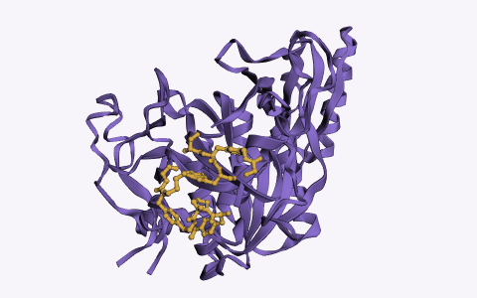
NEEDLE
PART 1 · PRODUCT
Repatha: best label, falling price
Each drug's target in 3D
Protein Data Bank crystal structures
[8]
Repatha[1]
PCSK9 + antibody · PDB 3H42
Praluent[2]
PCSK9, its target · PDB 2P4E
Leqvio[3]
PCSK9, its target · PDB 2P4E
Lipfendra[4]
PCSK9 + drug-series peptide · PDB 10SB
Approved uses
Heart events + procedures
Heart events, no procedures
LDL only
LDL only
Boxed warning
None
None
None
None
Dosing
Shot, 2-4 wks
Shot, 2-4 wks
Shot, 2x a year
Daily pill, 30-min fast
U.S. exclusivity
2029 / 2032[5]
Not sourced
2034[7]
No date
Net price
Down 7%, units up 35%[6]
Not disclosed
Not disclosed
Not disclosed
TAKEAWAYS
LIMITS GROWTH
Falling price
FINANCIAL TIE
1% price cut ≈ $30M[5]
PRICED IN?
No (medium confidence)
[1] Repatha label [2] Praluent label [3] Leqvio label [4] Lipfendra label [5] Amgen 10-K pp. 7, 65 [6] Amgen 10-Q Q1 p. 32 [7] Novartis 20-F [8] RCSB PDB 3H42, 2P4E, 10SB
4
Notes:
SLIDE 4 · 40 sec · PARKER
Repatha against Praluent, Leqvio and Merck's new pill, Lipfendra.
Repatha has the best label: it's the only one whose outcomes claim includes heart procedures.
What limits it is price. Amgen guides net price down mid-single digits, and each 1% is about $30 million.
We call it not priced in, at medium confidence, because no product-level analyst estimates exist.

Slide 5
NEEDLE
PART 2 · THE CEO MOVE
Spend $12.5M to defend a $2.3B U.S. asset
We commit $12.5M* and 12 people* to offer the FDA a fully funded TAVNEOS trial instead of withdrawal. Trial money is spent only if the FDA agrees.
$12.5M*
3.0 pts*
$413M*
Finding 1
max loss
odds gain to break even
yearly gross profit at risk
our Sharpest Needle
REJECTED
WE'RE WRONG IF (MONTHS 6-12)
EVIDENCE / LIMITS
• Repatha rebates: ~$424M* cost, needs a 14.2% lift
• Repatha campaign: not new, left out side effects
• FDA denies the hearing
• No FDA go-ahead by month 12*
• Sales under $114M a quarter
• FDA's own trial: 21 of 300 enrolled
• No FDA precedent for this
* labelled assumption based on agentic research
[1] Amgen 10-Q Q2 2026, pp. 16, 39, 54 [2] Federal Register, Apr 30 2026 [3] Q2 2026 call
5
Notes:
SLIDE 5 · 60 sec · PARKER, then AIDAN
PARKER: As CEO, we commit $12.5 million and 12 people to offer the FDA a fully funded TAVNEOS trial instead of withdrawal. Trial money moves only if the FDA agrees.
The most we lose is $12.5 million, to defend a $2.3 billion U.S. asset. We break even if the offer raises the odds of keeping the drug by 3 points.
AIDAN: We rejected Repatha rebates, about $424 million for a sales lift we couldn't support, and a Repatha campaign, which was already management's plan and left out side effects.
We'll know we're wrong if the FDA denies the hearing, gives no go-ahead by month 12, or U.S. sales drop under $114 million a quarter.
And to be straight with you: there's no FDA precedent for accepting this. That's why we cap the spend.

Slide 6
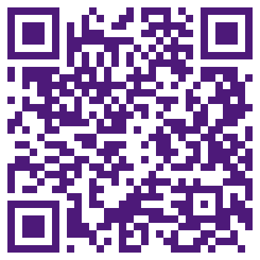
NEEDLE
Live demo.
Find the needle
The CEO move
1
2
Every answer cited.
Open the demo
Notes:
SLIDE 6 · rest of the time · AIDAN drives, PARKER narrates
AIDAN: This is the live product. Scan the code if you want to follow along on your phone.
[Click Find the needle. Wait for the answer.]
AIDAN: Every number has a footnote.
[Click the $2.4B footnote. The 10-Q opens at page 16.]
PARKER: That's the exact sentence in Amgen's 10-Q.
[Click The CEO Move.]
PARKER: Same check on the move: the budget, the math, and what would prove us wrong.
AIDAN: Two reusable skills, our own database, and every answer cited. Happy to take questions.

Slide 7
NEEDLE
APPENDIX
Supporting math and claims map
Needle
$2.3B U.S. ÷ 544M shares = $4.23/sh pre-tax; $2.4B ÷ $459M sales = 5.2x
Gross-to-net
$41,983M ÷ $77,131M gross = 54.4%; excess reserve build $1,067M = 10.7% of $9,958M cash flow
Inventory
0.22 x $381M = $84M; ÷ $345M Q1 growth = 24%
IRS
$3.6B + $5.1B + $2.0B - $0.9B - $2.2B = $7.6B; ÷ 544M = $13.97/sh
CEO Move return
$514M* x 80.4% margin = $413M*/yr; $12.5M* ÷ $413M* = 3.0 pts* break-even
Full trial
331 patients x $54,909 = $18.2M + $25M* = $43.2M; released only on FDA signal
No claims map or campaign materials. The move is a regulatory filing that no doctor or patient sees, so promo rules do not apply.
* labelled assumption. Every row links to its source.
7
Notes:
APPENDIX · not presented · Q&A prep
Why only medium confidence? No product-level analyst estimates exist.
What are the asterisks? Numbers no filing states: the $12.5M budget, 12 people, the month-12 deadline and the $413M yearly run-rate. Each is labelled in the model.
Is the $2.4B already in the stock? Analysts asked about TAVNEOS once in 10 calls, and the stock rose 2.4% on the filing.
How do you stop the AI making things up? Every number is checked against its page by code, a fresh agent re-checks all of them, and a person reads the page behind every needle.
Why not Merck? It ranked second. Its best finding, about $1.56B of IRS exposure, was smaller per share than Amgen's.

