Slide 1
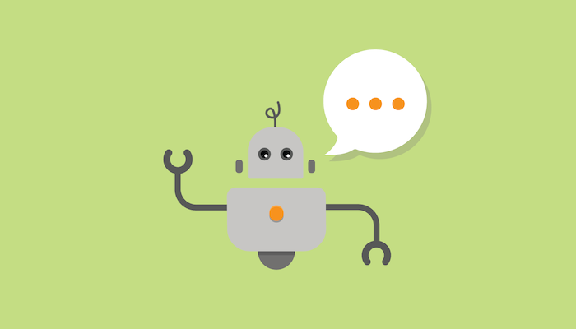

Slide 2
Who am I
Software Engineer with 15 years experience
Thales Australia – Software Systems Architect
Satalyst – Principal Architect/CTO
Stuck – Chief Troublemaking Officer
Boundlss – Lead Engineer

Slide 3
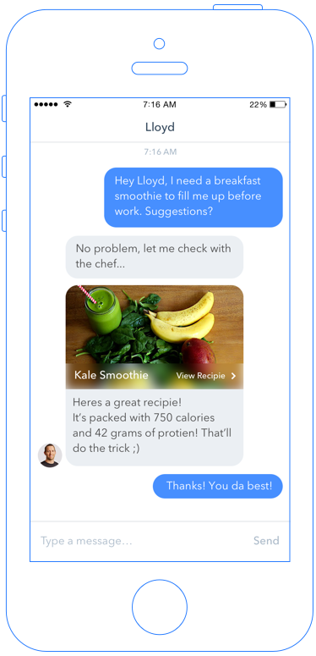
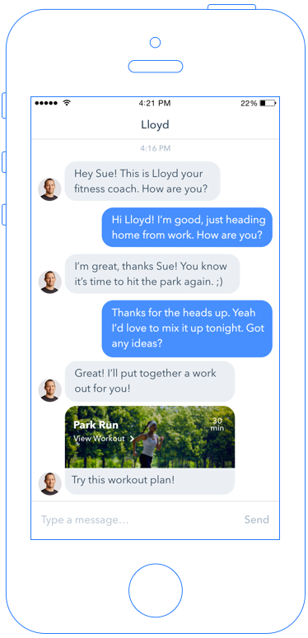
What is Boundlss?
Insuretech Start-up
Wearables, Big-Data, and Gamification improve health and wellbeing
Providing personalised coaching through AI and chatbots

Slide 4
What are chatbots?

Slide 5
User Interface that mimics chatting with a human
Interact in human terms, not machine terms
Not a new idea – been around since the 1960s
ELIZA
ALICE
Notes:
Conversation is the new UI

Slide 6
Types of Chatbots
Mimicry Agents
Appearance of conversation
No understanding of what is being said
ELIZA etc.
Intention-based Agents
Understand language as commands
Alexa, Google Home, Siri, Cortana
Conversational Agents
Engage in multi-turn conversations
Able to reason based on conversation history
Limited examples – all academic
Notes:
Intetion-based agents:
Identifying what the user wants the machine to do (the “intent”).
Figuring out the details of the intent so the machine can take action.

Slide 8
Why now?

Slide 9


Slide 10
“Chatbots will fundamentally revolutionize how computing is experienced by everybody.”
— Satya Nadella, Microsoft CEO

Slide 11
Growing popularity of messaging platforms
Customer expectations
Advances in AI and machine learning
Cheap and available Compute

Slide 12
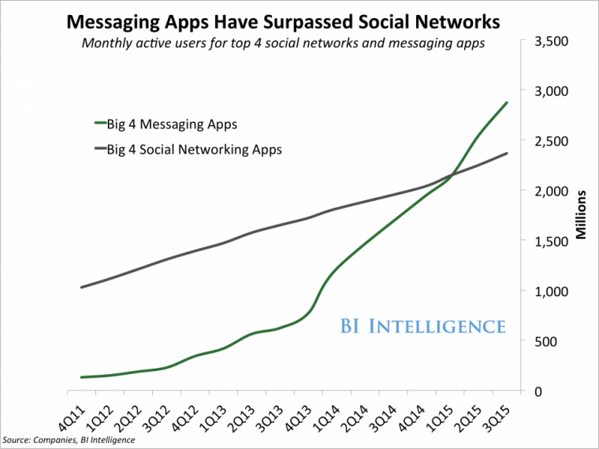
Notes:
Growing popularity of messaging platforms
Facebook Messenger alone has already 1.2 billion monthly active users, and Facebook is reaching almost 2 billion people

Slide 13
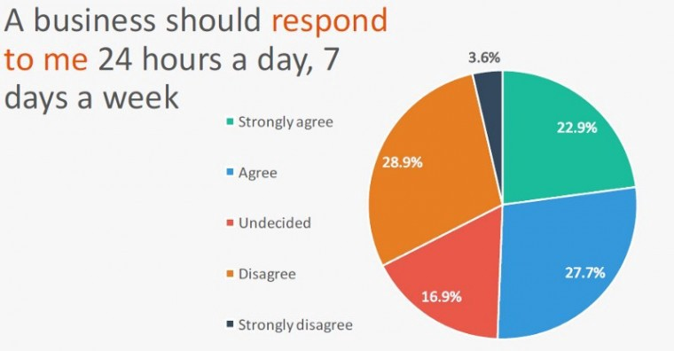
Notes:
Source: The 2016 Mobile Messaging Report
More than 65% of Millenials, Gen Xers and Boomers consider messaging their primary method of communication

Slide 14
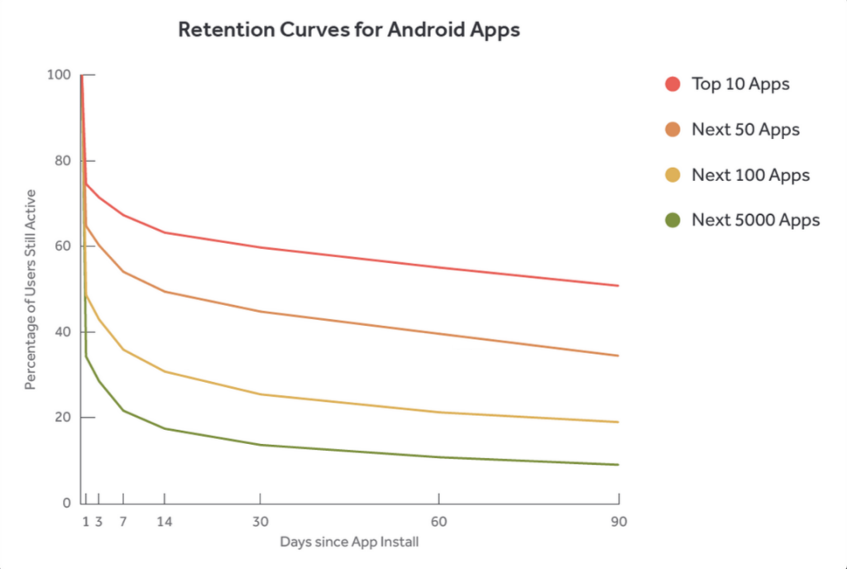
Apps Just Don’t Cut It
Too many apps to install
23% of users abandon apps after just 1 use
Bots are cheaper, easier and faster to develop and experiment with
Notes:
Source: Statista.com

Slide 15
Advantages of using Bots

Slide 16
Quick and Easy
Nothing to install
No friction to use
Standard UI
Notes:
Chatbots are deployed where the users are already – chat apps
There’s no download, sign-in or sign-up process to use a bot
First time users can get value and solve their problems immediately

Slide 17
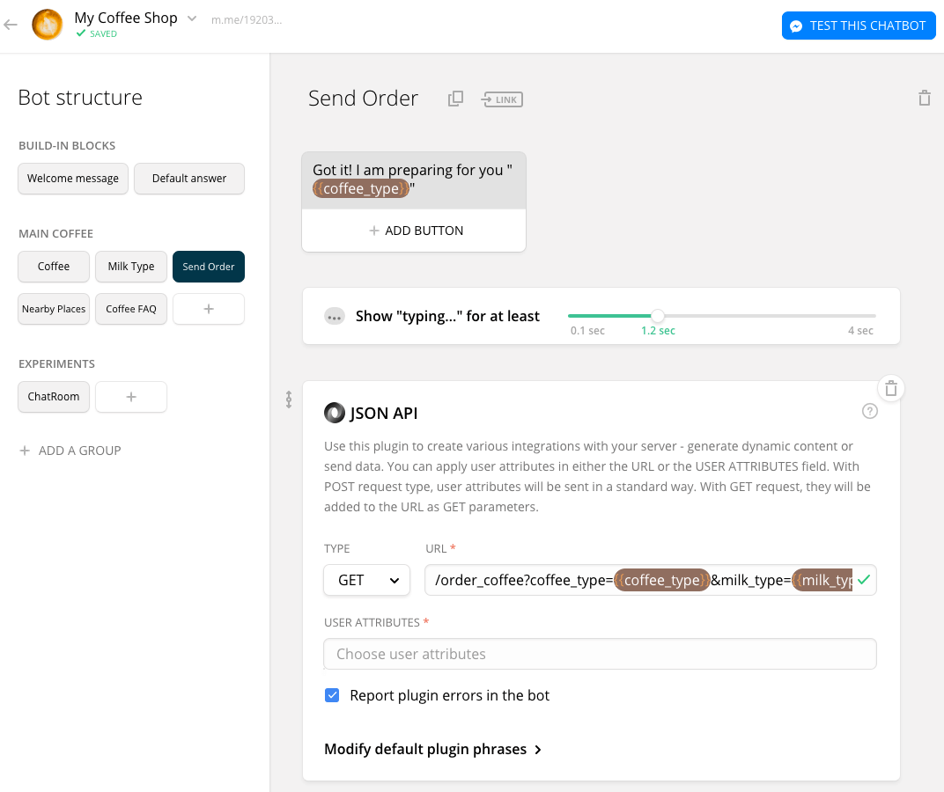
Simple Bots require no programming

Slide 18
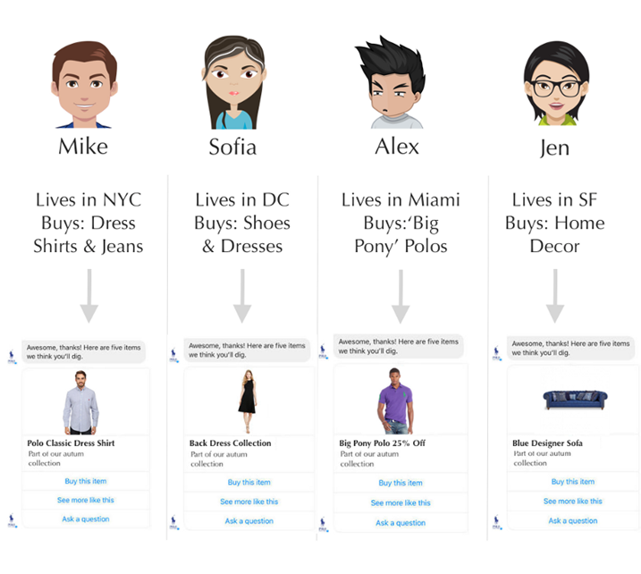
Uber-Personalisation

Slide 19
Building a Bot

Slide 20
Reasons to use a Chatbot
Conversational:
When an App can’t do it because multiple variable inputs are needed to solve the problem.
Simplicity:
When a bot offers the most immediate and direct solution to a person’s problem.

Slide 21
Identity
Topical
Typically for entertainment
Task-Driven / Transactional
Help users get a task done
Gaming
“Choose your own Adventure”
Notes:
Pick a category, don’t try to be everything.

Slide 22
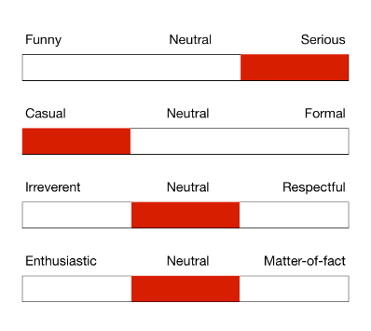
Personality / Voice
Your bot should have a personality
Consider personas from UX design
Gender?
The best way to evoke emotion is through personality
Notes:
Current digital assistants are all female – perpetuating a social norm about

Slide 23
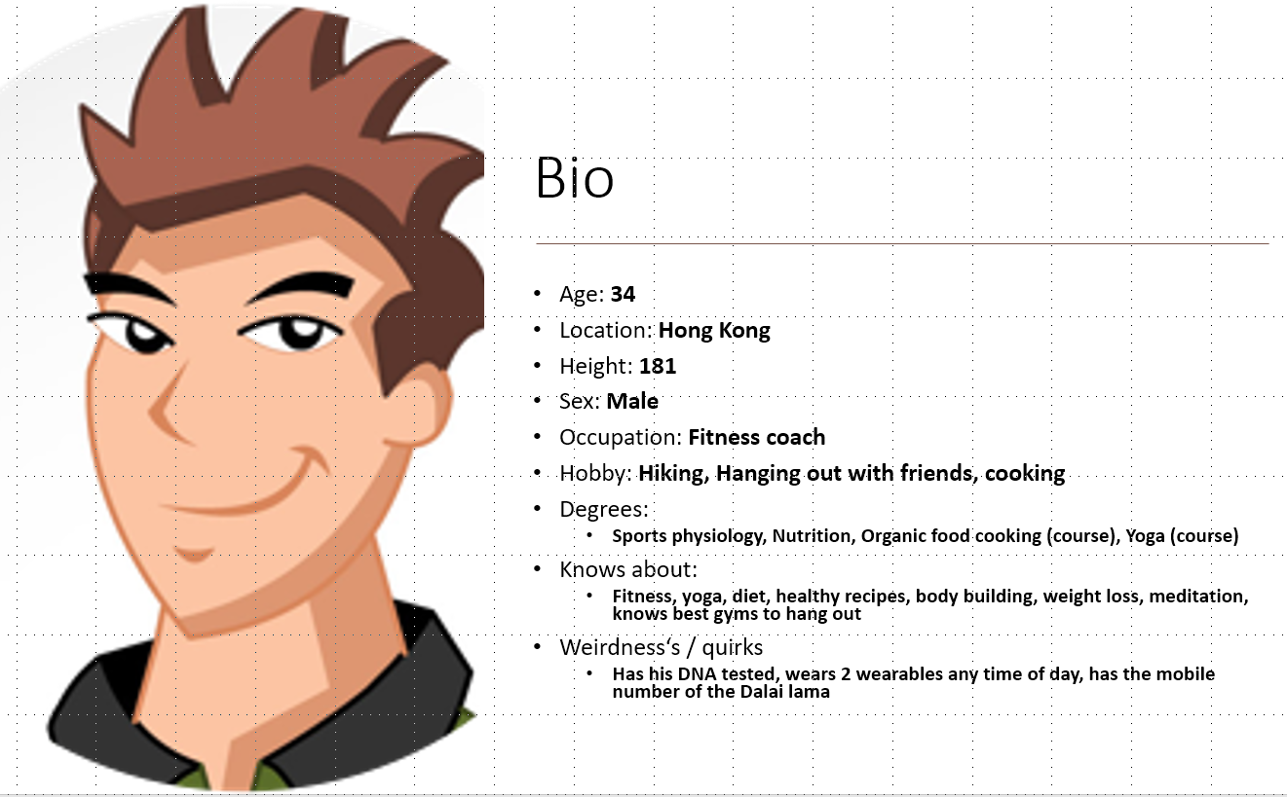
Alex:
Casual & funny (but stays polite & respectful)
Responsive
Modern / Young, but wise
Teasing & flirty
Understanding and confident
Fun to hang out with, takes too many selfies for Instagram

Slide 24
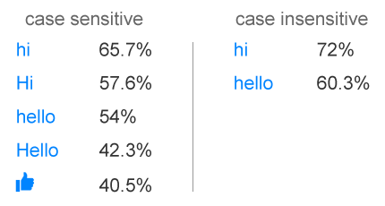
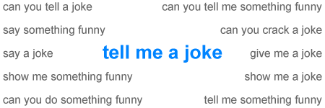
Handle Small-Talk
Most users start a conversation with ‘hi’ or ‘hello’
12% of users ask to be told a joke.
Notes:
People will try to hook up with your bot.

Slide 25
Plan your Conversations
“Rails” vs NLP
Not everything is NLP “free form” conversation
Plan out the user journeys through the conversation
Use a mind-map tool
Notes:
“Rails” are preset conversation paths
NLP is syntactical analysis of free text input

