Slide 1


Slide 2
Who am I
Software Engineer with 15 years experience
Thales Australia – Software Systems Architect
Satalyst – Principal Architect/CTO
Stuck – Chief Troublemaking Officer
Boundlss – Lead Engineer

Slide 3
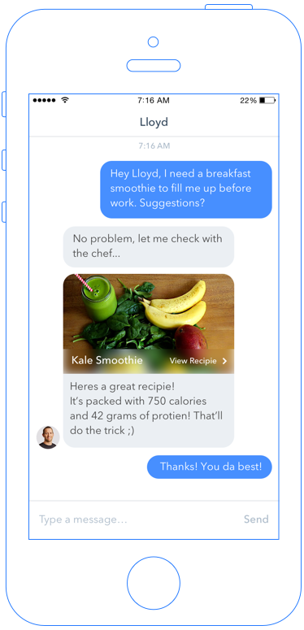
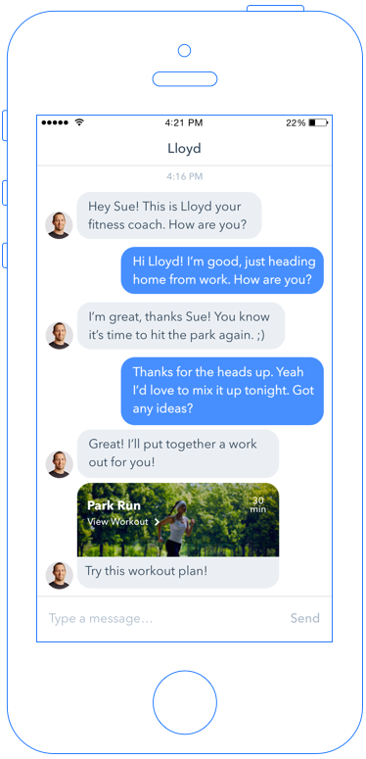
What is Boundlss?
Insuretech Start-up
Wearables, Big-Data, and Gamification improve health and wellbeing
Providing personalised coaching through AI and chatbots

Slide 4
Overview
What are chatbots?
Why now?
Opportunities
Build a Chatbot
Tips for building your own Chatbot

Slide 5
What are chatbots?

Slide 6
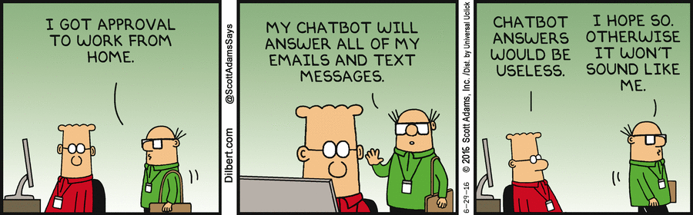

Slide 7
User Interface that mimics chatting with a human
Interact in human terms, not machine terms
Function on top of messaging platforms
Not a new idea – been around since the 1960s
ELIZA
ALICE
Notes:
Conversation is the new UI

Slide 8


Types of Chatbots
/rebuild
Command bots
Command-line over chat
Task-Based
Order a Pizza
Conversational
Answer support questions
Notes:
Less structure as we move to the right
Expensive and difficult as we move to the right

Slide 9
Why now?

Slide 10


Slide 11
“Chatbots will fundamentally revolutionize how computing is experienced by everybody.”
— Satya Nadella, Microsoft CEO

Slide 12
Growing popularity of messaging platforms
Customer expectations
Advances in AI and machine learning
Cheap and available Compute

Slide 13
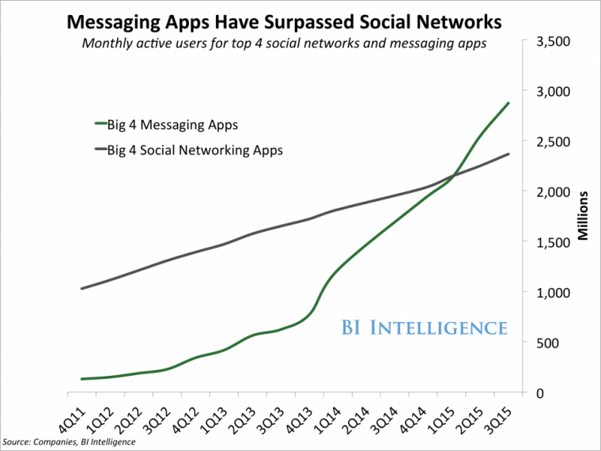
Notes:
Growing popularity of messaging platforms
Facebook Messenger alone has already 1.2 billion monthly active users, and Facebook is reaching almost 2 billion people

Slide 14
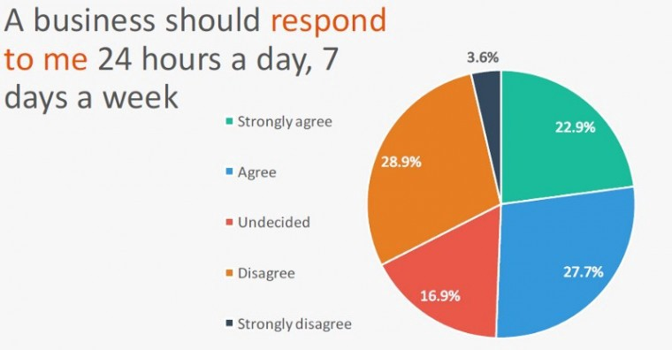
Notes:
Source: The 2016 Mobile Messaging Report
More than 65% of Millenials, Gen Xers and Boomers consider messaging their primary method of communication

Slide 15
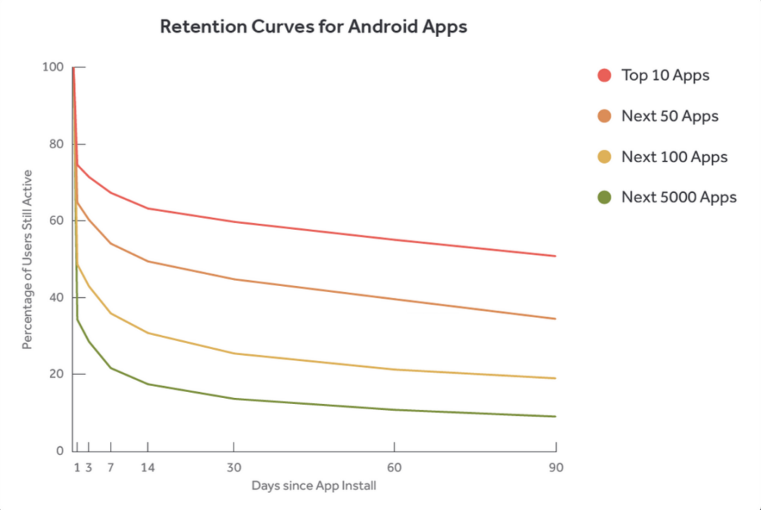
Apps Just Don’t Cut It
Too many apps to install
23% of users abandon apps after just 1 use
Bots are cheaper, easier and faster to develop and experiment with
Notes:
Source: Statista.com

Slide 16
Opportunities

Slide 17
Companies
Interact with brands inside messaging apps
Manage simple customer service requests
E.g. FAQ Generator
Automate tedious/repetitive tasks
Surface data from internal systems for employees

Slide 18
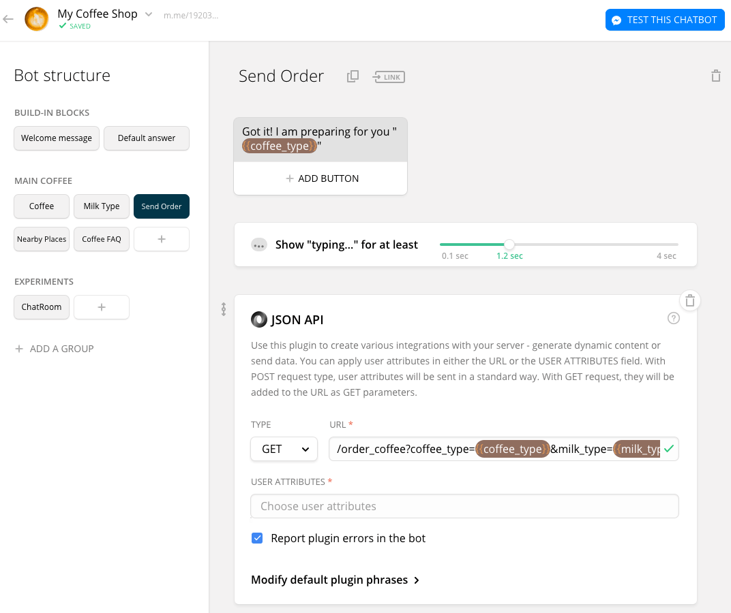
Companies – Rapid Delivery

Slide 19
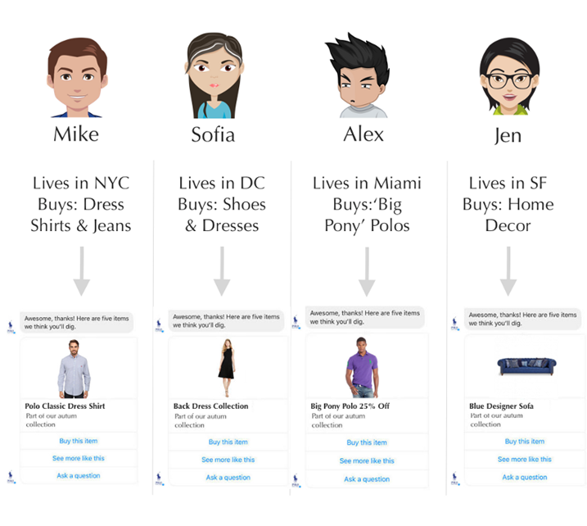
Brands - Uber-Personalisation

Slide 20
Developers
Actually Build Once (for a change)!
Iterate quickly
Distribute broadly
Replace legacy LOB applications
Extend using API’s
Notes:
Build once – same backend across web, iOS, Android etc.
Very simple UI

Slide 21
Bot Hacking Time!

Slide 22
Tips for Building a Bot

Slide 23
Problems best suited to a Chatbot
Conversational:
When an App can’t do it because multiple variable inputs are needed to solve the problem.
Simplicity:
When a bot offers the most immediate and direct solution to a person’s problem.
Notes:
Not all interactions are conversations!
NO:

Slide 24
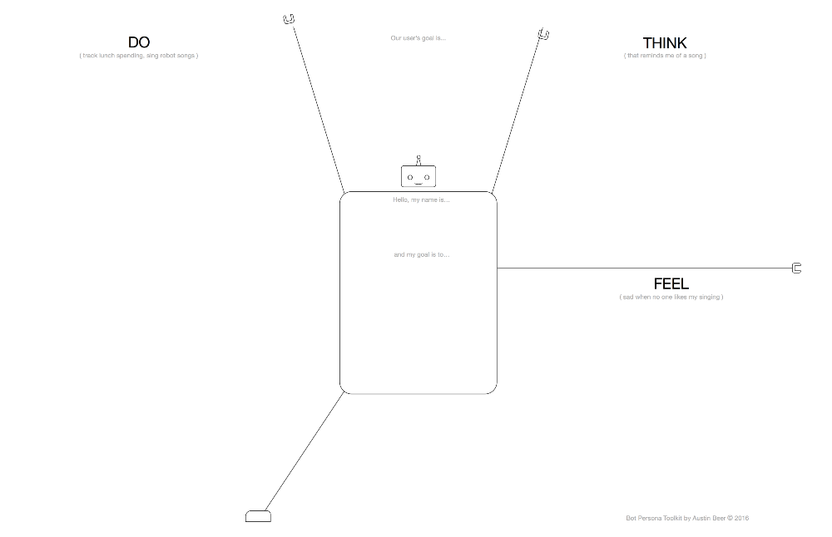

Slide 25
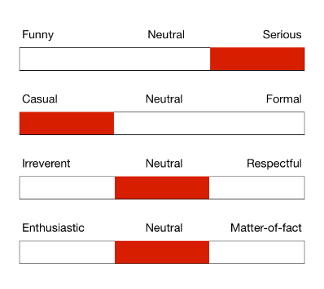
Personality / Voice
Your bot should have a personality
Consider personas from UX design
The best way to evoke emotion is through personality
Notes:
Current digital assistants are all female – perpetuating a social norm about

Slide 26
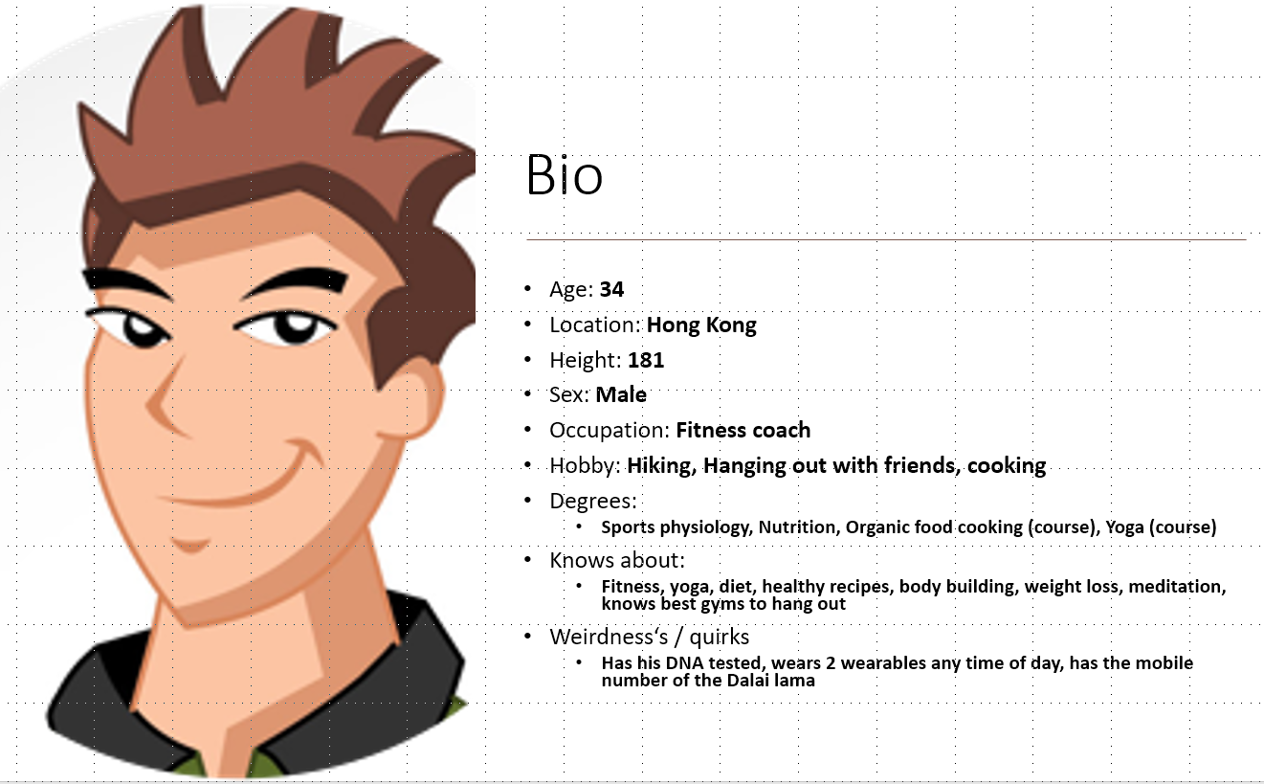
Alex:
Casual & funny (but stays polite & respectful)
Responsive
Modern / Young, but wise
Teasing & flirty
Understanding and confident
Fun to hang out with, takes too many selfies for Instagram

Slide 27
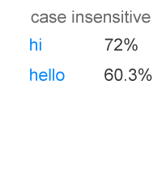
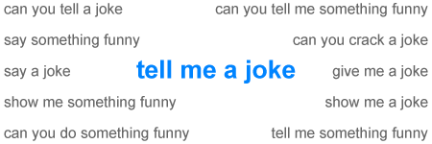
Handle Small Talk
Most users start a conversation with ‘hi’ or ‘hello’
12% of users ask to be told a joke.
Notes:
People will try to hook up with your bot.

Slide 28
Plan Your Conversations
“Rails” vs NLP
Not everything is NLP “free form” conversation
Plan out the user journeys through the conversation
Use a mind-map tool
Notes:
“Rails” are preset conversation paths
NLP is syntactical analysis of free text input
- Value for app is human expertise or value is in an automated task <- neither of these “require” NLP
Follow the same user flow as you would if you were actually speaking to a person.
The bot shouldn’t sound too clever, using complicated grammar or language structures. Keep it simple and be concise.
Don’t use gender-specific pronouns, because you never know who’s on the other side of the conversation.
Prepare a set of slightly different canned replies to make the conversation more human-like.
Add help messages and suggestions for when the user feels lost.
Write witty replies for unsupported topics, so that the bot doesn’t look dumb.

Slide 29
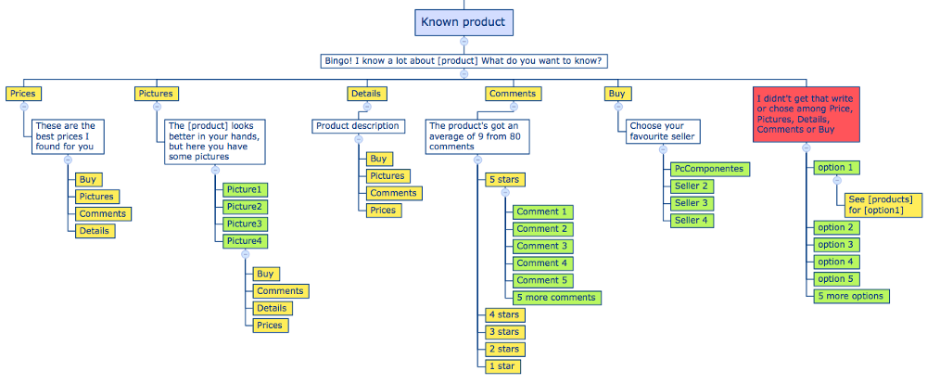

Slide 30
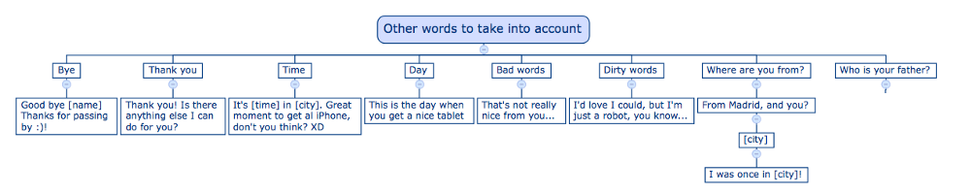

Slide 31
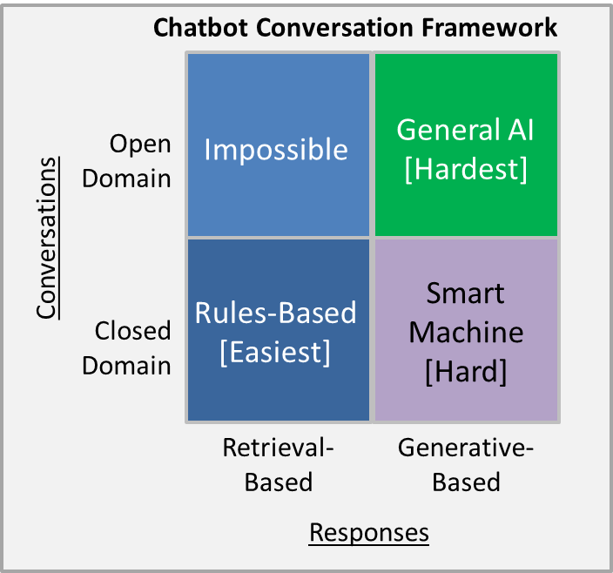

Slide 32
More Tips
Try to add variety to responses
Not everything has to be conversational
Web View
Buttons / Carousel
Have some fun!

Slide 33
I was putting so much effort on making it “conversational” and actually a few helps and hints was much easier and effective than spending hours on getting the models right.
- Guillermo Gette, maker of the popular /todo Slack app

