Slide 1
Online Retail — Client Pitch
Aidan Qadi • Professor Binkowski
Python (pandas, NumPy, matplotlib)

Slide 2
Introduction — Question & Purpose
Question: Which products, seasons, markets, and customer segments drive revenue, and how should we act on it?
Purpose: Convert raw transactions into decisions on pricing, inventory, targeting, and retention.
Notes:
Frame the business problem before the method; tie each later result to a decision lever (price, inventory, CRM).

Slide 3
Introduction — Who Benefits
Merchandising & Inventory: what to stock, when to stock it.
Marketing/CRM: whom to target with VIP, win‑back, and nurture journeys.
Operations & Supply Chain: headcount and logistics ahead of peak months.
Finance & Country Managers: margin guardrails and international plays.

Slide 4
Methodology — Data & Unit of Analysis
Dataset: Online Retail CSV loaded to Colab (cleaned ➜ online_retail_cleaned.csv).
Unit of analysis: transaction line (InvoiceNo–StockCode).
Core fields: Quantity, UnitPrice, InvoiceDate, CustomerID, Country.
Derived feature: Revenue = Quantity × UnitPrice.
Notes:
Keep wording concise on slides; elaborate verbally if needed.

Slide 5
Methodology — Tools & Cleaning
Tools: Jupyter/Colab, pandas, NumPy, matplotlib; RFM via quantile scoring (R, F, M).
Cleaning: removed credit notes (InvoiceNo starts with 'C'), non‑positive qty/price, null SKUs; standardized columns; de‑duplicated.

Slide 6
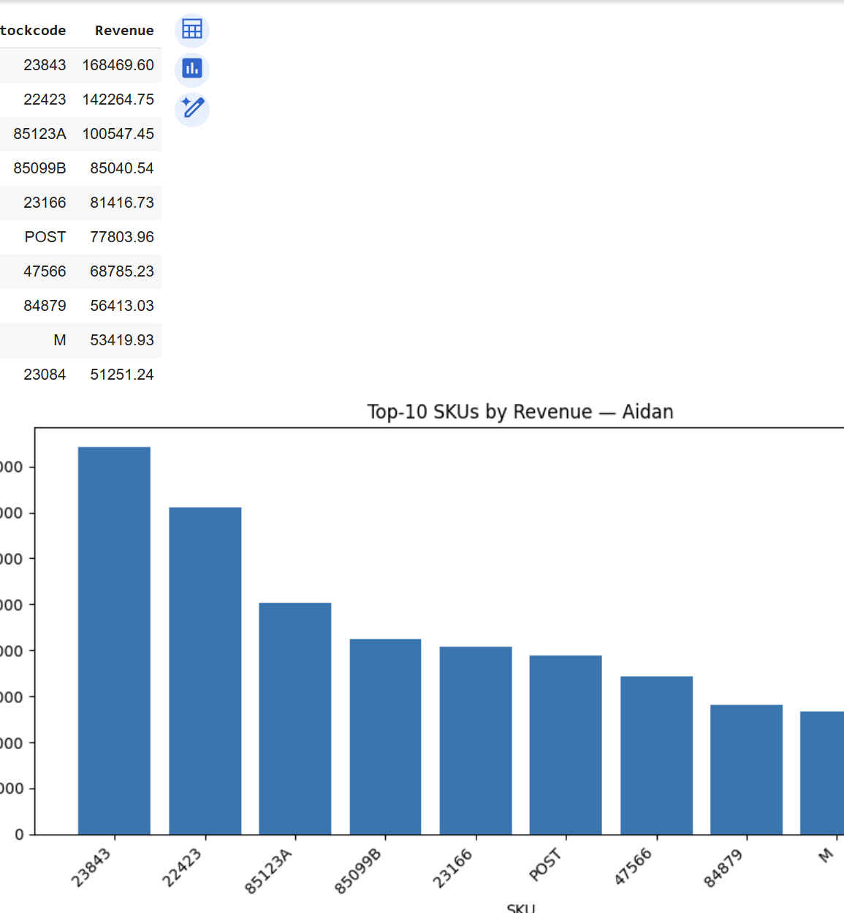
SKUs by Revenue
Conclusion – A small set of SKUs holds a disproportionate share of revenue
Actions - Lock inventory, vendor terms, as well as page placement for top 5 SKUs
Validate the unit margins on the top products before scaling paid traffic

Slide 7
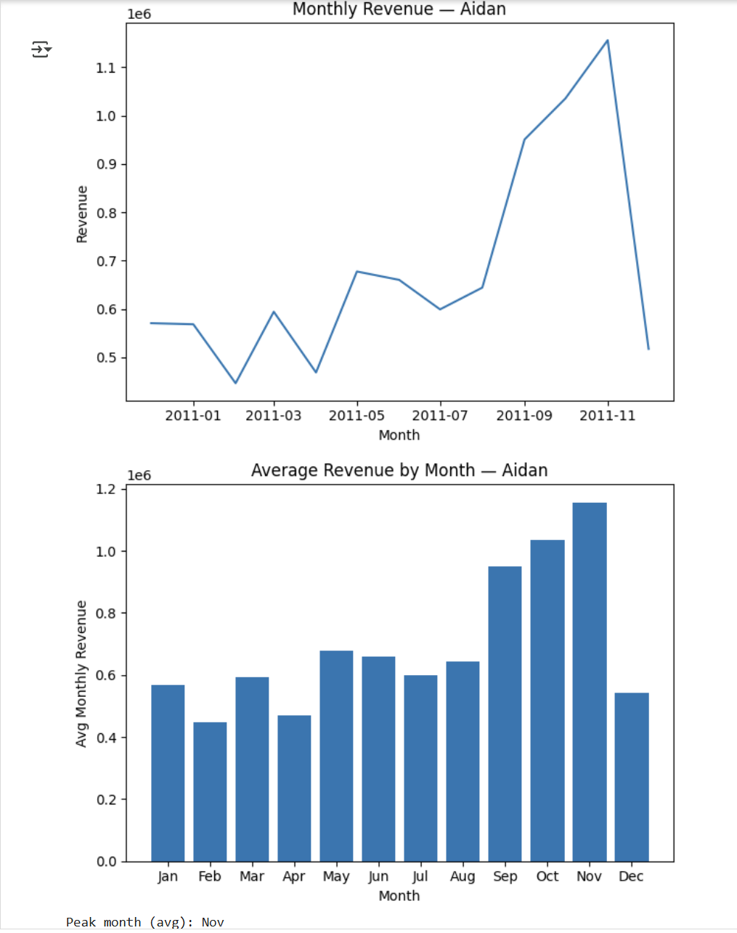
Conclusion – Demand peaks in November Actions – Pull forward inventory and staffing by mid October Use December for gift-card pushes as opposed to forcing full price volume

Slide 8
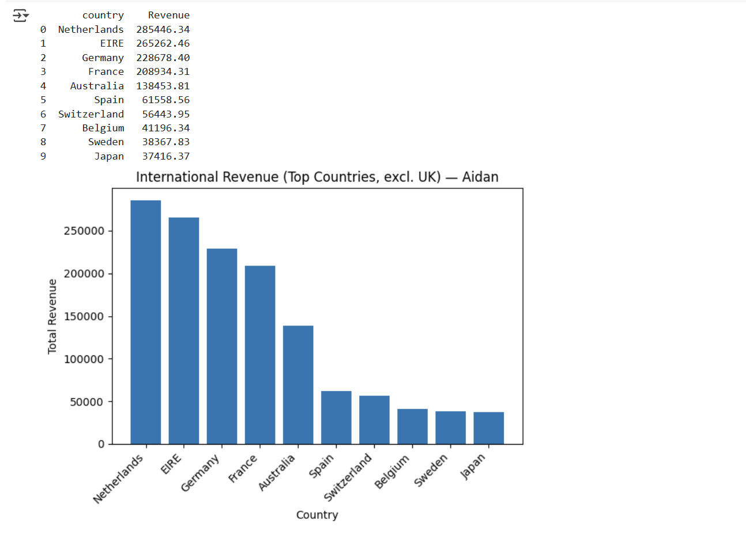
Conclusion – NL, IE,DE,FR are best performing non-UK countries in revenue
Actions – Localize the currency, shipping choices for the following countries
Look for more regional distributors for NL/DE to bring down delivery time

Slide 9
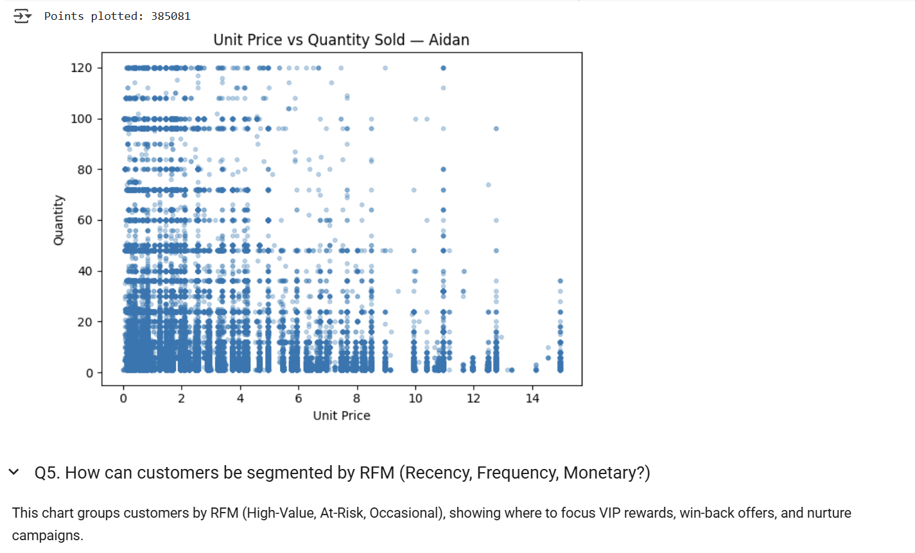
Conclusion – Demand is moderately price – sensitive, with the higher priced items needing value framing over discounting
Actions – Avoid the blanket discounts and run smaller price up tests on stable SKUs
Estimate the SKU – level elasticity to set the price experiment guidelines

Slide 10
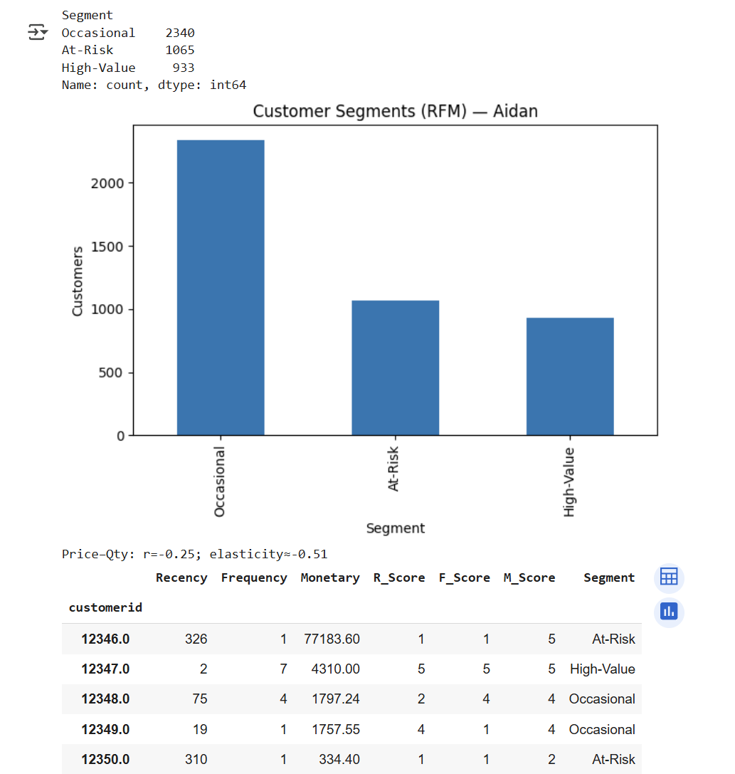
Conclusion – We must guide the occasional customer towards a second purchase
Action – For occasional buyers have a second purchase program
At-risk 14–30-day incentives
High value gets VIP access, priority support

Slide 11
Results — What the Data Says (Q1-Q3)
Top products by revenue: #1 21175 $3,656; #2 85099B $3,056; #3 47566 $2,116 (also 22112 $1,514; 85123A $1,195; 22730 $1,126).
Seasonality: November is the peak month on average.
International leaders: EIRE $6,090; Netherlands $4,975; Germany $4,357; France $3,892.
Notes:
Add your product bar and monthly trend plots here when ready.

Slide 12
Results — Pricing Dynamics (Q4)
Scope: 385,081 transactions plotted.
Correlation: unit price vs quantity r ≈ −0.25; log–log elasticity ≈ −0.51 (1% price ↑ → ~0.51% units ↓).
Pattern: most sales under $5 and <10 units; items >$10 rarely sell in high quantities.
Notes:
Insert the scatter (or hexbin) and a small note on elasticity interpretation.

Slide 13
Results — Customer Segmentation (Q5, RFM)
4,338 customers segmented: Occasional 53.9% (2,340), At‑Risk 24.6% (1,065), High‑Value 21.5% (933).
Implication: sizable VIP core, sizable win‑back pool, majority nurture cohort.
Notes:
Insert your RFM bar chart; consider a small table with segment definitions in the appendix.

Slide 14
Future Work
Seasonal revenue forecasting with holiday flags and inventory implications.
SKU‑ and country‑level elasticity controlling for promotions and seasonality.
Upgrade RFM to CLV; run controlled experiments for VIP, win‑back, and nurture programs.

Slide 15
Appendix — Supporting Details
Cleaning pipeline: drop credit notes; non‑positive qty/price; missing SKUs; de‑dup; standardize columns.
Formulas: Revenue=Quantity×UnitPrice; elasticity from log‑log regression; RFM quantiles for segmenting.
Artifacts: cleaned CSV (online_retail_cleaned.csv); notebook with reproducible steps; placeholders for plots.

