Slide 1
Cyclistic: How to Make the Casual a Member
By: Aidan Rogers
Last updated: January 20th, 2023

Slide 2
Guiding Question
“How do annual members and casual riders use Cyclistic bikes differently?”

Slide 3
How do we answer this question and what is its purpose?
How:
Using Cyclistic data from January 2022 - December 2022, we will figure out how casual riders use the Cyclistic bikes differently from members
Purpose:
We will use this information to find how to best convert casual riders into members

Slide 4

The Data

Slide 5
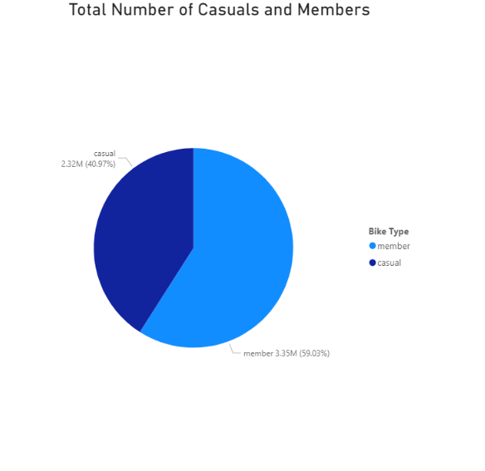
Casuals vs. Members
First, it’s important to see the number of riders vs members
Members are the larger percentage of users, but casuals still make up 2/5
Casuals are a massive user base to capitalize on

Slide 6
How are these users differing in their biking habits?

Slide 7
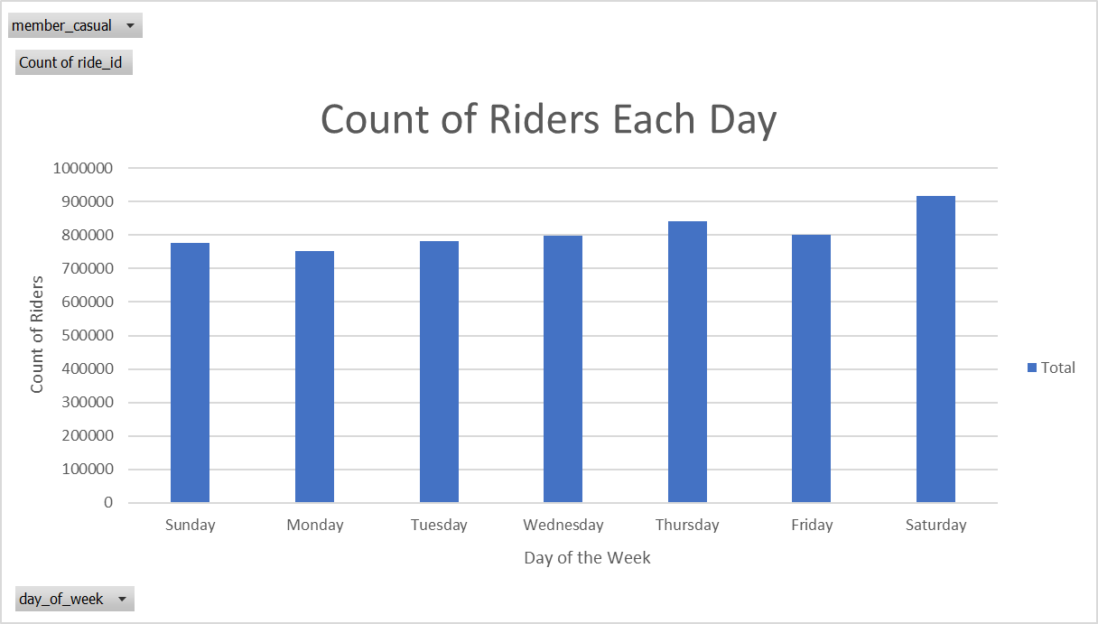
Riders Per Day
For all riders use across the week is quite uniform, only peaking on Saturday

Slide 8
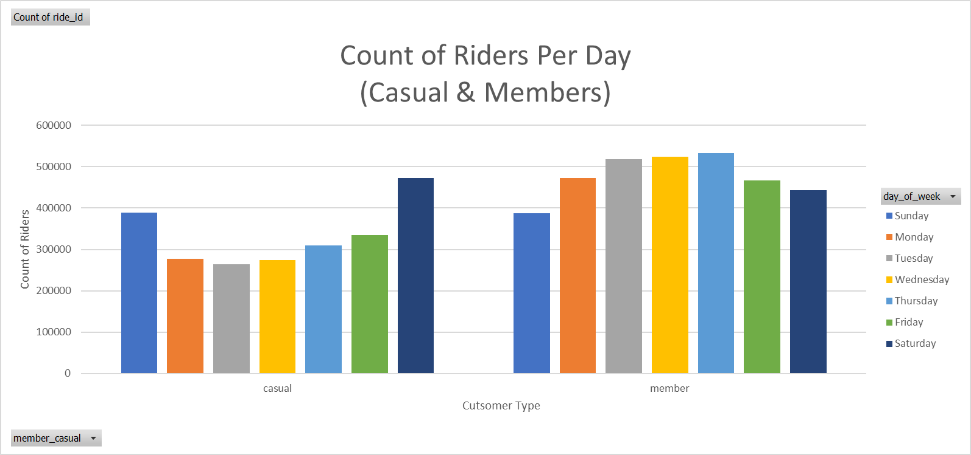
Riders Per Day
When you look at the riders per day split by user type a new story is told
Casual riders are using the bikes way more on the weekends than the weekdays
Members have a more uniform distribution but ride more during the week

Slide 9
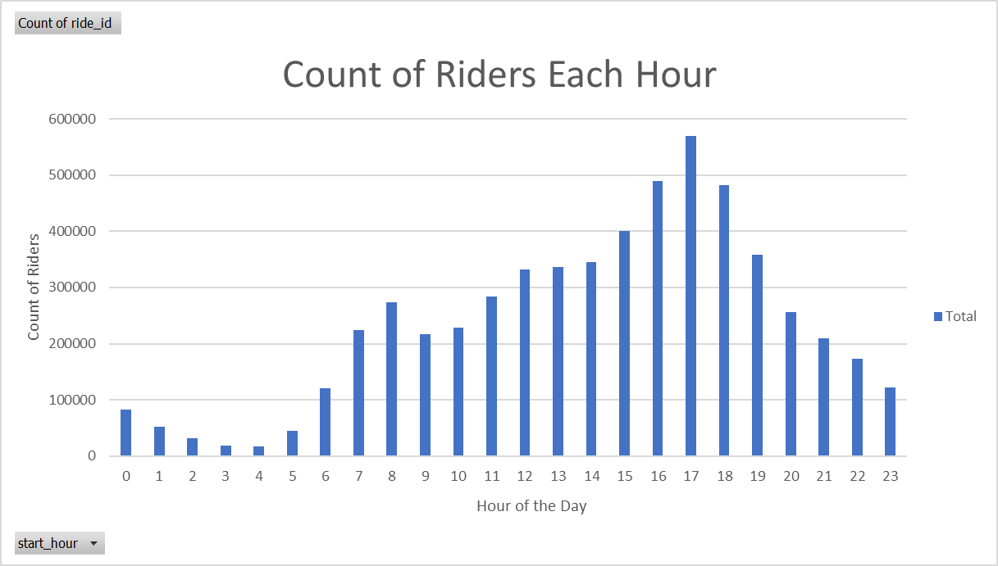
Riders Per Hour
Number of riders peaks in the afternoon hours (around 5pm)
See a slight bump in the early hours of the morning, something to keep in mind

Slide 10
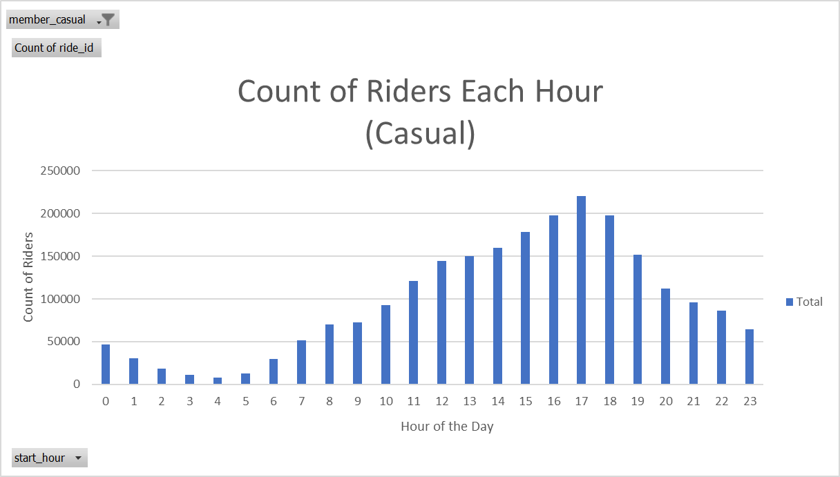
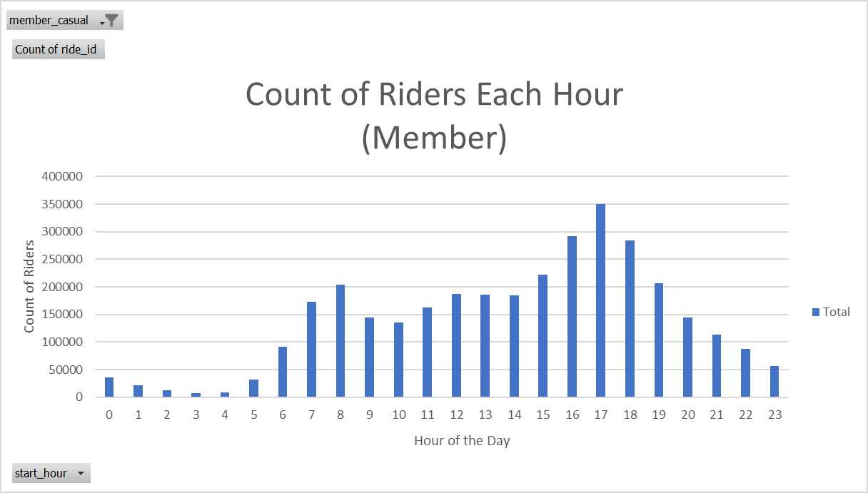
Casual riders gradually start riding more as it gets close to 5pm and less after
Members also ride the most at 5pm but they see a large bump in riders at 8am
Peaks at 8am and 5pm would align with commuting hours for many individuals

Slide 11
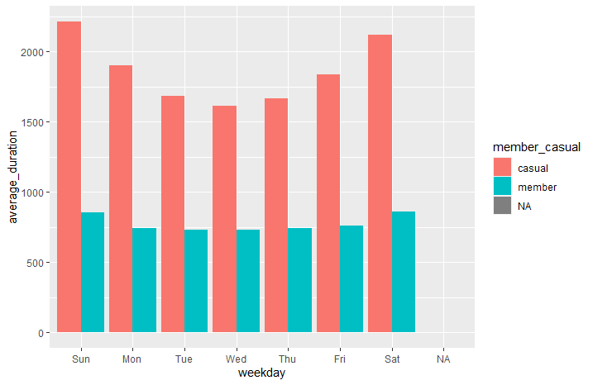
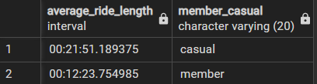
Casual Recreation vs. Member Commute
(in seconds)
With more riders on weekdays and peaks at 8am and 5pm members seem to use bikes often to commute
With more rides on the weekends and the afternoon casual riders seem to ride more for recreation
Average ride times seem to point to casuals going on long rides for recreation, on weekends especially

Slide 12
Weekends aren’t the only time casual riders are out more

Slide 13
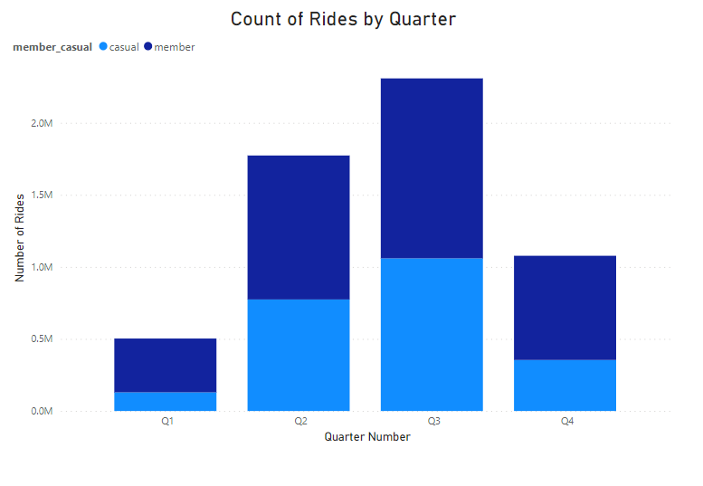
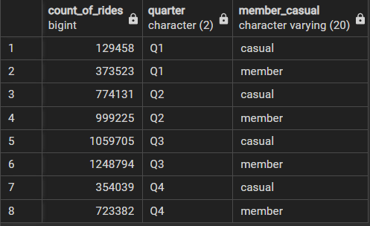
Riders by Quarter
Riders of all types come out more in Q3
A perfect time to start trying to getting casuals to think about commuting (over 1 million casual riders)

Slide 14
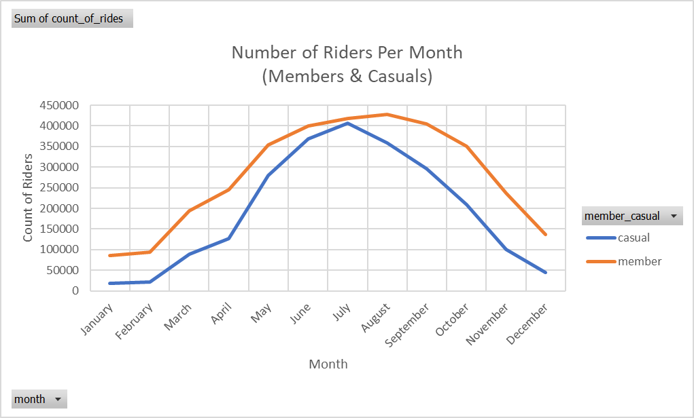
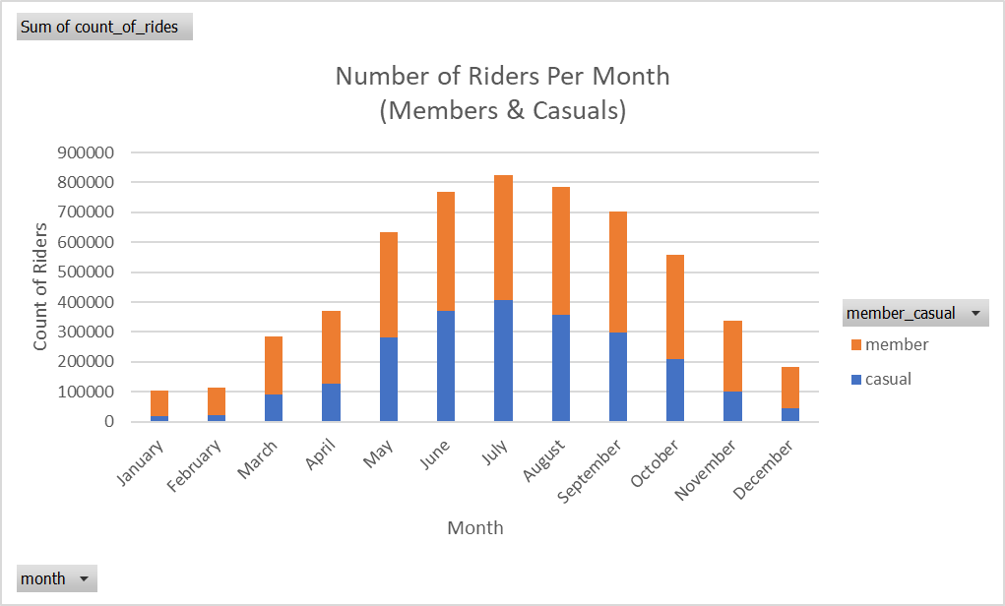
A Closer Look
Causal rider numbers hit a sharp peak in July
July is the perfect time to release marketing campaigns to keep casual riders around like how members stick around after July

Slide 15
We know when to find Casual riders but what about where?

Slide 16
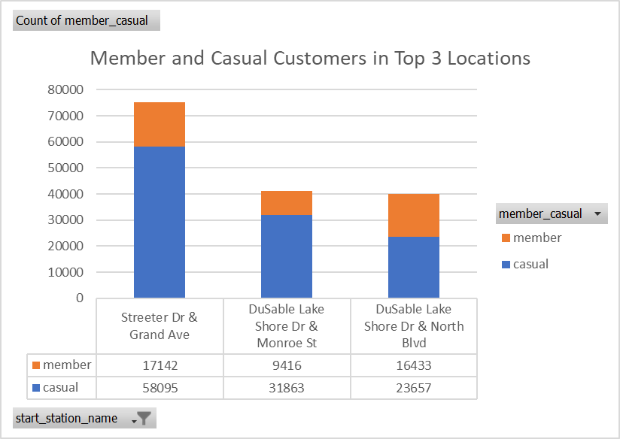
Top Cyclistic Locations
The most popular locations among Cyclistic users
Casual riders make up a large portion of the most popular locations overall
Great locations to target in particular

Slide 17
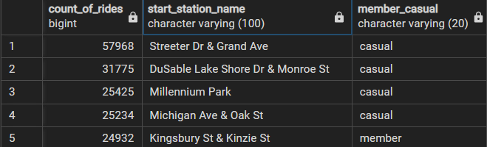
The most popular locations when grouped by user type
4 of the 5 most popular locations for a user type are for casual members
Shows that casual members are bunched up in areas perfect for advertising

Slide 18
How to Bring in Members
Create
Create advertisements to encourage casual members to start commuting with cyclistic
Start
Start rolling out ads and marketing budget in quarter 3, especially in July to have the best chance of converting members
Target
Target ads in specific locations that hold a lot of casual Cylclistic riders

