Slide 1
Taylor Swift Popularity Data Analysis
By: Aidan Rogers
Last updated: April 23rd, 2023

Slide 2
Guiding Question
“How do the sonic qualities of Taylor Swift’s albums affect their popularity?”

Slide 3
How do we answer this question and what is its purpose?
How:
Using Taylor Swift Spotify data from multiple sources on Kaggle. Compare different sonic qualities to popularity.
Purpose:
We will use this information to find what factors impact a Taylor Swift album’s popularity the most

Slide 4
Key Definitions
Acousticness: A confidence measure from 0.0 to 1.0 of whether the track is acoustic. 1.0 represents high confidence the track is acoustic.
Danceability: Describes how suitable a track is for dancing based on a combination of musical elements including tempo, rhythm stability, beat strength, and overall regularity. A value of 0.0 is least danceable and 1.0 is most danceable.
Loudness: The overall loudness of a track in decibels (dB). Loudness values are averaged across the entire track and are useful for comparing relative loudness of tracks.

Slide 5

The Data

Slide 6
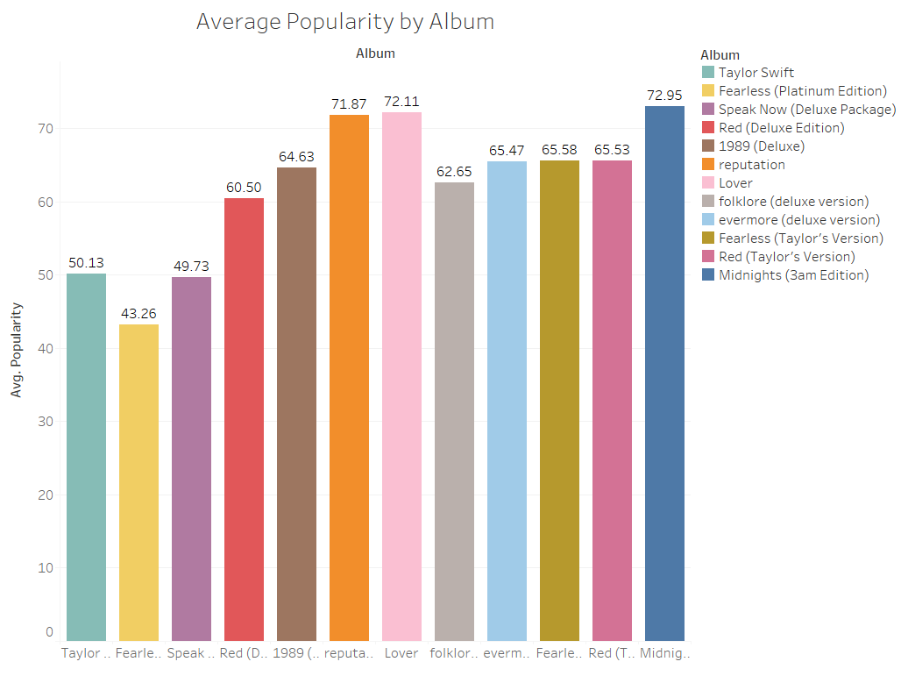
Popularity Per Album
Average popularity of each album
Popularity seems to generally increase over time
Most popular albums are Midnights, Lover, and Reputation

Slide 7
How do sonic qualities relate to popularity?

Slide 8
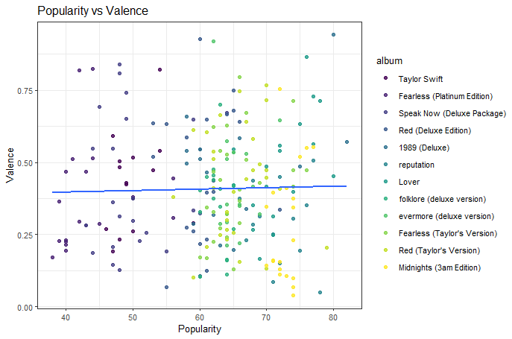
Valence vs. Popularity
Valence (positivity of a song) appears to have very little relation with the popularity of a song

Slide 9
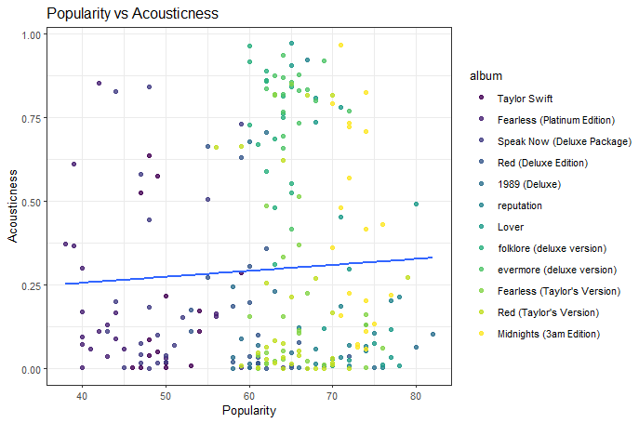
Acousticness vs. Popularity
While slightly more related to popularity acousticness has also little relationship to popularity like valence

Slide 10
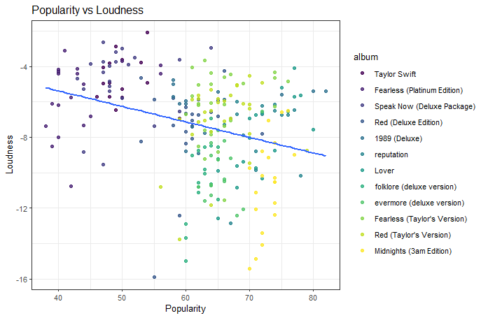
Loudness vs. Popularity
Loudness actually does appear to have a relationship to popularity
A negative and not super strong relationship

Slide 11
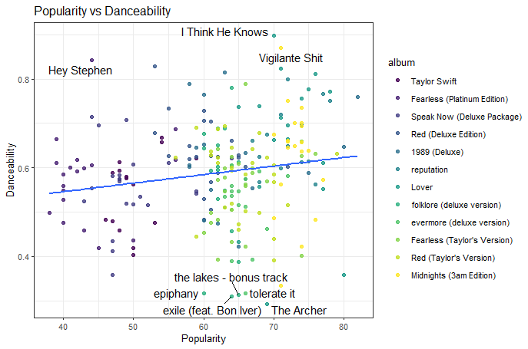
Danceability vs. Popularity
Danceability is the most positively related sonic quality to popularity
Some of the most and least danceable songs are labeled to show examples

Slide 12
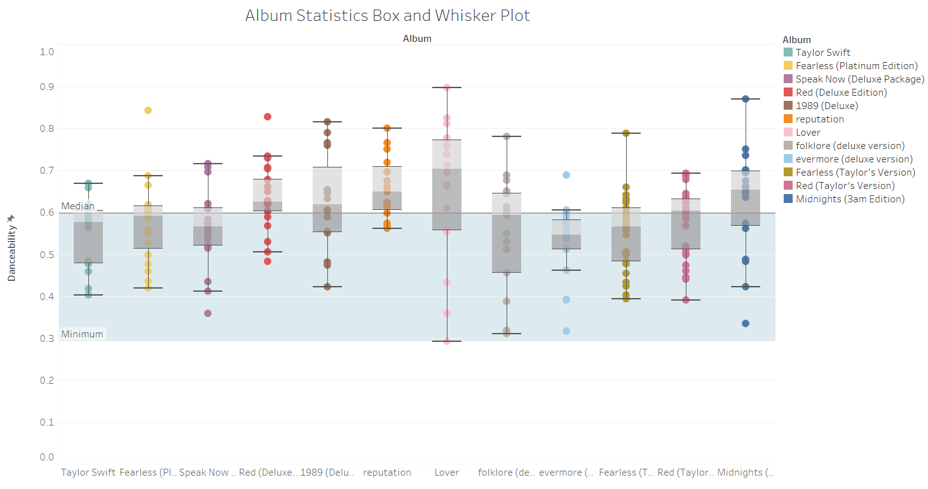
Danceability Distribution
The most popular albums tend to have a majority of songs above the median danceability line
Danceability could be what helps push albums to being the most popular, not necessarily popular to being with

Slide 13
Sonic qualities have only some relation. What is the true indicator of popularity?

Slide 14
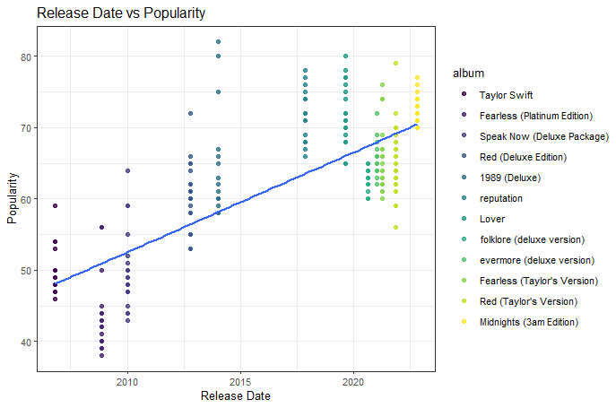
Release Date vs Popularity
Release date very clearly has a relationship with popularity.
Aligns with the initial trend in average popularity we noticed at the beginning

Slide 15
Key Findings
Acousticness does not seem to have any apparent relationship with popularity
Loudness seems to have slight negative relationship with popularity
Danceability seems to have a slight positive relationship with popularity
Release date is the biggest key factor when it comes to the popularity of a Taylor Swift release

