Slide 1


Adobe Express with Firefly: A Case Study
Aidan Olander

Slide 2
Summary of Approach
Basic EDA
Began with variable review, utilized Jupyter Notebooks with Python to explore data behavior and anomalies
Data Cleaning
Brought outliers within 3 deviations, cleaned up mismatched strings, and created dummy columns for categorical values
Grouping/Charts
Used pandas and seaborn packages to compare across categories, creating evidence for insights
Qualitative Research
Actionable Steps
Condensed visuals and insights into actionable recommendations to drive goals
Read news articles and US Copyright Office documents to connect qualitative insights with quantitative evidence
Notes:
Familiarized myself with the PDF and Excel spreadsheet so I knew what the data meant. Starting brainstorming ways to segment data for possible analysis. Loaded data from Excel into Jupyter Notebooks so I could start cleaning.
Cleaned outliers so they were within 3 standard deviations from the mean, sorted categorical columns to find all truly unique values. Dealt with missing values. Cleaned up strings from categorical columns that nearly matched each other, such as ”IC” and ”IC (Individual Contributor)”. Once unique values were obtained, dummy columns were created for categorical columns that I wished to analyze more numerically, notably Stance on AI, Scope of Deployment, Concerns, Use Cases, and Relevant Features. I kept these dummy column creations in different data frames so that the original DF wouldn’t grow wide and unwieldy.
Broke down certain segments of the data, such as by Customer Level, Industry, Sales Stage, Data Source, Region, etc, to analyze differences in customer sentiments about uses and concerns. Once insights started to bubble up from different ways of cutting the data, used seaborn and matplotlib to create visualizations that highlighted these insights in easily visible formats.
Seeing that the most important quantitative insights were about the legality of AI usage, I directed my qualitative research to highlight current court cases and decisions about AI issues that are relevant to the sales teams. Assembled the main issues and how Adobe is prepared to tackle them.
Reduced insights both quantitative and qualitative into 4 actionable steps to improve the product, improve the sales pitch, and push for wider positioning.

Slide 3
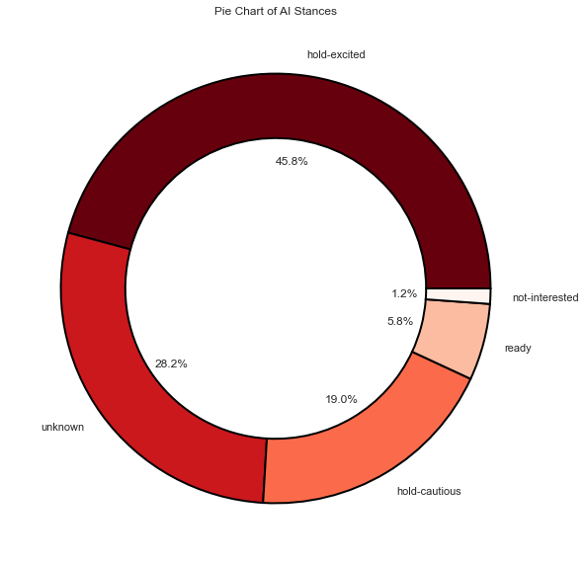
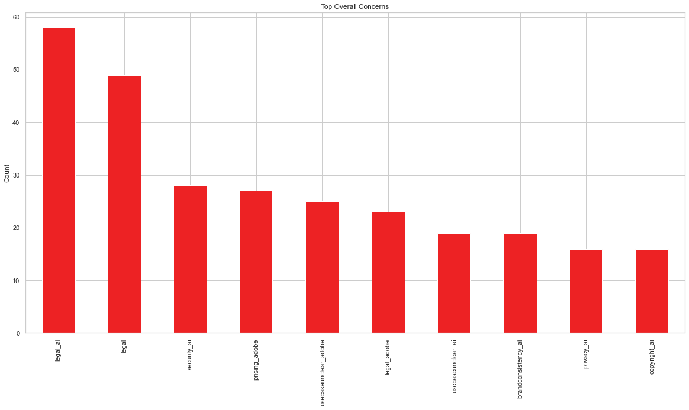
Quantitative Analysis
Nearly half customers sampled are excited to use AI – but are holding off
The dominant concern is the legality of AI
Current customers are more interested in sitewide deployment
Competitor C is worth researching further
Inside Sales team customers unusually focused on price
Partnership team contains all the Opportunity Size outliers
Strategic Sales team customers are interested in Content Supply Chain usage
Notes:
Note – Sales Stage 6 is a current customer, labeled N/A in original data
Other interesting insights:
- VPs more interested with Content Supply Chain usage than any other customer level
- Construction almost exclusively interested in brainstorming and concepting features
- C-suite cares less about AI features like Generative Fill, and more about indemnification, commercial safety, and APIs
- Strategic Accounts are much more likely to see usage possibilities in Sales departments, Non-Strategic accounts see very little use
- Express, Generative Fill, and Text-To-Image most mentioned features
- Concepting, Social Media, and Brainstorming most mentioned use cases
- Local, State, and Federal governments as Industries were extremely divided on concerns, use cases, and features. Cannot be treated as one
- Fairly obvious, but C-suite offers the largest Opportunity Size on average across Customer Levels

Slide 4
Qualitative Analysis
AI Training Controversy
AI Copyright Controversy
The issue –
AI Legality
“Artists suing generative artificial intelligence art generators have hit a stumbling block … unauthorized use of billions of images downloaded from the internet to train AI systems, with a federal judge’s dismissal of most claims.”
– Hollywood Reporter¹
“Judge Howell wrote that copyright has never been granted to work that was ‘absent any guiding human hand.’ ”
- The Verge³
“Judge Howell did acknowledge that humanity is ‘approaching new frontiers in copyright’ … she wrote that this would create ‘challenging questions regarding how much human input is necessary’ to copyright AI-created art, noting that AI models are often trained on pre-existing work.”
- The Verge³
“USCO would consider granting copyright if there is further editing, manipulation or improvement on the AI-generated product by the artist.”
- The Art Newspaper⁴
“The Court defined an ‘author’ as ‘he to whom anything owes its origin; originator; maker; one who completes a work of science or literature.’ ”
- USCO AI Policy Guidance⁵
New frontier of Generative AI law
Customers want reassurance that AI usage will not cause legal problems in the future
A developing landscape, but two clear areas of litigation are emerging
Anticipating which issues customers might face could help in creating a sales strategy
“A trade group for U.S. authors has sued OpenAI … accusing the company of unlawfully training its popular artificial-intelligence based chatbot ChatGPT on their work.”
- Reuters²
”The Authors Guild's lawsuit claims that the datasets used to train OpenAI's large language model to respond to human prompts included text from the authors' books that may have been taken from illegal online "pirate" book repositories.”
- Reuters²
“Trained on Adobe Stock images, openly licensed content, and public domain content, Firefly is designed to be safe for commercial use.”
“We do not train on any Creative Cloud subscribers’ personal content.”
“Through efforts like the Content Authenticity Initiative and the Coalition for Content Provenance and Authenticity, we’re standing up for accountability, responsibility, and transparency in generative AI.”
“We’re working toward a universal “Do Not Train” Content Credentials tag that will remain associated with a piece of content wherever it’s used, published, or stored.”
- Adobe Firefly Product Page⁶
Adobe
Response
Notes:
Researching this issue brought to light two main hurdles for AI usage for Adobe customers. Those who want to use it for marketing materials and advertisements are more likely to care about the training controversy, which Adobe customers do not have to worry about (as seen on Adobe’s Firefly product page). However, copyrighting materials made within Adobe Express with Firefly may be more of a concern to the Media & Entertainment industry, or other related industries. This legal controversy seems murkier than the first, though human guidance and participation during the media creation process should be enough for the US Copyright Office.
1. “Artists Lose First Round of Copyright Infringement Case Against AI Art Generators”, Cho, Winston. Hollywood Reporter. October 30th, 2023. https://www.hollywoodreporter.com/business/business-news/artists-copyright-infringement-case-ai-art-generators-1235632929/
2. “John Grisham, other top US authors sue OpenAI over copyrights”, Brittain, Blake. Reuters. September 21st, 2023. https://www.reuters.com/legal/john-grisham-other-top-us-authors-sue-openai-over-copyrights-2023-09-20/
3. “AI-generated art cannot be copyrighted, rules a US federal judge”, Davis, Wes. The Verge. August 19th, 2023.
https://www.theverge.com/2023/8/19/23838458/ai-generated-art-no-copyright-district-court
4. “What the latest US court ruling means for AI-generated art’s copyright status”, Kerem Yavuz, Sarp. The Art Newspaper. September 1st, 2023. https://www.theartnewspaper.com/2023/09/02/artificial-intelligence-lawsuit-decision-us-copyright-law
5. “Copyright Registration Guidance: Works Containing Material Generated by Artificial Intelligence”. United States Copyright Office. March 16th, 2023. https://www.copyright.gov/ai/ai_policy_guidance.pdf
6. https://www.adobe.com/products/firefly.html

Slide 5




Actionable Recommendations
01
02
03
04
Teach AI Legal Climate
Revisit Current Customers
Research Competitor C
Dissect Sales Teams
Brief all sales teams on current AI legal landscape, including how Firefly has been trained. Webinars, Lunches with Legal, or simple PDF guides could be used.
Push sales teams to engage with old clients who use Adobe Express for single departments. Gather marketing material for inter-departmental usage.
Join demos, read press releases, speak with current customers. Determine what they are doing differently to stand out.
Discuss price sensitivity with Inside Sales team, audit Partnership team’s numbers, and develop Content Supply Chain marketing materials for Strategic Sales team.

