Slide 1



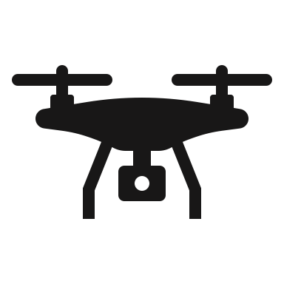
Target
Mode 1
No Observations
Start
Mode 2

Slide 2
Target
Mode 1
No Observations
Start
Mode 2

Slide 3
Target
Mode 1
Start
Mode 2

Slide 4
Target
Mode 1
Start
Mode 2

Slide 5
Target
Mode 1
Start
Mode 2

Slide 6
Target
Mode 1
Start
Mode 2

Slide 7
Target
Mode 1
Start
Mode 2

Slide 8
Target
Mode 1
Start
Observed
Mode 2

Slide 9
Target
Mode 1
Start
Observed
Mode 2

Slide 10
x
Mode 2
No Observations
Mode 1

Slide 11
Target
x
Mode 2
No Observations
Start
Mode 1

Slide 12
x
Target
No Observations
Mode 2
Start
Mode 1

Slide 13
x
Expert 3
No Observations
Expert 2
Expert 1

Slide 14
x
No Observations
Expert 2
Expert 1

Slide 15
Target
Mode 2
Start
Mode 1

Slide 16
Target
Mode 2
Start
Mode 1

Slide 17
Target
Mode 2
Start
Mode 1

Slide 18
Target
Mode 2
Start
Mode 1

Slide 19
Target
Mode 2
Start
Mode 1

