Slide 1
Support Vector Machines

Slide 2
Before we start!
Make a new directory, and then from the command line:
git clone https://github.com/aidantmcb/SVM_Demo.git
(or otherwise download the repository)
SVM_Demo.ipynb has empty fields for you to fill in
SVM_Demo_Key.ipynb is fully completed if you want to check your work

Slide 3
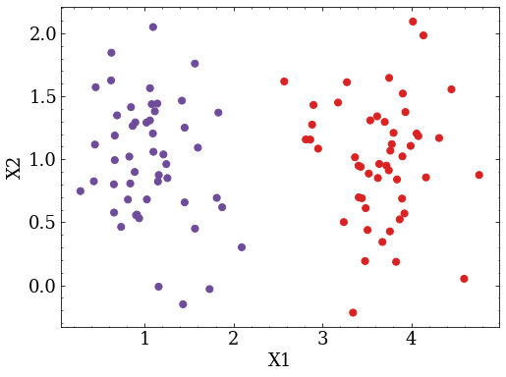

Slide 4
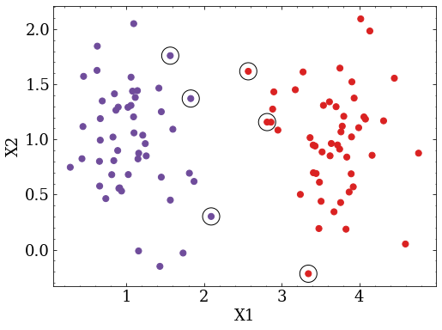

Slide 5
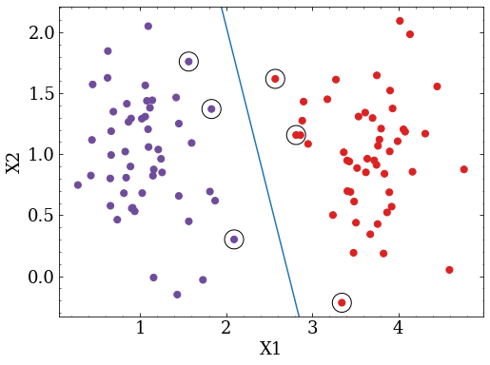
These points are called “support vectors”!

Slide 6
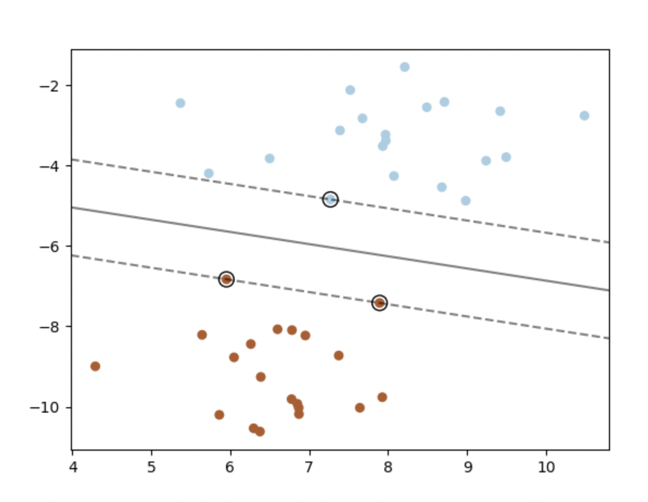
Support Vector Machines
Machine learning algorithms to choose support vectors and find the optimal hyperplanes between them
Trained on multi-dimensional input data (X1, X2, …) with known labels (blue, red, …)
Once trained, models can be used to predict labels for new data
X2
Label: -1
Label: +1
X1

Slide 7
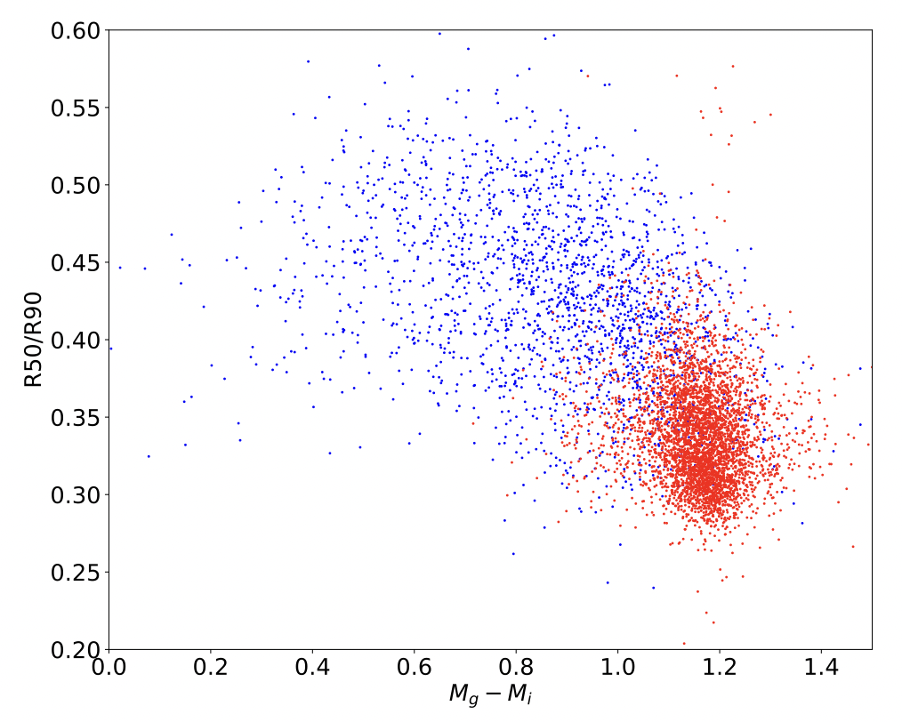
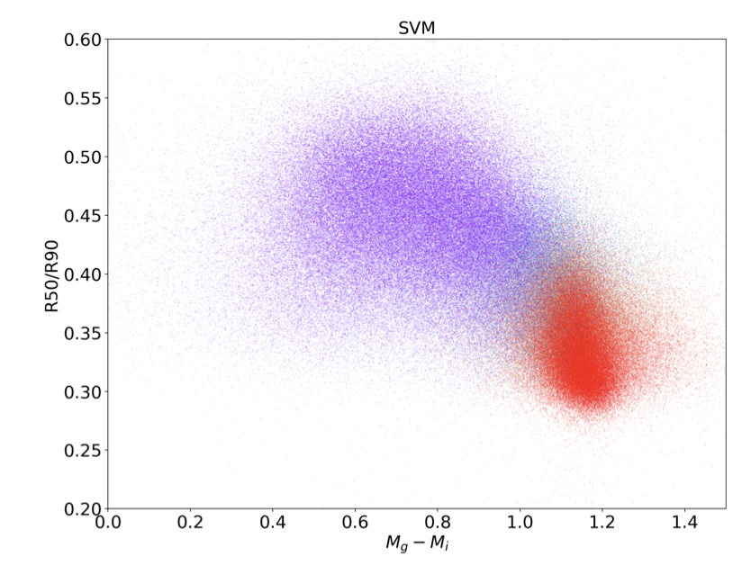
Applications
Galaxies in SDSS data, labeled by hand
Late type
Classification (supervised)
Fitting a SVM model on labeled training data, then applying to a larger unlabeled dataset
Regression (unsupervised)
Early type

Slide 8
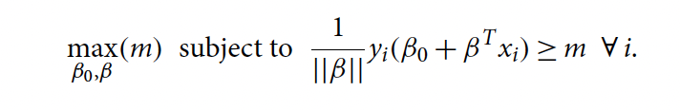
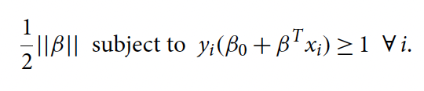

Theory: hyperplanes
Want to maximize the margin m between the hyperplane and support vectors
$$x_{1…n}$$
m
X2
minimize
Label: -1
Label: +1
X1

Slide 9
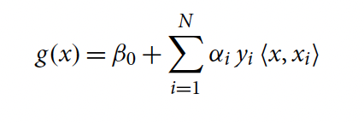
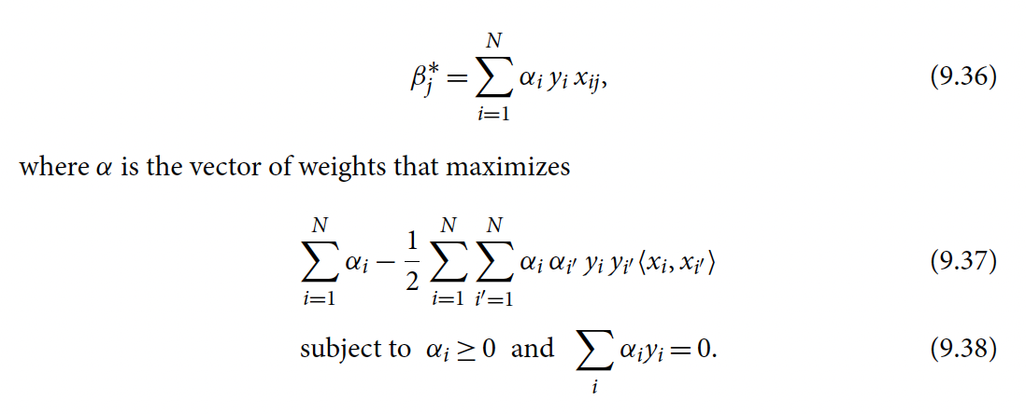
Theory: optimization
Any optimization problem can be viewed from its “primal” formulation, or its “dual” formulation
The resulting optimization problem is a “quadratic program” which is solvable using various algorithms

Slide 10
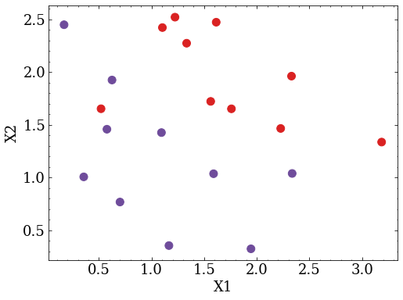
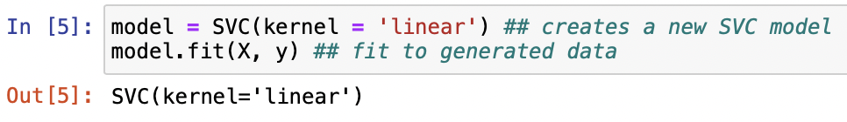
Example: linear SVM classification
Run the section “Linear SVMs”
Train a SVM to distinguish two randomly generated classes
X and y describe data from two separate Gaussian distributions
To fit the model to the data:

Slide 11
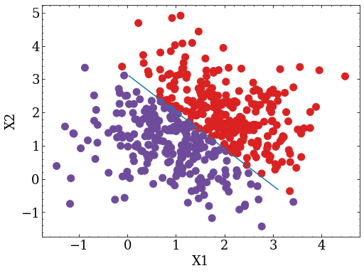
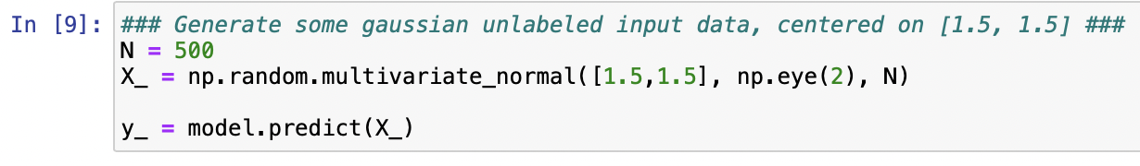
Example: linear SVM prediction
Run the section “Linear SVMs”

Slide 12
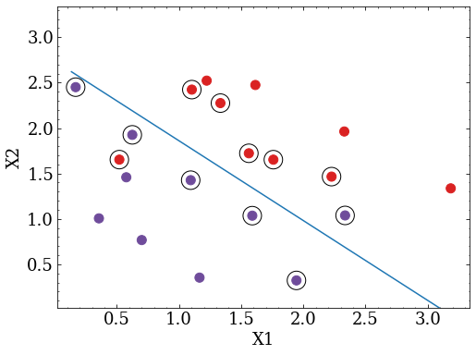
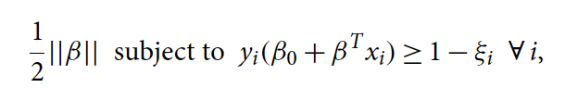
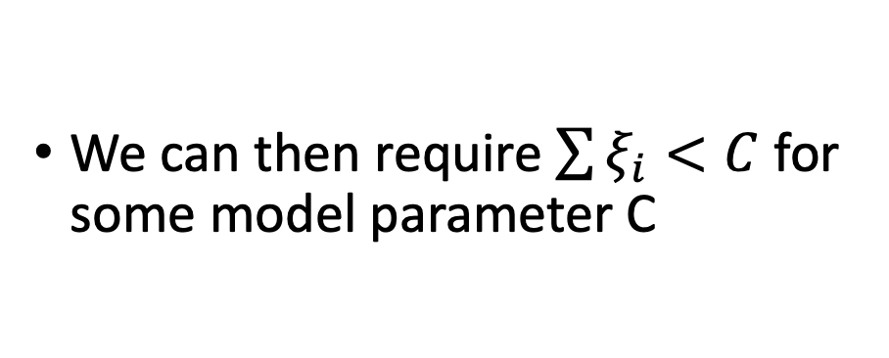
Slack variables
In practice, we typically allow for some number of support vectors to be within our margins
We can then require $\sum{ξ_{i}<C}$ for some model parameter C

Slide 13
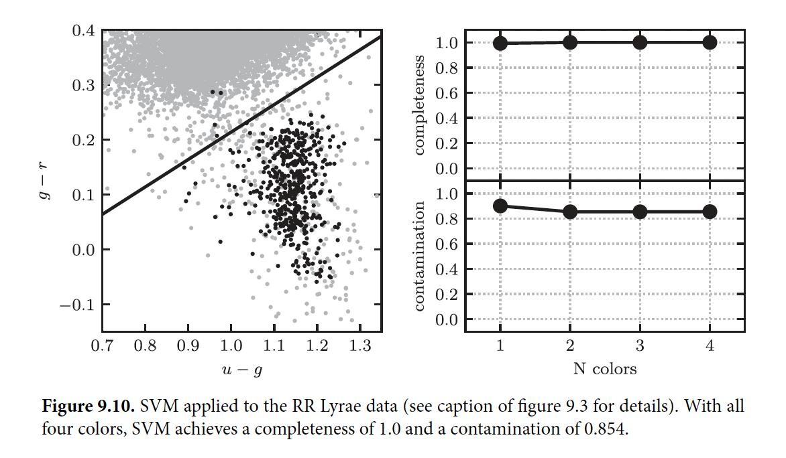
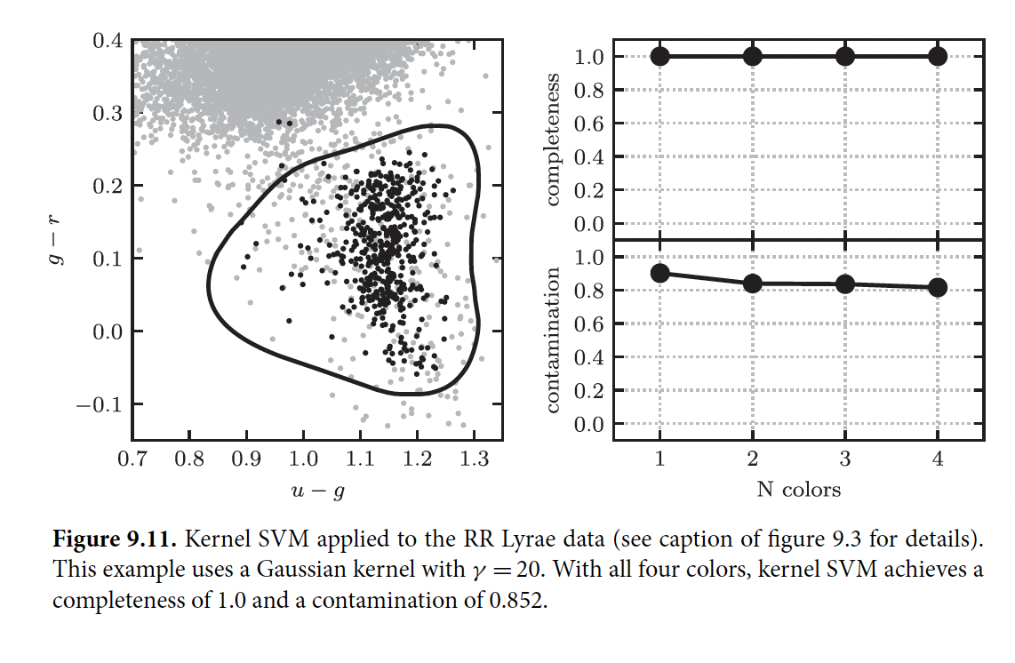
Nonlinear Classification

Slide 14
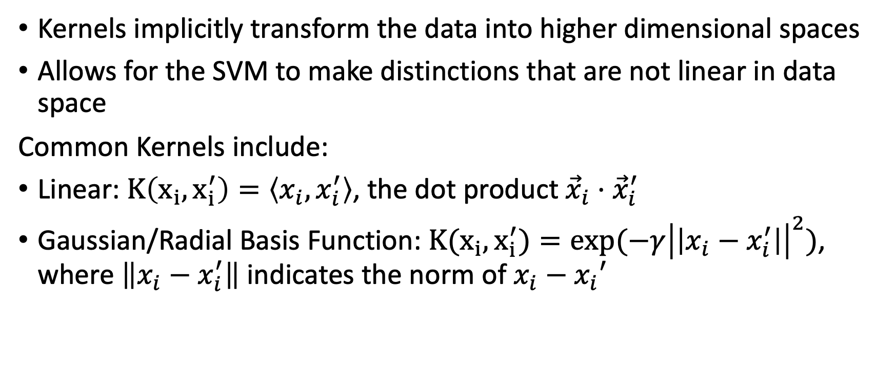
Kernel Functions
Kernels implicitly transform the data into higher dimensional spaces
Allows for the SVM to make distinctions that are not linear in data space
Common Kernels include:
Linear: $K\left(x_{i}, x_{i}^{′}\right)=\left\langle x_{i}, x_{i}^{′}\right\rangle$, the dot product ${\vec{x}}_{i}⋅{\vec{x}}_{i}^{′}$
Gaussian/Radial Basis Function: $K(x_{i}, x_{i}^{′})=exp{(−γ{\left|\left|x_{i}−x_{i}^{′}\right|\right|}^{2})}$, where $\left\|x_{i}−x_{i}^{′}\right\|$ indicates the norm of $x_{i}−x_{i}′$

Slide 15
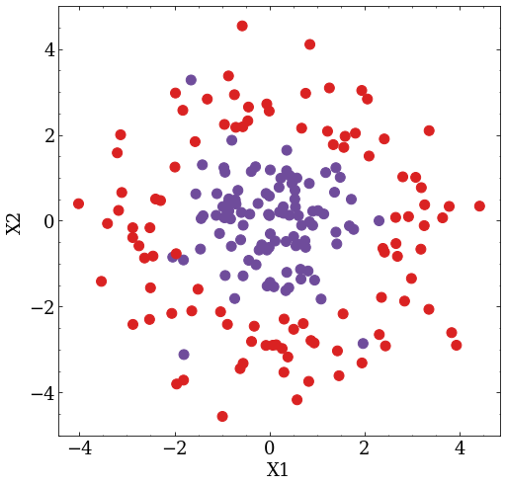
Nonlinear Classification Example
Run the section “SVMs with nonlinear data”
Try fitting with the linear kernel, then change your kernel type to ‘rbf’ (a Gaussian kernel)

Slide 16
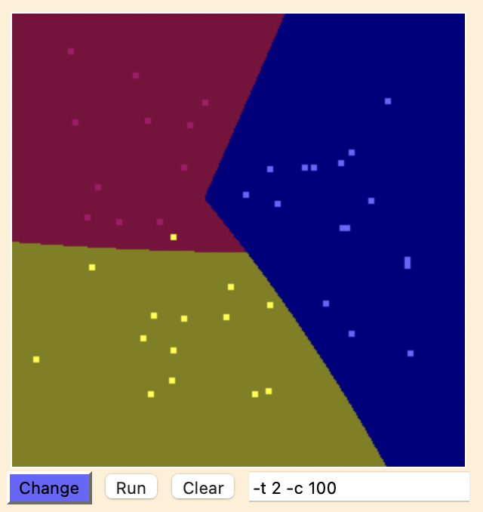
Example: more than two classes

Slide 17
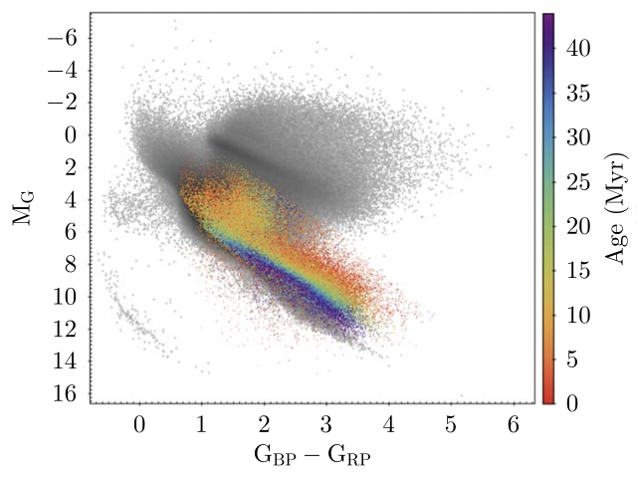
Classification of pre-main sequence stars

Slide 18
References
Pedregosa et al. (2011), JMLR 12, pp. 2825-2830.
Vavilova et al. (2021), A&A 648, A122 (2021). https://doi.org/10.1051/0004-6361/202038981
The scikit-learn SVM overview is very good; find it here!

Slide 19
Junk
https://www.csie.ntu.edu.tw/~cjlin/libsvm/ cool demo
https://www.csie.ntu.edu.tw/~cjlin/papers/guide/guide.pdf

