Slide 1
X
Bias (HL)
Affiliation
Bias (OUT)
Status
Y
Episodes Alive
Chronological Order
Relevance
Gender
Input
Hidden Layer
Output

Slide 2
main.py
cloud
main.py
data = [train, test]
results = txt
process
predictions
/app
Dockerfile
flask
numpy
requests

Slide 3
containers
docker-flask
Dockerfile
app
main.py

Slide 4
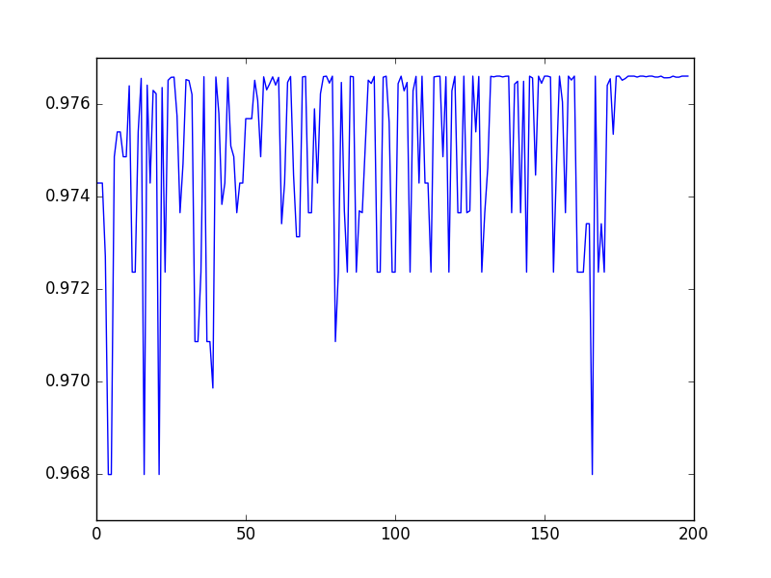
Change in Training Output
Prediction
Training Set Input

Slide 5
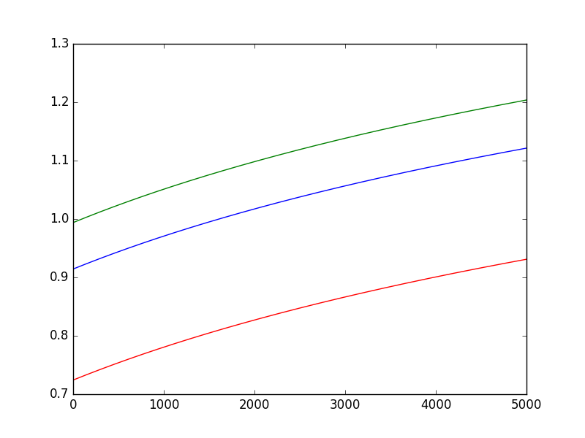
Adjustment of Weights in Training Set
Weight Values
Epochs

Slide 6
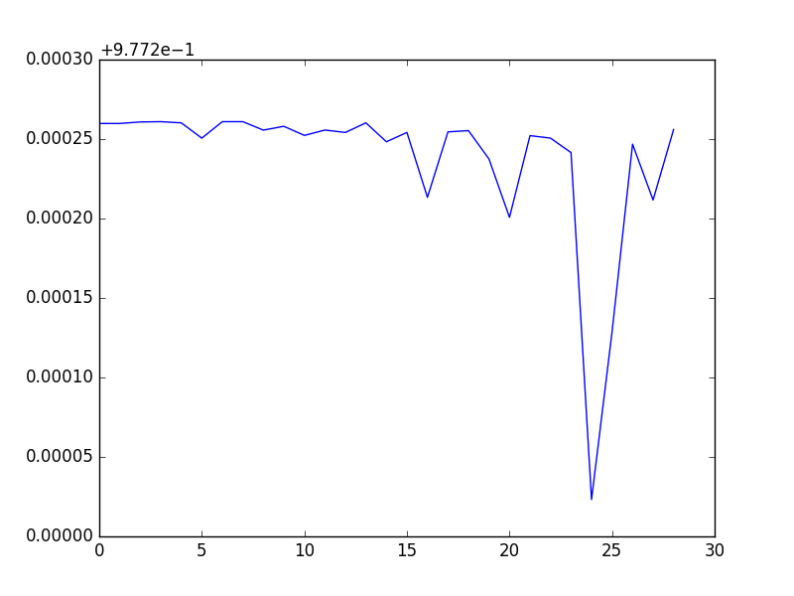
Results of
Testing Set
Prediction
Testing Set Input

