Slide 1
Olist Analysis
Aidas Rasimas

Slide 2
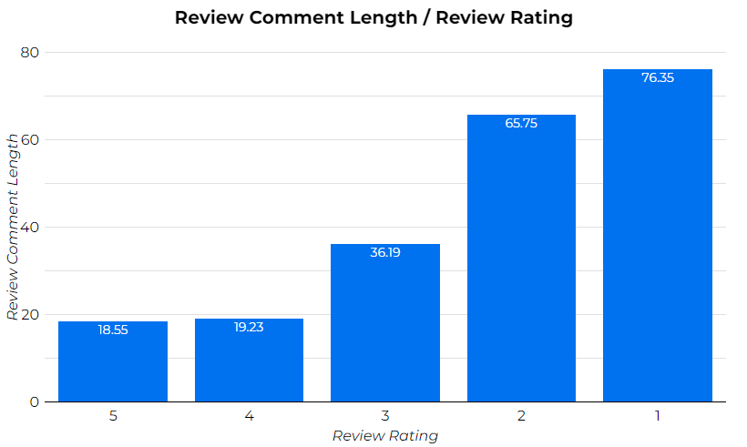
Review Comment Length / Review Rating
Review comment length is correlated with lower review rating. The more characters customer uses in their review, the more likely that it is a negative review.
Suggestion to create live notification to CONTACT US if customer types more than 45 characters while writing review.

Slide 3
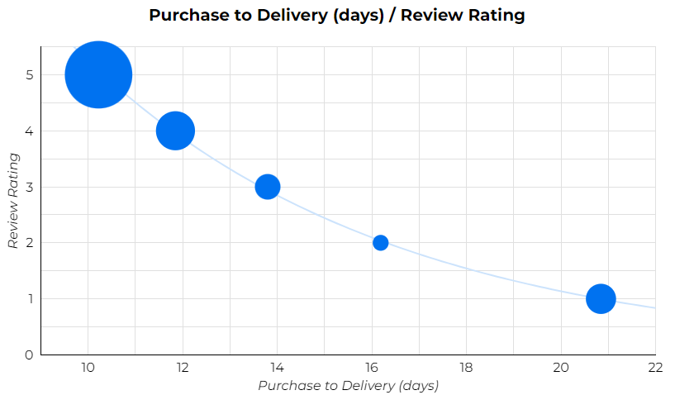
Purchase to Delivery (days) / Review Rating
10.22
20.85
Longer purchase to delivery is very correlated to customers leaving lower review ratings.
Suggestion: if order takes longer than 12 days to deliver – give a call to customer. Apologize for inconvenience and show that we care.

Slide 4
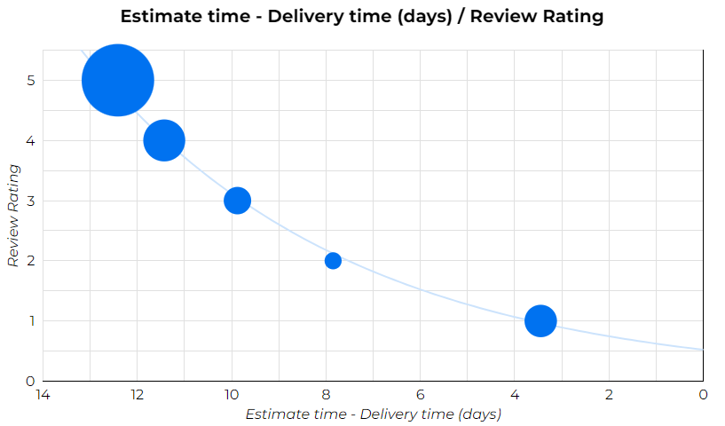
Estimate Delivery Time – Delivery Time (days) / Review Rating
12.41
3.45
Customers love if their order arrives before estimated time.
Suggestion to play around with order delivery estimation. Maybe take 100 orders and on purpose estimate delivery by 2 days longer and see if such estimation will positively impact reviews.
Contact customers when order is not delivered yet and very close to estimated delivery

Slide 5
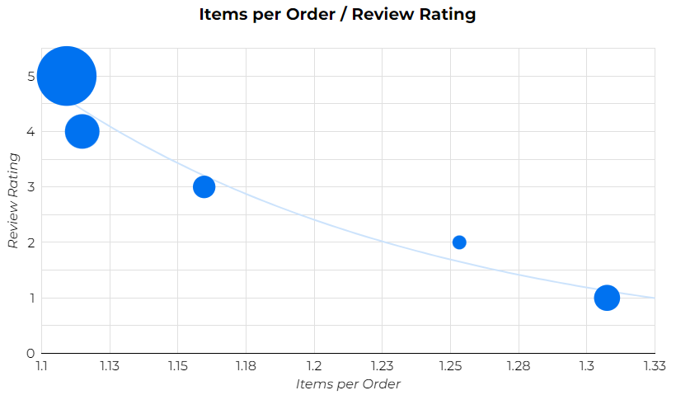
Items per Order / Review Rating
1.11
1.31
Average review rating if order contains 1-4 items 4.11, but orders with 5 or more items, had an average rating of 3.28.
10.95% of 1-4 item orders had 1 star rating. While 30.02% of 5 or more item orders had 1 star rating.
Suggestion pay a lot of attention to customers with multiple products per order. Contact all 136 customers with 5 or more items per order to figure out what exactly gone wrong.

Slide 6
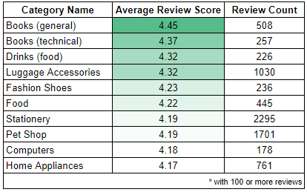
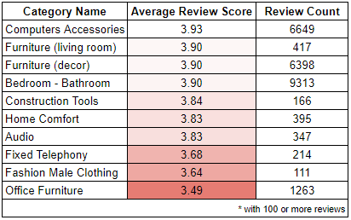
Product Category Review Scores
Book and food orders have great reviews. Maybe sellers can send books, food as a compensation to customers who had issues with their order (late delivery etc.)
Customers need help with furniture orders. Might be pottential issue with size or issues while putting furniture together. Potential to upsell with assembly service.
Generally the larger in volume product is the more risk for negative review. Inform customer support to pay more attention to larger size product orders.

Slide 7
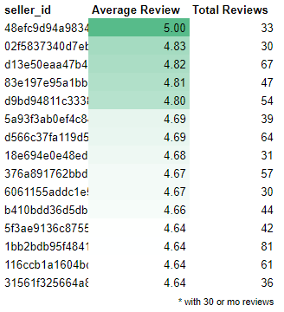
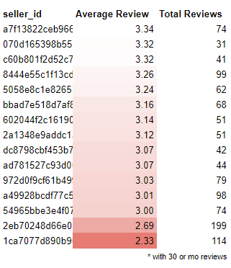
Top / Bottom Sellers by Review Score
Additionally motivate sellers with great average review score. Maybe mark them as „Trusted Sellers“, reduce fees.
Contact sellers with low (below 3.5) average review score. Figure out what were the main issues.

Slide 8
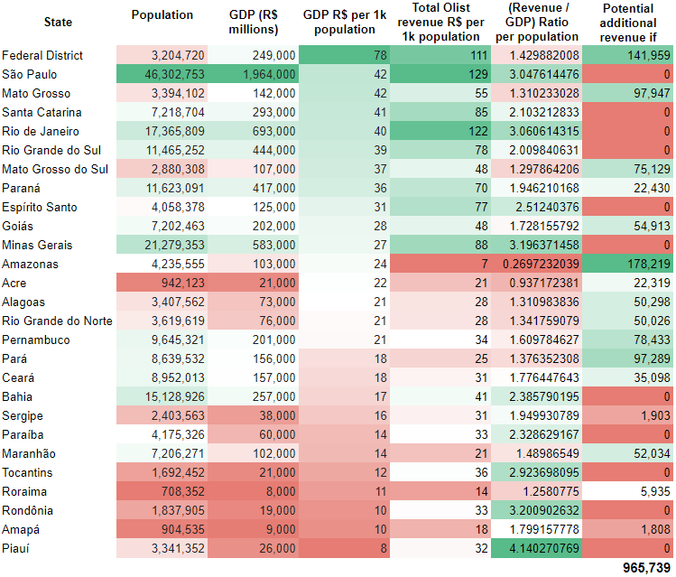

Slide 9
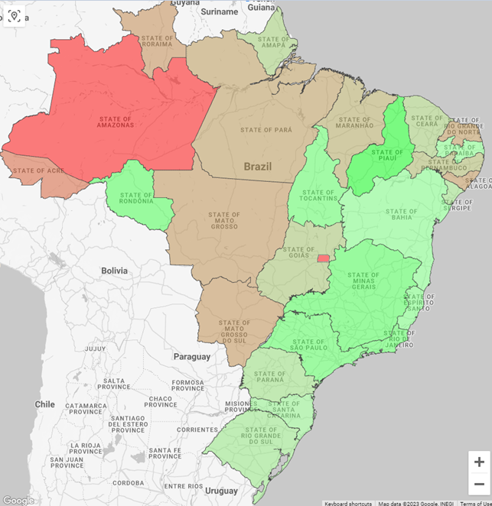
Acre
xx
Pará
45%
+97k
Amazonas +640%
+178k
Mato Grosso 53%
+98k
Federal District
+40%
+141k

Slide 10
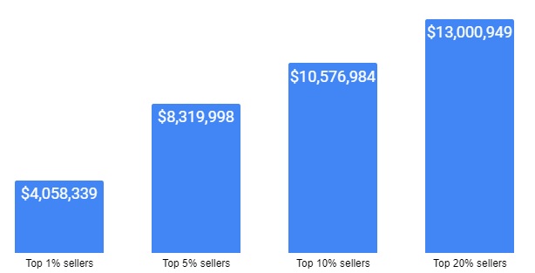
Top 20% Sellers Bring 80% Revenue
82.06%
66.76%
52.51%
25.62%
Pareto principle works when it comes to revenue from sellers.
20% of sellers account for 82% of total revenue generated.

Slide 11
Summary
Majority of long reviews have bad rating. Last chance to cath these reviews with popup to CONTACT US, offer help to solve problem before review is posted
A lot of bad reviews are related to delivery time.
Need to pay more attention to orders where customer ordered 5 or more items or large volume items. Make sure that customer understand how to asseble item and prioritize these orders delivery.
Create additional marking for best rated sellers „Trusted Seller“ and invastigate sellers with worse ratings.
Several states have big potential for revenue increase. Investigate what is lacking in these areas. Maybe not enough sellers who ship to these states or there is demand for different products.
Pareto principle (80/20) works when it comes to revenue from sellers. 20% of sellers account for 82% of total revenue generated.

