Slide 1
AdventureWorks sales overview
Aidas Rasimas

Slide 2
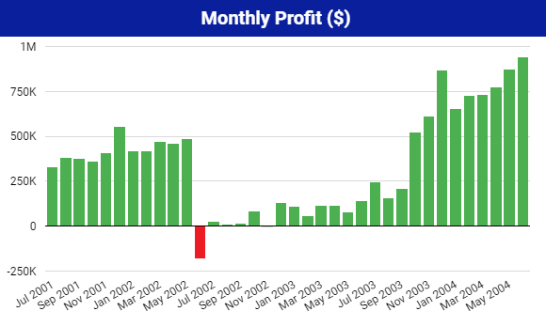
Period of June 2002 to September 2003 significant profit decrease
Profit started recovering since October 2003

Slide 3
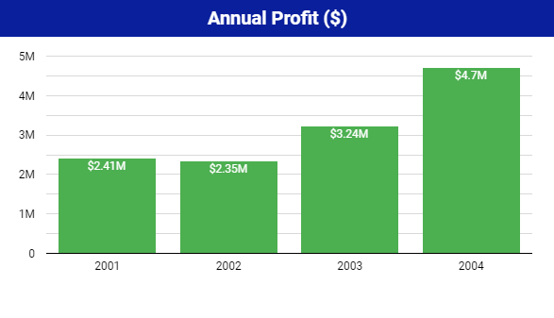
In 2004 only in 6 months we already reached $4.7M in profit. It is almost as much as 2001 and 2002 years combined profit (4.76M)

Slide 4
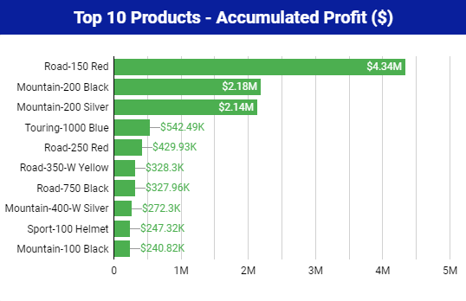
Road-150 Red bike is still product which brought the most profit for our company
Mountain-200 series bikes are not that far behind. Brought total of 4.32M in profit

Slide 5
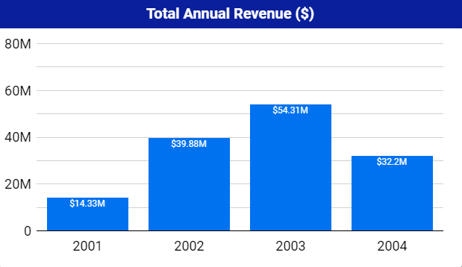
$83.72M
Projected 54% year over year revenue increase in 2004

Slide 6
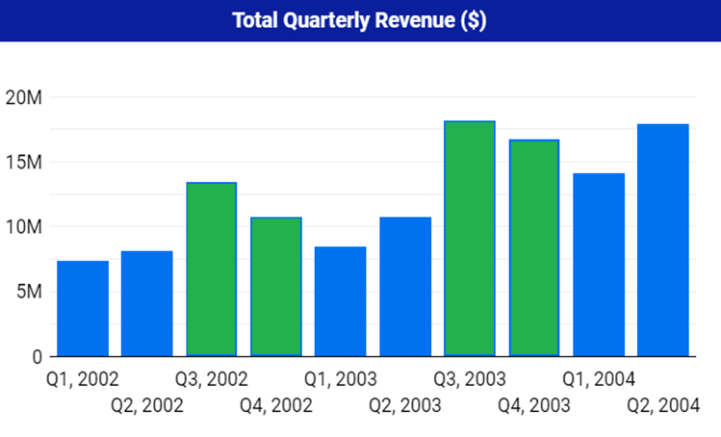
81%
56%
Revenue typically increase in 2nd half of the year.

Slide 7
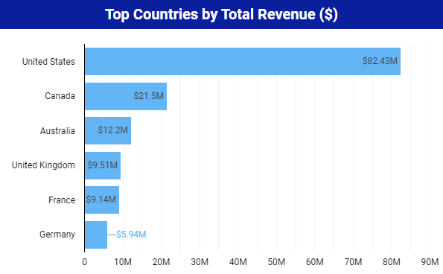
$24.59M
Biggest market for our products is still North America with United States leading the way.

Slide 8
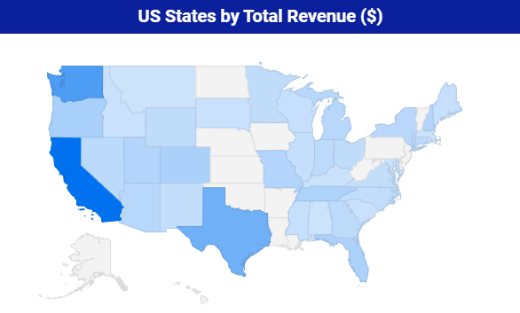
Washington $12.06M
California $19.5M
Texas $8.89M
California, Washington DC and Texas are States which brings the most revenue.

Slide 9
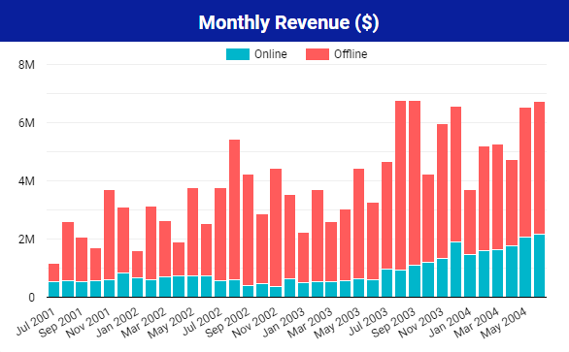
Main revenue still comes from our physical stores (Offline)
Our Online store has significant revenue increase in last 12 months
Online store’s last 12 months revenue increased 55% in comparison to previous 12 months

Slide 10
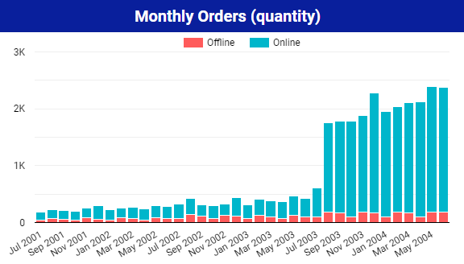
1574
(560% increase)
281
281 Online orders in August of 2002
1574 Online orders in August of 2003 (560% increase)

Slide 11
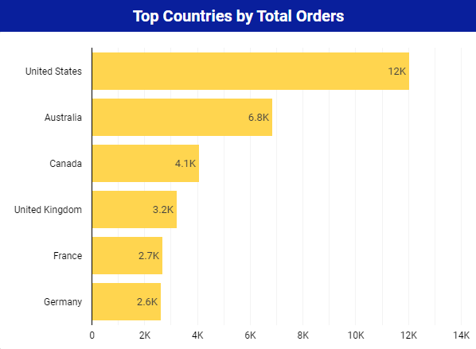
8.5k
United States leading the way with most orders per country
2nd region with most orders is Europe

Slide 12
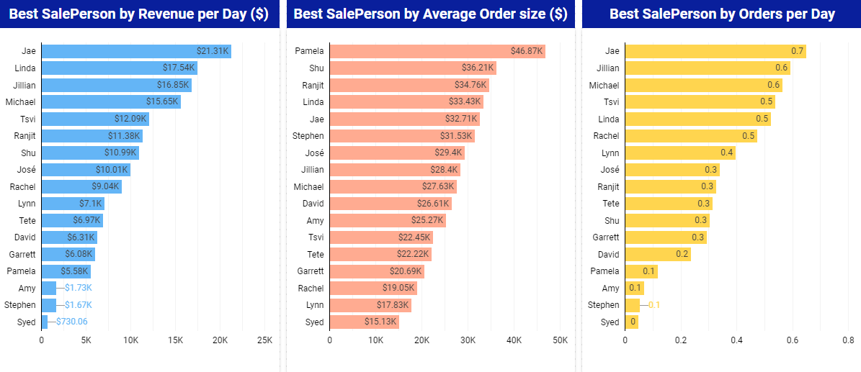
$21.31k
0.7
$17.54k
0.6
$16.85
$33.43k
$32.71k
0.5
$28.4k
Big disparity between Sales People
Opportunity to transfer knowledge from the best to less successful Sales People?

Slide 13
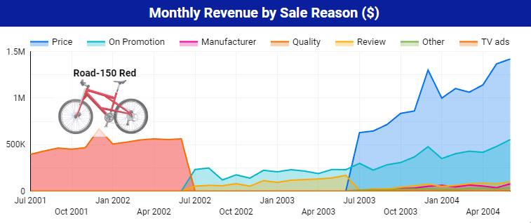
We started company with our iconic Road-150 Red bicycle which was bought mainly because of it’s quality
Now experiencing Online sales boom with loads of Online orders which attract customers because of the price

Slide 14
Period of June 2002 to September 2003 significant profit decrease
Profit started recovering since October 2003

Slide 15
Summary
Projected 54% year over year revenue increase in 2004
2004 half year profit is highest it is ever been 4.7M in 6 months
New products introduction in our Online store increased monthly Online orders 5x times (540%)
59% revenue comes from North America market
There is opportunity to transfer knowledge from the best to less successful Sales People. That would further increase Offline sales revenue.

