Slide 1

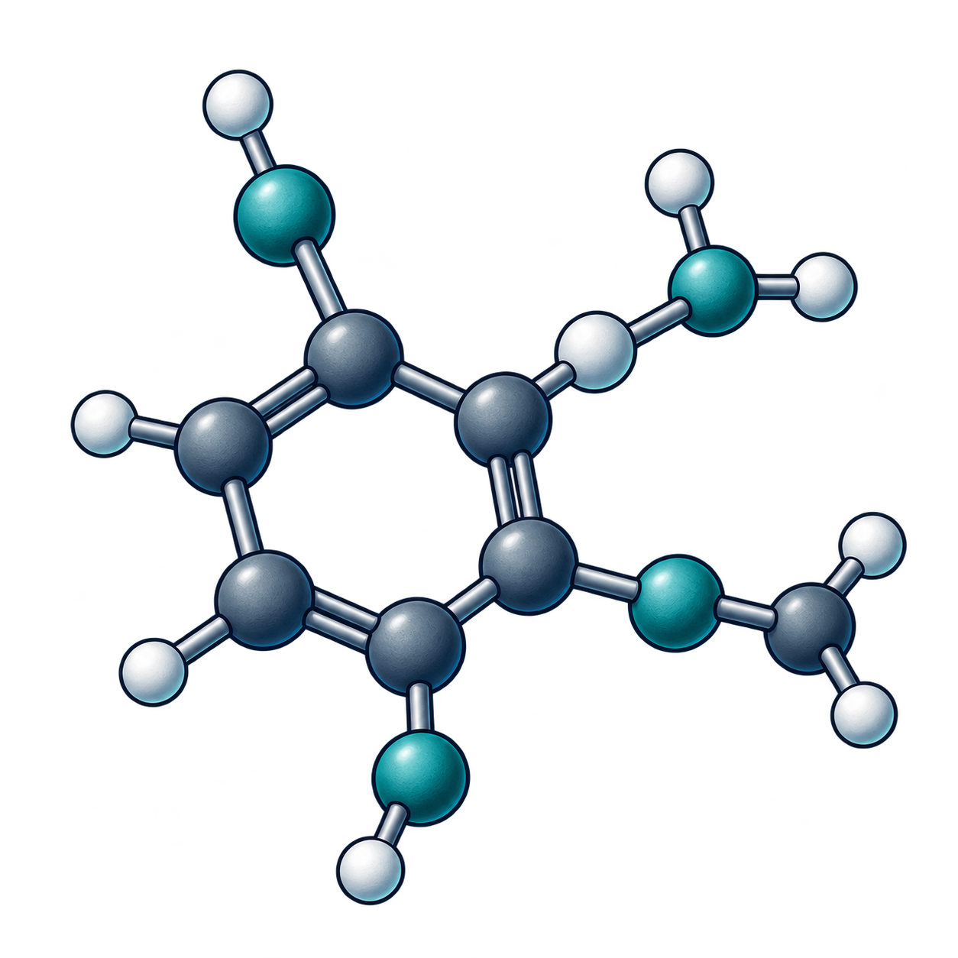
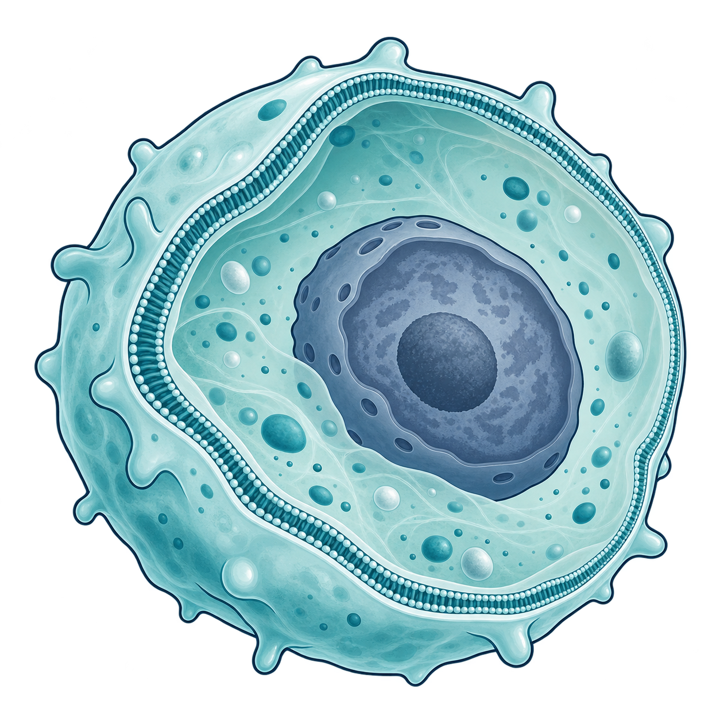
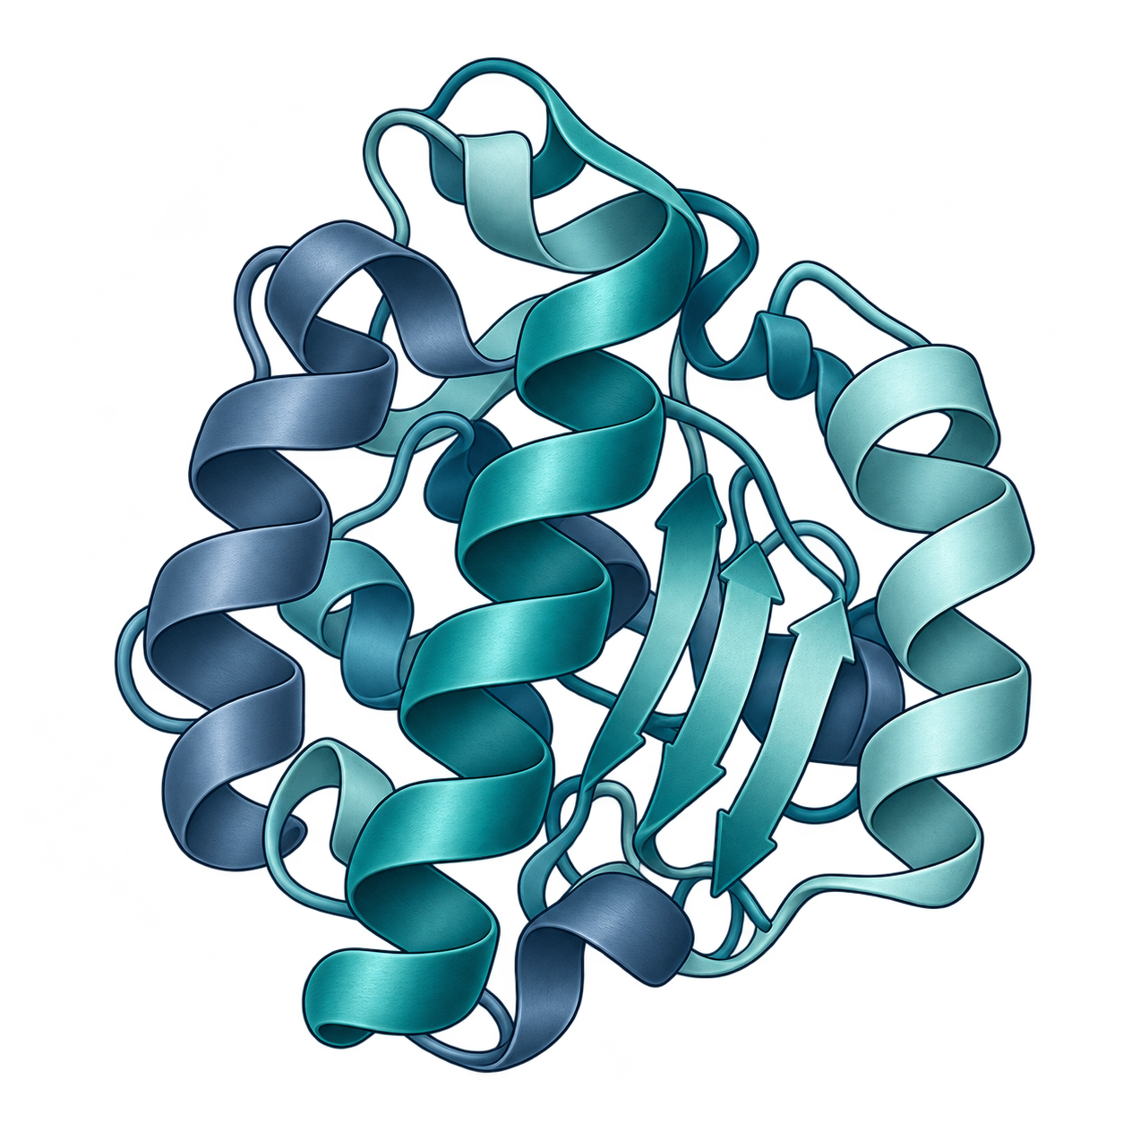
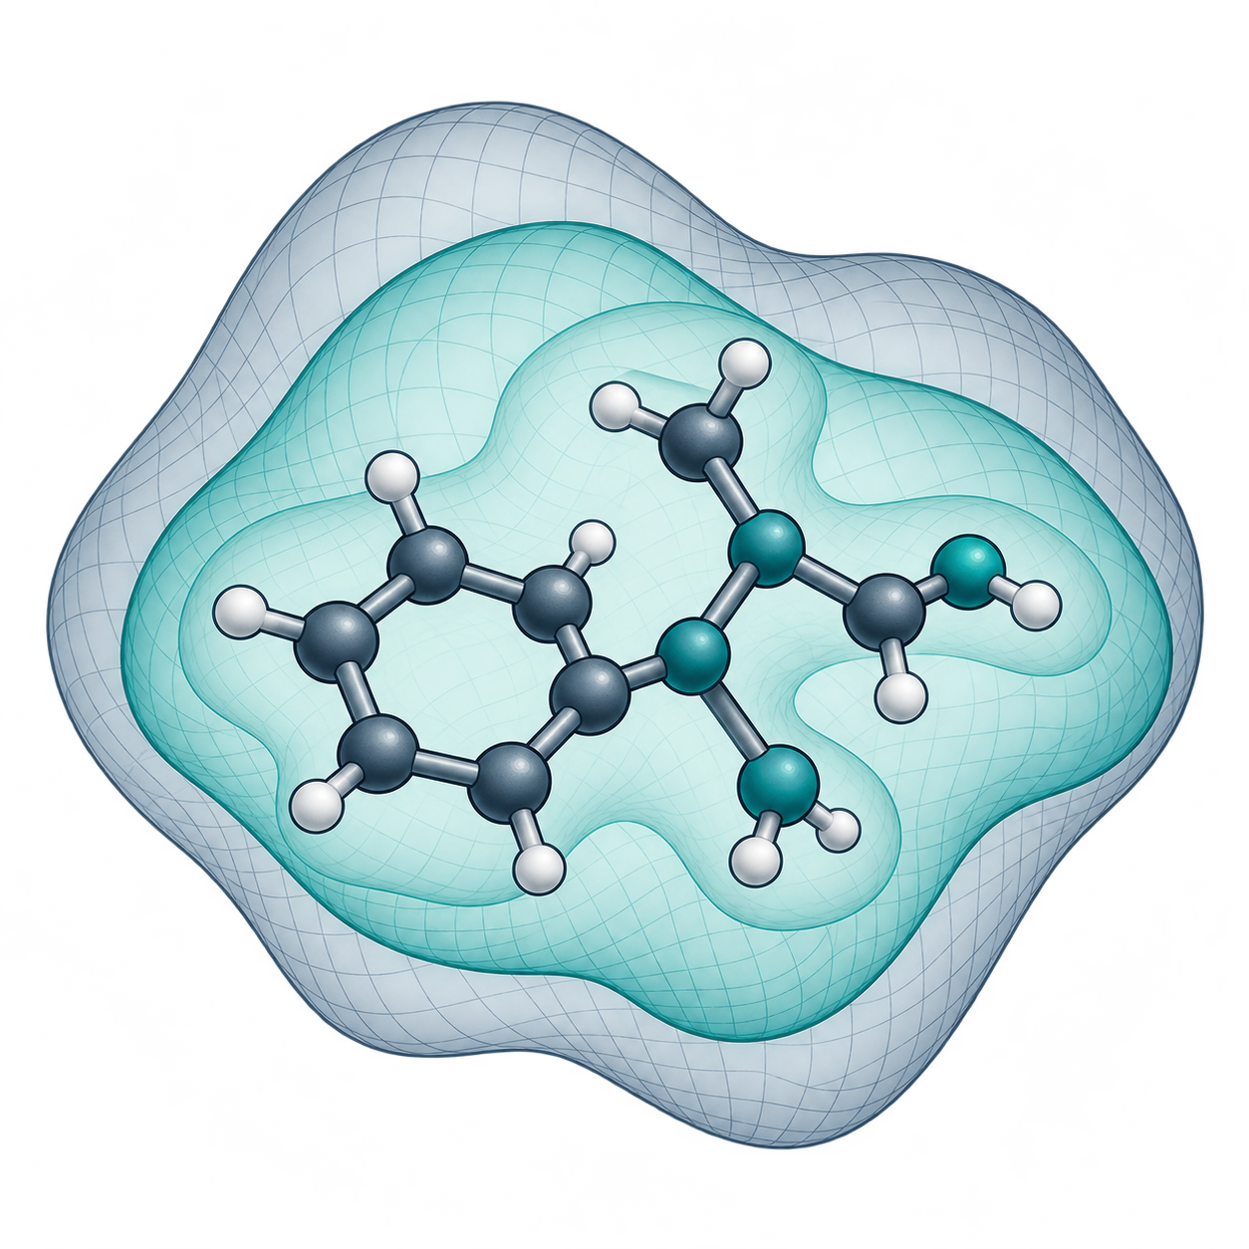
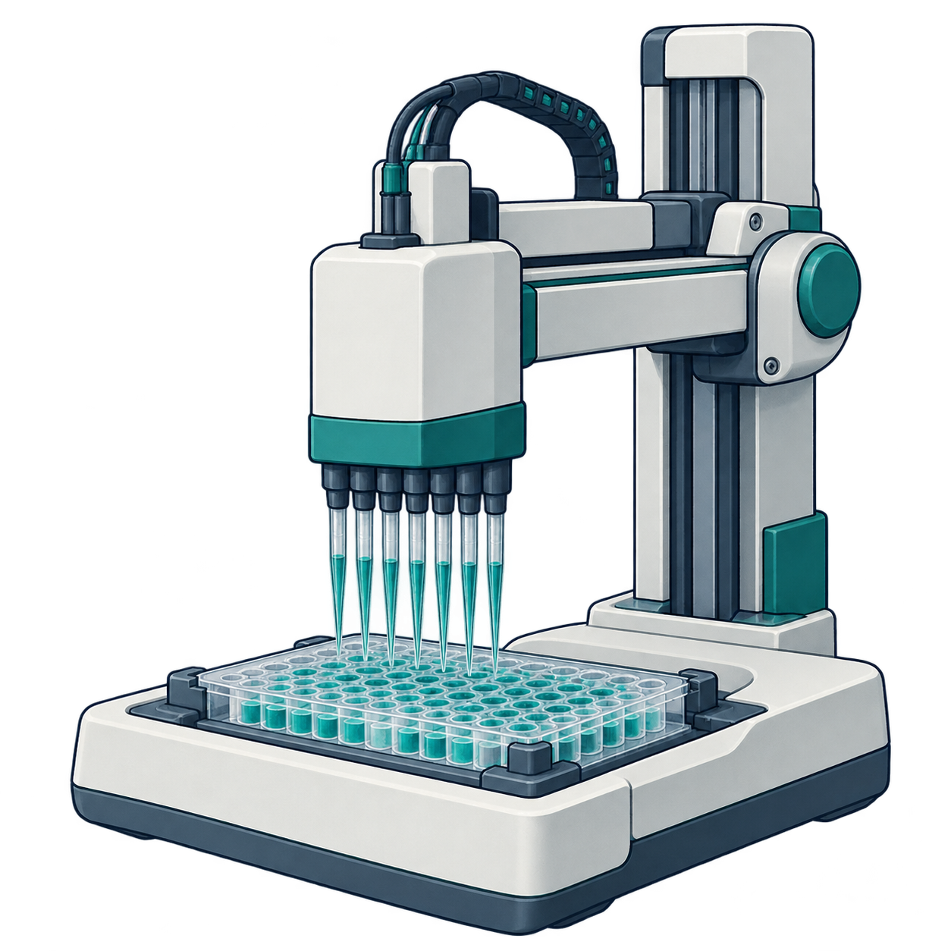
Shared prerequisites connect the learning paths
Core
Small
molecules
Targets
and cells
Biologics
Structure
and
physics
Agents
and
feedback
Shared lesson
25
29
16
17
15
14
Listed lessons in route
5
Evidence claim boundaries
3
Therapeutic decision framing
3
Biological representations
2
Identity lineage and reuse
1
Docking and free energy
2
Model table construction
2
Baseline fitting and
validation
1
Metrics and uncertainty
1
Regression and
classification errors
1
Uncertainty to decisions
Prerequisite
Core inclusion
10 lessons · 21 prerequisite relations
Core inclusion is a separate relation. The core route lists no prerequisites.
Conceptual illustrations; native labels and relationships.
Notes:
Prerequisites across six learning paths. The current curriculum YAML names 10 shared prerequisite lessons and 21 prerequisite relations across five specialist routes. Filled circles denote stated prerequisites. The separate core column uses dashed hollow squares for the 8 shared lessons also listed in the core route. Row badges count routes requiring each lesson; header counts give the listed lessons in each route. The core route states no prerequisites. These counts describe the map, not difficulty, coverage or observed learning. Route illustrations are AI-generated concepts.
Source: catalog/curriculum/tracks.yaml#learning_paths
The conceptual PNG assets are independently movable/replaceable, not vector-editable.
All text, symbols, shapes and directional arrows are native PowerPoint objects.
AI-generated conceptual artwork is not scientific evidence. Actual backend identity is recorded privately when exposed.

