Slide 1


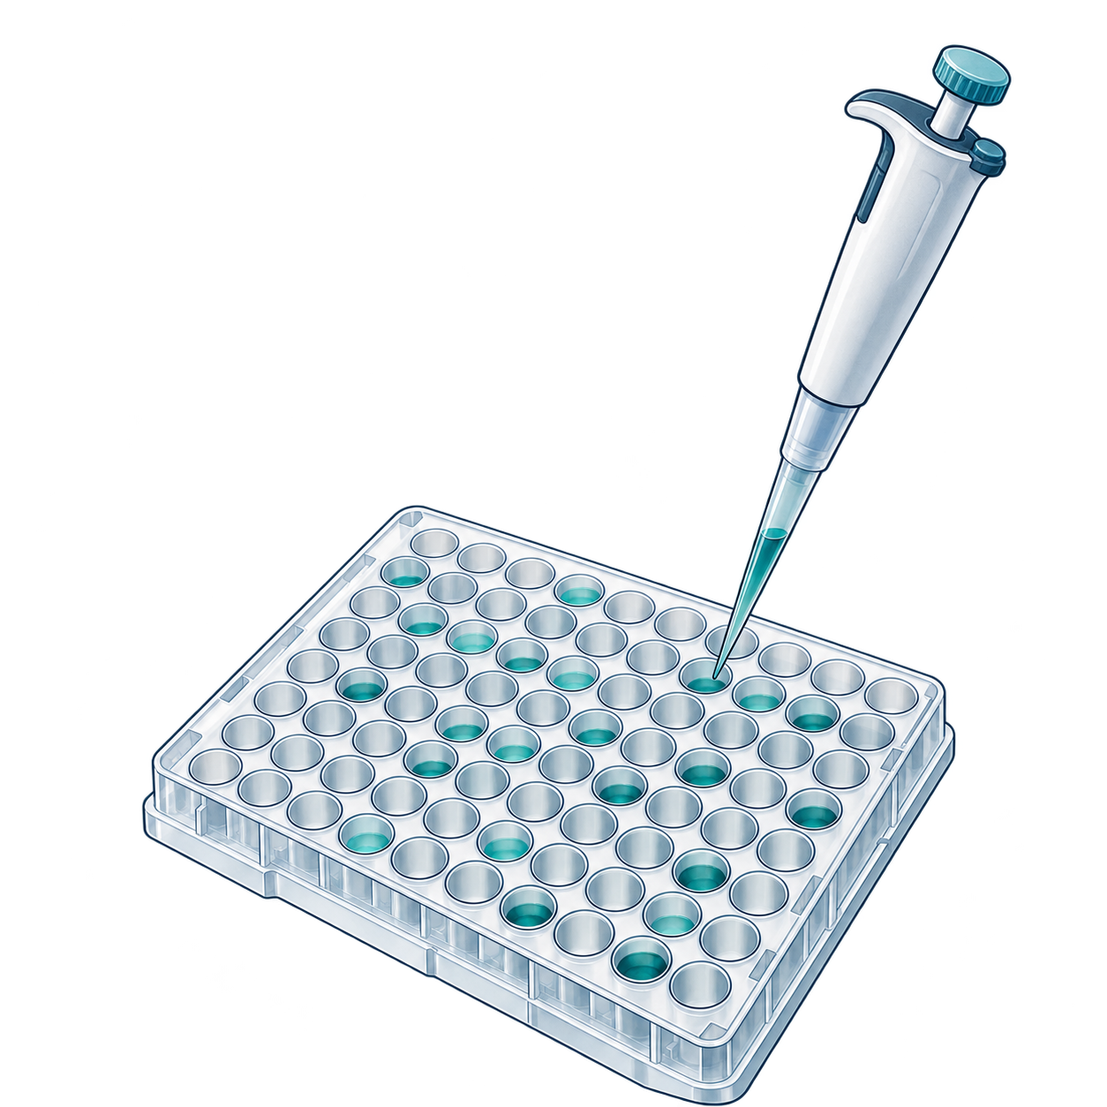
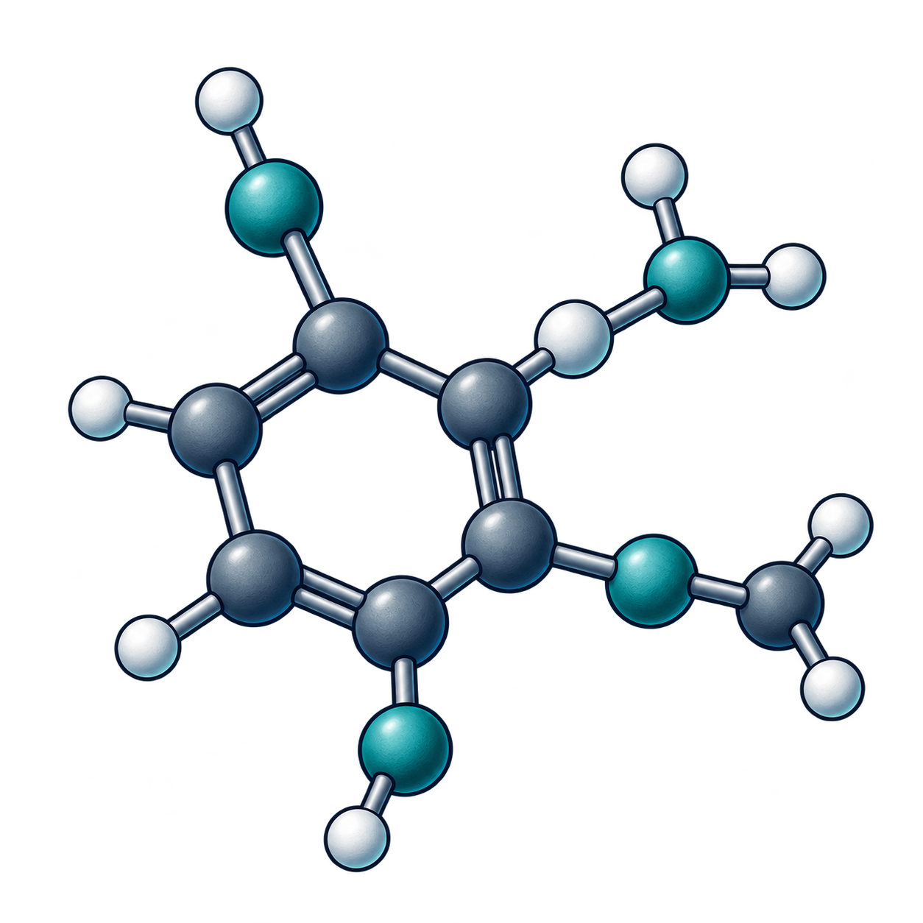

From a disease question to a candidate decision
1
Disease and
mechanism
2
Target
identification
3
Target validation
Decision
Decision
Decision
Causal
relevance
Actionable
entity
Phenotype
change
Correlation as mechanism
Identity collapse
Evidence reuse
6
Hit confirmation
5
Hit discovery
4
Assay and data
strategy
Decision
Decision
Decision
Attributable
activity
Worth
confirming?
Optimisation
quantity
Artefact as binding
Retrospective as
prospective
Pooled endpoints
7
Hit-to-lead
8
Lead optimisation
9
Candidate nomination
Decision
Decision
Decision
Series
headroom
Acceptable
trade-off
Package
coherence
Endpoint loss
Scalar hides liability
Confidence as experiment
Numbers and arrows give stage order. Warm diamond labels identify frequent failures.
AI-generated conceptual illustrations. Native labels and relationships.
Notes:
Target to candidate. Nine numbered stages follow the canonical decision table, in a serpentine reading order. Each stage pairs a conceptual object with its decision and an explicitly labelled frequent failure. Native arrows indicate stage order only. AI-generated illustrations, repeated assay objects and their internal marks are conceptual and do not report candidate counts, binding, causal effects or success probabilities. The strong cheap baselines and complete evidence contracts remain in the adjacent source table.
Source: report/aidd-commons-living-report-v0.1.md#the-target-to-candidate-pipeline
The conceptual PNG assets are independently movable/replaceable, not vector-editable.
All text, symbols, shapes and directional arrows are native PowerPoint objects.
AI-generated conceptual artwork is not scientific evidence. Actual backend identity is recorded privately when exposed.

